Slide 1
Project 2 Response
Rora Zhu FINTECH 590

Slide 2
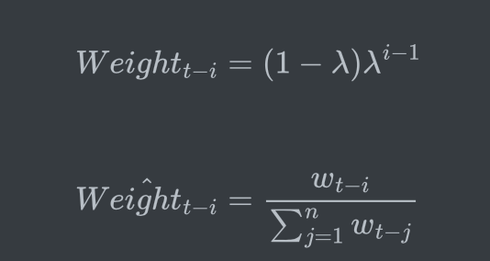
Problem 1
Calculate exponentially weighted covariance matrix
Generate exponential weights using
Generate exponential covariance for X and Y using
3. Generate exponential covariance matrix

Slide 3
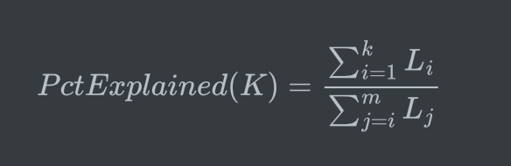
Problem 1
Use PCA and plot the cumulative variance explained by each eigenvalue
I first use the eigh built-in function to calculate the eigenvalues and eigenvectors of the covariance matrix
Then, I cumulate the eigenvalues from the largest to the smallest to calculate the explanation power

Slide 4
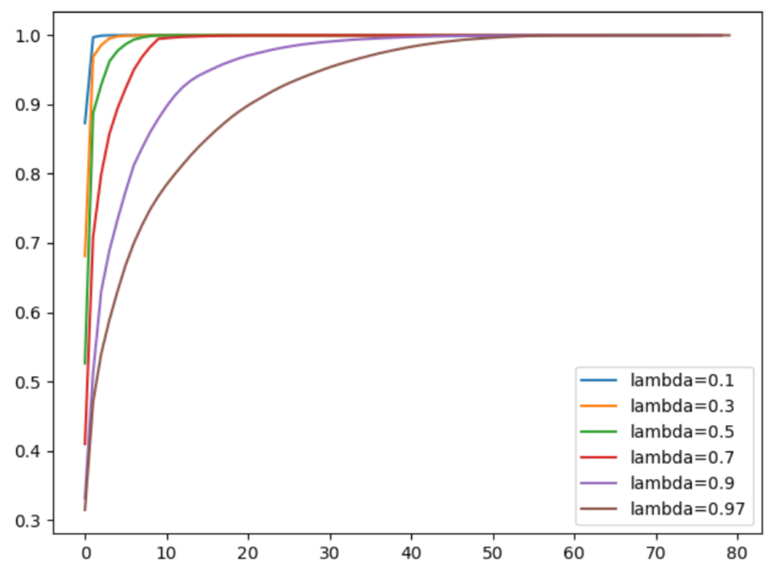
Problem 1
The percentages explained given different different lambdas are shown below.
The larger the lambda, the slower the explanation power converges to 1.

Slide 5
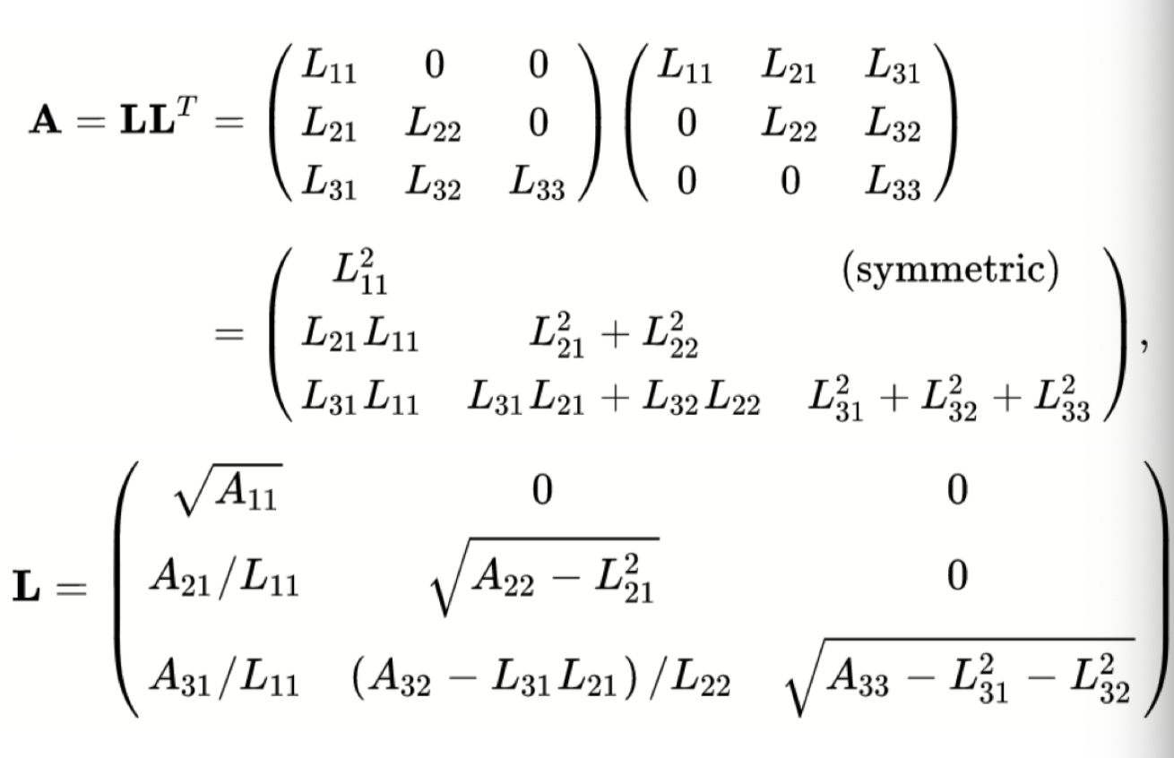
Problem 2
Implement chol_psd() and near_psd()
CholeskyPSD

Slide 6
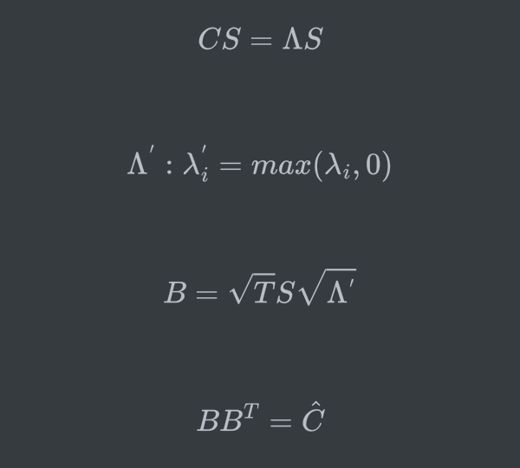
Problem 2
Implement chol_psd() and near_psd()
NearPSD: find a near PSD correlation matrix for the non-PSD correlation matrix by replacing its negative eigenvalues with 0 and multiplying the eigenvector matrix with a scaling matrix.

Slide 7
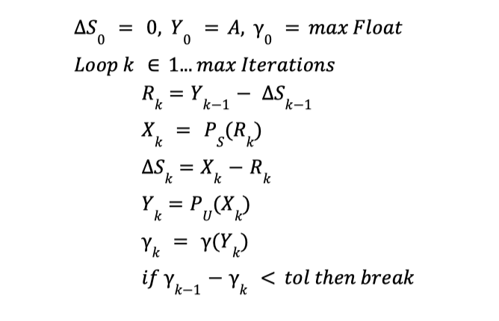
Problem 2
Implement Higham's 2002 nearest psd correlation function
Higham algorithm finds the nearest PSD correlation matrix by projecting the initial matrix twice. The first projection replaces the diagonal elements to 1, and the second projection replaces the negative eigenvalues to 0.

Slide 8
Problem 2
Implement Higham's 2002 nearest psd correlation function
Higham algorithm finds the nearest PSD correlation matrix by projecting the initial matrix twice. The first projection replaces the diagonal elements to 1, and the second projection replaces the negative eigenvalues to 0.

Slide 9
Problem 2
Use near_psd() and Higham’s method to fix the matrix. Confirm the matrix is now PSD.
To confirm the matrix is PSD after using nearPSD() and highamNearPSD(), I pass in the output matrix to CholeskyPSD(), and realize that there is no NAN values. This means that my output matrix is PSD.

Slide 10
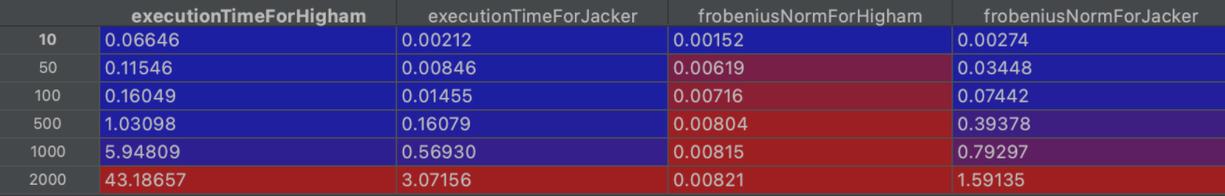
Problem 2
Compare the results of both using the Frobenius Norm. Compare the run time between the two. How does the run time of each function compare as N increases?

Slide 11
Problem 2
Compare the results of both using the Frobenius Norm. Compare the run time between the two. How does the run time of each function compare as N increases?
Given an n, the execution time for Higham algorithm is always larger than that for Near PSD algorithm. As n increases, the execution time for Higham algorithm and Near PSD algorithm increase, but the execution time for Higham algorithm increases faster than the execution time for Near PSD. This is because the time complexity of Higham algorithm is n square, but the time complexity of Near PSD algorithm is n.
Given an n, the Frobenius norm for Higham algorithm is always smaller than that for Near PSD algorithm. As n increases, the Frobenius norm for Higham algorithm and Near PSD algorithm increase, but the Frobenius norm for Higham algorithm increases slower than the Frobenius norm for Near PSD.

Slide 12
Problem 2
pros and cons of each method
Near PSD:
Pros: low time complexity, quick to run
Cons: relatively low accuracy
Higham:
Pros: high accuracy
Cons: high time complexity, slow to run

Slide 13
Problem 3
Implement a multivariate normal simulation that allows for simulation directly from a covariance matrix or using PCA with an optional parameter for % variance explained
My Steps:
Calculate the standard deviation, EW standard deviation, Pearson correlation, and EW Pearson correlation from the covariance matrix of 101 stocks.
Construct 4 different covariance matrices using the standard deviations and correlations matrices above.
Use CholeskyPSD or PCA to construct the root. In terms of PCA, small eigenvalues are omitted once the explanation power exceeds a certain level.
Substitute the root into the multinormal simulation process to calculate 25000 draws of random data.
After simulating 25000 draws of data, calculate its covariance matrix and compare it with the 4 covariance matrices using Frobenius norm.

Slide 14
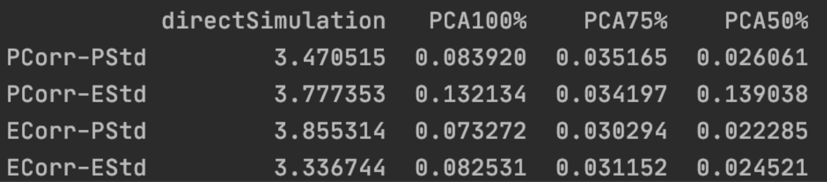
Problem 3
Compare the simulated covariance to it’s input matrix using the Frobenius Norm. Compare the run times for each simulation.
The Execution time for direct simulation is the longest. The lower the explanation power, the shorter the execution time.

Slide 15
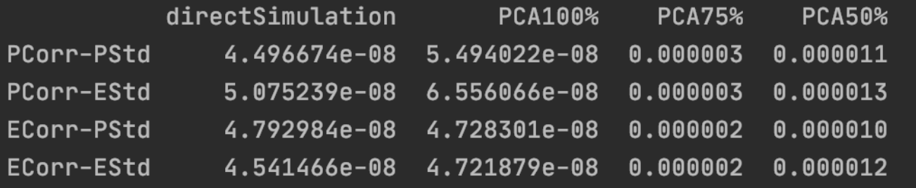
Problem 3
Compare the simulated covariance to it’s input matrix using the Frobenius Norm. Compare the run times for each simulation.
The accuracy for direct simulation and PCA with 100% explained has the highest accuracy. The lower the explanation power, the worse the accuracy.

Slide 16
Problem 3
What can we say about the trade offs between time to run and accuracy.
Therefore, there is a tradeoff between execution time and accuracy. Generally, inaccurate results need less time.

