Slide 1
Response for Project 4
Rora Zhu FinTech 590

Slide 2
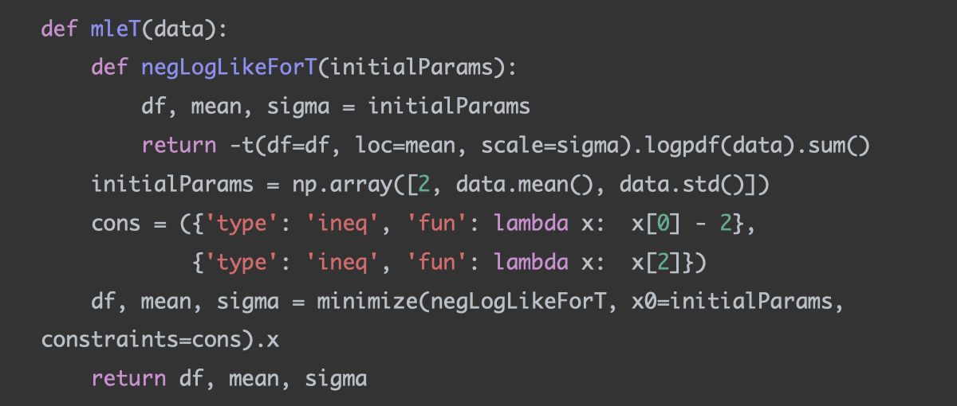
Problem 1
Fit a Normal Distribution and a Generalized T distribution to this data
I first use MLE to estimate data's mean and standard deviation.

Slide 3
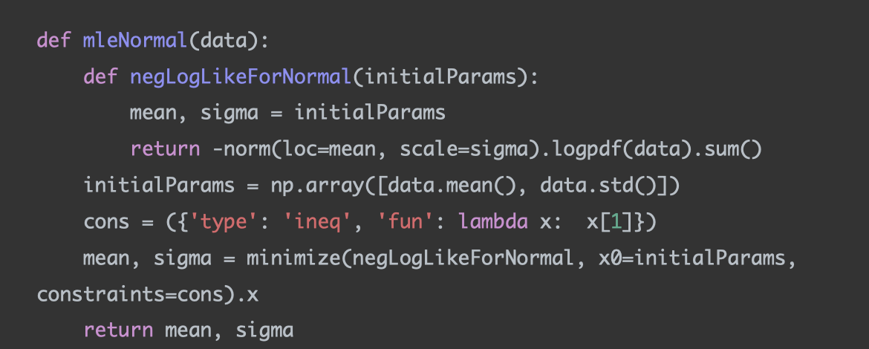
Problem 1
Fit a Normal Distribution and a Generalized T distribution to this data
I first use MLE to estimate data's mean and standard deviation.

Slide 4
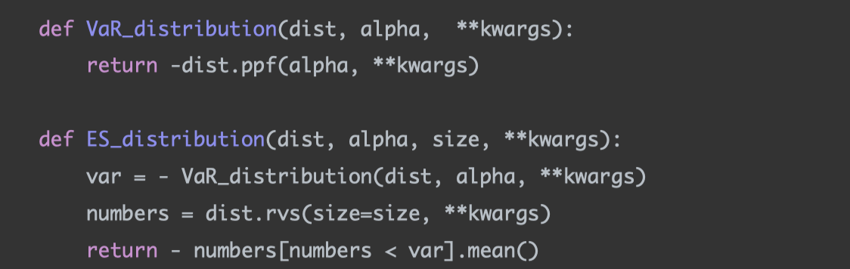
Problem 1
Fit a Normal Distribution and a Generalized T distribution to this data
I then constructed a VaR function that accepts any distribution and returns the quantile with specified alpha, and a ES function that accepts any distribution, simulates n draws of data, and returns the mean beyond the quantile with specified alpha. dist represents any distribution provided by scipy.stats, and **kwargs is used to deal with loc, scale, df etc,. in the quantile function.

Slide 5
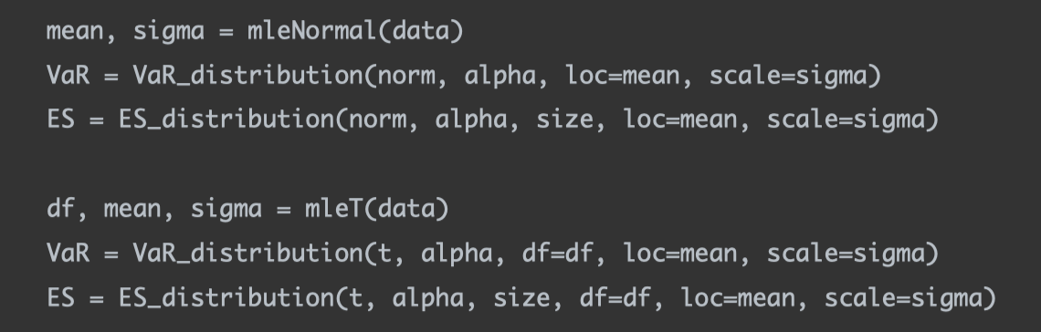
Problem 1
Calculate the VaR and ES for both fitted distributions
Finally, I called the MLE functions, VaR function, and ES function.

Slide 6
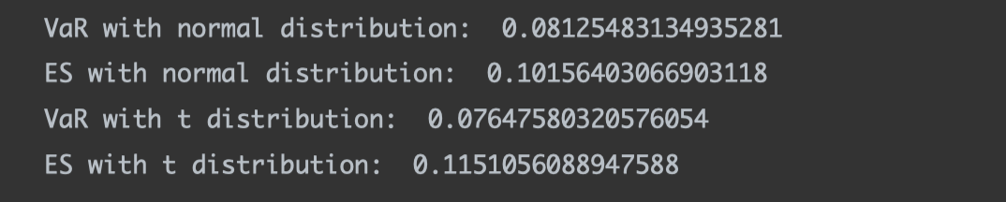
Problem 1
Calculate the VaR and ES for both fitted distributions

Slide 7
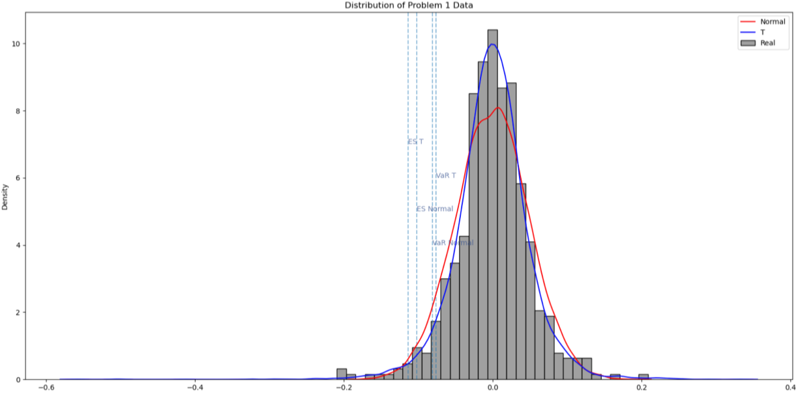
Problem 1
Overlay the graphs the distribution PDFs, VaR, and ES values. What do you notice? Explain the differences.

Slide 8
Problem 1
Overlay the graphs the distribution PDFs, VaR, and ES values. What do you notice? Explain the differences.
First, t distribution fits the data better. It has fatter tails and a higher peak than the normal distribution.
Second, t distribution gives more pessimistic ES and VaR than those given by the normal distribution. ES T is larger than ES Normal, while VaR T is larger than VaR Normal.
Third, ES gives larger losses than those given by VaR. ES T is larger than VaR T, while ES Normal is larger than VaR Normal.

Slide 9
Problem 2
In your main repository, create a Library for risk management. Create modules, classes, packages, etc as you see fit. Include all the functionality we have discussed so far in class. Make sure it includes
Covariance estimation techniques
Non PSD fixes for correlation matrices
Simulation Methods
VaR calculation methods (all discussed)
ES calculation
See RiskManagementPackage and tests.

Slide 10
Problem 3
Fit a Generalized T model to each stock and calculate the VaR and ES of each portfolio as well as your total VaR and ES.
My steps:
Given DailyPrice.csv, transform prices to returns using return_calculate function
Input stock returns to copulaSimulation function. The function outputs simulated returns. Specifically in the copulaSimulation function:
For each stock Xi,
Use MLE to find the parameters for each Xi under t distribution
Transform Xi into a uniform vector Ui, where Ui is Xi's CDF following t distribution
Calculate the Spearman correlation given matrix U
Input the Spearman correlation to Cholesky factorization function. The function returns the root of the covariance matrix (here correlation matrix equals to covariance matrix since std is 1)

Slide 11
Problem 3
Fit a Generalized T model to each stock and calculate the VaR and ES of each portfolio as well as your total VaR and ES.
My steps:
Given DailyPrice.csv, transform prices to returns using return_calculate function
Input stock returns to copulaSimulation function. The function outputs simulated returns. Specifically in the copulaSimulation function:
Input the root to dataSimulation function. The function returns n draws of data following multivariate normal distribution
For each Ui,
Transform Ui into a uniform variable using the standard normal CDF Ui’
Transform Ui' into Xi's quantile function following t distribution to backout Xi'

Slide 12
Problem 3
Fit a Generalized T model to each stock and calculate the VaR and ES of each portfolio as well as your total VaR and ES.
My steps:
Calculate the current prices, holdings, and current values for each portfolio
Multiply current values with simulatedReturns element-wise, sum at columns to get portfolio loss
Pass in portfolio loss to VaR_raw, VaR_distribution, ES_raw, ES_distribution given in problem 1to calculate VaR and ES

Slide 13
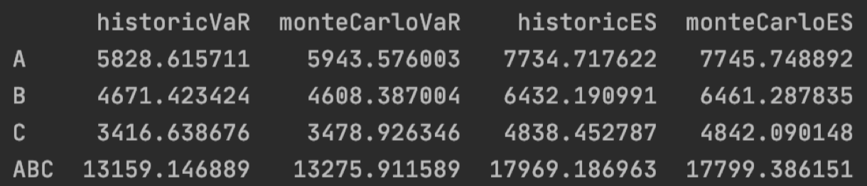
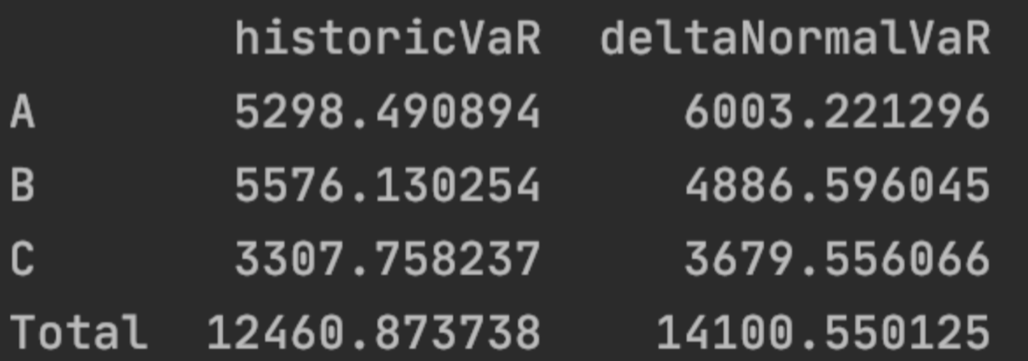
Problem 3
Compare the results from this to your VaR form Problem 3 from Week 4.
Week 5 results
Week 4 results

Slide 14
Problem 3
Compare the results from this to your VaR form Problem 3 from Week 4.
The results are similar. Very generally speaking, after considering the dependency structure among different stocks and setting the marginal distribution of the portfolio to be t distributions, VaRs tend to become larger than those deriving from historical distributions.

