Slide 1
Response for Project 5
Rora Zhu FinTech 590

Slide 2
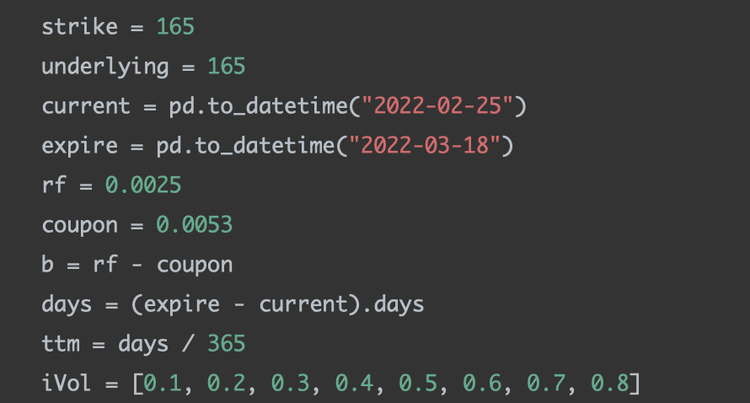
Problem 1
For a range of implied volatilities between 10% and 80%, plot the value of the call and the put
I use BSM formula to find options' values. Let inputs be:

Slide 3
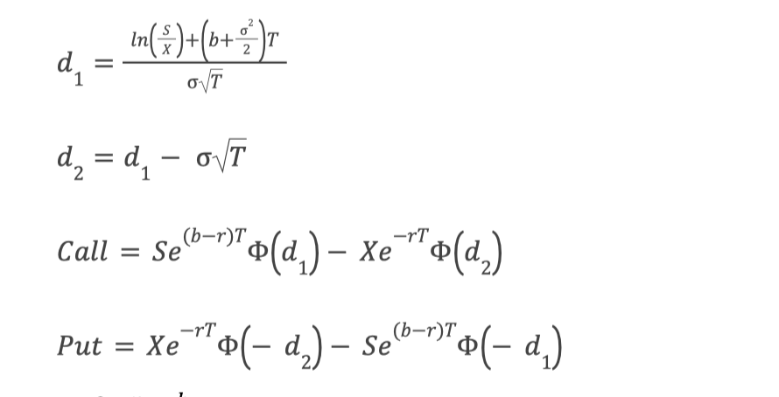
Problem 1
For a range of implied volatilities between 10% and 80%, plot the value of the call and the put
and pass them into the BSM formula:

Slide 4
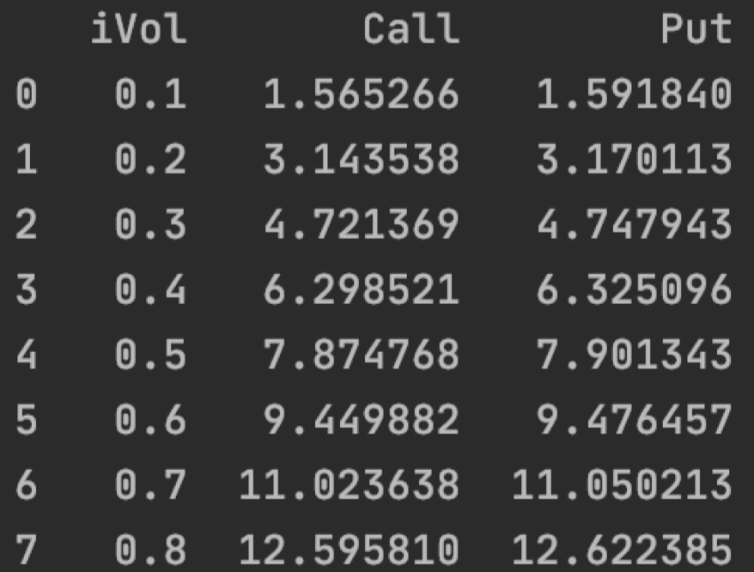
Problem 1
For a range of implied volatilities between 10% and 80%, plot the value of the call and the put
I get option values under different implied volatilities.

Slide 5
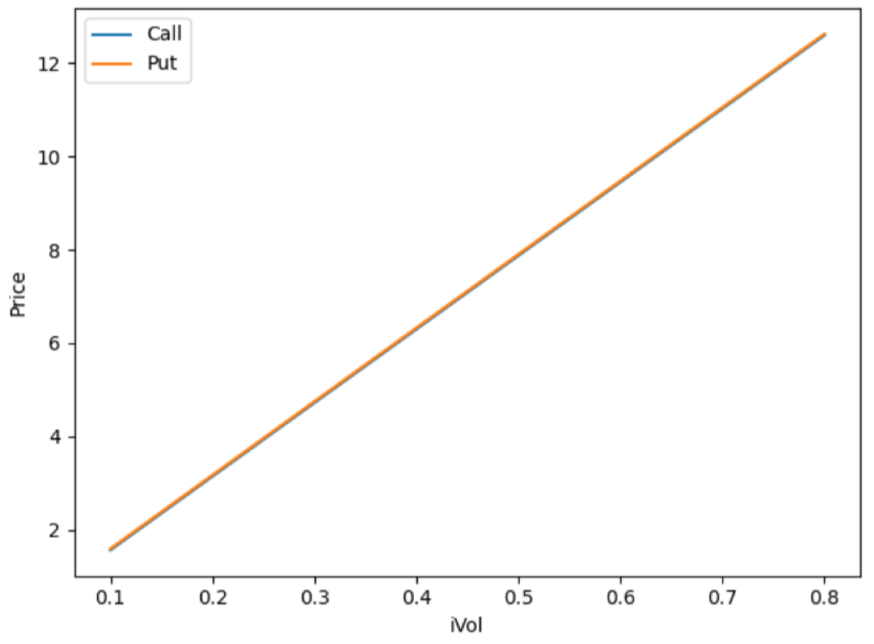
Problem 1
For a range of implied volatilities between 10% and 80%, plot the value of the call and the put
Plot the value of the call and the put:

Slide 6
Problem 1
Discuss these graphs. How does the supply and demand affect the implied volatility?
1. When the option price is at-the-money, implied volatility seems to have a linear relationship with the option price. The larger the implied volatility, the larger the option price.
2. The graph for call overlaps with the graph for put.
3. Implied volatility is directly influenced by the supply and demand of the underlying options and by the market's expectation of the share price's direction. As expectations rise, or as the demand for an option increases, option price will rise, implied volatility will rise, and option values will rise.

Slide 7
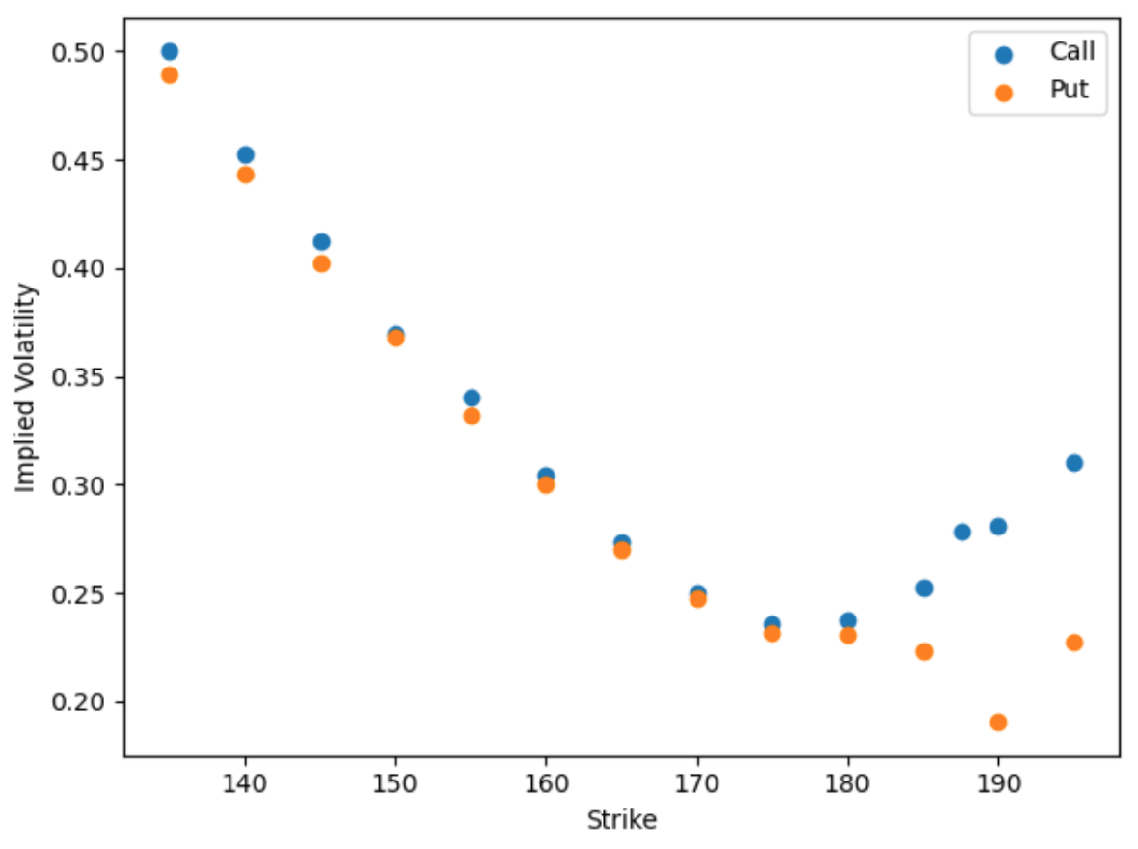
Problem 2
Calculate the implied volatility for each option. Plot the implied volatility vs the strike price for Puts and Calls.

Slide 8
Problem 2
Discuss the shape of these graphs. What market dynamics could make these graphs?
The shape of these graphs looks like a skewed smile. Academically, this is called an implied volatility smirk.
Theoretically, implied volatility measures the perceived volatility of the underlying asset. Regardless of the strike price, all options with the same underlying asset should have the same actual volatility. Therefore, the actual volatility should be a horizontal line in the gragh above. When the strike price equals to the underlying asset price, implied volatility should be the most accurate measure of the actual volatility. therefore, the actual volatility line should pass across (164.85, f(164.85)).

Slide 9
Problem 2
Discuss the shape of these graphs. What market dynamics could make these graphs?
However, we observe a skewed smile shape of the implied volatility. The IV for options at the lower strikes are higher than the IV at higher strikes. This pattern suggests that in-the-money calls and out-of-the-money puts are more expensive compared to out-of-the-money calls and in-the-money puts.
The popular explanation for the manifestation of the reverse volatility skew is that investors are generally worried about market crashes and buy puts for protection.
Another possible explanation is that in-the-money calls have become popular alternatives to outright stock purchases as they offer leverage. This leads to greater demands for in-the-money calls and therefore increased IV at the lower strikes.

Slide 10
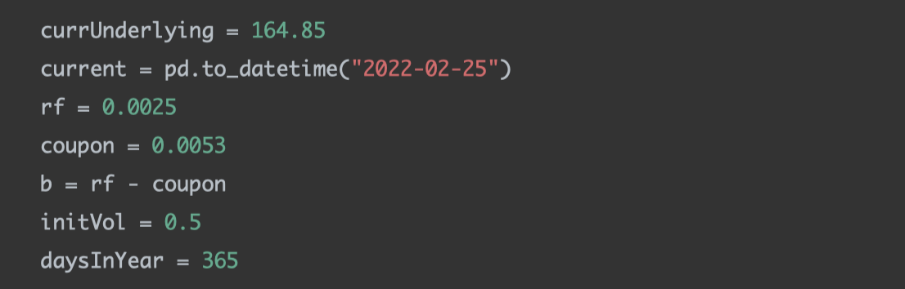
Problem 3
For each of the portfolios, graph the portfolio value over a range of underlying values. Plot the portfolio values.
Steps
For each option, calculate the implied volatility given the underlying inputs.
Simulate a range of underlying prices and calculate the corresponding option prices using the implied volatilities calculated above.

Slide 11
Problem 3
For each of the portfolios, graph the portfolio value over a range of underlying values. Plot the portfolio values.
Steps
Multiply options prices with holdings to calculate the portfolio values.
Plot.

Slide 12
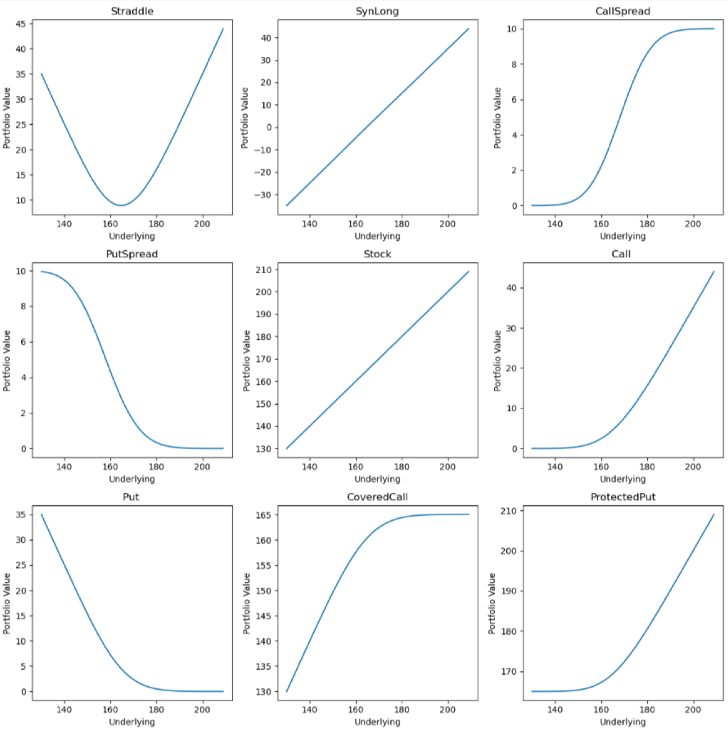
Problem 3
For each of the portfolios, graph the portfolio value over a range of underlying values. Plot the portfolio values.

Slide 13

Problem 3
Discuss the shapes.
Straddle has a smile shape. The goal of this strategy is to profit from a very strong move, usually triggered by a newsworthy event, in either direction by the underlying asset.
SynLong has the same shape with Stock. It can be used to simulate a stock payoff. This is related to the Put Call Parity.
CallSpread and PutSpread benefit from a stock's limited increase in price.

Slide 14


Problem 3
Discuss the shapes.
ProtectedCall has the same shape with the reversed Put. It can be used to simulate a put payoff. This is related to the Put Call Parity.
ProtectedPut has the same shape with Call. It can be used to simulate a call payoff. This is related to the Put Call Parity.

Slide 15
Problem 3
Simulate AAPL returns 10 days ahead and apply those returns to the current AAPL price (above). Calculate Mean, VaR and ES. Discuss.
Steps:
Calculate the standard deviation of AAPL returns in DailyReturn.csv.
Simulate 10 normally distributed returns according to my fitted standard deviation. Assume loc=0.
Use my simulated returns to get 10 day predicted prices ahead, starting from the current AAPL price.
For each option, calculate the tenth day's option price.
Multiply options prices with holdings to calculate the portfolio values.
Iterate 2-4 10000 times. Calculate the mean, VaR, and ES for the portfolio values.

Slide 16
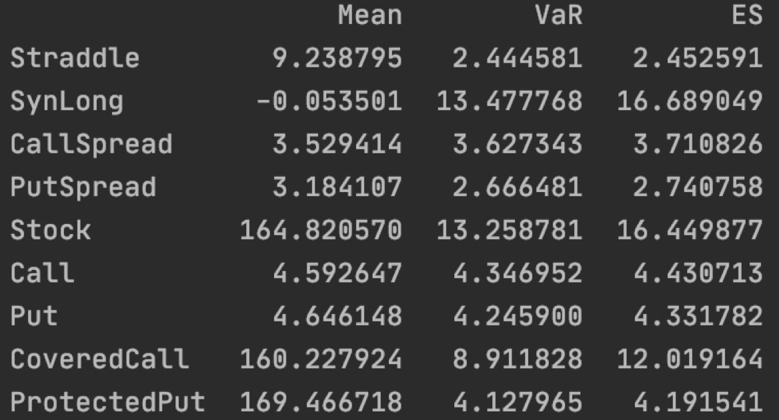
Problem 3
Simulate AAPL returns 10 days ahead and apply those returns to the current AAPL price (above). Calculate Mean, VaR and ES. Discuss.
Results

Slide 17
Problem 3
Simulate AAPL returns 10 days ahead and apply those returns to the current AAPL price (above). Calculate Mean, VaR and ES. Discuss.
Results

Slide 18
Problem 3
Simulate AAPL returns 10 days ahead and apply those returns to the current AAPL price (above). Calculate Mean, VaR and ES. Discuss.
Straddle has the smallest VaR and ES, since it is a strategy that benefits from extreme cases.
SynLong has similar VaR and ES with Stock, since it simulates Stock.
CallSpread and PutSpread have relatively small VaR and ES, since they benefit from a stock's limited increase in price.
ProtectedPut has the same VaR and ES with Call, since it simulates Call.

