Slide 1
Project 1
FINTECH 590 Rora Zhu

Slide 2
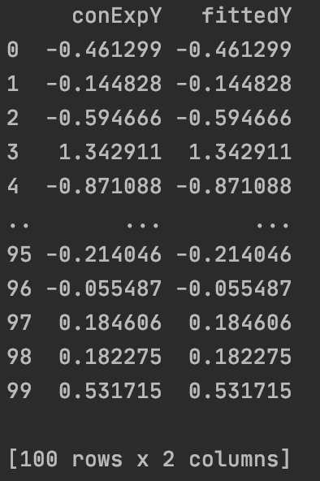
Problem 1
Compare the conditional distribution of the Multivariate Normal, to the OLS equations

Slide 3
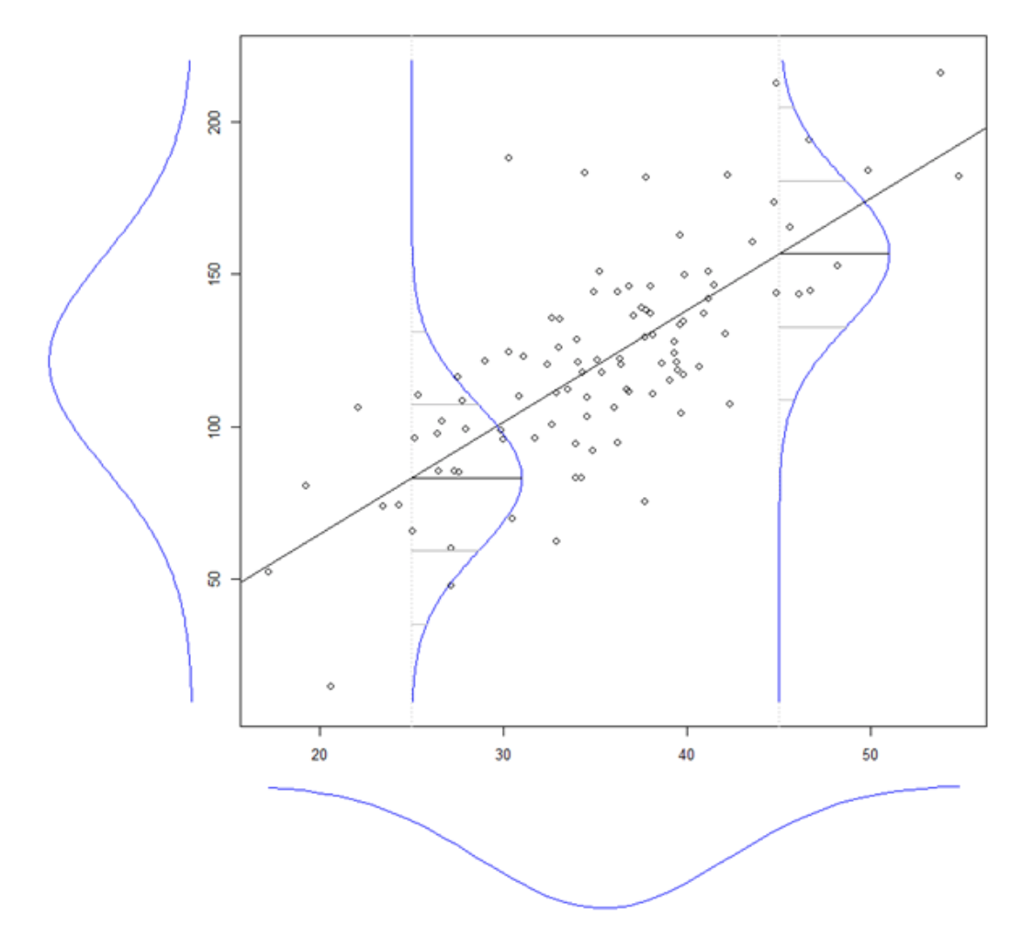
Problem 1
Are these values the same? Why?
They are the same.

Slide 4
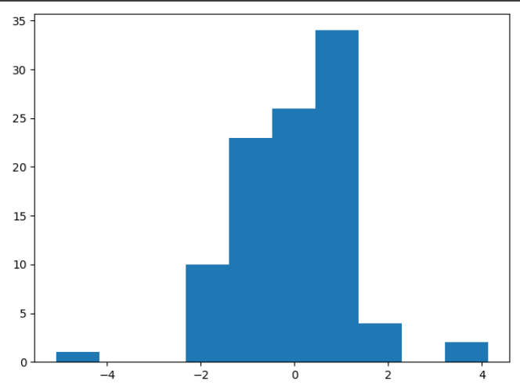
Problem 2
Fit the data using OLS and calculate the error vector. Look at it’s distribution

Slide 5
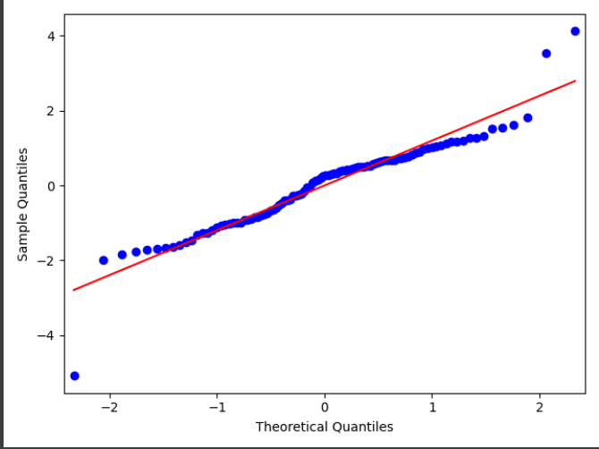

Problem 2
How well does it fit the assumption of normally distributed errors?
qqplot
SW test

Slide 6
Problem 2
Fit the data using MLE given the assumption of normality. Then fit the MLE using the assumption of a T distribution of the errors. Which is the best fit?

Slide 7
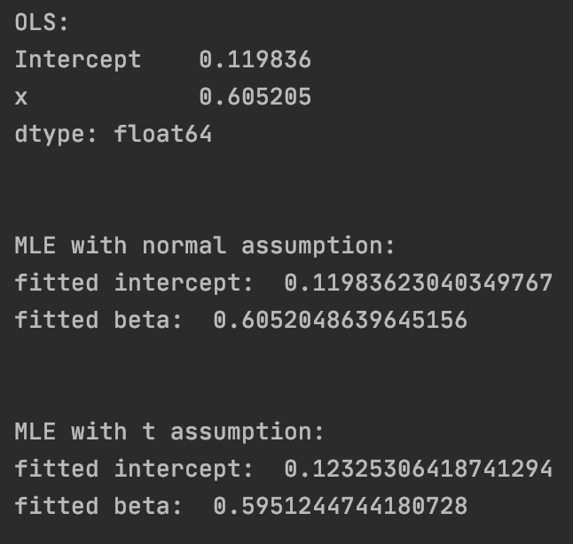
Problem 2
What are the fitted parameters of each and how do they compare?

Slide 8
Problem 2
What does this tell us about the breaking of the normality assumption in regards to expected values in this case?
The breaking of the normality assumption will influence parameter estimation

Slide 9
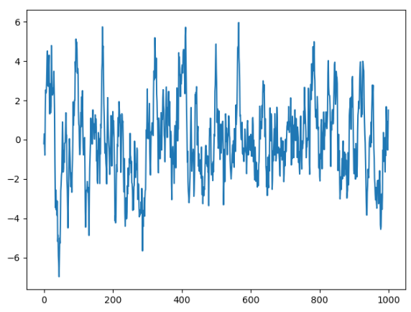
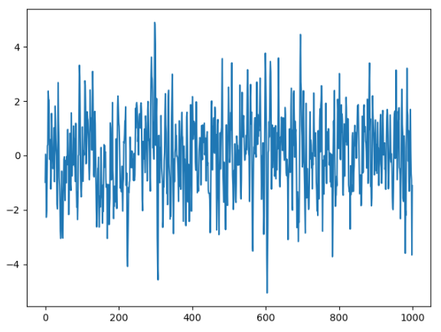
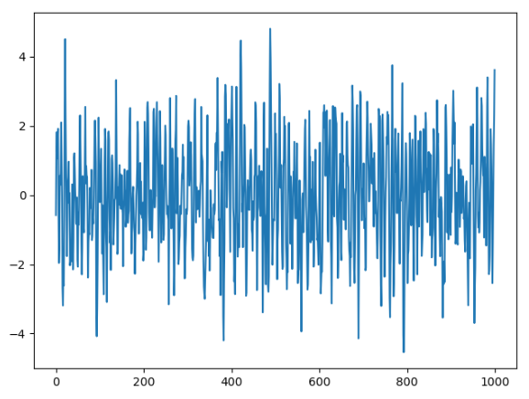
Problem 3
Simulate AR(1) through AR(3) and MA(1) through MA(3) processes
AR = np.array([1, -0.9])
AR = np.array([1, -0.9, 0.3])
AR = np.array([1, -0.9, 0.3, 0.2])

Slide 10
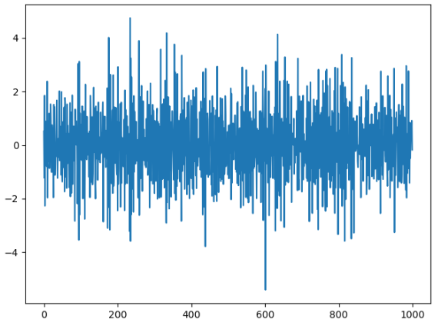
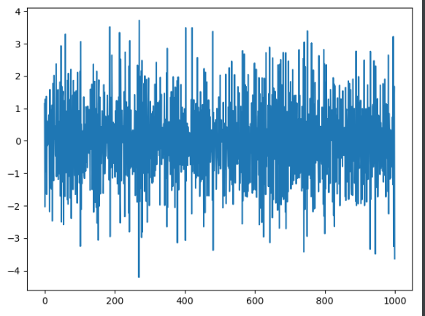
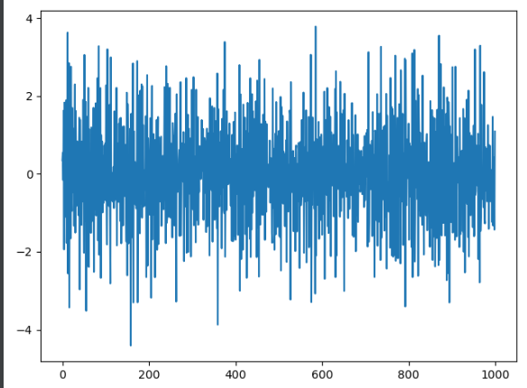
Problem 3
Simulate AR(1) through AR(3) and MA(1) through MA(3) processes
MA = np.array([1, -0.9])
MA = np.array([1, -0.9, 0.3])
MA = np.array([1, -0.9, 0.3, 0.2])

Slide 11
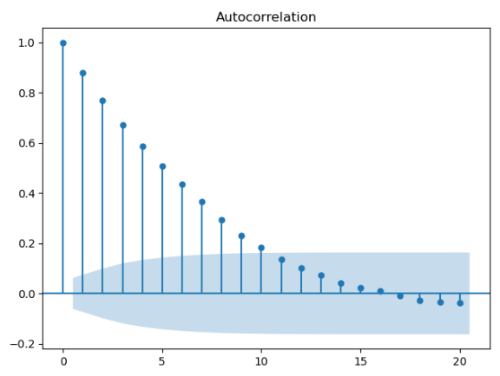
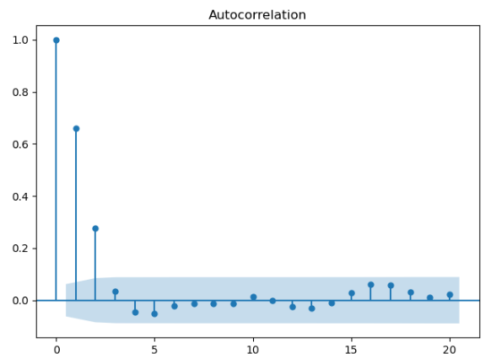
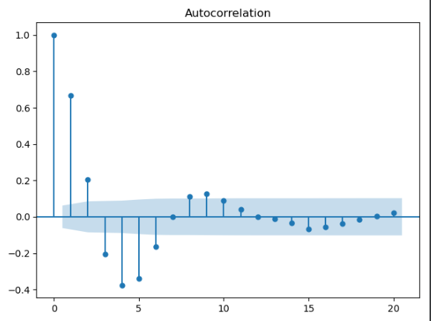
Problem 3
ACF and PACF graphs
AR1
AR2
AR3

Slide 12
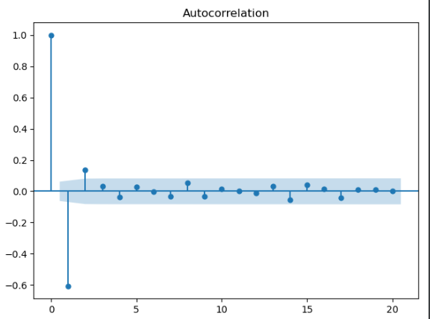
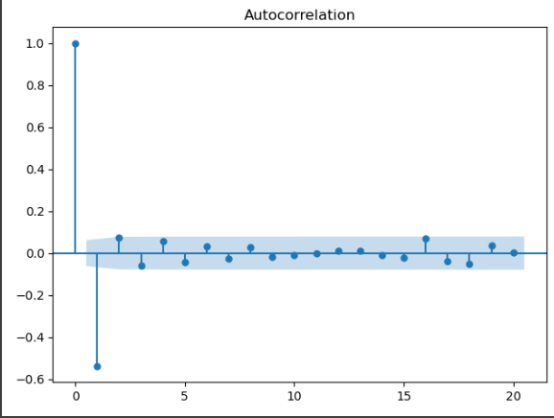
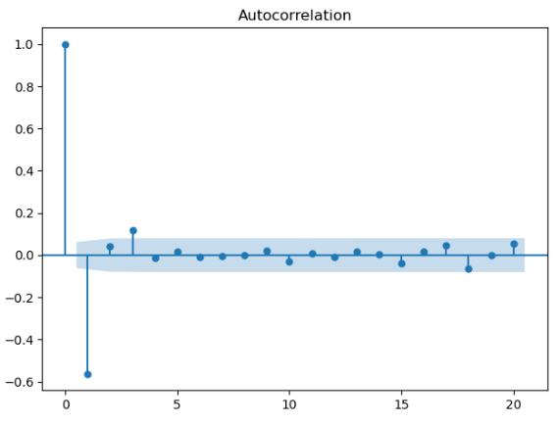
Problem 3
ACF and PACF graphs
MA1
MA2
MA3

Slide 13
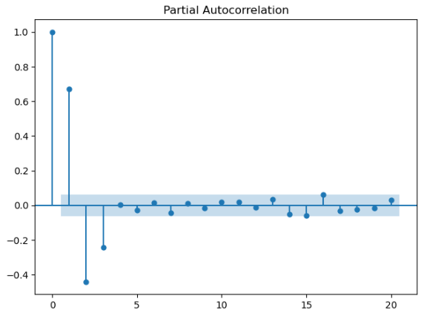
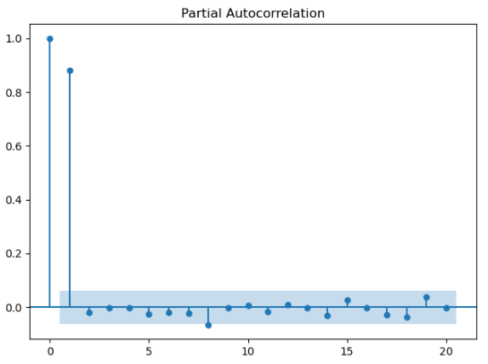
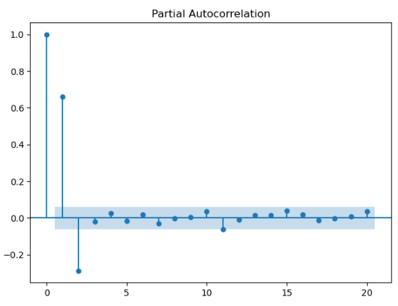
Problem 3
ACF and PACF graphs
AR1
AR2
AR3

Slide 14
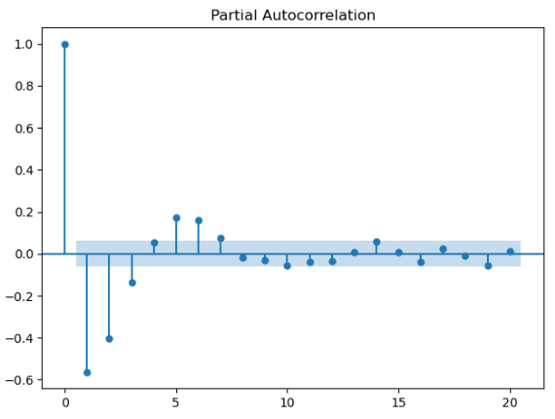
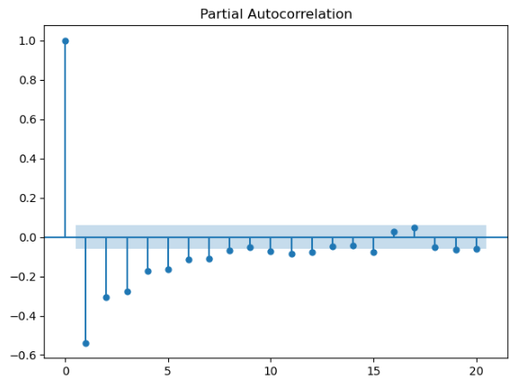
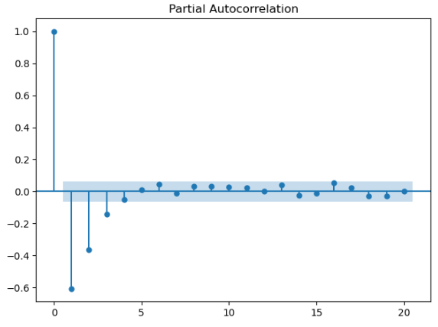
Problem 3
ACF and PACF graphs
MA1
MA2
MA3

Slide 15
Problem 3
How do the graphs help us to identify the type and order of each process?
AR1

Slide 16
Problem 3
How do the graphs help us to identify the type and order of each process?
AR2

Slide 17
Problem 3
How do the graphs help us to identify the type and order of each process?
MA1

Slide 18
Problem 3
How do the graphs help us to identify the type and order of each process?
If a process is an AR process, its autocorrelation will decrease, or oscillate to decrease slowly, and the number of lags that are significantly differ from 0 in the partial autocorrelation indicates the order of this AR process.
If a process is an MA process, its partial autocorrelation will decrease, or oscillate to decrease slowly, and the number of lags that are significantly differ from 0 in the autocorrelation indicates the order of this MA process.

