Slide 1
Response for Project 6
FINTECH 590 Rora Zhu

Slide 2
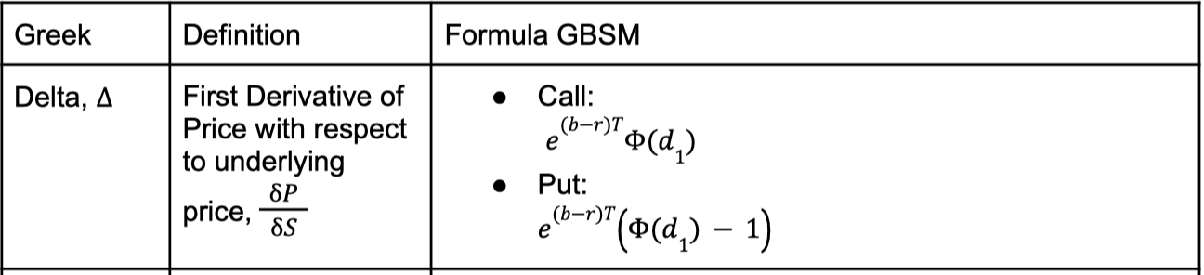
Problem 1
Implement the closed form Greeks for GBSM
Calculate the Greeks according to the following tables.

Slide 3
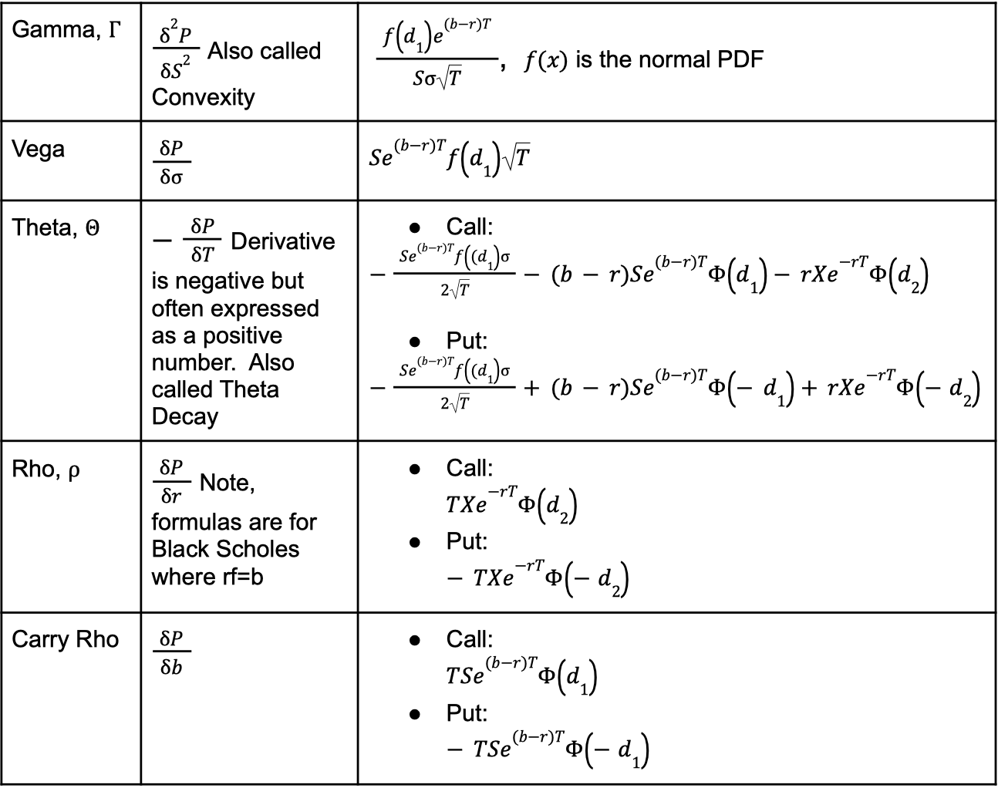
Problem 1
Implement the closed form Greeks for GBSM
Calculate the Greeks according to the following tables.

Slide 4
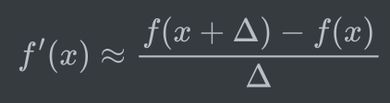
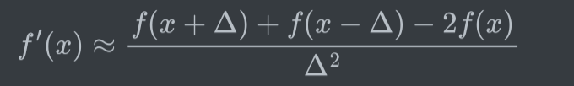
Problem 1
Implement a finite difference derivative calculation
I set the small increment to be 0.001 and use forward-diffence to calculate Delta, Vega, Theta, Rho, and Carry Rho.
I use the following finite difference function to calculate Gamma.

Slide 5
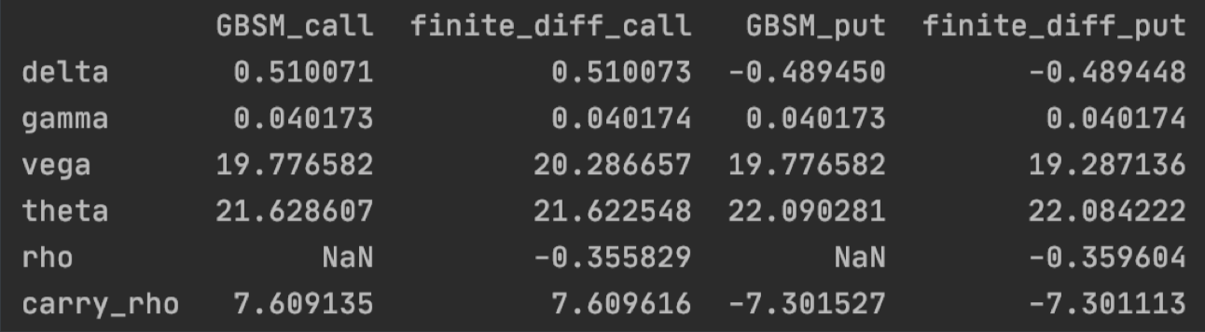
Problem 1
Compare the values between the two methods for both a call and a put.
Two methods have almost the same results. Deltas are ranged from -1 to 1. The sum of the two deltas approach to 1. Gammas are positive and very small. The sensitivities of time to maturity and implied volatility are large. The sensitivity of carry costs associated with American call is positive, while the sensitivity of carry costs associated with American put is negative.

Slide 6
Problem 1
Implement the binomial tree valuation for American options with and without discrete dividends. Calculate the value of the call and the put.
Steps for implementing the binomial tree valuation:
If there are no dividends during previously implemented. the life of the option, use the recombining tree method
Construct the nodes up to the first dividend payment. For each node:
Value No Exercise: Recursively call the non-recombining tree with the stock price minus the dividend and any remaining dividends to be paid.
Value Exercise: Payoff function with the price before the dividend.
Using backward induction, find the value at the starting node.

Slide 7
Problem 1
Implement the binomial tree valuation for American options with and without discrete dividends. Calculate the value of the call and the put.
Results
Price of American call with dividend | Price of American put with dividend
3.856 | 4.417

Slide 8
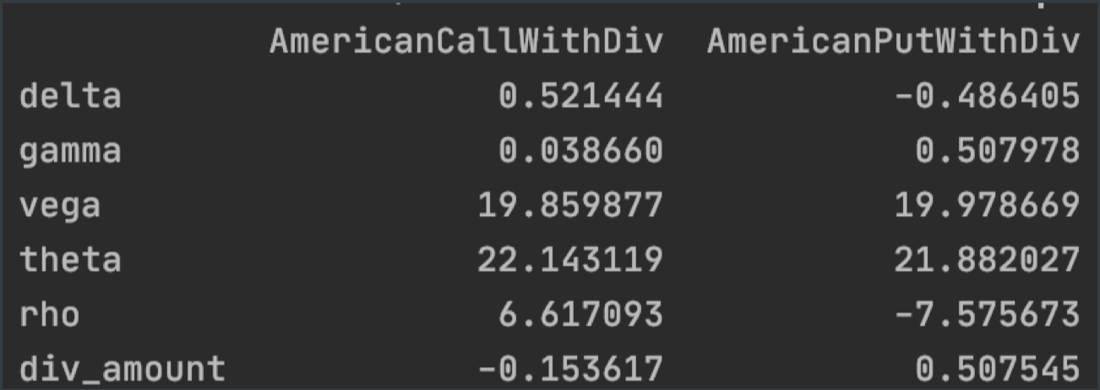
Problem 1
Calculate the Greeks of each. What is the sensitivity of the put and call to a change in the dividend amount?
I set the small increment to be 0.001 and use forward-difference to calculate Delta, Vega, Theta, Rho, and sensitivity of dividend amount.
Since Gamma is too small to be identified if I set the increment to be 0.001, I adjust the increment to be 1 for Gamma.
The sensitivity of the put and call to a change in the dividend amount is 0.507 and -0.15 respectively.

Slide 9
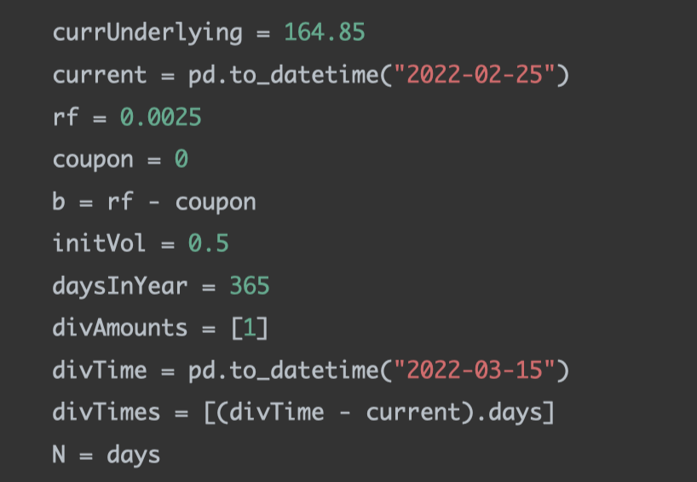
Problem 2
Fit a Normal distribution to AAPL returns – assume 0 mean return. Simulate AAPL returns 10 days ahead and apply those returns to the current AAPL price (above). Calculate Mean, VaR and ES.
For each option, calculate the implied volatility given the underlying inputs.

Slide 10
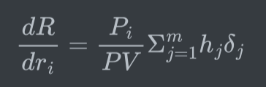
Problem 2
Fit a Normal distribution to AAPL returns – assume 0 mean return. Simulate AAPL returns 10 days ahead and apply those returns to the current AAPL price (above). Calculate Mean, VaR and ES.
Set the increment to be 0.001 and calculate Delta for each option in the portfolio using forward difference and the Binary Tree model for American option with dividends.
Calculate each portfolio's present value.
Calculate each portfolio's gradient using the following formula.

Slide 11

Problem 2
Fit a Normal distribution to AAPL returns – assume 0 mean return. Simulate AAPL returns 10 days ahead and apply those returns to the current AAPL price (above). Calculate Mean, VaR and ES.
Calculate each portfolio's standard deviation using the following formula.
Simulate portfolio returns 10 days ahead assuming normal distribution with location equaling to 0 and scale equaling to each porfolio's standard deviation.

Slide 12
Problem 2
Fit a Normal distribution to AAPL returns – assume 0 mean return. Simulate AAPL returns 10 days ahead and apply those returns to the current AAPL price (above). Calculate Mean, VaR and ES.
Calculate each portfolio's standard deviation using the following formula.
Simulate portfolio returns 10 days ahead assuming normal distribution with location equaling to 0 and scale equaling to each portfolio's standard deviation.

Slide 13
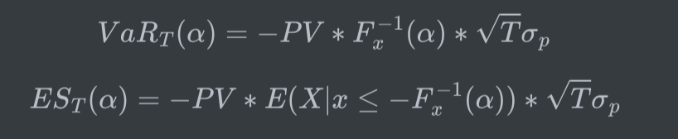
Problem 2
Fit a Normal distribution to AAPL returns – assume 0 mean return. Simulate AAPL returns 10 days ahead and apply those returns to the current AAPL price (above). Calculate Mean, VaR and ES.
Calculate the mean, VaR, and ES using the following formulas

Slide 14
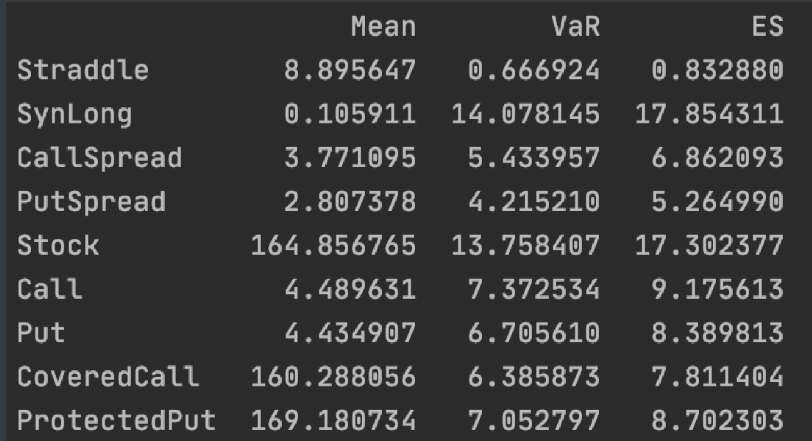
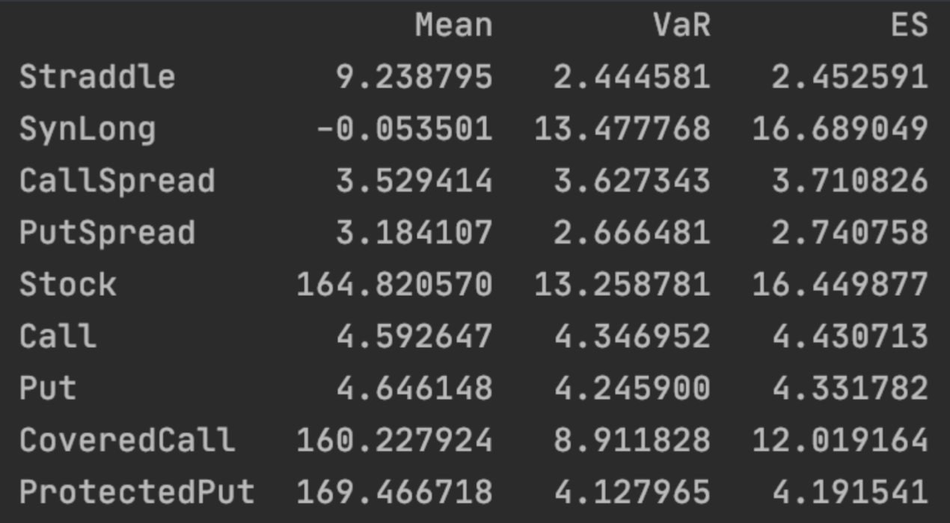
Problem 2
Compare these results to last week’s results.
Delta normal Last week's results
The results are quite similar.

Slide 15
Problem 3
Use the Fama French 3 factor return time series as well as the Carhart Momentum time series to fit a 4 factor model to the following stocks.
For each stock, fit a 4 factor FF model with an alpha to find betas considering the last 60 days returns.

Slide 16
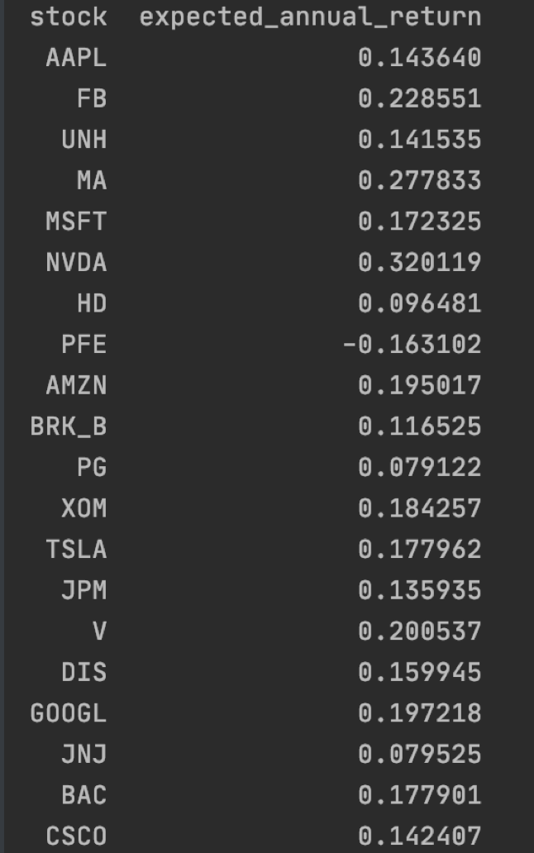
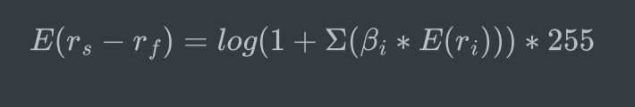
Problem 3
Based on the past 10 years of factor returns, find the expected annual return of each stock.
Calculate the geographic annualized expected return based on 10 years of factor returns.

Slide 17
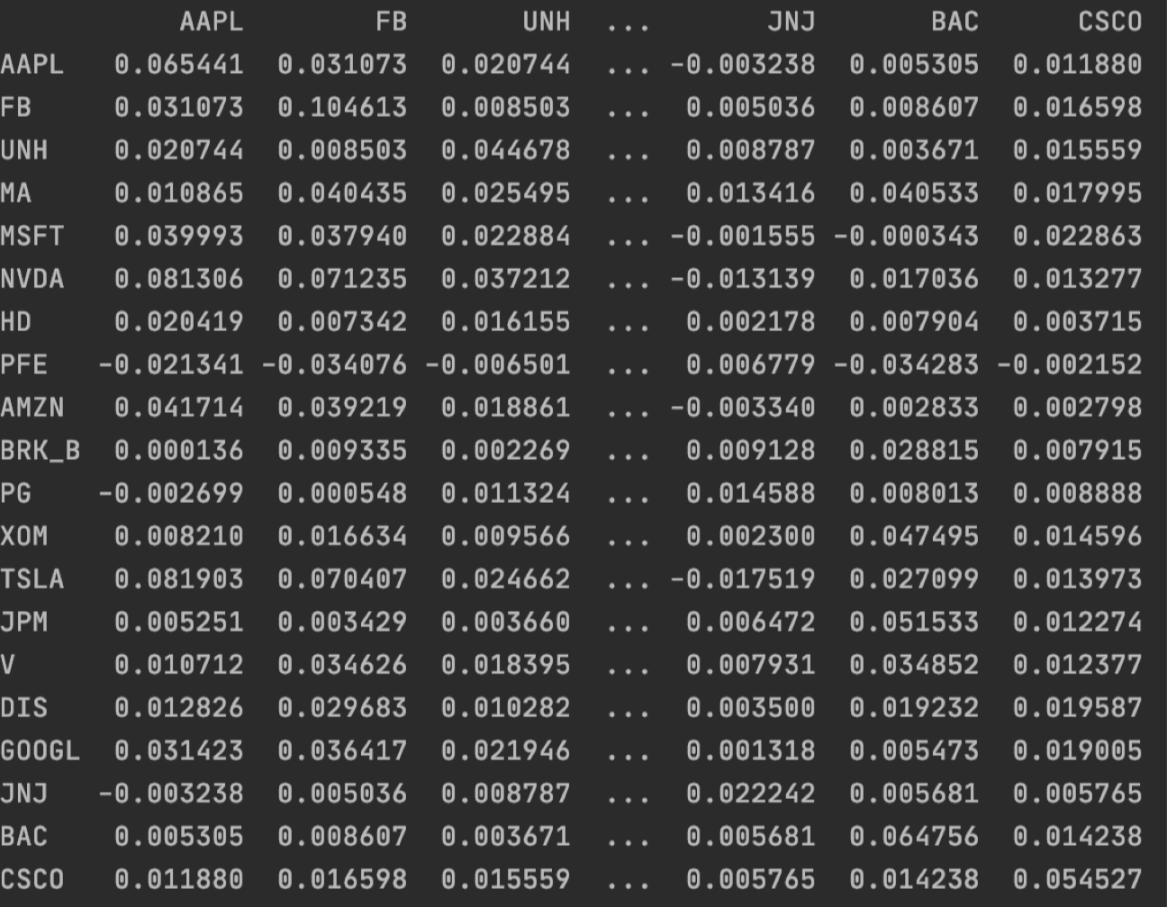

Problem 3
Construct an annual covariance matrix for the 10 stocks.
Calculate the geographic annualized covariance based on 10 years of factor returns.

Slide 18
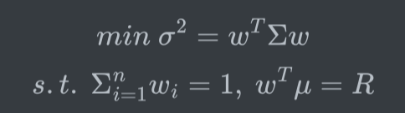
Problem 3
Assume the risk free rate is 0.0025. Find the super efficient portfolio.
Define the optimization function to be
Set initial weights to be equally weighted decimals and pass them into the optimization function. Let the optimization function find the minimum weights given each specified R.
Pass the minimum weights into the objective function to find the minimized standard deviation. Draw the efficient frontier.
Compare the Sharpe ratio for each R, find the super efficient portfolio.

Slide 19
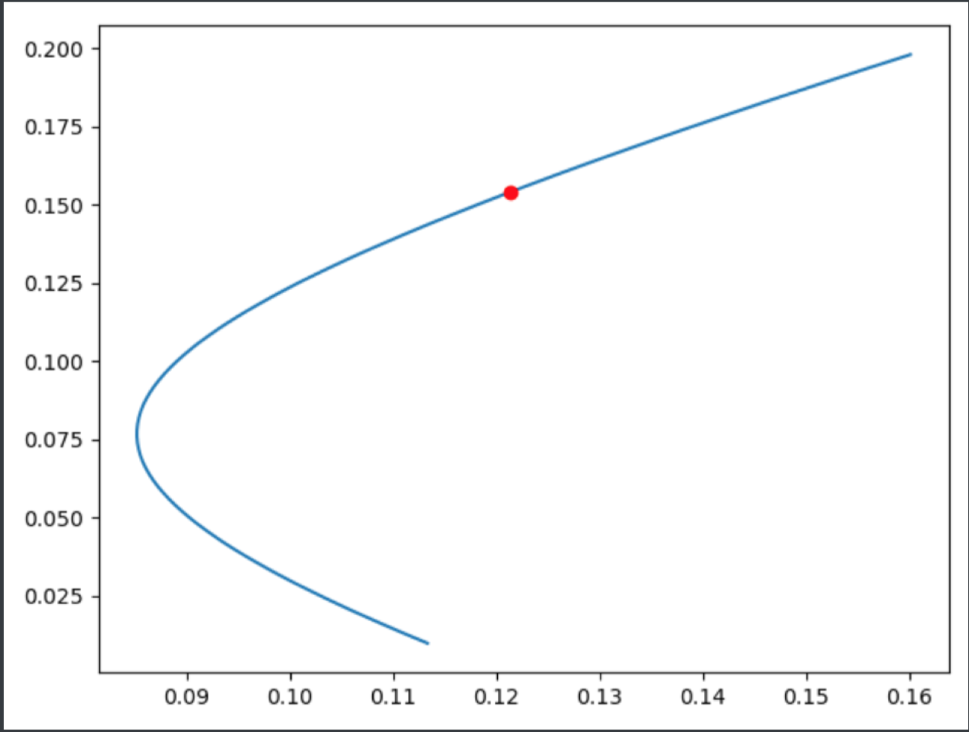
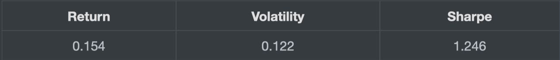
Problem 3
Assume the risk free rate is 0.0025. Find the super efficient portfolio.
The best portfolio is

