Slide 1
Project 1
FINTECH 590 Rora Zhu

Slide 2
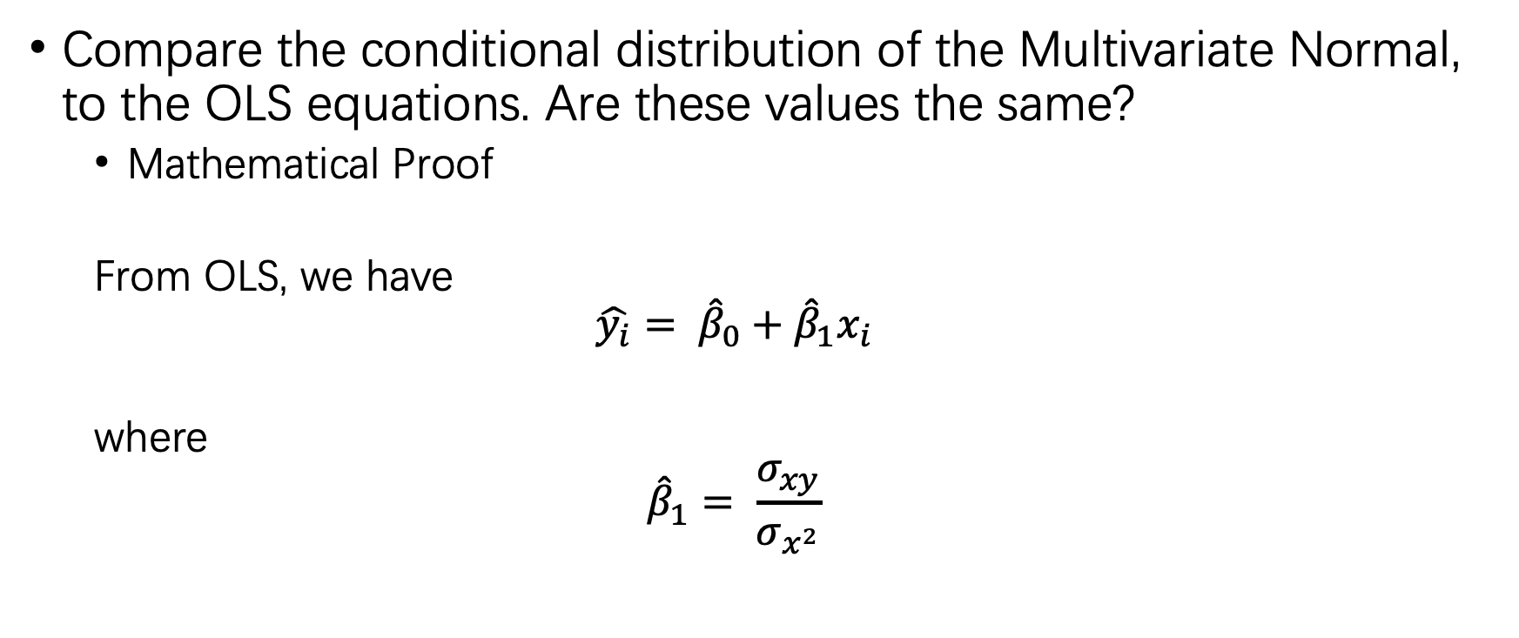
Problem 1
Compare the conditional distribution of the Multivariate Normal, to the OLS equations. Are these values the same?
Mathematical Proof
From OLS, we have
$$\hat{y_{i}}= {\hat{β}}_{0}+{\hat{β}}_{1}x_{i}$$
where
$${\hat{β}}_{1}= \frac{σ_{xy}}{σ_{x^{2}}}$$

Slide 3
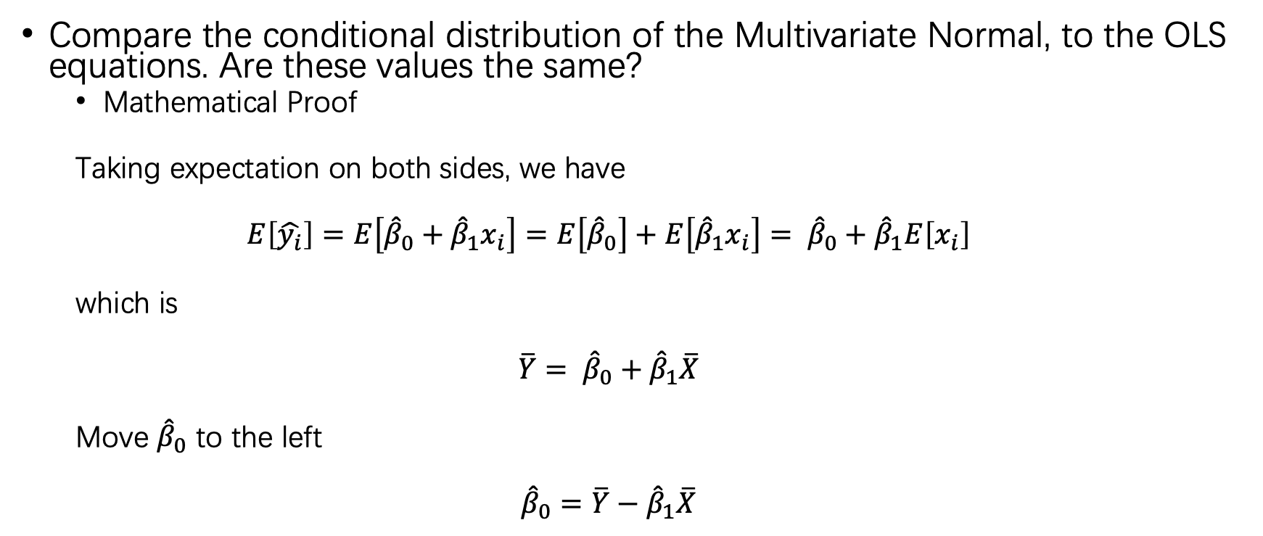
Problem 1
Compare the conditional distribution of the Multivariate Normal, to the OLS equations. Are these values the same?
Mathematical Proof
Taking expectation on both sides, we have
$$E\left[\hat{y_{i}}\right]=E\left[{\hat{β}}_{0}+{\hat{β}}_{1}x_{i}\right]=E\left[{\hat{β}}_{0}\right]+E\left[{\hat{β}}_{1}x_{i}\right]= {\hat{β}}_{0}+{\hat{β}}_{1}E\left[x_{i}\right]$$
which is
$$\overline{Y}= {\hat{β}}_{0}+{\hat{β}}_{1}\overline{X}$$
Move ${\hat{β}}_{0}$ to the left
$${\hat{β}}_{0}=\overline{Y}−{\hat{β}}_{1}\overline{X}$$

Slide 4
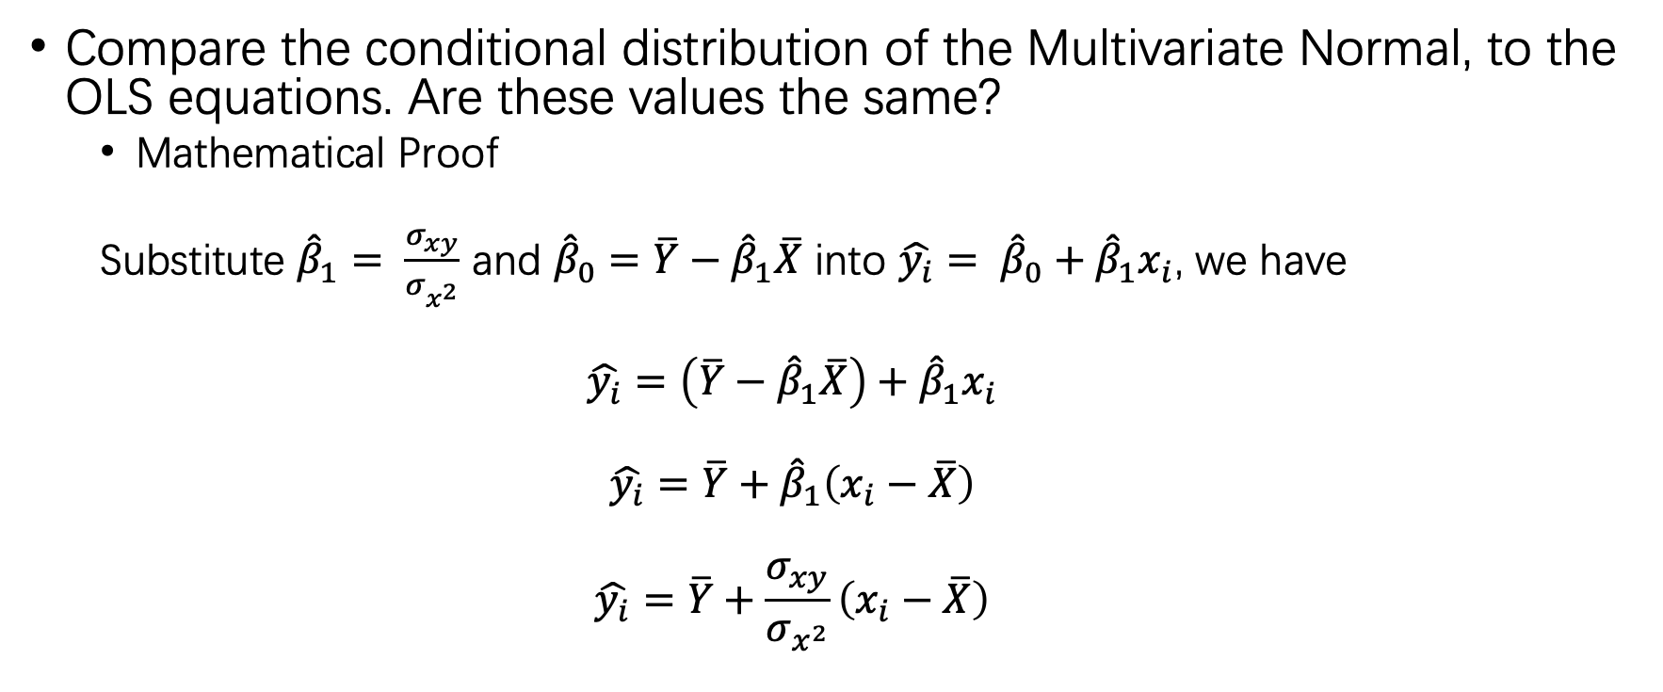
Problem 1
Compare the conditional distribution of the Multivariate Normal, to the OLS equations. Are these values the same?
Mathematical Proof
Substitute ${\hat{β}}_{1}= \frac{σ_{xy}}{σ_{x^{2}}}$ and ${\hat{β}}_{0}=\overline{Y}−{\hat{β}}_{1}\overline{X}$ into $\hat{y_{i}}= {\hat{β}}_{0}+{\hat{β}}_{1}x_{i}$, we have
$$\hat{y_{i}}=\left(\overline{Y}−{\hat{β}}_{1}\overline{X}\right)+{\hat{β}}_{1}x_{i}$$
$$\hat{y_{i}}=\overline{Y}+{\hat{β}}_{1}\left(x_{i}−\overline{X}\right)$$
$$\hat{y_{i}}=\overline{Y}+\frac{σ_{xy}}{σ_{x^{2}}}\left(x_{i}−\overline{X}\right)$$

Slide 5
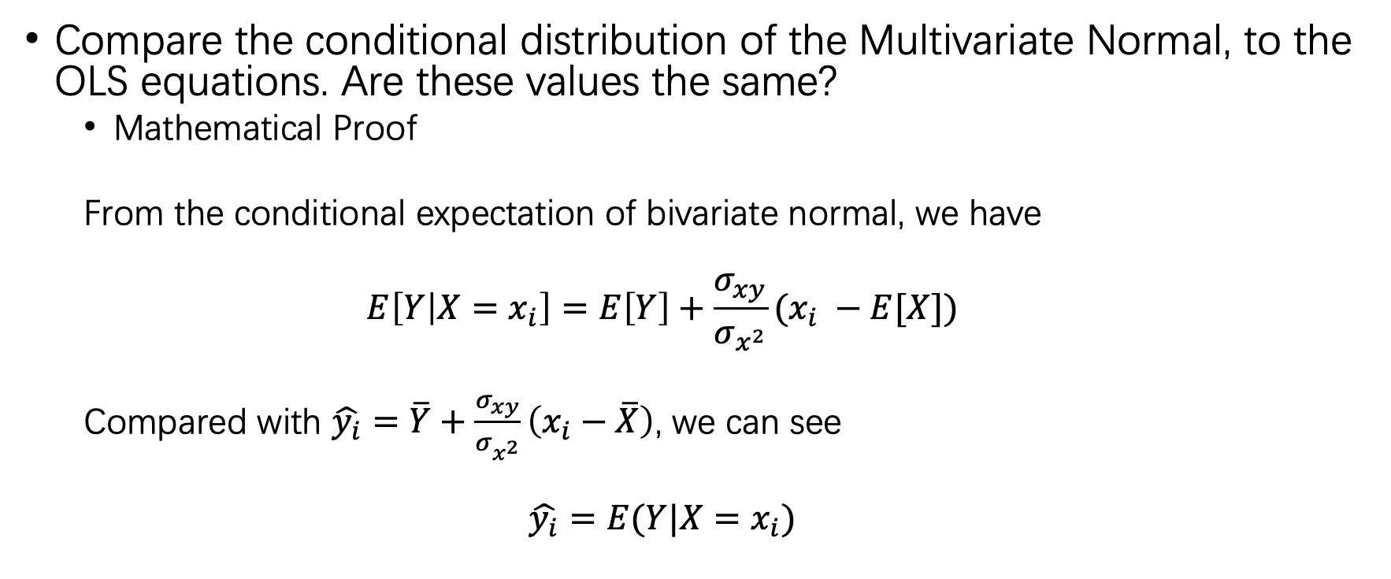
Problem 1
Compare the conditional distribution of the Multivariate Normal, to the OLS equations. Are these values the same?
Mathematical Proof
From the conditional expectation of bivariate normal, we have
$$E\left[Y | X=x_{i}\right]=E\left[Y\right]+\frac{σ_{xy}}{σ_{x^{2}}}(x_{i} −E[X])$$
Compared with $\hat{y_{i}}=\overline{Y}+\frac{σ_{xy}}{σ_{x^{2}}}\left(x_{i}−\overline{X}\right)$, we can see
$$\hat{y_{i}}=E(Y|X=x_{i})$$

Slide 6
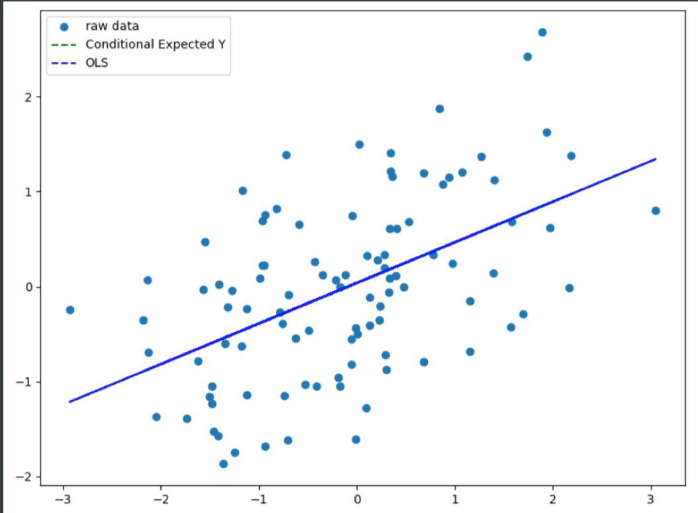
Problem 1
Compare the conditional distribution of the Multivariate Normal, to the OLS equations. Are these values the same?
Empirical Proof

Slide 7
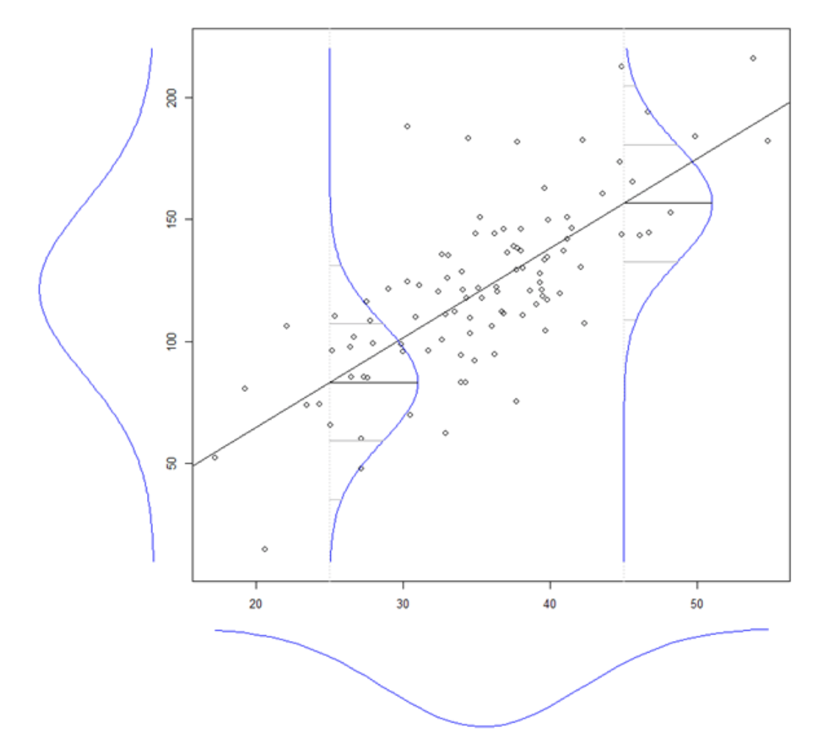

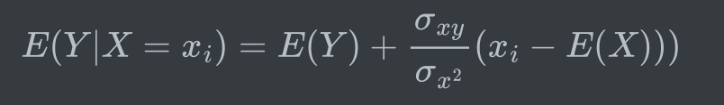
Problem 1
Why?

Slide 8
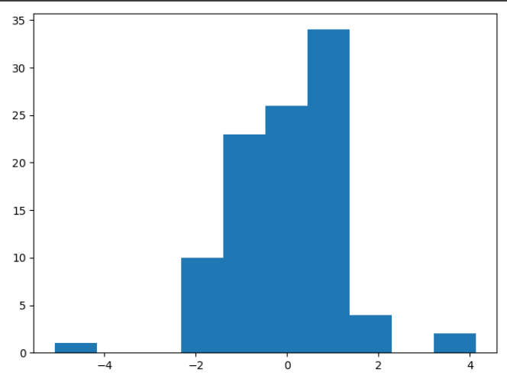
Problem 2
Fit the data using OLS and calculate the error vector. Look at it’s distribution

Slide 9
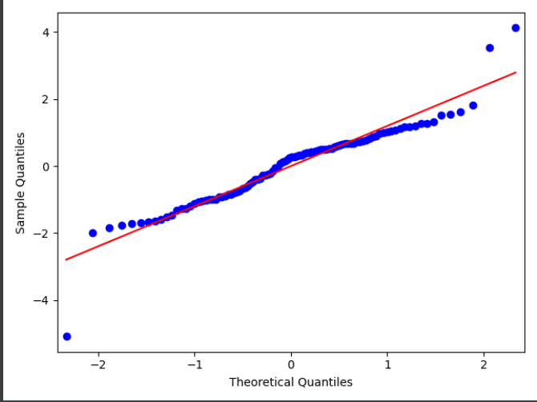

Problem 2
How well does it fit the assumption of normally distributed errors?
qqplot
SW test

Slide 10
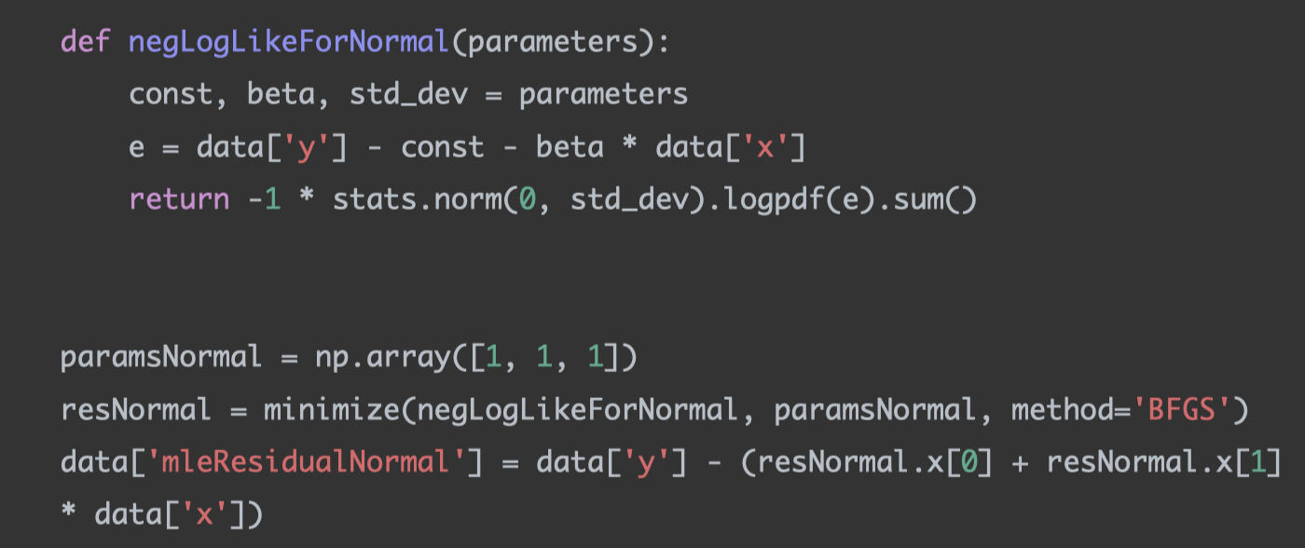
Problem 2
Fit the data using MLE given the assumption of normality. Then fit the MLE using the assumption of a T distribution of the errors. Which is the best fit?

Slide 11
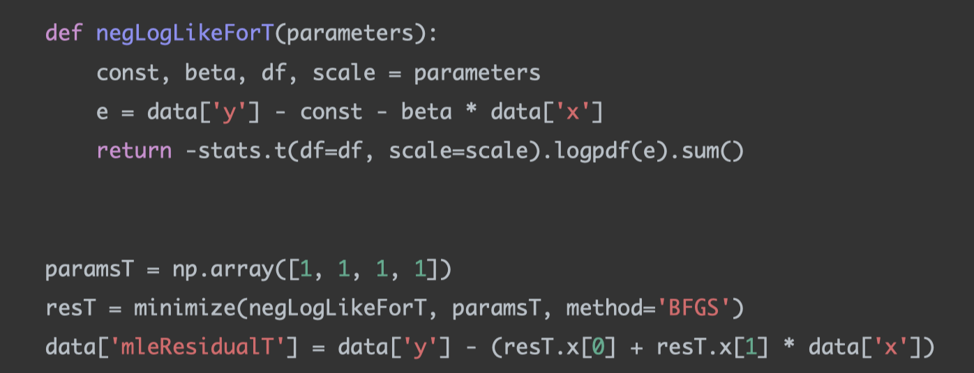
Problem 2
Fit the data using MLE given the assumption of normality. Then fit the MLE using the assumption of a T distribution of the errors. Which is the best fit?

Slide 12
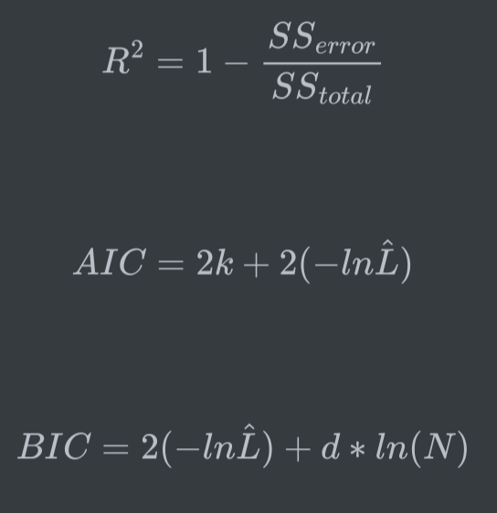
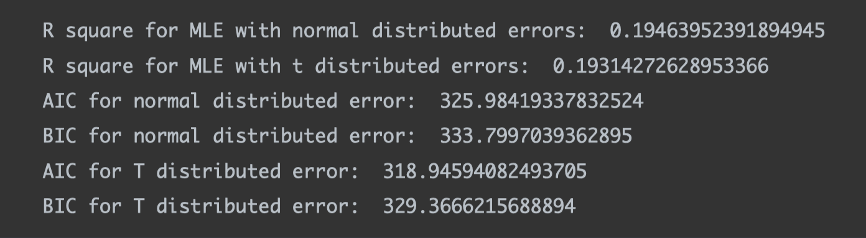

Problem 2
Fit the data using MLE given the assumption of normality. Then fit the MLE using the assumption of a T distribution of the errors. Which is the best fit?
From $R^{2}$, MLE normal is a better fit
From AIC and BIC, MLE t is a better fit

Slide 13
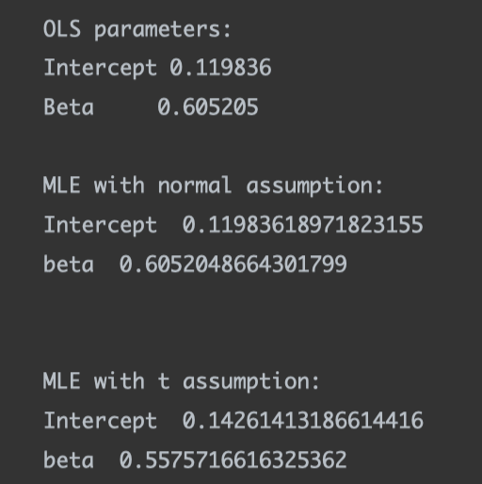
Problem 2
What are the fitted parameters of each and how do they compare?

Slide 14
Problem 2
What does this tell us about the breaking of the normality assumption in regards to expected values in this case?
The breaking of the normality assumption will influence parameter estimation
If the normality assumption is broken, generalized t assumption is a better estimate

Slide 15
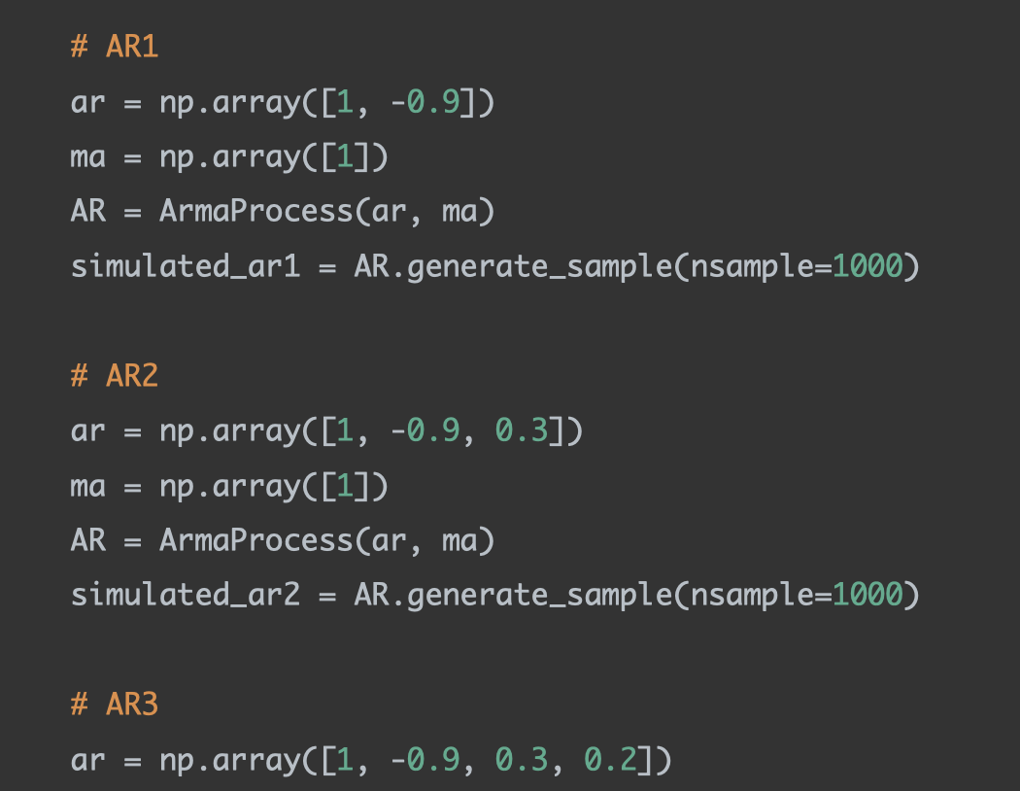
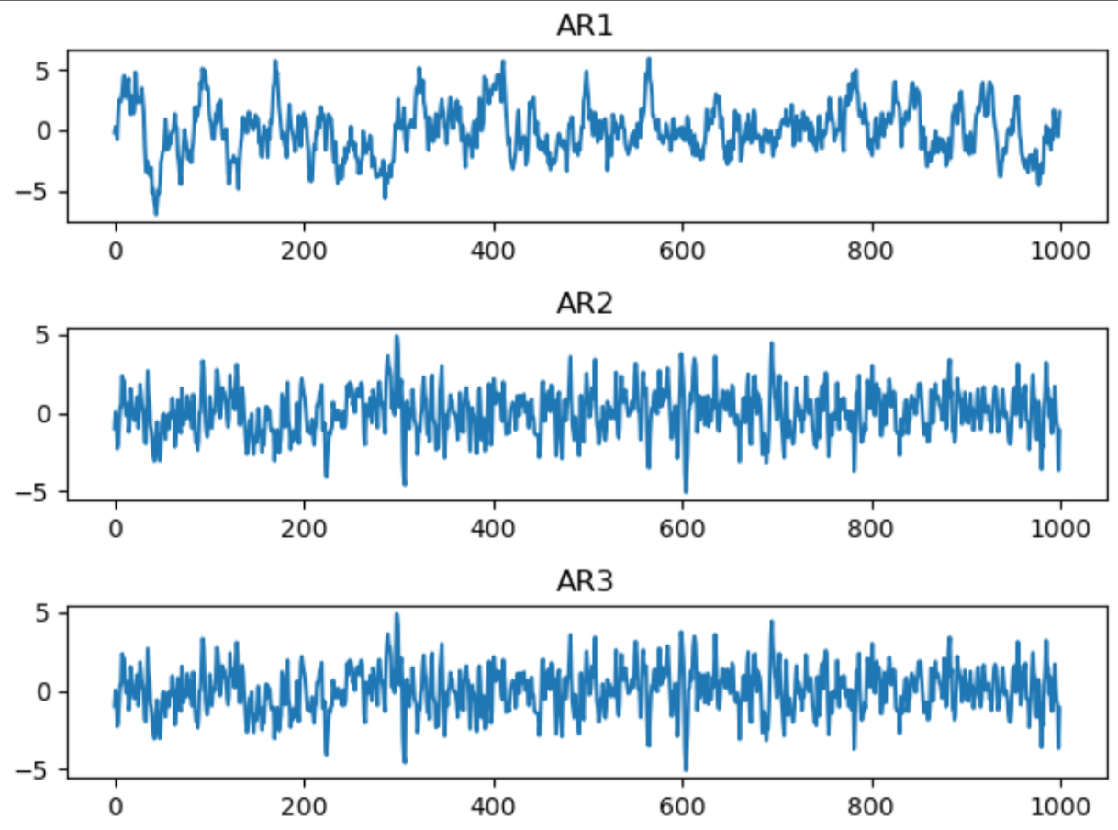
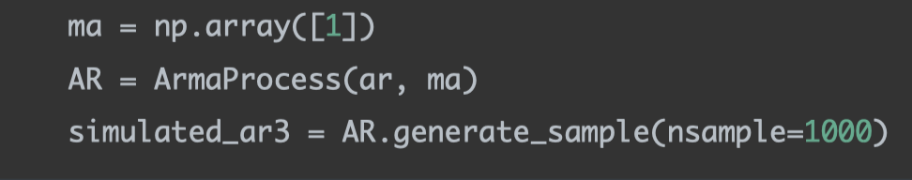
Problem 3
Simulate AR(1) through AR(3) and MA(1) through MA(3) processes

Slide 16
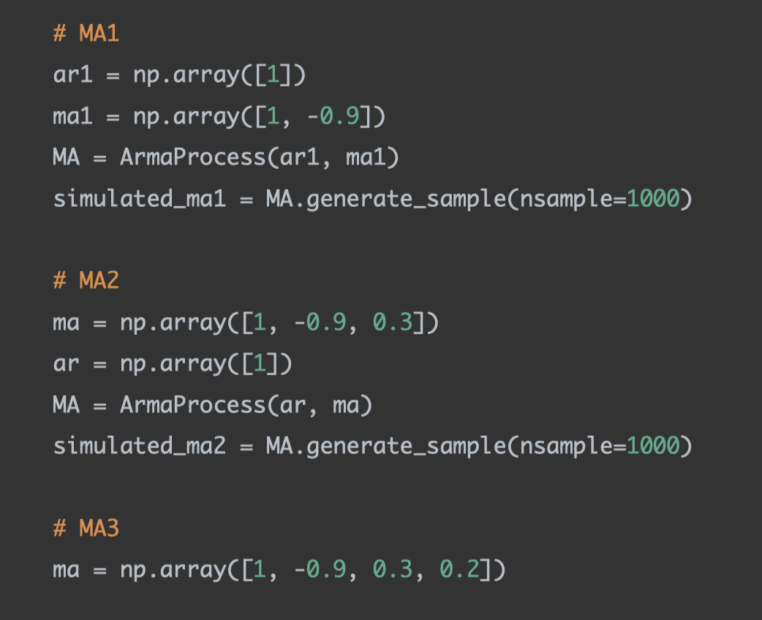
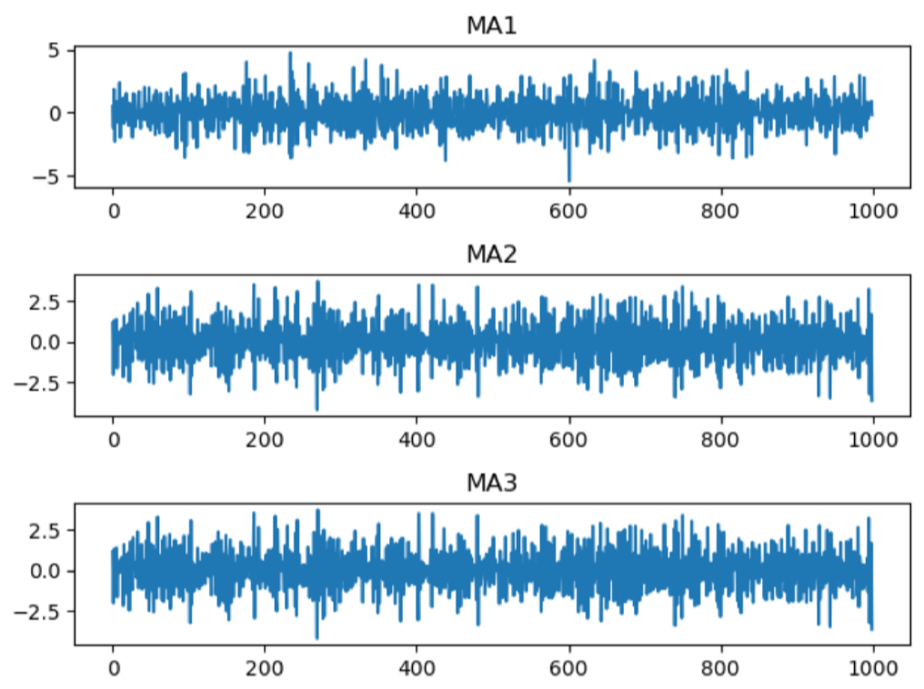
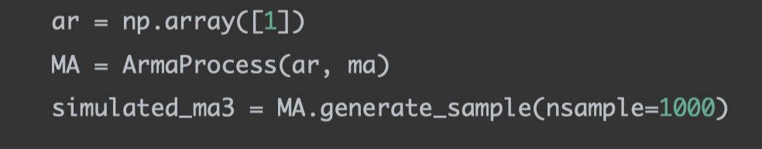
Problem 3
Simulate AR(1) through AR(3) and MA(1) through MA(3) processes

Slide 17
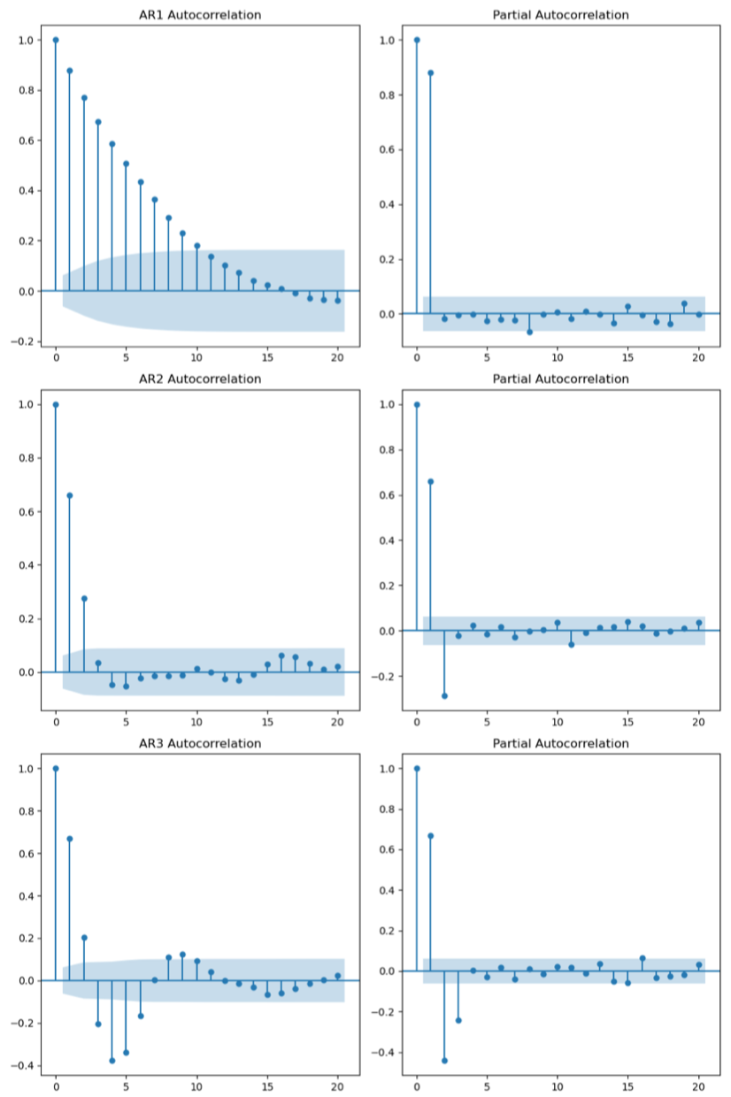
Problem 3
ACF and PACF graphs

Slide 18
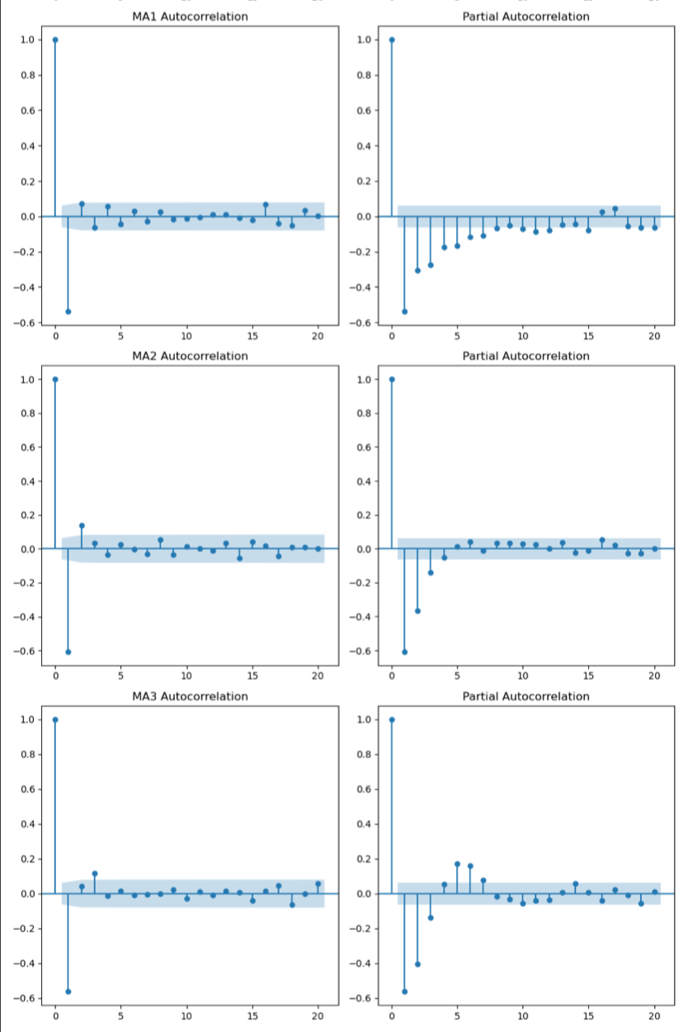
Problem 3
ACF and PACF graphs

Slide 19
Problem 3
How do the graphs help us to identify the type and order of each process?
If a process is an AR process, its autocorrelation will decrease, or oscillate to decrease slowly, and the number of lags that are significantly differ from 0 in the partial autocorrelation indicates the order of this AR process.
If a process is an MA process, its partial autocorrelation will decrease, or oscillate to decrease slowly, and the number of lags that are significantly differ from 0 in the autocorrelation indicates the order of this MA process.

