Slide 1

PIRKT! An Online Selling Platform
By:
Ali Elouafiq
Ayoub Khobalatte
Mohammed Redouane Khrifi
Mohammed Wael Khobalatte
Wassim Benhallam

Slide 2
Special Thanks To
Dr. Nasser Assem
Ms. Hind Seddiki
Ms. Mounya Nyami
Ms. Ouassima Ajenaf

Slide 3
Outline
Overview
Project Objectives
The hurdles
Entity Relationship Diagram (ERD)
Business Rules
Conclusion
Demonstration

Slide 4
Project Overview
A genuine idea in the Moroccan business market.
An easy to use portal
A friendly administration panel

Slide 5
Project Objectives
Apply our skills in a real life, business related project.
Verify the learning outcomes of this course
Facilitate the process of looking for products and purchasing them
Managing the store can be done quickly and pain free

Slide 6
The hurdles
Getting accommodated with .NET Framework and SQL for the first time
New Environment: Microsoft Visual Studio
Time and Data efficiency
Team Management
Regrouping the different parts and tasks.
Meeting Our Objectives.

Slide 7
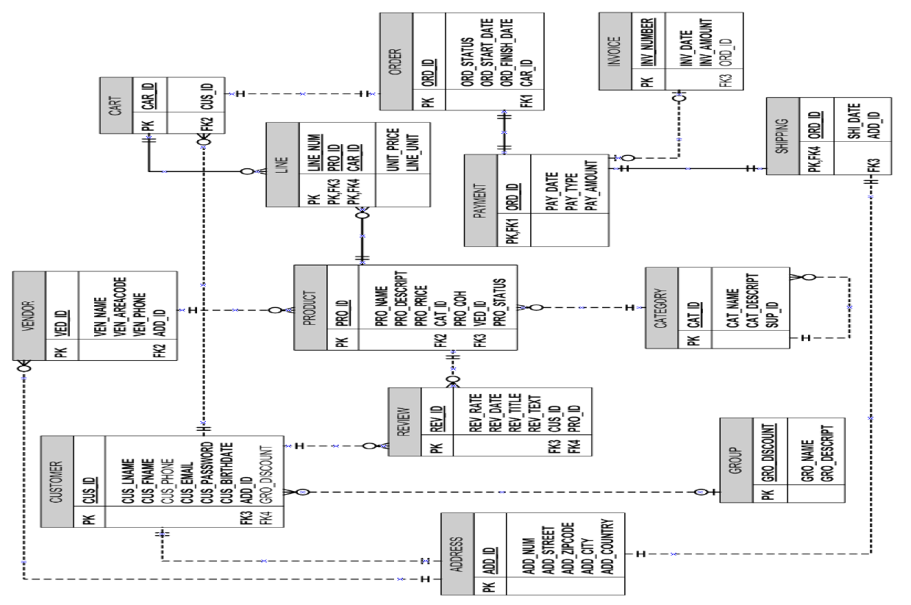
Entity Relashionship Diagram

Slide 8
Examples of Business Rules
The Customer Product Relationship (many-to-many)
The Product Category Relationship(one-to-many)
The Category Category Relationship(one-to-many unary)

Slide 9
Conclusion
Academic Experience
Real Word Experience
Future Work

Slide 10
Thank you for your attention !
Any Question ?

