Slide 1
Web Scraping
By Emil kjer RMIT University
Emil@Kjer.info March 2012

Slide 2
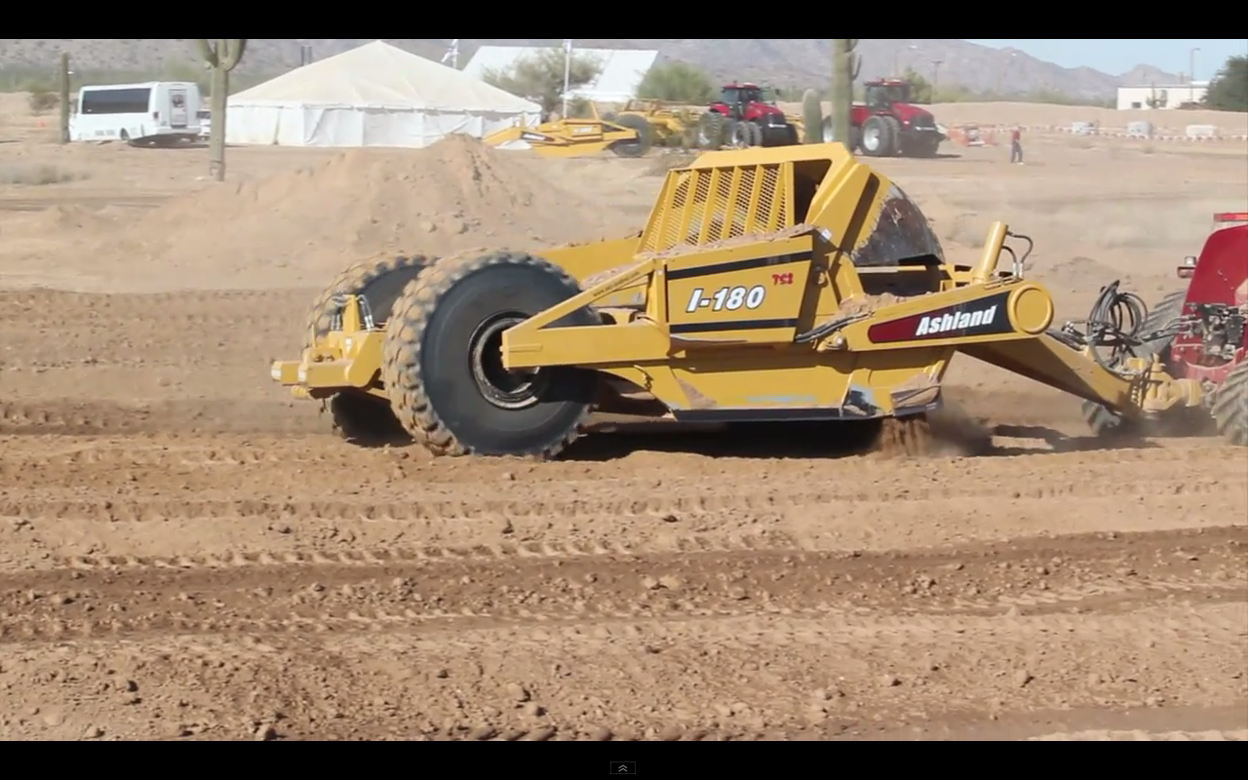
What is scraping?
From http://youtu.be/--THSIi85I8

Slide 3
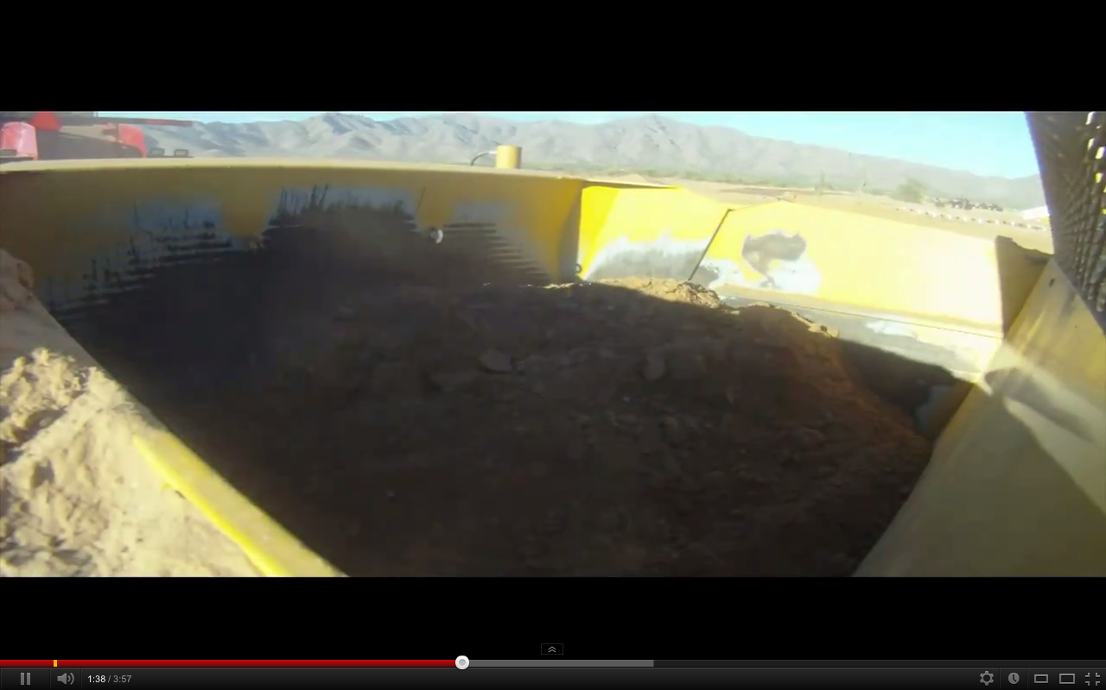
What is scraping?
From http://youtu.be/--THSIi85I8

Slide 4

What is scraping?
From http://youtu.be/--THSIi85I8

Slide 5
What scraping is
Web scraping / web harvesting / web data extraction
Collect content from a source
Firefox, Chrome, Safari
wget, curl, urllib2[python], URL[java], Net::HTTP[ruby]
Do something to the content
Parser with regular expression
BeautifulSoup [python]
Jsoup [java]

Slide 6
What to use it for?
Research
News mashup
Weather app
Movie comparison
Webcrawler

Slide 7
remarks
Politeness
Heavy load
Amount of data
Private sources
Bad code
Robustness
Data changes form
Broken links

Slide 8
Timetables
In a browser go to:
http://www.metlinkmelbourne.com.au/timetables
Select transport mode
http://www.metlinkmelbourne.com.au/timetables/metropolitan-trains
Select a route e.g. Alamain Line
http://www.metlinkmelbourne.com.au/route/view/1
Select a direction e.g. to city
http://tt.metlinkmelbourne.com.au/tt/XSLT_TTB_REQUEST?command=direct&language=en&outputFormat=0&net=vic&line=02ALM&project=ttb&itdLPxx_selLineDir=H&sup=B
Download the page via. the browser e.g. in Safari File > Save As… > Format "Page Source".

Slide 9
Get and extract 1
Simple and “solution” using Python and BeautifulSoup
From file
From url
HTML parsed to objects
BeautifulSoup
http://www.crummy.com/software/BeautifulSoup/

Slide 10
Get and extract 2
Using Java and Jsoup
From file
From url
HTML parsed to objects
Jsoup
http://jsoup.org
Alternative from javax for parsing html as documents javax.swing.text.html.HTMLEditorKit

Slide 11
summary
Many applications
Collect data
Do something with the data
Politeness and robustness
Source code at https://github.com/emilkjer/Web-Scraping

