Slide 1
Sécurité

Slide 2
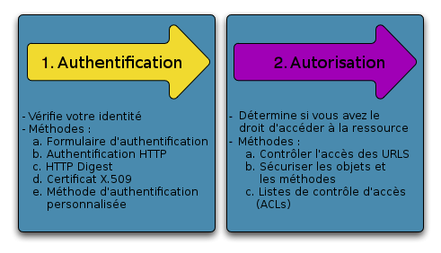
Principe

Slide 3
security.yaml
security:
firewalls:
secured_area:
pattern: ^/
anonymous: ~
http_basic:
realm: "Secured Demo Area"
access_control:
- { path: ^/admin, roles: ROLE_ADMIN }
providers:
in_memory:
memory:
users:
ryan: { password: ryanpass, roles: 'ROLE_USER' }
admin: { password: kitten, roles: 'ROLE_ADMIN' }
encoders:
Symfony\Component\Security\Core\User\User: plaintext

Slide 4
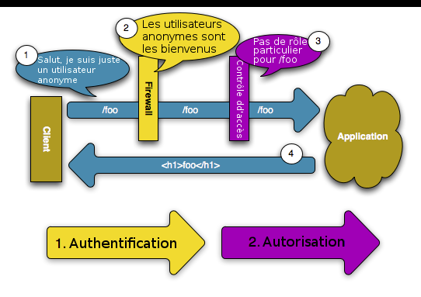
Principe
HTTP 200 Ok

Slide 5
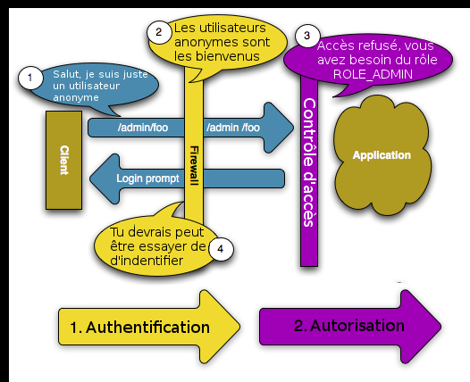
Principe
HTTP 401 Unauthorized
HTTP 302 Found

Slide 6
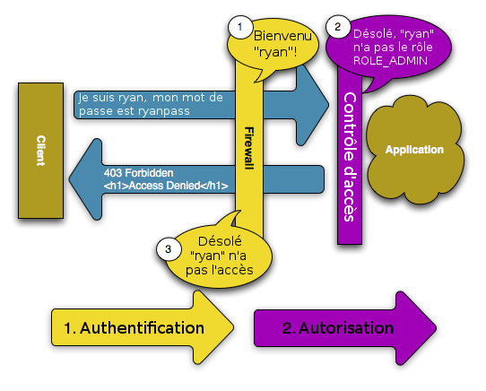
Principe
HTTP 403 Forbidden

Slide 7
Principe
Pare-feu
Gère l'authentification
Login
DOIT se trouver derrière un pare-feu
DOIT être accessible aux anonymes
→ access_control IS_AUTHENTICATED_ANONYMOUSLY ou
→ second pare-feu

Slide 8
security.yml
if (false === $this->get('security.context')
->isGranted('ROLE_ADMIN')) {
throw new AccessDeniedException();
}
{% if is_granted('ROLE_ADMIN') %}

