Slide 1
P. KARTHIKEYAN
Generative AI for Engineering (E2324)
IBM-EDUNET FOUNDATION
Email: karthickprakash2004@gmail.com
Reg No: 211521243082
Department of AI & DS
Panimalar Institute of Technology, Chennai
3/28/2024

Slide 2
PROJECT TITLE
"Predictive Analysis of Heart Disease Using LSTM Neural Networks"

Slide 3

AGENDA
Problem Statement
Proposed System/Solution
System Development Approach
Algorithm & Deployment
Result
Conclusion
Future Scope
References

Slide 4
PROBLEM STATEMENT
Problem Statement: The objective of this project is to develop a predictive model using LSTM (Long Short-Term Memory) neural networks to accurately classify the presence or absence of heart disease based on various clinical parameters. By leveraging a dataset containing features such as age, sex, cholesterol levels, and other medical indicators, the goal is to build a robust predictive tool that can assist healthcare professionals in early detection and risk assessment of heart disease.

Slide 5
PROPOSED SYSTEM
Data Acquisition
Data Preprocessing
Model Development
Model Training
Model Evaluation
Visualization and Interpretation
Model Deployment (Optional)
Documentation and Reporting
‹#›

Slide 6
SYSTEM DEVELOPMENT APPROACH
Agile Methodology
Agile principles emphasize iterative development, collaboration, and adaptability.
Ideal for projects with evolving requirements and complex data analysis tasks.
Iterative Process
Break down project into manageable tasks.
Work in short iterations or sprints (1-4 weeks).
Continuous Planning
Define project scope, objectives, and deliverables.
Create a backlog of tasks and prioritize them.
Development Cycle
Sprint Planning: Select tasks for each sprint.
Daily Stand-up Meetings: Discuss progress and challenges.
Iterative Development: Build, test, and refine the system incrementally.
Testing and Integration
Continuous Integration: Integrate new changes frequently.
Automated Testing: Validate functionality, performance, and accuracy.

Slide 7
ALGORITHM & DEVELOPMENT
Data Acquisition
Obtain dataset containing clinical parameters and heart disease labels.
Data Preprocessing
Handle missing values, encode categorical variables, standardize numerical features.
Split data into training and testing sets.
Model Development
LSTM Architecture: Design LSTM neural network for sequential data.
Input Preparation: Reshape data for LSTM input.
Model Components: LSTM layers, dropout layers, dense output layer with sigmoid activation.
Model Compilation: Specify loss function, optimizer, metrics.
Model Training
Train LSTM model using training data.
Utilize techniques like early stopping to prevent overfitting.
Model Evaluation
Generate predictions on test set.
Evaluate model performance using accuracy, precision, recall, F1-score, ROC-AUC.
.

Slide 8
ALGORITHM & DEVELOPMENT
Visualization and Interpretation
Plot learning curves to visualize training progress.
Plot ROC curve and confusion matrix for performance assessment.
Deployment (Optional)
Deploy model in production environment for real-time predictions.
Integrate model into existing healthcare systems for decision support.
Documentation and Reporting
Document data preprocessing, model architecture, and training process.
Prepare comprehensive report summarizing methodology, findings, and recommendations.
Benefits
Accurate prediction of heart disease risk.
Early detection leads to timely intervention and improved patient outcomes.
Conclusion
LSTM-based heart disease prediction model offers valuable insights for healthcare professionals.
Enhance patient care and management through predictive analytics.

Slide 9
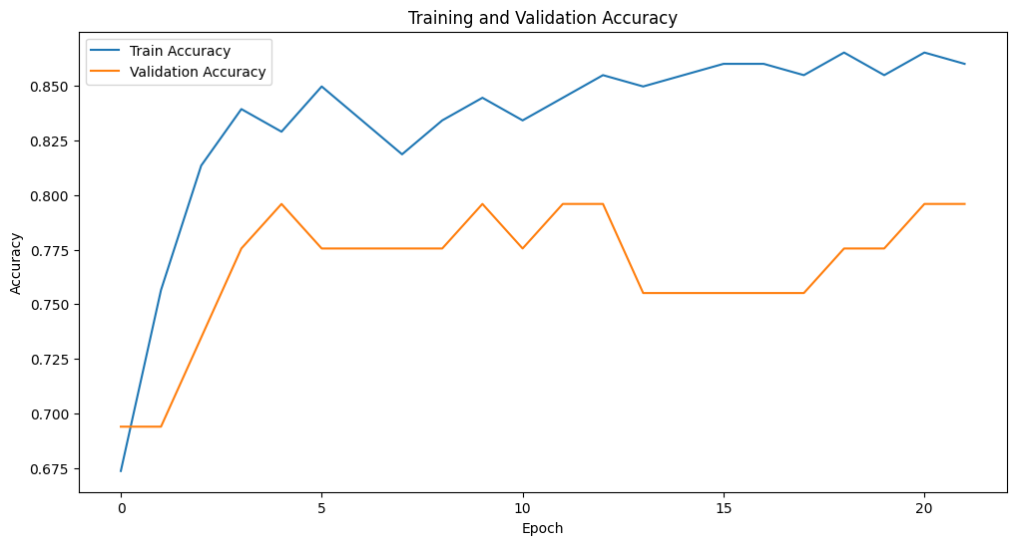
RESULT
*
‹#›

Slide 10
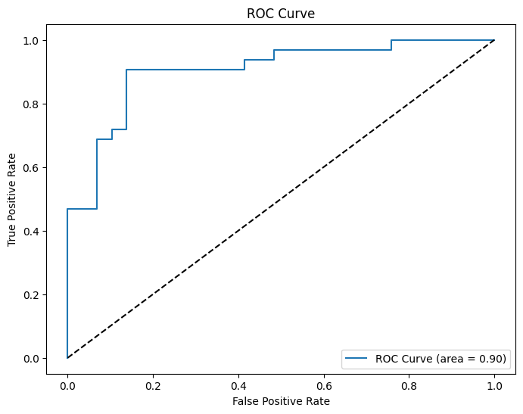
RESULT
‹#›

Slide 11
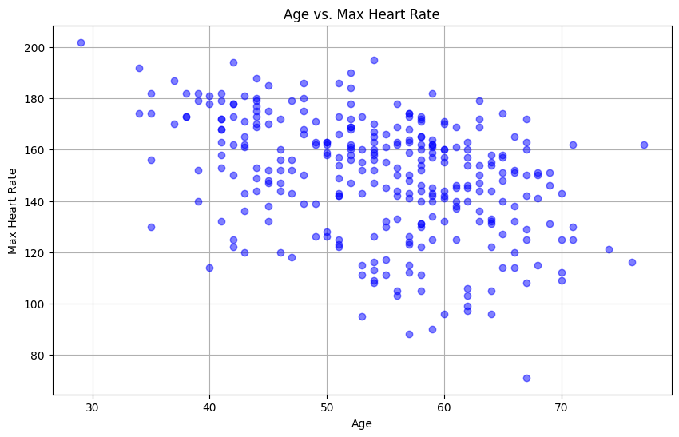
RESULT
‹#›

Slide 12
CONCLUSION
Accurate Prediction: The LSTM model demonstrated strong performance in classifying heart disease presence based on clinical parameters.
Insights into Performance: Confusion matrix analysis and visualization of learning curves provided clear understanding of model performance and areas for improvement.
Clinical Applications: The model offers potential for aiding healthcare professionals in risk assessment, leading to timely interventions and better patient outcomes.
Future Directions: Refinement of model architecture, integration of diverse data sources, and addressing ethical considerations are key for enhancing predictive accuracy and applicability.
Ethical Considerations: Ensuring transparency, privacy, and interpretability are vital for responsible deployment of predictive analytics tools in healthcare.
The Coding of the project is uploaded in GitHub, click below button to see the code :)
Code Lhttps://github.com/RoronoaKarthi/IBM_EDUNET_GENAI.gitink
‹#›

Slide 13
“ANOTHER FORM OF MODERNIZATION IS CONSERVING ENERGY FOR THE FUTURE”
THANK YOU!

