Slide 1
HOSTEL MANAGEMENT SYSTEM
DBMS Project
Group members:
N.Jaswanth
V.Michael
Kushal . C
Under the guidance of
D.Prasad sir

Slide 2

National institute of technology Andhra Pradesh
Department of Computer Science and Engineering
Certificate
This is to certify that the DBMS project entitled, “HOSTEL MANAGEMENT SYSTEM" has been done by N . JASWANTH(422224),
V . MICHAEL (422268) and KUSHAL . C (422204) of Bachelor of Techonolgy , Computer Science and Engineering during semester IV from National Institute of Technology Andhra Pradesh.

Slide 3
agenda
Abstract
Introduction
Advantages over existing System
Entities and their attributes
Schema of relations
ER Model
Relational Model of Database
Integrity Constraints

Slide 4
abstract
Welcome to the presentation of our Database Management System (DBMS) project, focusing on the development of Hostel Registration and Management System. Our project aims to streamline the management of hostel accommodations within our institute, offering a centralized platform for student enrollment, allocation of accommodations, and facility management. By integrating essential functionalities such as student registration, room allocation, and facility tracking, our system enhances efficiency and transparency in hostel operations. Leveraging SQL for database management and Python for backend development, we ensure a user-friendly experience for both administrators and students. Through this project, we showcase the power of DBMS in optimizing hostel management processes, improving student satisfaction, and facilitating administrative operations.

Slide 5
introduction
Welcome to the presentation of our Hostel Registration Management System. Our system is designed to revolutionize the way hostel accommodations are managed for students within our institute. By providing a centralized platform for handling student enrollment details, accommodation allocation, and facility management, we aim to optimize the efficiency, accuracy, and transparency of the entire process. Through the implementation of robust database management techniques utilizing SQL , our system ensures seamless integration and user-friendly interaction for both administrators and students alike. Furthermore, our project addresses the evolving needs of our institute's student population and administrative staff, contributing to a more efficient and effective hostel management system. We'll explore the key functionalities, significance, and technological aspects of our Hostel Registration Management System throughout this presentation, highlighting its potential to enhance the overall administrative operations.

Slide 6
Advantages over existing system
Streamlined Room Allocation: Our hostel management system optimizes the room allocation process, ensuring efficient utilization of hostel space and minimizing manual errors.
Real-time Updates: With our system, administrators can access real-time data on room availability, student occupancy, and maintenance status, leading to better decision-making and enhanced operational efficiency.
Improved Communication: The system facilitates seamless communication between hostel administrators, students, and staff, reducing communication gaps and enhancing overall coordination.
Customizable Reporting: Administrators can generate customizable reports on various aspects of hostel management, including occupancy rates, maintenance history, and financial transactions, enabling data-driven decision-making and compliance monitoring.

Slide 7
Entities and their attribures
1.Instute_Students –
regno(Primary key) , rollno , name , phno , dob , gender , personal_email , college_email , department , programme , join_date , year
2.Hostel_Students –
regno(Primary key) , rollno , name , phno , dob , gender , college_email , hostel_id , floorid , room_id , cot _number
3.Hostels –
hostelid(primary key) , hostel_name , capacity

Slide 8
Entities and their attributes
4.Floors –
floor_id(primary key) , hostel_id , capacity
5.Rooms-
room_id (primary key) , floor_id , capacity , status ,
6.Cots-
primary key(room_id , cot_number) , status

Slide 9
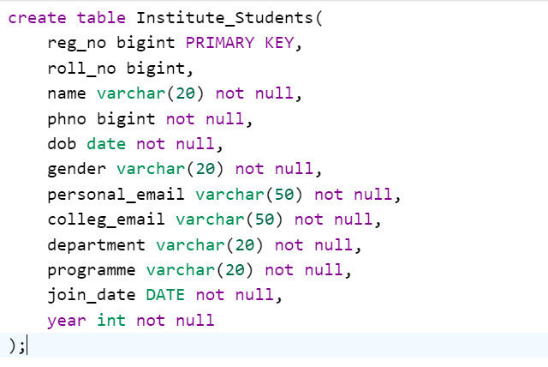
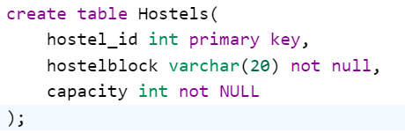
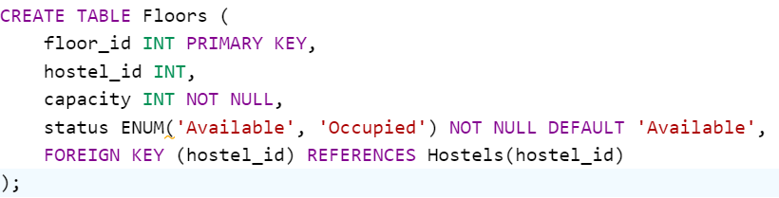
Schemas of relations

Slide 10
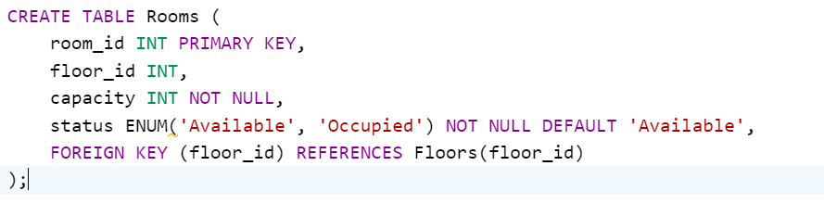
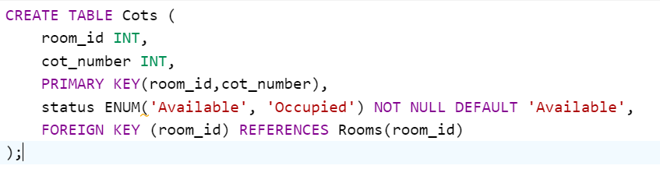
Schemas of relations

Slide 11
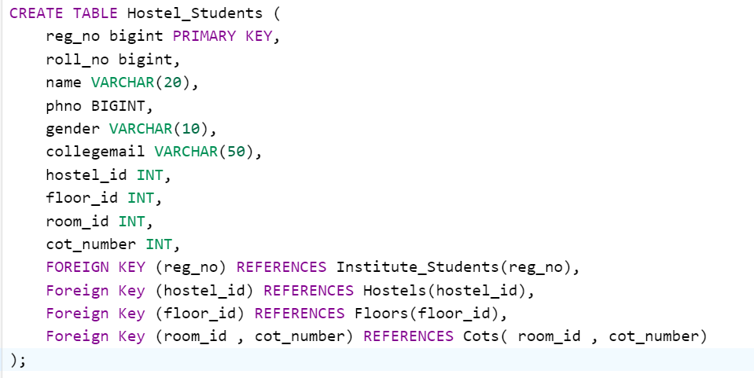
Schemas of relations

Slide 12
Relational cardinalities
The relationship between the Institute_Students and Hostel_Students:entities exhibits a one-to-one (1:1) cardinality.
The relationship between the Hostel_Students and Hostels entities exhibits a many-to-one (n:1) cardinality.
The relationship between the Hostel_Students and Floors entities exhibits a many-to-one (n:1) cardinality.
The relationship between the Hostel_Students and Cots entities exhibits a one-to-one (1:1) cardinality.
The relationship between the Rooms and Floors entities exhibits a many-to-one (n:1) cardinality.
The relationship between the Cots and Rooms entities exhibits a many-to-one (n:1) cardinality.
The relationship between the Floors and Hostels entities exhibits a many-to-one (n:1) cardinality.

Slide 13
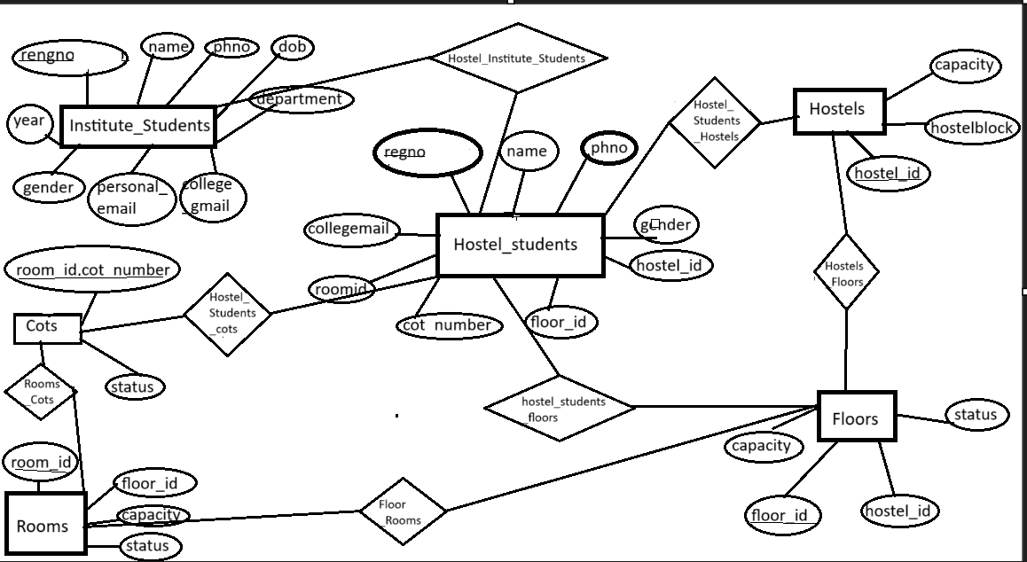
Er model

Slide 14
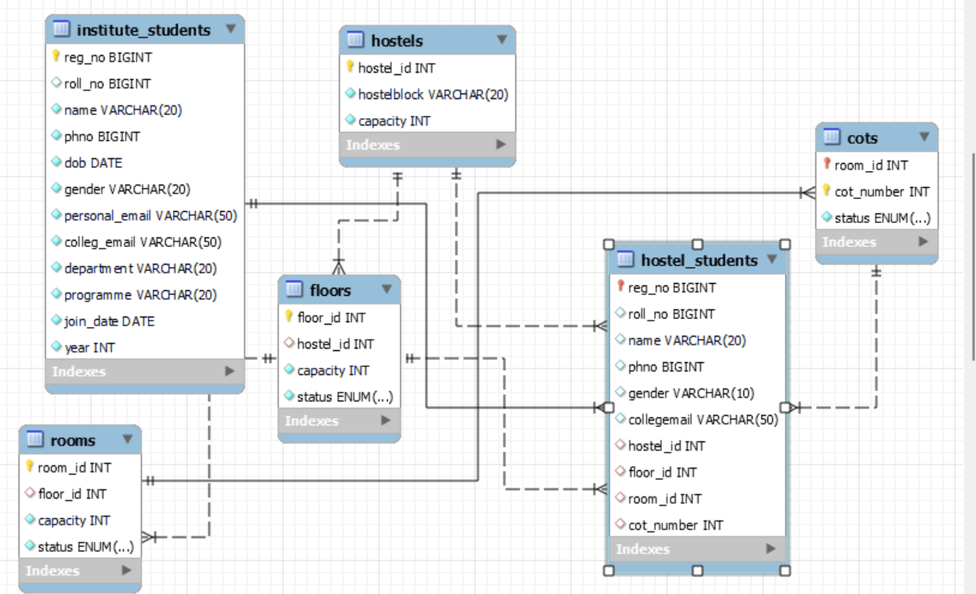
Relational model of database
The database is in 3NF

Slide 15
Normalization
1. Institute_Students: It has a primary key (reg_no) and there are no partial dependencies or transitive dependencies, so it satisfies 1NF , 2NF and 3NF.
2. Hostel_Students : It has a primary key (reg_no) and there are no partial dependencies or transitive dependencies, so it satisfies 1NF , 2NF and 3NF.
3. Hostels: : It has a primary key (hostel_id) and there are no partial dependencies or transitive dependencies, so it satisfies 1NF , 2NF and 3NF.
4. Floors: It has a primary key (floor_id) and there are no partial dependencies or transitive dependencies, so it satisfies 1NF , 2NF and 3NF.
5. Rooms: It has a primary key (room_id) and there are no partial dependencies or transitive dependencies, so it satisfies 1NF , 2NF and 3NF..
6. Cots: It has a primary key room_id, cot_number) and there are no partial dependencies or transitive dependencies, so it satisfies 1NF , 2NF and 3NF..
All tables (Institute_Students, Hostel_Students, Hostels, Floors, Rooms, Cots) satisfy 1NF, 2NF, and 3NF.

Slide 16

Physical database design

Slide 17
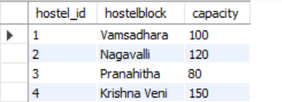

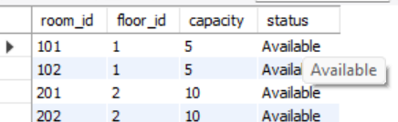
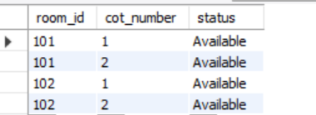
Physical database design

Slide 18
Integrity constraints
Primary Key Constraint: Ensures that each record in a table has a unique identifier.
Example: In Hostels table , Primary Key constraint is defined on the “hostel_id” column.
Foreign Key Constraint: Enforces referential integrity by ensuring that values in a column (or columns) of one table match values in another table's primary key or unique key.
Example :
Foreign key constraints in :Hostel_Students references :
‘reg_no’ to Institue_students(‘reg_no’ ),
‘hostel_id’ to Hostels(‘hostel_id’),
‘floor_id’ to Floors(‘floor_id’),
‘room_id’ and ‘cot_number’ to Cots(‘room_id’ , ‘cot_number’)

Slide 19
Integrity constraints
NOT NULL Constraint: Ensures that a column cannot contain NULL values.
Example: All column in all tables have been explicitly defined as not null.
CHECK Constraint: There are no explicit CHECK constraints defined in the provided schema

Slide 20
Problems we faced
Normalization to 3NF: Employing normalization techniques to organize data into third normal form (3NF), reducing redundancy and ensuring data integrity
Data Validation and Constraints: Enforcing data validation rules and constraints at the database level to prevent invalid or inconsistent data entry.Like adding not null constraints etc.
Schema Evolution: Handling changes to the database schema over time, such as adding new tables or columns, without disrupting existing functionality.
Data Redundancy : Maintained data redundancy by removing repetitive columns in cots table and making more tables

Slide 21
conclusion
The Hostel Management System optimizes hostel accommodation management in educational institutions. Using a structured database and key constraints, it ensures accurate record-keeping and streamlined allocation processes. Real-time updates on room availability facilitate efficient decision-making. The system's hierarchy enables effective facility management, while ENUM columns enhance usability. With secure data storage, it prioritizes student information security. Ultimately, the project aims to enhance hostel administration efficiency, resource allocation, and overall student living experiences.

Slide 22
Thank you

