Slide 1
EPICS PROJECT
HOSTEL REGISTRATION FOR STUDENTS OF NIT AP

Slide 2
AGENDA
Introduction​
Languages and Modules
Registration Process
Database
​Benefits
Conclusion

Slide 3
Introduction
The web application we've developed facilitates hostel registration. During the registration process, students often encounter significant challenges, such as long wait times in queues. However, with our website, students can create an account and select their preferred hostel block and room, streamlining the registration process. This not only expedites registration but also alleviates the need for prolonged queueing. As a result, both students and hostel officers benefit from the improved efficiency of the registration process.

Slide 4
Project screenshots

Slide 5
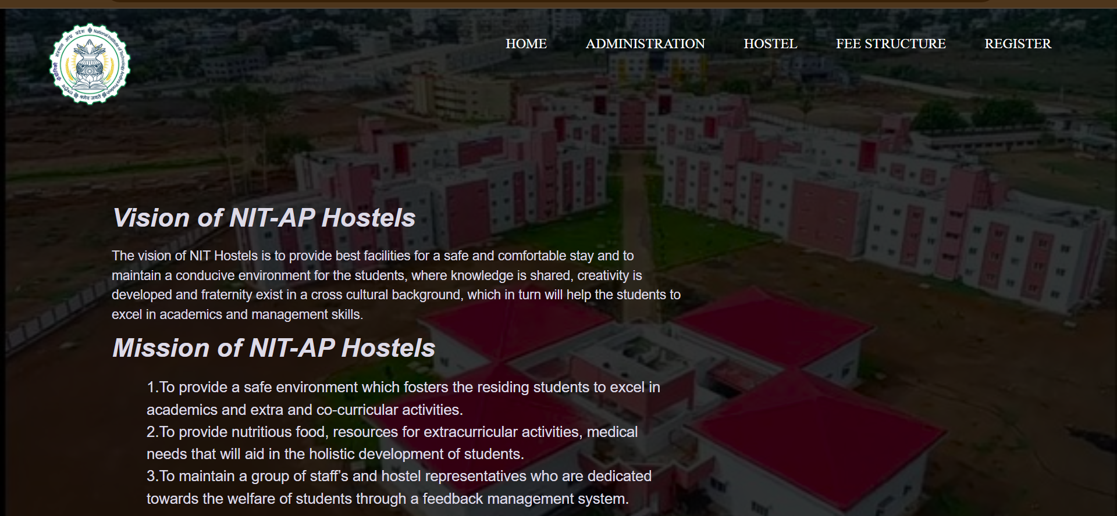

Slide 6
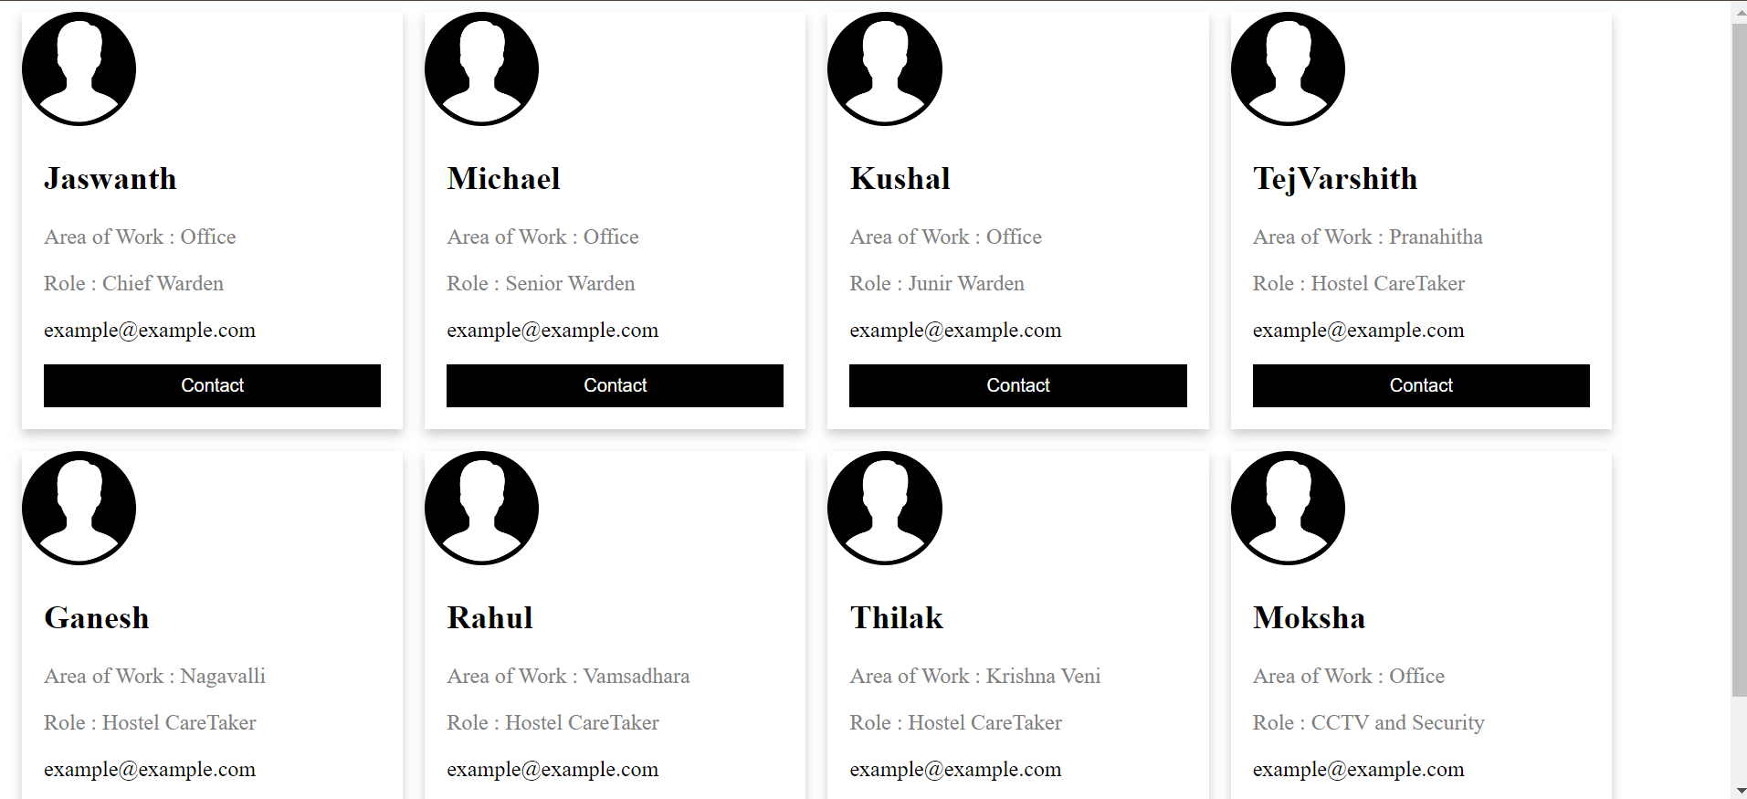

Slide 7
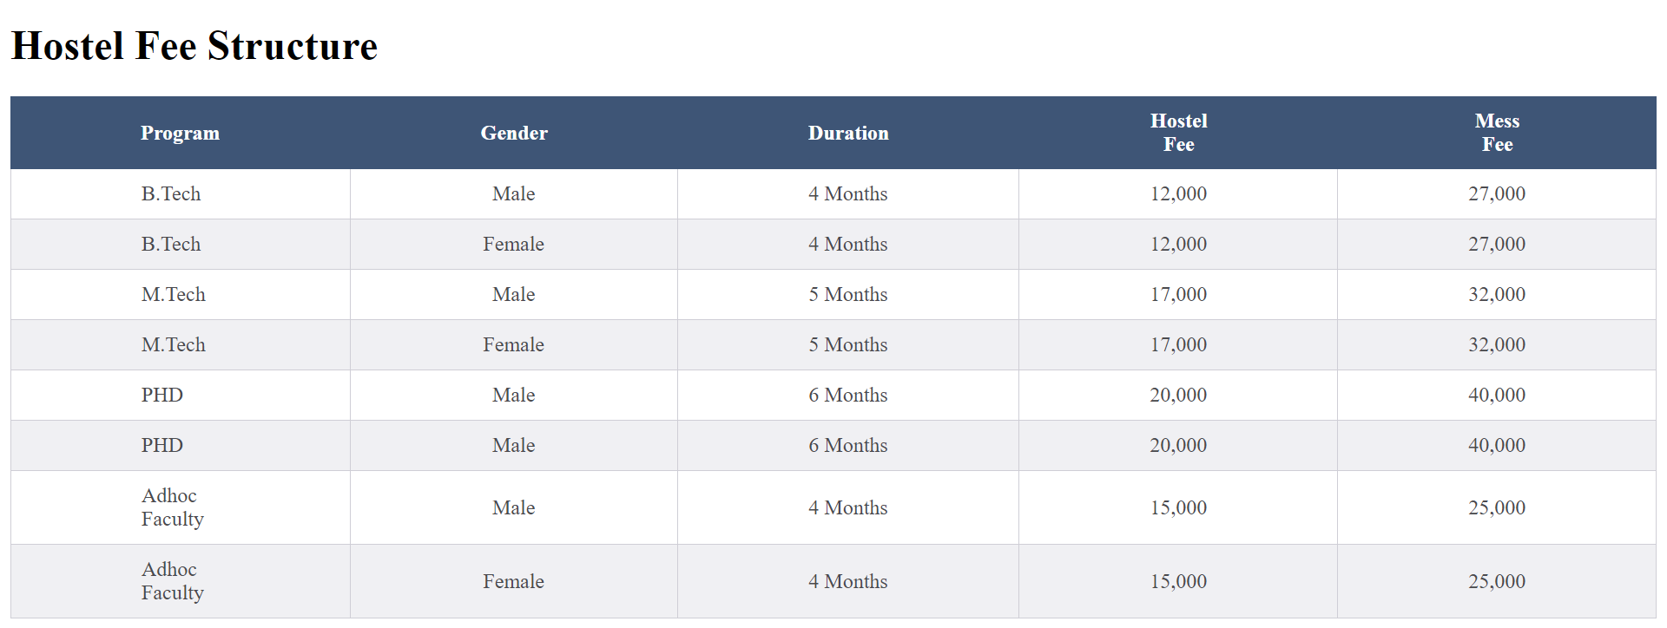

Slide 8
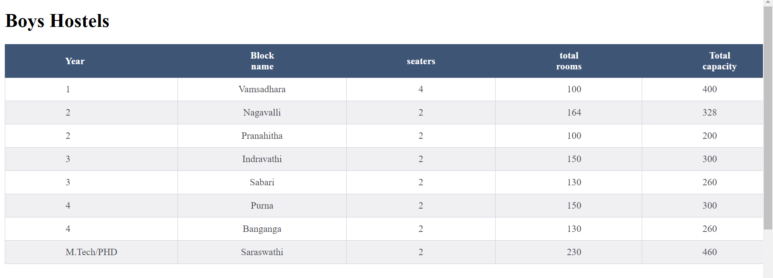

Slide 9
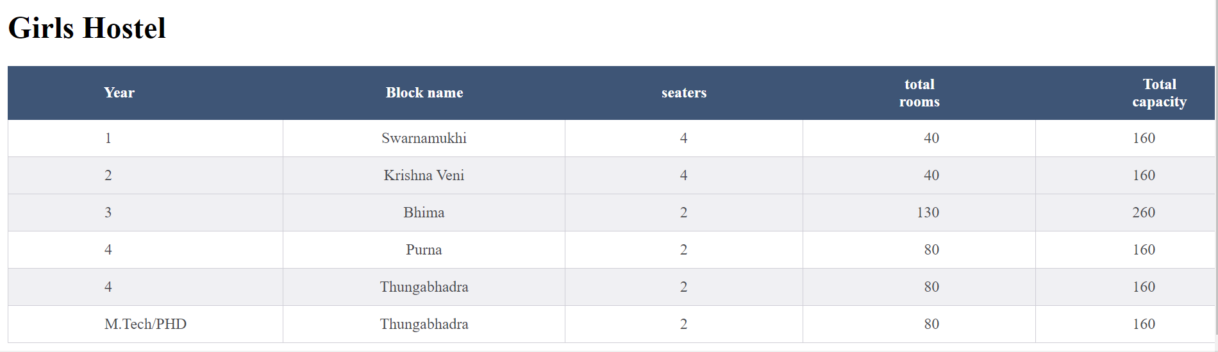

Slide 10
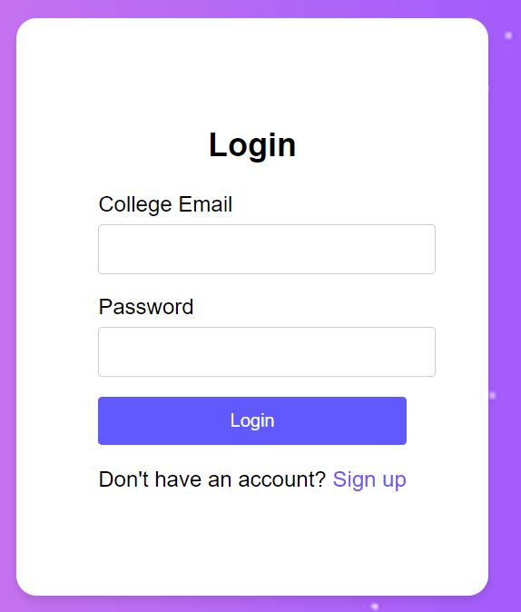
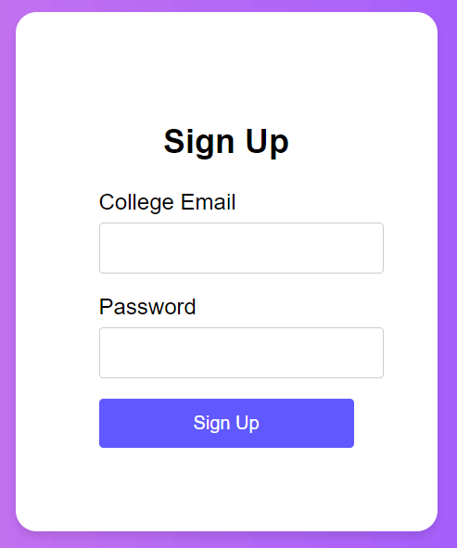

Slide 11
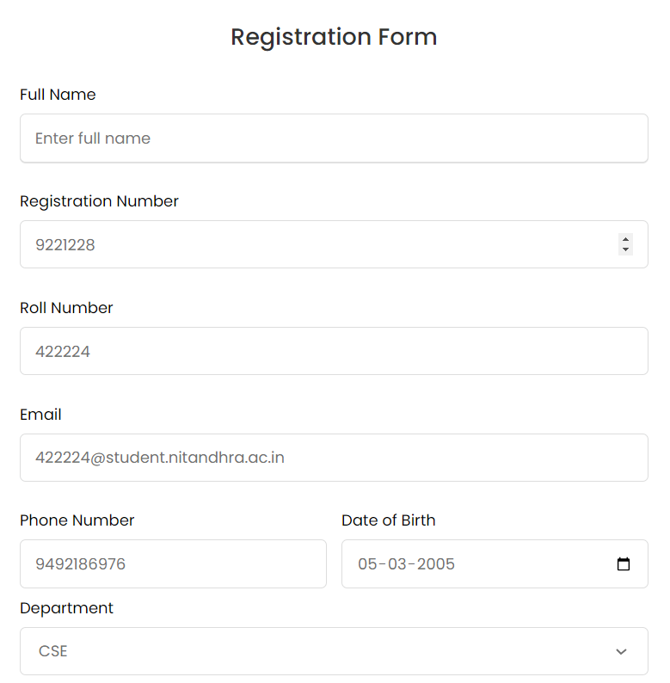
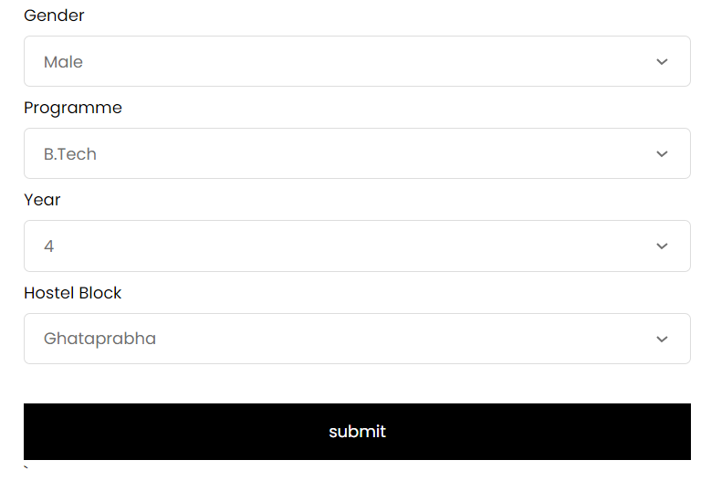

Slide 12
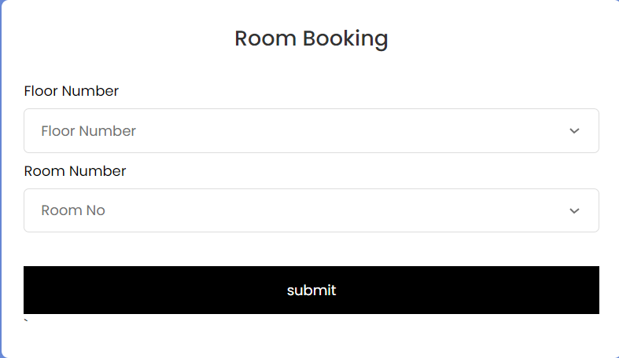

Slide 13
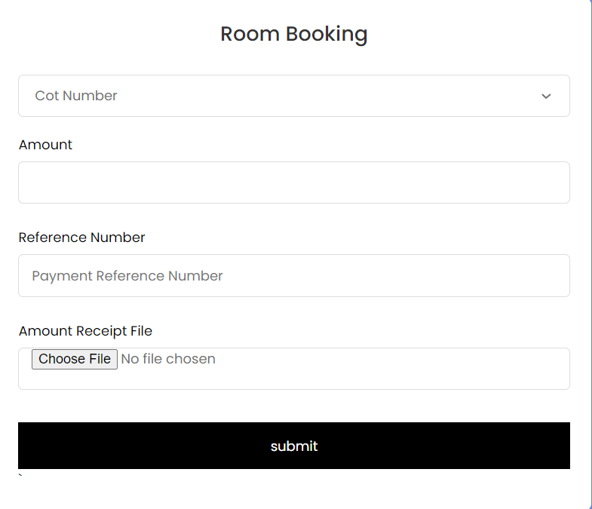

Slide 14



Languages and modules
HTML(Hyper Text Markup Language)
CSS(Cascading Style Sheets)
JAVASCRIPT
The standard markup language for creating web pages . Html provides structure and contents of a web page
It provides framework for organizing and presenting about the hostels to users
CSS is a style sheet language used to control the presentation and layout of HTML elements on a web page
We used CSS to customize the appearance of HTML elements, including colors, fonts, margins etc.
We used CSS properties such as font-family, background-color, position, border etc.. For the appearance of elements
JavaScript primarily runs in web browsers, allowing it to manipulate HTML and CSS to create dynamic and interactive web content.
JavaScript is supported by all modern web browsers and can be used on various platforms, including desktop and mobile devices.
It has DOM(document object model) which is used as event listeners to interact with web page and manipulate html elements

Slide 15



Languages and modules
Embedded JAVA SCRIPT
EXPRESS JS
NODE JS
EJS is used to enable dynamic content generation embedding by java script code directly into HTML templates, making it easy to work with dynamic data and logic.
It is used to create dynamic web pages in node js
Means, these templates typically contain placeholders or variables that are replaced with actual values during runtime
It is runtime environment that allows to execute the java script code server side outside the web browser
It has various routes for different endpoints like get,post etc., These routes handle incoming HTTP requests and send responses back to client
It is used to establish connection to database and can do operations like reading or inserting or deleting data in our database
Node.js is an open-source, server-side JavaScript runtime environment that allows to run JavaScript code on the server.
Node.js is cross-platform and runs on various operating systems, including Windows, macOS, and Linux.
It is used to build the server side logic of your application
It handles HTTP requests from clients, processes data and sends responses back to the client

Slide 16


Languages and modules
POSTGRE SQL
Sql(structured Query Language)
PostgreSQL, often referred to as Postgres, is an open-source relational database management system (RDBMS) known for its reliability, robustness, and extensive features
It gives wide range of built in data types and supports customs data type
It is ACID-compliant (Atomicity, Consistency, Isolation, Durability), which ensures data integrity and reliability in transactions.
PostgreSQL adheres to SQL standards and provides comprehensive support for SQL commands, data types, operators, and functions.
For our website we didn’t use external cloud or third party apps
SQL is a standardized programming language used for managind database
It provides a means to interact with databses by defining and manipulation data , as well as querying and managing the database structure
We create a table student which contains details of all the Students and another table HostelStudents which contains the details of students who registered and this table some attributes(reg no,roll no) refers to (reg no,roll no) attributes of Students table

Slide 17
Registration process
In main page on nav-bar if we click on register then a login page appears students have to login by their email id provided by the college they can create a new account. In the registration form students have to fill the required options like registration number , roll number etc.. and based on the program and year of student and their gender hostel blocks option will be loaded and student can choose their hostel block ,floor number and room number. In backend server we store the details of students who registered for the hostels . In case for example , in 1st floor room number 18 is fully occupied then the option for that selecting 1st floor room number 18 will not be shown as an option in the form and remaining available room numbers are shown as options . If total floor of a hostel block is occupied then it is removed as an option from our website.
Below slides are the screenshots of Login page and Registration Form

Slide 18
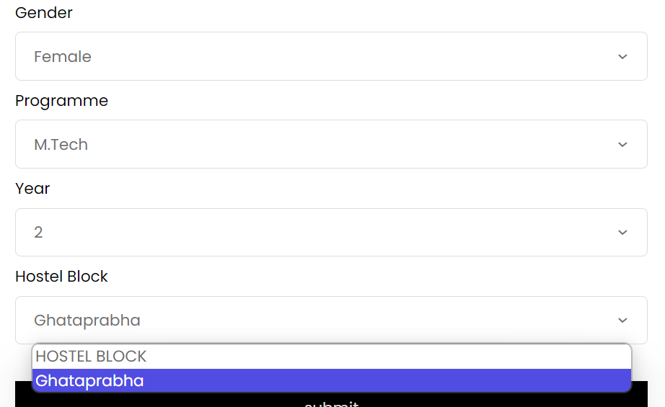
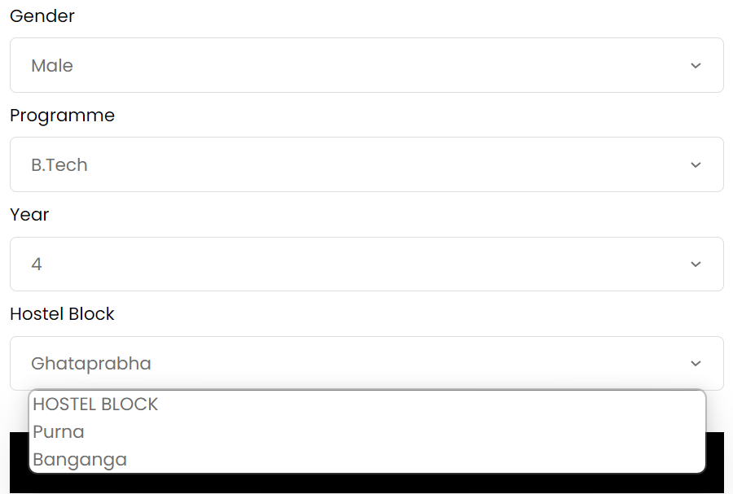
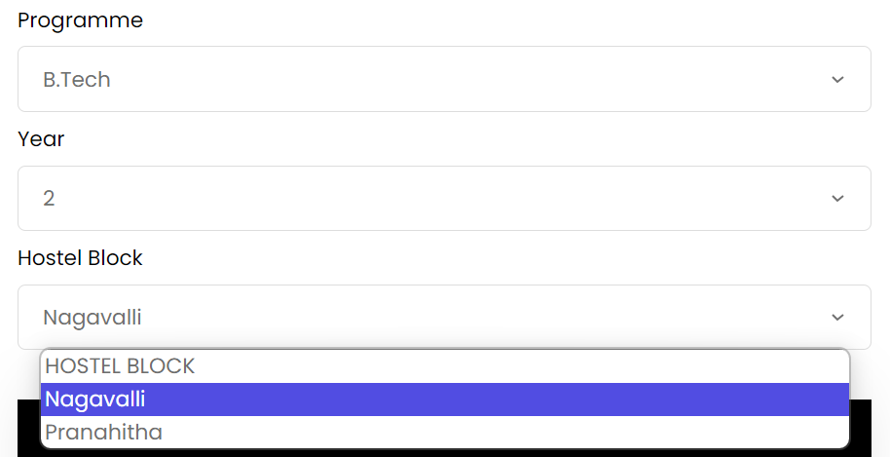

Slide 19
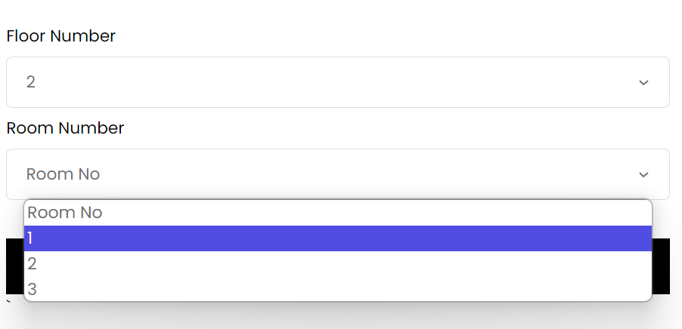
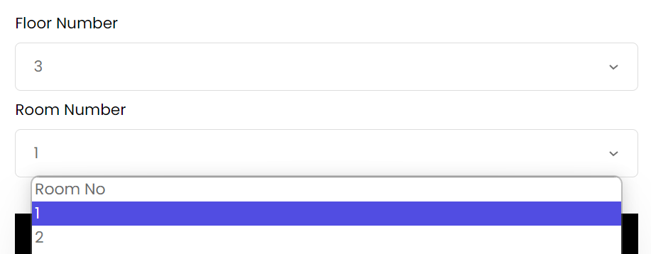
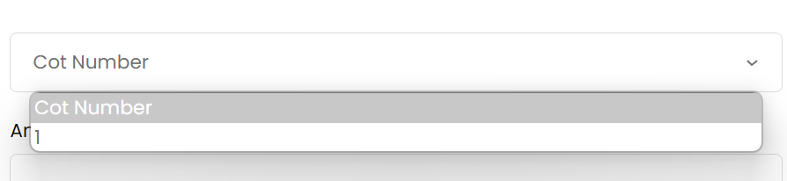

Slide 20
database
For database we use postgre sql and sql as query language
Initially , a table named as Institute_Student exists in the database which contains all the details of students like their name , reg_no , roll_no etc
At the time of registration we create another table “Hostel_Students” with attributes like name , reg_no , roll _no , gender , program , hostel_block etc
Now attributes reg no,roll no in Hostel_Students table reference to the attributes reg no,roll no in tables Students. So that if non access members or wrong roll no or reg no cannot be added into the HostelStudents table

Slide 21
Database ACCESS
student
Hostel warden
A student can only add his data like in which room he is going to take only at the time of registration
A login id will be given for students to register at the time of semester registration
Once registered student cannot again register
He is the database adminstrator
He can access the database and can manipulate data in it
He cans see all the hostel details of the student

Slide 22
Er-diagram

Slide 23
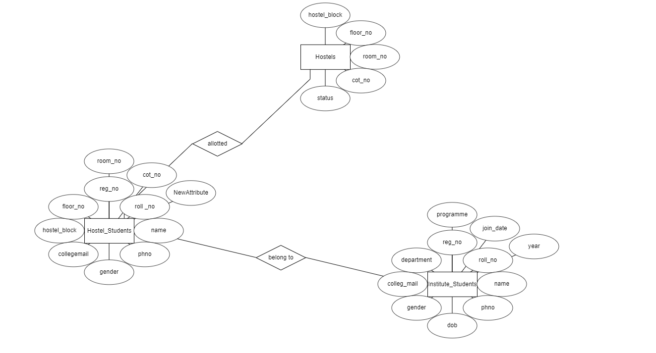

Slide 24
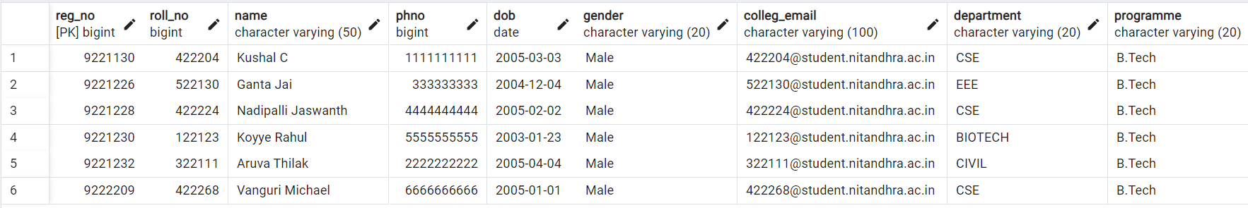

Slide 25
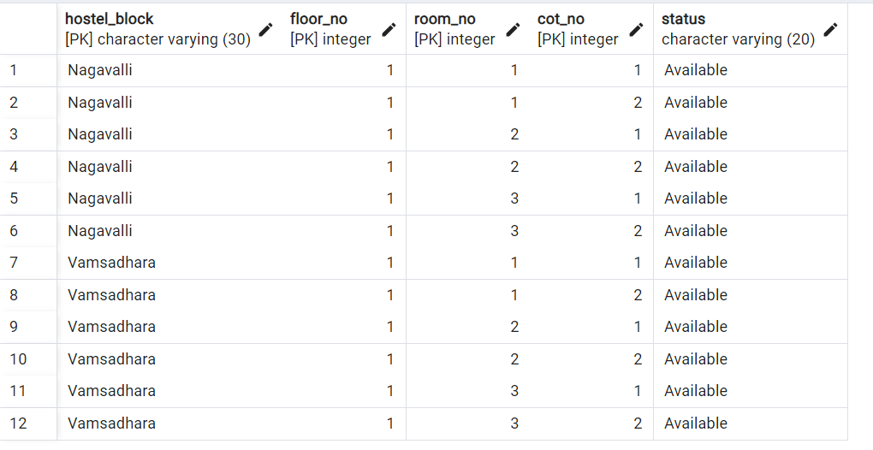

Slide 26
Benefits
For students who are unable to come to the college hostel registration it will be difficult for them or sometimes they may not get the rooms as registration date is completed or they have to pay extra fees
It helps in reducing time for registration
There will be no crowd at the office for the registration
Can be done easily within few seconds from anywhere and can be viewed in pc’s or mobile phones

Slide 27
conclusion
In conclusion, the Hostel Registration Web Application represents a significant improvement in the efficiency and convenience of the hostel registration process for students. By leveraging modern web technologies, we have successfully addressed the challenges faced by students during registration periods. The web application eliminates the need for students to wait in long queues by allowing them to register for hostel accommodation online. This significantly reduces the time and effort required for registration. Students can personalize their registration by selecting their preferred hostel block, room, and even roommates. This level of customization enhances the overall user experience and satisfaction.

Slide 28
THANK YOU
Ms . Sonia
-N.Jaswanth 422224
V.Michael 422268
C.Kushal 422204

