Slide 1
Software Engineering Project/ Web Application Development Web Infrastructure & PHP Basics
Dr. Asanka Wasala
Asanka.Wasala@ul.ie
T2-029, Lero, Tierney Building, University of Limerick, Limerick, Ireland

Slide 2
Web Infrastructure - BASICS Client – Server Architecture
Web Server
.. a program that, using the client/server model and the World Wide Web's Hypertext Transfer Protocol ( HTTP ), serves the files that form Web pages to Web users (whose computers contain HTTP clients that forward their requests).
e.g. Apache, Lighttpd, IIS

Slide 3
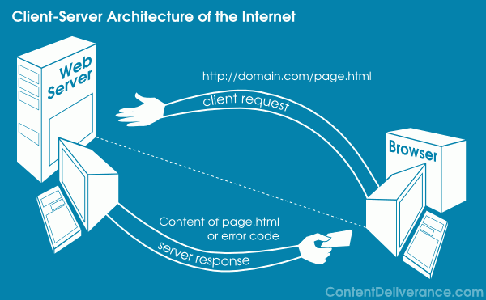
Web Infrastructure - BASICS Client – Server Architecture

Slide 4
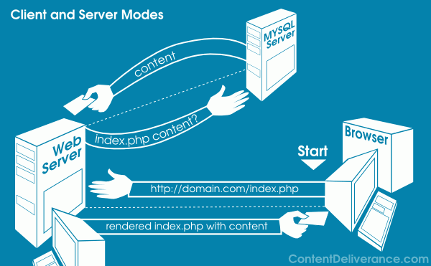
Web Infrastructure - BASICS Client – Server Architecture

Slide 5
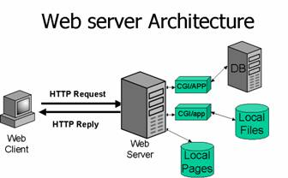
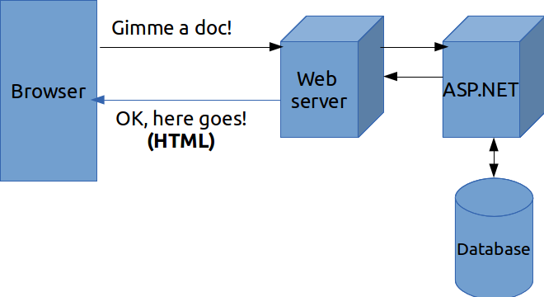
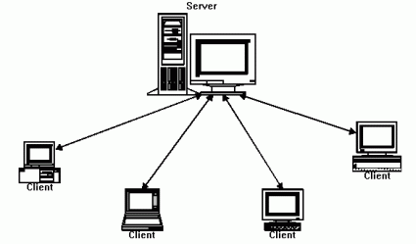
Web Infrastructure - BASICS Client – Server Architecture
PHP
http://act2.me/wp-content/uploads/2013/07/3.png
http://www.sans.org/security-resources/malwarefaq/images/guestbook_clip_image002_0000.jpg
Server side scripting
http://www.wildbunny.co.uk/blog/wp-content/uploads/2012/10/clientServer.gif

Slide 6
Web Infrastructure - BASICS Static vs Dynamic Web Pages
Does the content vary depending on use?
Server side scripting
Script (program) runs on the server
Result output as page
(More correctly) Processed result as output
Example:
Enter search term
Server conducts search
Server generates ads
Returns generic parts (Gooooogle etc.)
Returns ads
Return search results

Slide 7
PHP Basics
PHP - PHP Hypertext Processor
Cross-platform, Free & Works with virtually ALL servers
Runs on server / Server side scripting language
Embed scripts in HTML
Look like HTML pages to client (Browser only sees plain HTML)
Standalone language
Start -> Run -> CMD
cd to directory
PHP filename.php
File can contain: Text, HTML tags, scripts, code
File extensions: .php / .php3 / .phtml / .html

Slide 8
PHP Basics Installation & IDEs
Web server – Apache
Database server - MySQL
Server-side scripting language – PHP
Installation of servers
Linux + AMP = LAMP (search web for “LAMP server”)
Windows + AMP = WAMP
Mac + AMP = MAMP
XAMPP - https://www.apachefriends.org/index.html
Installation of IDE
Aptana - http://www.aptana.com/products/studio3/download.html
Try online : http://phpfiddle.org/

Slide 9
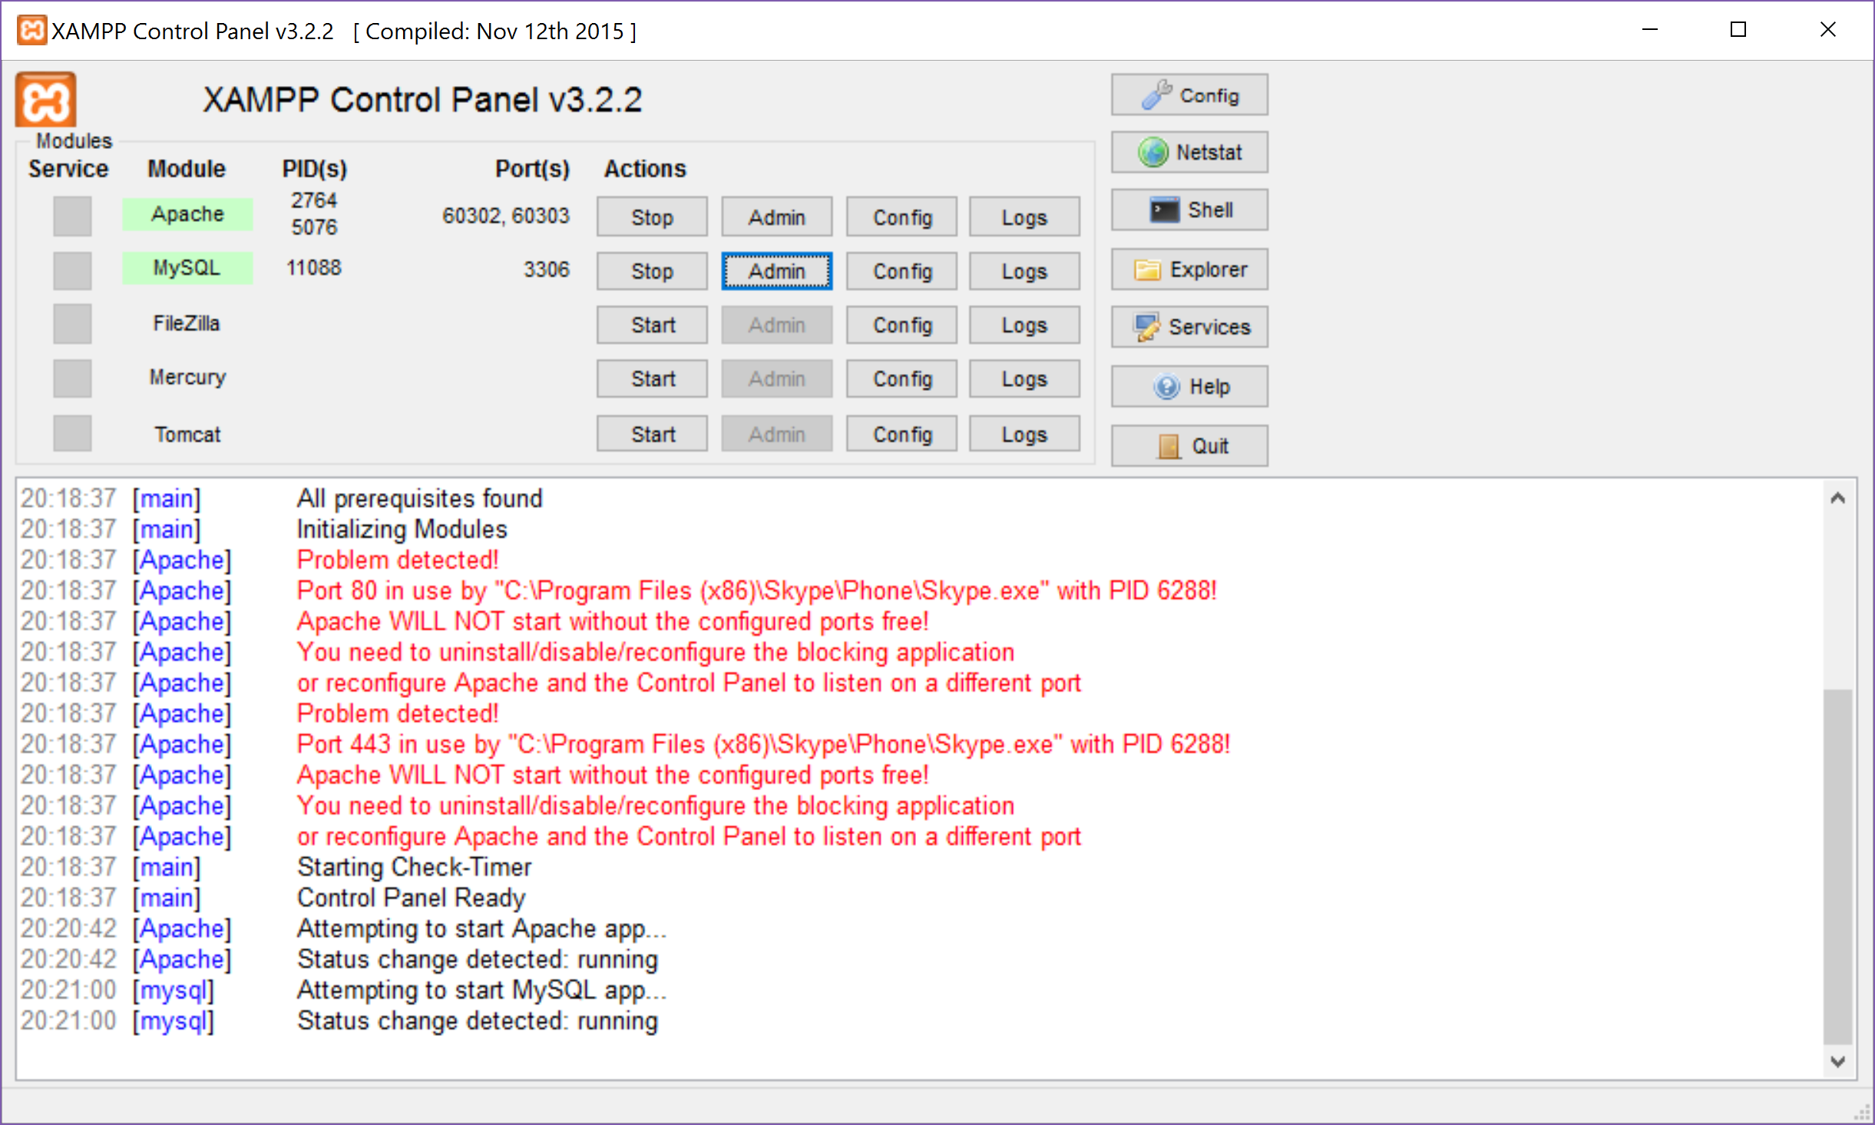
Running XAMPP

Slide 10
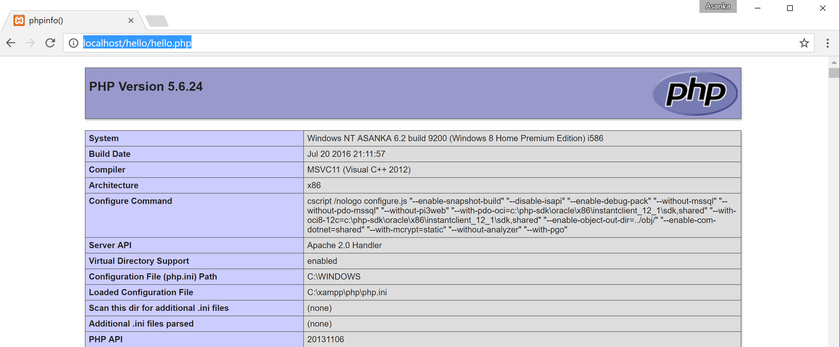
Testing PHP Installation
hello.php
<?php phpinfo(); ?>
C:\xampp\htdocs\hello\hello.php
Web root (in Linux /var/www/)

Slide 11
PHP Basics Default Syntax
<h3>Welcome!</h3>
<?php
echo "<p>Some dynamic output here</p>";
?>
<p>Some static output here</p>
<html>
<head>
<title><?php echo "Welcome to my Web site!";?></title>
</head>
<body>
<?php
$date = "July 26, 2017";
?>
<p>Today's date is <?=$date;?></p>
</body>
</html>

Slide 12
PHP Basics Commenting Your Code
<?php
// Title: My first PHP script
// Author: Asanka
echo "This is a PHP program";
?>
<?php
# Title: My PHP program
# Author: Jason
echo "This is a PHP program"; ?>
<?php
/* Title: My PHP Program
Author: Jason
Date: July 26, 2007 */ ?>

Slide 13
PHP Coding Style Guide Uniform Standard for Writing Code
Improves readability, clarity, simplicity and consistency
Go through:
http://www.php-fig.org/psr/psr-2/
https://www.cheatography.com/davechild/cheat-sheets/php-fig-psr-standards/
A list of guidelines to be followed while coding PHP
Use indent of 4 spaces (no tabs allowed);
Max length of a line 120 characters;
include one space between the control keywords such as if, for while, switch etc and the opening parenthesis;
always use <?php ?> to delimit php code;
opening brace MUST go on the same line, and the closing brace MUST go on the next line following the body;
Also see: http://softwareengineering.stackexchange.com/questions/196416/whats-the-dominant-naming-convention-for-variables-in-php-camelcase-or-undersc

Slide 14
PHP Basics Outputting Data to Browser
<?php
print("<p>I love the summertime.</p>");
$season = "summertime";
print "<p>I love the $season.</p>";
$heavyweight = "Lennox Lewis";
$lightweight = "Floyd Mayweather";
echo $heavyweight, " and ", $lightweight, " are great fighters.";
printf("%d bottles of tonic water cost $%.2f in {$season}", 100, 43.20); $cost = sprintf("$%.2f", 43.2); // $cost = $43.20
?>
Commonly used Type Specifiers (e.g. %d, %s, %f) – See Chapter 3, PG 64
echo() function is slightly faster as it returns nothing, whereas print() will return 1 if the statement is successfully output
printf() statement is ideal when you want to output a blend of static text and dynamic information stored within one or several variables.
sprintf() statement is functionally identical to printf() except that the output is assigned to a string rather than rendered to the browser.

Slide 15
PHP Variables/Identifiers
Loosely Typed
No need to state type of variable; PHP figures out type itself
Usual rules for naming variables
Always start with a $; Start with letter or underscore
Contain only alpha-numeric chars and underscores – No spaces; Case-sensitive ($color != $COLOR);
$var_name = value;
<?php
$number = "5";
$sum = 15 + $number;
echo $sum;
$sum = "twenty";
echo $sum;
?>
Guess the output?
Try on phpfiddle.org
<?php
$var=32;
$var=$ver+1;
print $var;
?>

Slide 16
PHP Data Types
Booleans
<?php
$alive = false; if (!$alive) echo "a";
$alive = 1; if ($alive) echo "b";
$alive = 0; if (!$alive) echo "e";
$test = (15 == "a");if (!$test) echo "f";
?>

Slide 17
PHP Data Types
Integers/Floats
<?php
/*integer*/
echo 42; // decimal
echo -678900; // decimal
echo 0755; // octal (decimal = 493)
echo 0xC4E; // hexadecimal (decimal = 3150)
/*float*/
echo 4.5678;
echo 4.0;
echo 8.7e4;
echo 1.23E+11;
$score = (int) 14.8; // $score = 14
echo $score;
?>
is_array() is_bool() is_float() is_integer() is_null() is_numeric()is_object()
is_string()
Chapter 3 – Table 3-2. Type Casting Operators

Slide 18
PHP Data Types
Strings
Constants
<?php
echo "9 string";
echo 'hi "Sam"';
$word = "word";
echo $word[1]; //o
$firstName = "first"; $secondName = " second";
echo $firstName.$secondName; //concatentation
$firstName .= $secondName //$firstName = $firstName.$secondName
?>
<?php
define("PI", 3.141592);
printf("The value of pi is %f", PI);
?>

Slide 19
Compound Datatypes Arrays
<?php
$months = array("January", "February", "March");
print $months[1];
$months[] = "April"; //append to the array
$months[13] = "Error"; // does not have to be continuous
//shows content of an array - useful when debugging
print_r($months);
?>
<?php
$months = array(1 => "January", 2 => "February", 3=> "March");
print $months[1];
$months = array("JAN" => "January", "FEB" => "February", "MAR" => "March");print $months["FEB"];
$months = array(1 => "January", "FEB" => "February", "March");
print_r($months);
?>

Slide 20
Compound Datatypes Arrays
Array is a collection of unordered data (usually!)
Arrays are variable sized
Arrays have keys and values
Keys can be integers or strings
Keys don’t even have to be the same type
Keys don’t occupy continuous space
Keys don’t need to be specified
<?php
$months = array("January", "February", "March");
unset($months[1]); //delete single item
print_r($months);
unset($months); //delete array
?>

Slide 21
Compound Datatypes Arrays
<?php
$countries = array (
"Ireland" => array( "population" => "4.595 million", "capital" => "Dublin"),
"USA" => array( "population" => "318.9 million", "capital" => "Washington, D.C." )
);
print $countries["Ireland"]["capital"];
print_r(array_keys($countries)); print_r(array_values($countries));
//searching for key
if (array_key_exists("Ireland",$countries)) print "Found"; //searching for value
$months = array("JAN", "FEB");
if (in_array("JAN",$months)) print "Found";
?>

Slide 22
Compound Datatypes Arrays
<?php
$countries = array ( "Ireland", "Japan", "China");
print count($countries); //count number of elements
asort($countries); //array sort
print_r($countries);
arsort($countries); //array reverse sort
print_r($countries);
$otherCountries = array ( "Poland", "Germany", "Korea");
print_r(array_merge($countries, $otherCountries)); //many other array related functions like array_slice, array_intersect ..
?>

Slide 23
Control Structures Conditional Statements
<?php
if ($userInput == $secretNumber) {
echo "<p>Congratulations!</p>";
} elseif (userInput - $secretNumber) < 10) {
echo "<p>You're getting close!</p>";
} else { echo "<p>Sorry!</p>"; }
$category = "news";
switch($category) {
case "news":
echo "<p>What's happening around the world</p>";
break;
case "weather": echo "<p>Your weekly forecast</p>";
break;
default:
echo "<p>Welcome to my Web site</p>";
} ?>

Slide 24
Looping Statements
<?php
$count = 1;
while ($count < 5) {
printf("%d squared = %d <br />", $count, pow($count, 2));
$count++;
}?>
<?php
$count = 11;
do {
printf("%d squared = %d <br />", $count, pow($count, 2));
} while ($count < 10);
?>
<?php
for ($kilometers = 1; $kilometers <= 5; $kilometers++) {
printf("%d kilometers = %f miles <br />", $kilometers, $kilometers*0.62140);
}?>

Slide 25
Looping Statements Arrays
<?php
$arr = array(25,50,75,100);
foreach ($arr as $value) {
print $value."<br>";
}
foreach ($arr as $key=> $value) {
print $key." --> ".$value."<BR>";
}
?>

Slide 26
Functions – Reusable code blocks Passing arguments by value
<?php
function calcSalesTax($price, $tax) {
$total = $price + ($price * $tax);
echo "Total cost: $total","<br>";
}
$pricetag = 15.00; $salestax = .075;
calcSalesTax($pricetag, $salestax);
print $pricetag.", ".$salestax;
?>
<?php
function calcSalesTax($price, $tax = .075) {
$total = $price + ($price * $tax);
return $total;
}
$pricetag = 15.00; print calcSalesTax($pricetag); ?>

Slide 27
Functions – Reusable code blocks Passing arguments by reference
<?php
function calculateCost(&$cost, $tax)
{
// Modify the $cost variable
$cost = $cost + ($cost * $tax);
// Perform some random change to the $tax variable.
$tax += 4;
}
$cost = 20.99;
$tax = 0.0575;
printf("Tax is %1.2f%% <br />", $tax*100); // Tax is 5.75%
printf("Cost is: $%1.2f <br/>", $cost); // Cost is: $20.99
calculateCost($cost, $tax);
printf("Tax is %1.2f%% <br />", $tax*100); // Tax is 5.75%
printf("Cost is: $%1.2f", $cost); //Cost is: $22.20
?>

Slide 28
Handling External Data Query Strings ($_GET[])
www.google.ie/search?q=hats
GET displays variable names and values in URL
print "Search query {$_GET['q']}<BR>"; //hats
www.yourwebsite.ie/getUser?id=12334&action=edit
print “User ID {$_GET[‘id']}<BR>"; //12334
print “User ID {$_GET[‘action']}<BR>"; //edit

Slide 29
Handling External Data Forms ($_POST)
<?php
if (isset($_POST['name'])) { // If the name field is filled in
$name = htmlentities($_POST['name']);
$email = htmlentities($_POST['email']);
printf("Hi %s! <br />", $name);
printf("email %s will soon be a spam-magnet! <br />", $email);
}
?>
<form action="process.php" method="post">
<p> Name:<br />
<input type="text" id="name" name="name" size="20" maxlength="40" />
</p> <p> Email Address:<br />
<input type="text" id="email" name="email" size="20" maxlength="40" />
</p> <input type="submit" id="submit" name = "submit" value="Go!" />
</form>

Slide 30
Handling External Data Forms ($_POST) - Validation
<?php
if (isset($_POST['name'])) { // If the name field is filled in
$name = htmlentities($_POST['name']);
$email = htmlentities($_POST['email']);
printf("Hi %s! <br />", $name);
if (!filter_var($email, FILTER_VALIDATE_EMAIL)) {
print "Invalid email format"; } else
printf("email %s will soon be a spam-magnet! <br />", $email);
?>
<form action="<?php echo htmlspecialchars ($_SERVER["PHP_SELF"]);?> "method="post">
<p> Name:<br />
<input type="text" id="name" name="name" size="20" maxlength = "40"/>
</p> <p> Email Address:<br />
<input type="text" id="email" name="email" size="20" maxlength="40" />
</p> <input type="submit" id="submit" name = "submit" value="Go!" /> </form>

Slide 31
Handling External Data Forms ($_POST) – Multivalued Form Components
<?php
if (isset($_POST['submit'])) {
echo "You like the following languages:<br />";
foreach($_POST['languages'] AS $language) {
$language = htmlentities($language); echo "$language<br />";}}
?>
<form action="" method="post">
What's your favorite programming language?(check all that apply):<br />
<input type="checkbox" name="languages[]" value="csharp" />C#<br/>
<input type="checkbox" name="languages[]" value="jscript" />JavaScript<br/>
<input type="checkbox" name="languages[]" value="perl" />Perl<br/>
<input type="checkbox" name="languages[]" value="php" />PHP<br/>
<input type="submit" name="submit" value="Submit!" />
</form>

Slide 32
Handling External Data File Upload
<form action="uploadmanager.php" enctype="multipart/form-data" method="post">
Last Name:<br /> <input type="text" name="name" value="" /><br />
Class Notes:<br /> <input type="file" name="classnotes" value="" /><br />
<p><input type="submit" name="submit" value="Submit Notes" /></p>
</form>
<?php
define ("FILEREPOSITORY","/home/www/htdocs/class/classnotes/"); //Set a constant
if (is_uploaded_file($_FILES['classnotes']['tmp_name'])) { //file posted?
$finfo = finfo_open(FILEINFO_MIME_TYPE);
$mime = finfo_file($finfo, $_FILES['classnotes']['tmp_name']);
if ($mime != "application/pdf") { //is it a pdf?
echo "<p>Class notes must be uploaded in PDF format.</p>";
} else { /* move uploaded file to final destination. */
$name = $_POST['name'];
$result = move_uploaded_file($_FILES['classnotes']['tmp_name'], FILEREPOSITORY."/$name.pdf");
if ($result == 1) echo "<p>File successfully uploaded.</p>";
else echo "<p>There was a problem uploading the file.</p>";
} //endIF
} //endIF
?>
https://www.sitepoint.com/file-uploads-with-php/ http://www.w3schools.com/php/php_file_upload.asp

Slide 33
PHP Forms
http://www.w3schools.com/php/php_forms.asp
https://www.formget.com/php-post-get/

Slide 34
Object-Oriented PHP
private - only the same class can access the property/method
protected - only the same class and classes derived from that class can access the property/method
public - have no access restrictions
<?php
class User {
public $name;
protected $wage;
private $dob;
public static $count;
function __construct($userName, $userWage=500, $userDob="NONE") {
self::$count++;
$this->name = $userName; $this->wage = $userWage; $this->dob = $userDob;
}
public function setName($newName) { $this->name = $newName; }
public function getName() { return $this->name; }
public function getWage() { return $this->wage; }
private function getDob() { return $this->$dob; }
public static function getUserCount() { return self::$count;}
}
?>

Slide 35
Object-Oriented PHP
It’s common practice to place each class in a separate file.
e.g. models/User.class.php
Ref:
Page 192 for auto-loading classes.
http://stackoverflow.com/questions/3546160/include-include-once-require-or-require-once
<?php
require_ones("models/User.class.php");
require_ones("models/Item.class.php");
$user1 = new User("John");
$user2 = new User("Mary");
print $user1->getName();
print $user2->getWage();
print $user2->getUserCount();
?>

Slide 36
(MY)SQL Basics
Create Read Update and Delete (CRUD) Operations using SQL
Recommended tutorials:
https://www.ntu.edu.sg/home/ehchua/programming/sql/MySQL_Beginner.html
http://www.phpforkids.com/mysql/mysql-tutorial-table-of-contents.php
CREATE DATABASE ClassRoom;
CREATE TABLE Students ( LastName varchar(30) NOT NULL, FirstName varchar(30) NOT NULL, StudentID int NOT NULL, Major varchar(20), Dorm varchar(20), PRIMARY KEY (StudentID) );
http://cse.unl.edu/~sscott/ShowFiles/SQL/CheatSheet/SQLCheatSheet.html

Slide 37
(MY)SQL Basics
INSERT INTO Students
(StudentID,FirstName,LastName)
VALUES (123456789,'John','Smith');
UPDATE Students SET
LastName='Jones' WHERE
StudentID=987654321;
SELECT LastName,FirstName
FROM Students
WHERE StudentID LIKE '%123%';

Slide 38
(MY)SQL Basics
SELECT LastName,COUNT(*)
FROM Students
GROUP BY LastName
HAVING LastName like '%son';
DELETE FROM Students
WHERE LastName like '%Smith%';
AND FirstName='John';

Slide 39
Data Access with PHP PDO Executing Queries
Executing a query with no result set: INSERT, UPDATE, DELETE
PDO::exec() method
Executing a query a single time
PDO::query() method
Executing a query multiple times with different/multiple parameters
PDO::query() with prepared statement
<?php
try {
$dbh = new PDO("mysql:host=localhost;dbname=buynsell", "dbuser", "secret");
} catch (PDOException $exception) {
printf("Connection error: %s", $exception->getMessage());}
?>

Slide 40
Data Access with PHP PDO Executing Queries
<?php
try {
$dbh = new PDO("mysql:host=localhost;dbname=buynsell", "dbuser", "secret");
} catch (PDOException $exception) {
printf("Connection error: %s", $exception->getMessage());
}
$query = "UPDATE items SET title=‘DVD Player' WHERE id='ZP457321'";
$affected = $dbh->exec($query);
echo "Total rows affected: $affected";
// Create and prepare the query
$query = "INSERT INTO items SET id = :id, title = :title";
$stmt = $dbh->prepare($query);
// Execute the query
$stmt->execute(array(':id' => '123213', ':title' => ‘Xbox One'));
// Execute again
$stmt->execute(array(':id' => '122213', ':title' => ‘iPhone 6'));
$query = "INSERT INTO items SET id = ?, title = ?";
$stmt = $dbh->prepare($query);
$stmt->bindParam(1, '123213'); $stmt->bindParam(2, ‘Xbox One');
$stmt->execute();
?>

Slide 41
Data Access with PHP PDO Retrieving Results
$query = "SELECT id, title FROM items ORDER BY title";
$result = $dbh->query($query);
printf("%d fields returned.", $result->columnCount()); //2 fields returned.
//Retrieving the Next Row in the Result Set
$stmt = $dbh->query("SELECT id, title FROM items ORDER BY title");
while ($row = $stmt->fetch(PDO::FETCH_ASSOC)) {
$id = $row['id'];
$title = $row['title'];
printf("Item: %s (%s) <br />", $title, $id);
}
//Simultaneously Returning All Result Set Rows
$rows = $stmt->fetchAll();
foreach ($rows as $row) {
$id = $row[0];
$title = $row[1];
printf("Item: %s (%s) <br />", $title, $id);
}
//Fetching a Single Column
$id = $result->fetchColumn(0); //fetch, first column (first row)
echo "tem: $id";

Slide 42
Sessions and Cookies
HTTP is a stateless protocol; It remembers nothing about the previous data transfers
Need for persistence:
PHP needs to remember previous instances of web site/page being requested by a client
Keep track of users as they traverse from one web page to another within a website
E.g. An online survey/questionnaire, ccounting the number of "hits" on a website
Two ways to achieve persistence in PHP: Cookies & Sessions
Client
Cookie
HTTP
server
Session

Slide 43
Cookies
Cookies include data, which a server-side script (e.g. PHP) sends to a web client to keep for a period of time.
Web browser saves data in the cookie as a small file on user’s computer
On every subsequent HTTP request, browser (i.e. web client) automatically sends the cookies back to server
Cookies are sent in the HTTP header and therefore not visible to the users
Cookies can preserve state but can be insecure
Interference by users
Not encrypted by the browsers (but may contain data encrypted by the server)

Slide 44
Cookies
current time + number of seconds in the future (60*60 = 3600 = 1 hour)
Fred has an expiration date a month from now
Name, Value, Expiration
<?php
setcookie("user","Conor",time()+3600);
$expire=time()+60*60*24*30;
setcookie("user2","Fred",$expire);
echo $_COOKIE["user"];
print_r($_COOKIE);
?>

Slide 45
Cookies
All cookies sorted in $_COOKIE
One value per name
Only the name and value (key/value) are sent, not the expiration date!
Deleting a cookie
Set expiration time in the past
Set the cookie with its name only: setcookie(“mycookie”);
Note:
Don't rely on cookies as the client can turn off the cookies support
Don’t store sensitive information in cookies

Slide 46
Cookies Wrong Approach!
<!DOCTYPE html PUBLIC "=//W3C//DTD XHMTL 1.1//EN" "http://www.w3.org/TR/xhtml11/DTD/xhtml11.dtd">
<html xmlns="http://www.w3.org/1999/xhmtl" xml:lang="en">
<head><title>PHP Script using Cookies</title>
<meta http-equiv="Content-Type" content="text/html; chatset=ISO-8859-1" />
</head>
<body>
<?php
$value = “James";
setcookie (“user", $value);
echo “User cookie set<br>";
?>
</body>
</html>
Gets an error!:
Warning: Cannot modify header information - headers already sent by (output started at /var/www/html/TESTandre/159339/PHP/cookie_with_headers.php:9) in /var/www/html/TESTandre/159339/PHP/cookie_with_headers.php on line 11
(adapted from Stobart & Parsons (2008))
Cookies read at the session start.
Cookies have to be sent before the header elements

Slide 47
Cookies Correct Approach
<?php
$value = “James";
setcookie (“user", $value);
?>
<!DOCTYPE html PUBLIC "=//W3C//DTD XHMTL 1.1//EN" "http://www.w3.org/TR/xhtml11/DTD/xhtml11.dtd">
<html xmlns="http://www.w3.org/1999/xhmtl" xml:lang="en">
<head><title>PHP Script using Cookies</title>
<meta http-equiv="Content-Type" content="text/html; chatset=ISO-8859-1" />
</head>
<body>
<?php
echo “User cookie set<br>";
?>
</body>
</html>

Slide 48
PHP Sessions
Similar to cookies, but data stored on the server
Store user related information in the server side fore later use
Stay connected until communication is finished
Server keeps track of where client came from
Takes up space on server, not all servers have disks!
More secure, works even cookies are disabled.
Sessions assign a unique id (UID) for each visitor and store/associate variables and values with this UID
You must start up the session before you can store any information in a PHP session (asks PHP to allocate a UID for session) and must call the session_start() function first in all scripts that need to participate in the same session.
<?php session_start(); ?> <html> <body> </body> </html>

Slide 49
PHP Sessions Session Variables
$_SESSION["variable_name"] = Value;
If (!$_SESSION["variable_name"]) { ..}
<?php
session_start();
if (login($_POST['user'], $_POST['passwd'])) {
$_SESSION['user'] = $_POST['user'];
}
else
unset($_SESSION['user']);
…
?>
..
<?php
session_start();
if (! isset($_SESSION['user'])) {
// User has not yet logged on
}
…
?>

Slide 50
PHP Sessions Ending a Session
<?php // Initialize the session. // If you are using session_name("something"), don't forget it now! session_start(); // Unset all of the session variables. $_SESSION = array(); // If it's desired to kill the session, also delete the session cookie. // Note: This will destroy the session, and not just the session data! if (ini_get("session.use_cookies")) { $params = session_get_cookie_params(); setcookie(session_name(), '', time() - 42000, $params["path"], $params["domain"], $params["secure"], $params["httponly"] ); } // Finally, destroy the session. session_destroy(); ?>

Slide 51
PHP Sessions Ending a Session
session_start();
session_unset();
session_destroy();
session_write_close();
setcookie(session_name(),'',0,'/');
session_regenerate_id(true);

Slide 52
Implementing a Login Mechanism
Uses both cookies and database
Write cookie on login
Enter userid, date and IP address into database
Logging in...
No cookie?
Delete any database entries
Write a cookie
Cookie exists (when going to main page)
Does entry in database correspond to this machine?
If not, delete cookie and log user out.
No cookie but corresponding database entry (main page)
Delete database entry
Send to login screen

Slide 53
Implementing a Login Mechanism
What happens if the user is logged in to two different machines?
Machine #1: Cookie + Database entry.
Machine #2: No cookie + no database entry.
Log in:
Delete database entry corresponding to machine #1
User logged out of machine #1, logged in with machine #2
e.g. Amazon
Different layers of security
One layer to see suggested purchases
Deeper layer to buy something

