Slide 1
Data Services:
Data Carpentry – Introduction

Slide 2
Aims for the day
Introductions!
The Minimum knowledge for self learning:
Our Data Platform
Version Control and Git
SQL
Python
Data and Python

Slide 3

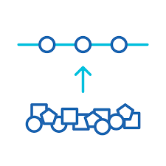
Data Services + You!
You
Your data
How you want your data to look
Notes:
Lots of messy data out there

Slide 4

Data Services
A central store for all of Ofgem’s Data
+
Additional tools
Notes:
We want to automate the boring stuff. Store everything in a clean and accessible format

Slide 5
Data Services + You!
Notes:
Let’s iterate – you clean your data and put it into the cloud

Slide 6

Data Services + You!
Notes:
When you’re happen – we’ll automate the collection
The boring stuff is automated and you’re free to work on the interesting stuff.

Slide 7
Let’s get started!

