Slide 1
Data Services:
Data Carpentry – Introduction to Git

Slide 2
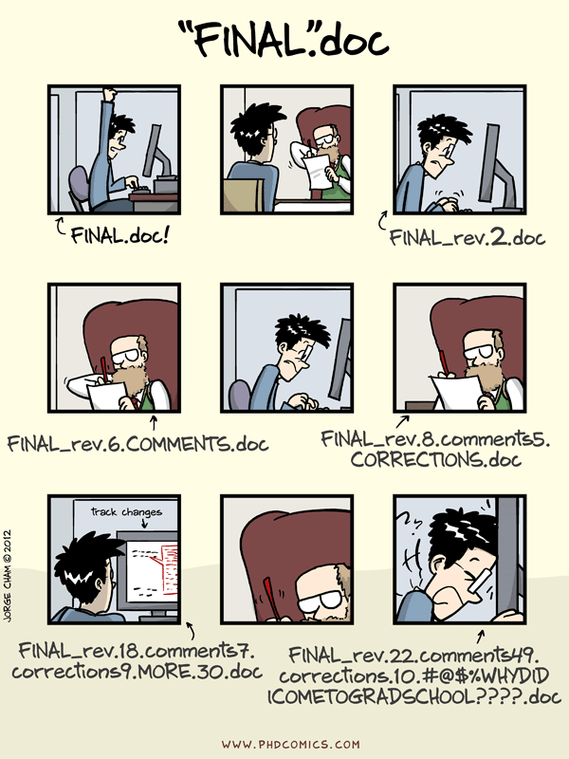
The need for Version control

Slide 3
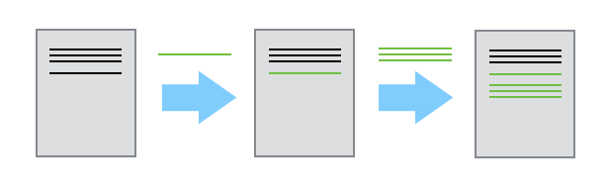
Documents can change

Slide 4
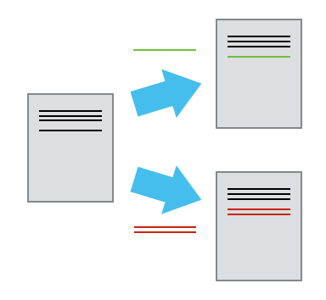
Multiple users may wish to make edits at one time

Slide 5
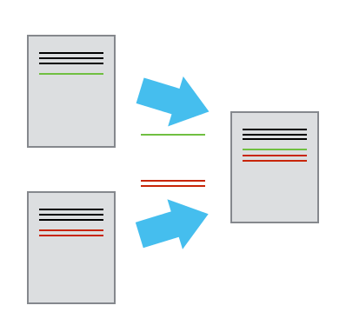
These edits must be merged

Slide 6
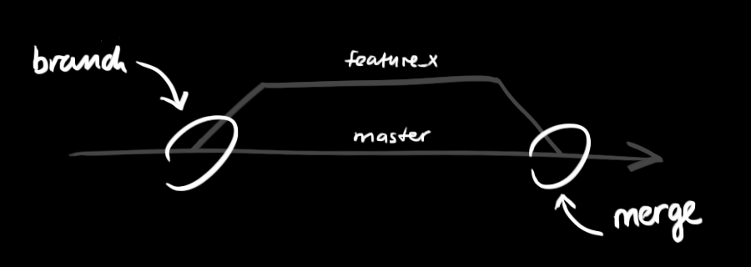
Working practice

Slide 7
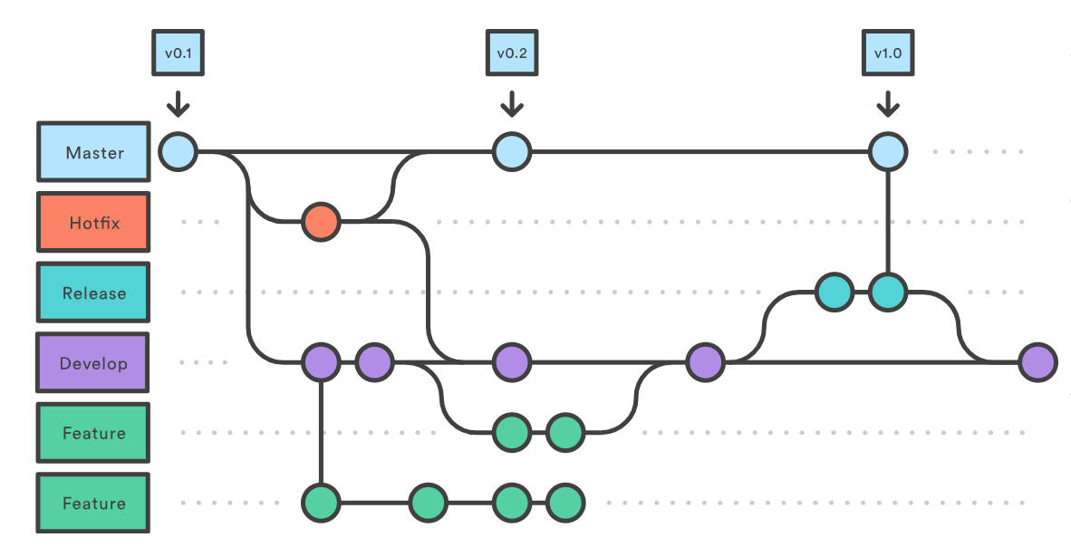
Working practice

Slide 8
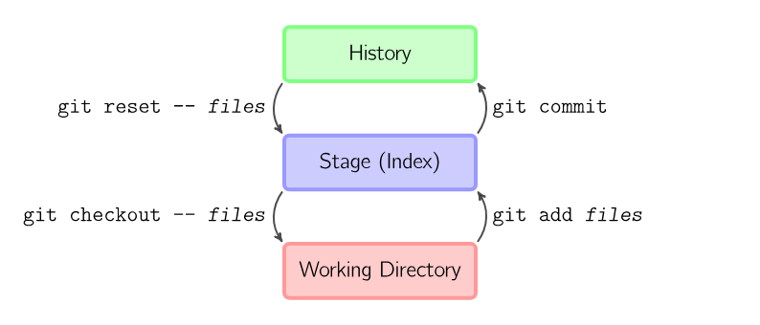
Working practice

Slide 9
Further Reading
Software Carpentry
http://swcarpentry.github.io/git-novice/
Github
https://guides.github.com/
Git Guide
http://rogerdudler.github.io/git-guide/

