Slide 1
Data Services:
Data Carpentry – Introduction to Data Platforms and SQL

Slide 2
What is this Data Platform thing?

Slide 3

Hadoop History:
Doug Cutting and Mike Cafarella founded Hadoop in 2005.
It was originally developed to support distribution for the Nutch search engine project.
Doug, who was working at Yahoo! at the time named the project after his son's toy elephant.

Slide 4
2009: Yahoo runs 17 clusters with 24,000 machines. Using Hadoop one terabyte can be sorted in 62 seconds.
2011: Rob Beardon and Eric Badleschieler spin out Hortonworks out of Yahoo.
2017: Apache Hadoop 2.8 Available. Hadoop Core product: Common, HDFS, YARN, MapReduce

Slide 5



Moving data to processing unit
(Traditional Approach)

Slide 6
Moving data to processing unit
(Traditional Approach)
Moving processing unit to data
(MapReduce Approach)
Notes:
Data is distributed too

Slide 7
Co-designed, co-developed, co-deployed
Not a separate storage system with processor everything is on top of each other.
What’s the point?
Distributed and parallelized processing of data
Moving compute to the data is easier than the reverse
As system is formed of interlocking pieces, a slide on each:
Hadoop core
HDFS (Hadoop Distributed File System)
MapReduce
YARN (Yet another resource negotiator)

Slide 8
Co-designed, co-developed, co-deployed
Not a separate storage system with processor everything is on top of each other.
What’s the point?
Distributed and parallelized processing of data
Moving compute to the data is easier than the reverse
As system is formed of interlocking pieces, a slide on each:
Hadoop core
HDFS (Hadoop Distributed File System)
MapReduce
YARN (Yet another resource negotiator)
THE ABILITY TO
SCALE!

Slide 9
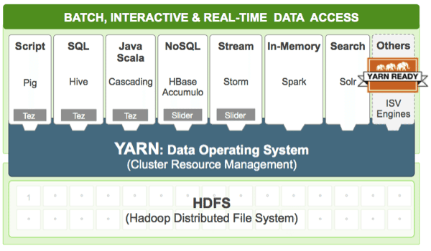

Slide 11
“The Apache Hive data warehouse software facilitates reading, writing, and managing large datasets residing in distributed storage using SQL.”
https://hive.apache.org/

Slide 12
Structured Query Language (SQL) The Language of Databases

Slide 13
Structured Query Language (SQL) The Language of Databases
SELECT __________ FROM ___________ WHERE ____________ ;
column
TestName
DateTime
Operator
Engineer
TestType
AbortDeviceComment
table
metadata errordata
measurements
condition
DateTime > '2016-05-08'
TestName LIKE 'C1%'
AbortDeviceComment LIKE 'MEXA%'
Engineer LIKE '%Downing%'
VehicleID LIKE 'DH34%'

Slide 14
Structured Query Language (SQL) The Language of Databases
SELECT __________ FROM ___________ WHERE ____________ ;
column
TestName
DateTime
Operator
Engineer
TestType
AbortDeviceComment
table
metadata errordata
measurements
condition
DateTime > '2016-05-08'
TestName LIKE 'C1%'
AbortDeviceComment LIKE 'MEXA%'
Engineer LIKE '%Downing%'
VehicleID LIKE 'DH34%'

Slide 15
Structured Query Language (SQL) Simple Examples
SELECT __________ FROM ___________ WHERE ____________ ;
Data from certain date range
SELECT TestName, DateTime, CO2 FROM metadata WHERE DateTime > '2016-06-20' AND DateTime < '2016-06-27';
Set numerical limits on data
SELECT TestName, DateTime, CO2 FROM metadata WHERE TestName LIKE '%C1%' AND CO2 BETWEEN -0.1 AND 0.1;
Data from individual engineers SELECT TestName, Engineer, Testtype FROM metadata WHERE Engineer like '%Downing%';
Counting records in certain category and sort
SELECT COUNT(TestName) AS count, Engineer FROM metadata GROUP BY Engineer ORDER BY count DESC;

Slide 16
Watch out:
There are variations in SQL depending on the server / software
The guide for Hive specific commands can be found here:
https://cwiki.apache.org/confluence/display/Hive/LanguageManual+UDF
Lots of inbuilt functions: COUNT, SUM, MAX, MIN, CORR(COL1, COL2), MONTHS_BETWEEN(COL1, COL2)

Slide 17
Zeppelin Demo
Demo
Find records for people called David?
How many women survived?
What was the average age of the survivors?
Draw a graph!

Slide 18
Further Reading
SQL is well established and so there are many resources;
In app and web format, SoloLearn has an excellent and accessible course (4 modules ~ 5 hours). Other online courses DataCamp, Coursera, Khan Academy
http://www.sololearn.com/Course/SQL/
The ‘manual’ of web languages -- w3schools. Can be dry but very detailed.
http://www.w3schools.com/sql/
Google and StackOverFlow forum for query advice
http://stackoverflow.com/questions/tagged/sql
Also check here for many more links
https://www.quora.com/How-do-I-learn-SQL

