Slide 1
Strengthening the Quality of HMRC Statistics
Chris Davies, Office for Statistics Regulation
UK Statistics Authority
September 2021

Slide 2

Who we are
The regulatory arm of the UK Statistics Authority
Promote and safeguard the production and publication of official statistics
Do not produce statistics and are separate from the Office for National Statistics (ONS)

Slide 3
Our vision is that statistics serve the public good
In a world of abundant data, we want people to have confidence in statistics produced by the public sector

Slide 4
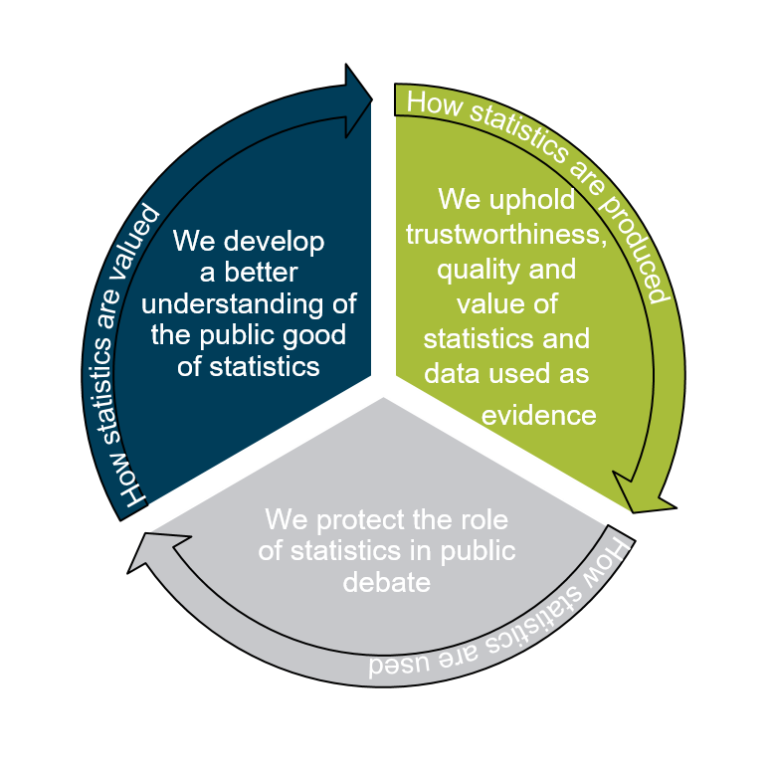
Our role
Advocate the use of quality assurance tools such as Reproducible Analytical Pipelines
Regulation of Artificial Intelligence and Data Science

Slide 5
The review
In September 2019, HMRC invited OSR to carry out a review of the principles and processes underpinning the quality of HMRC’s official statistics.
This review was proactively initiated after HMRC identified a significant error in published Corporation Tax receipt statistics, between 2011 to 2019. Revised receipts figures were £4bn lower than previously published in 2018/19.
The report was published in April 2020.

Slide 6
During the review
HMRC people were open and receptive – willing to be asked and to answer potentially difficult questions
There was a strong message from the top about openness and honesty
The Review seemed to be a real priority to HMRC
The senior team in KAI welcomed the findings of the review, and were clearly focussed on the impact our report could have on the public reputation of HMRC and the morale of statisticians working in KAI.

Slide 7
Key findings
HMRC produces lots of official statistics and most of the time does it well
Quality assurance and quality management should be strengthened
We made recommendations in 5 areas (see Annex)
Recommendations
Leadership and oversight of quality management in KAI
Working with data providers and QA of input data
QA of analysis and publications
Published materials relating to quality of HMRC official statistics
Analytical resources and training

Slide 8
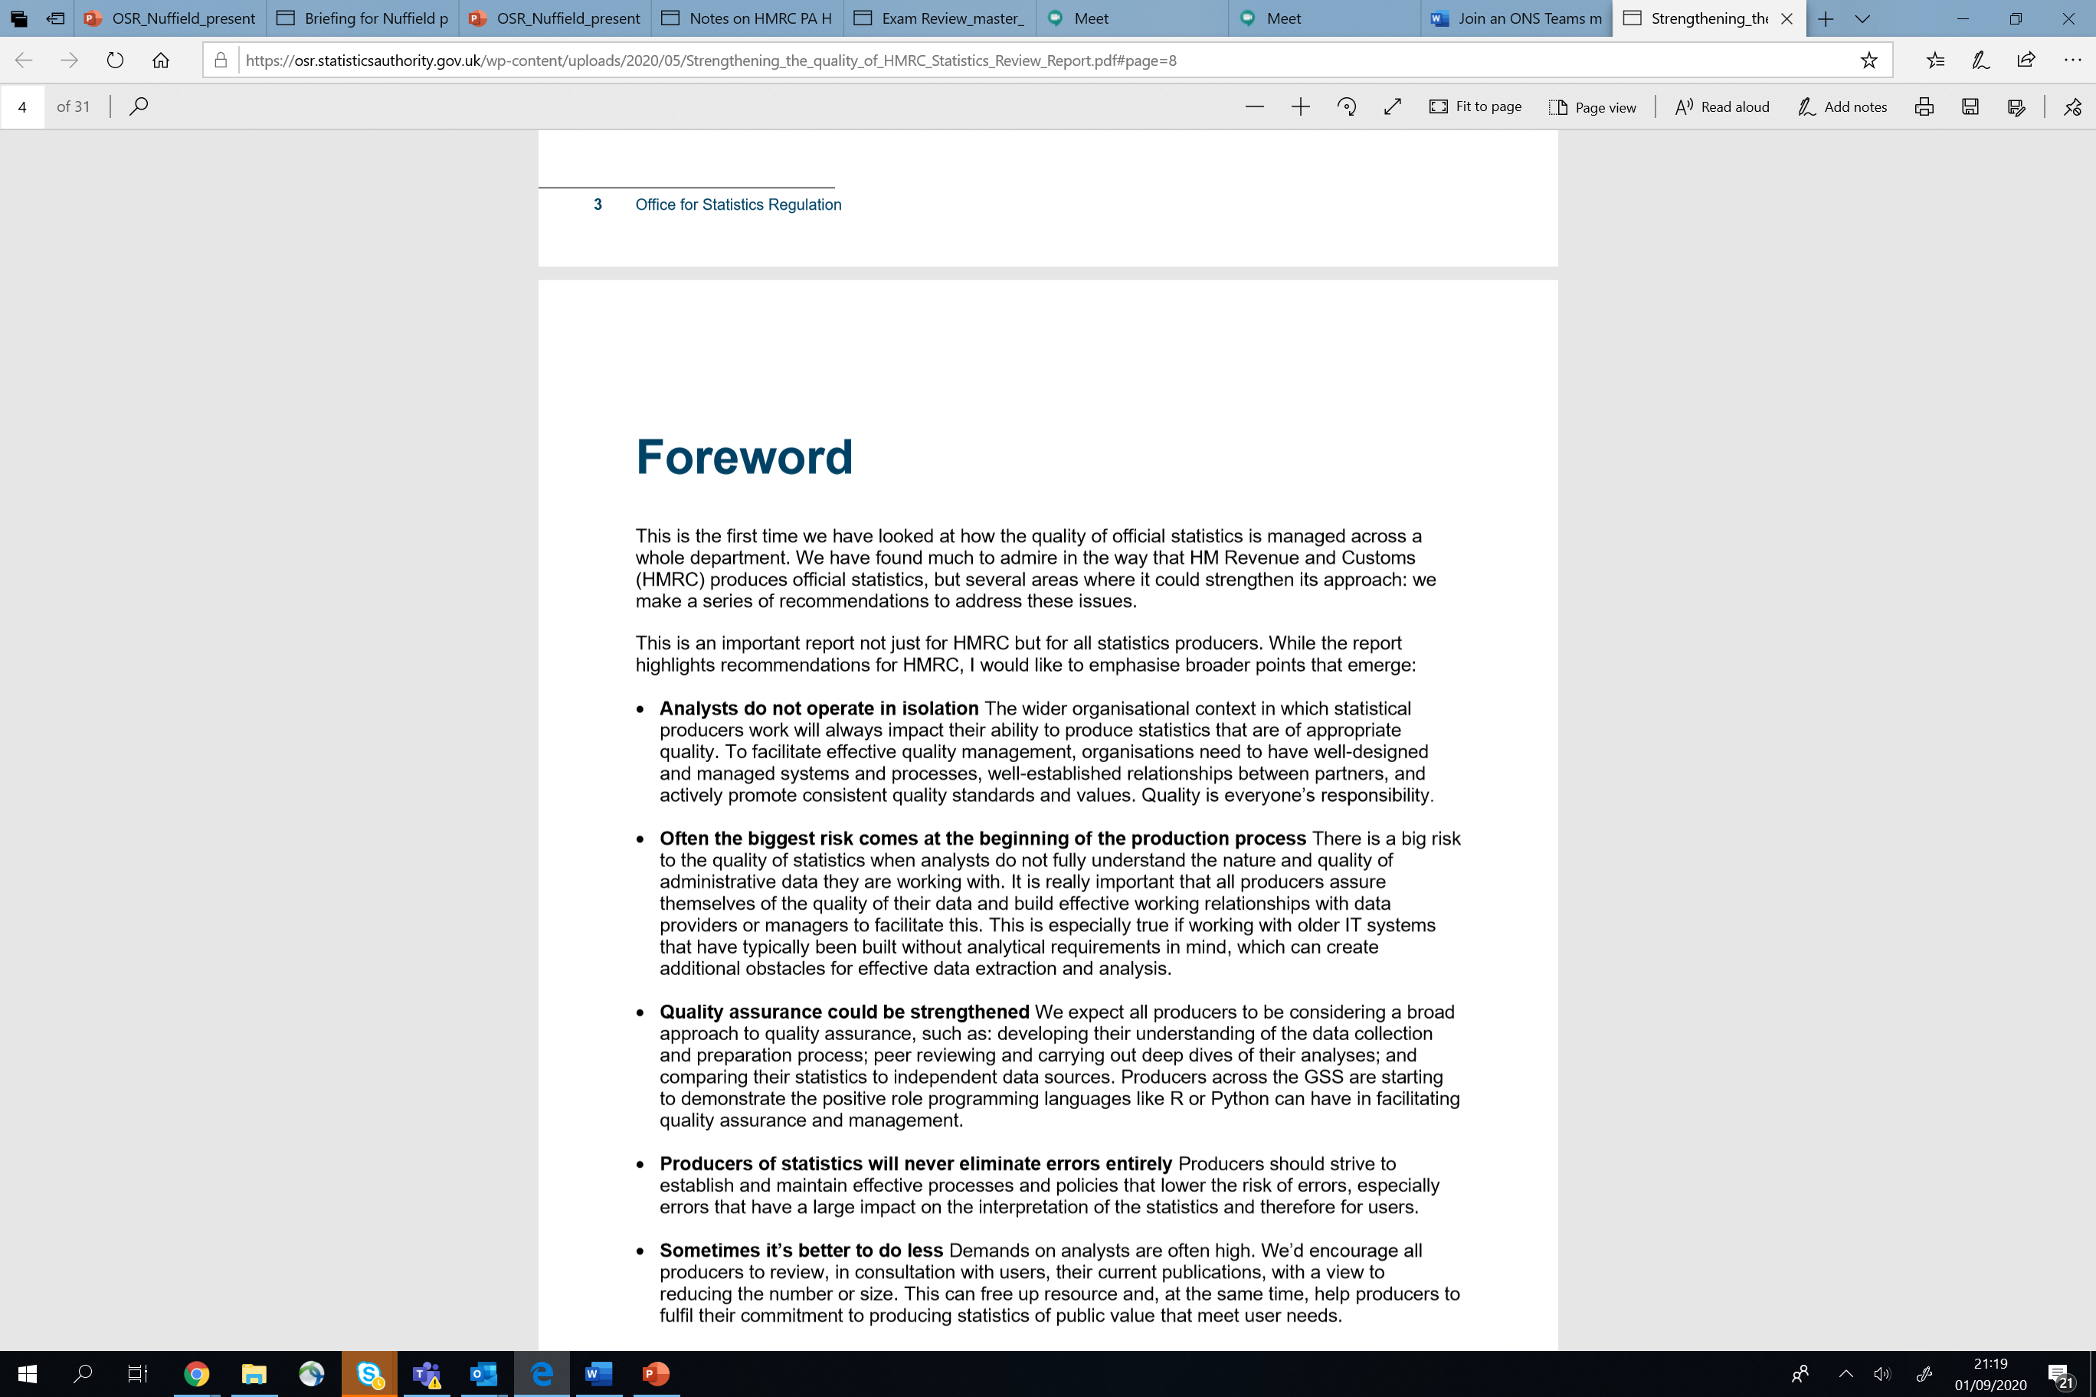
2 broader messages for HMRC Senior leadership:
"Analysts do not operate in isolation" to add text
"the biggest risk comes at the beginning of the production process"​

Slide 9
What’s happened since the report
KAI has responded warmly to the review. KAI:
has appointed an experienced statistician to lead implementation of recommendations
is establishing a new area within KAI, with up to 10 posts, to focus on quality and data
is developing new guidance on how to QA data, analysis and statistics
each of the four areas within KAI is reviewing their official statistics publications, to ensure analytical resource is being used effectively.
Behavioural change – Enhanced statistical quality and assurance has led to HMRC viewing their statistics and data as assets.
BUT....
KAI can't do it on its own. Recommendations for working with other parts of HMRC and creating process maps for individual data flows are a crucial part of quality improvement

Slide 10
Strengthening the Quality of HMRC Statistics
Chris Davies, Office for Statistics Regulation
UK Statistics Authority
September 2021

Slide 11
Annex

Slide 12
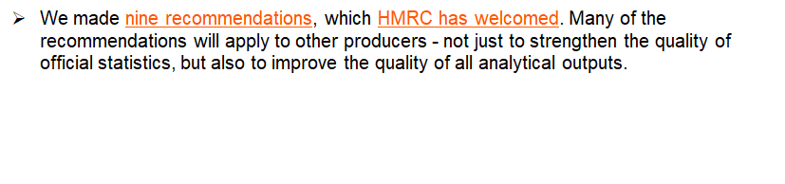
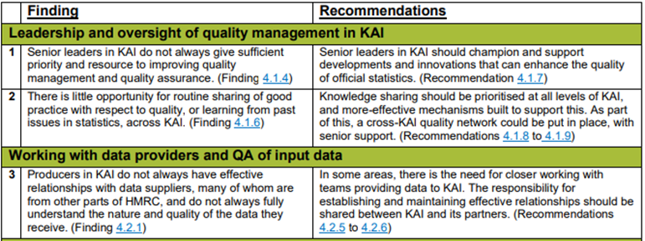
What did we find

Slide 13
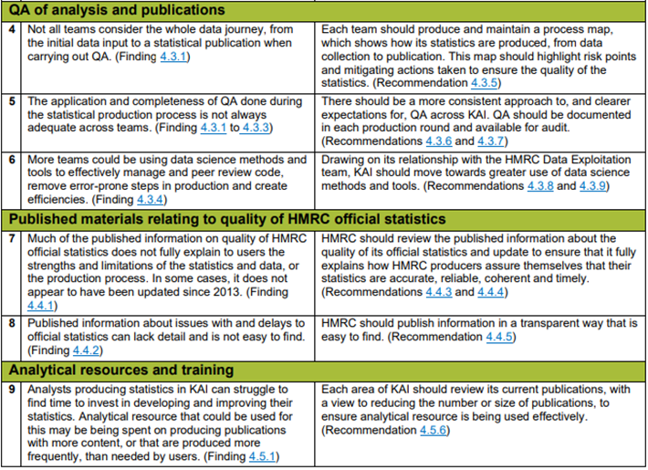
What did we find

