Slide 1
MIO Data Project Spoke
Show and Tell 4: Sprint 08
MIO Team
07/11/19

Slide 2
Show & Tell agenda
Agenda:
Sprint goals
Sprint progress
MIO team updates

Slide 3
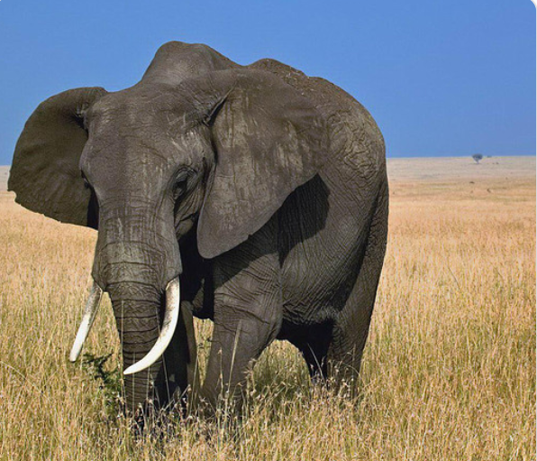
New team member!
Welcome to Manish!

Slide 4
MIO team updates
MIO team updates
W/C 04/11: Sponsors have agreed to extend Alpha from 8 to 12 Sprints – this means Alpha will go on until mid-Jan
Manish from Data Services has been confirmed as the project’s Data Engineer from sprint 9 onwards. He will build the Hub data pipeline in Sprints 9 to 12
3 DevOps tickets are being worked on in the Hub in preparation for building the pipeline
Sprint 9 will focus on preparing to build the Hub data pipeline, mapping and coding work
Early Beta planning has begun: estimations of the resource required, length of a Beta phase and costs have been submitted to Sponsors
3 Beta planning sessions have been set up for November and December
And finally – along with the sprint board we have also set up a Kanban board to help track activities regards Handover, Beta Planning and the DPIA

Slide 5
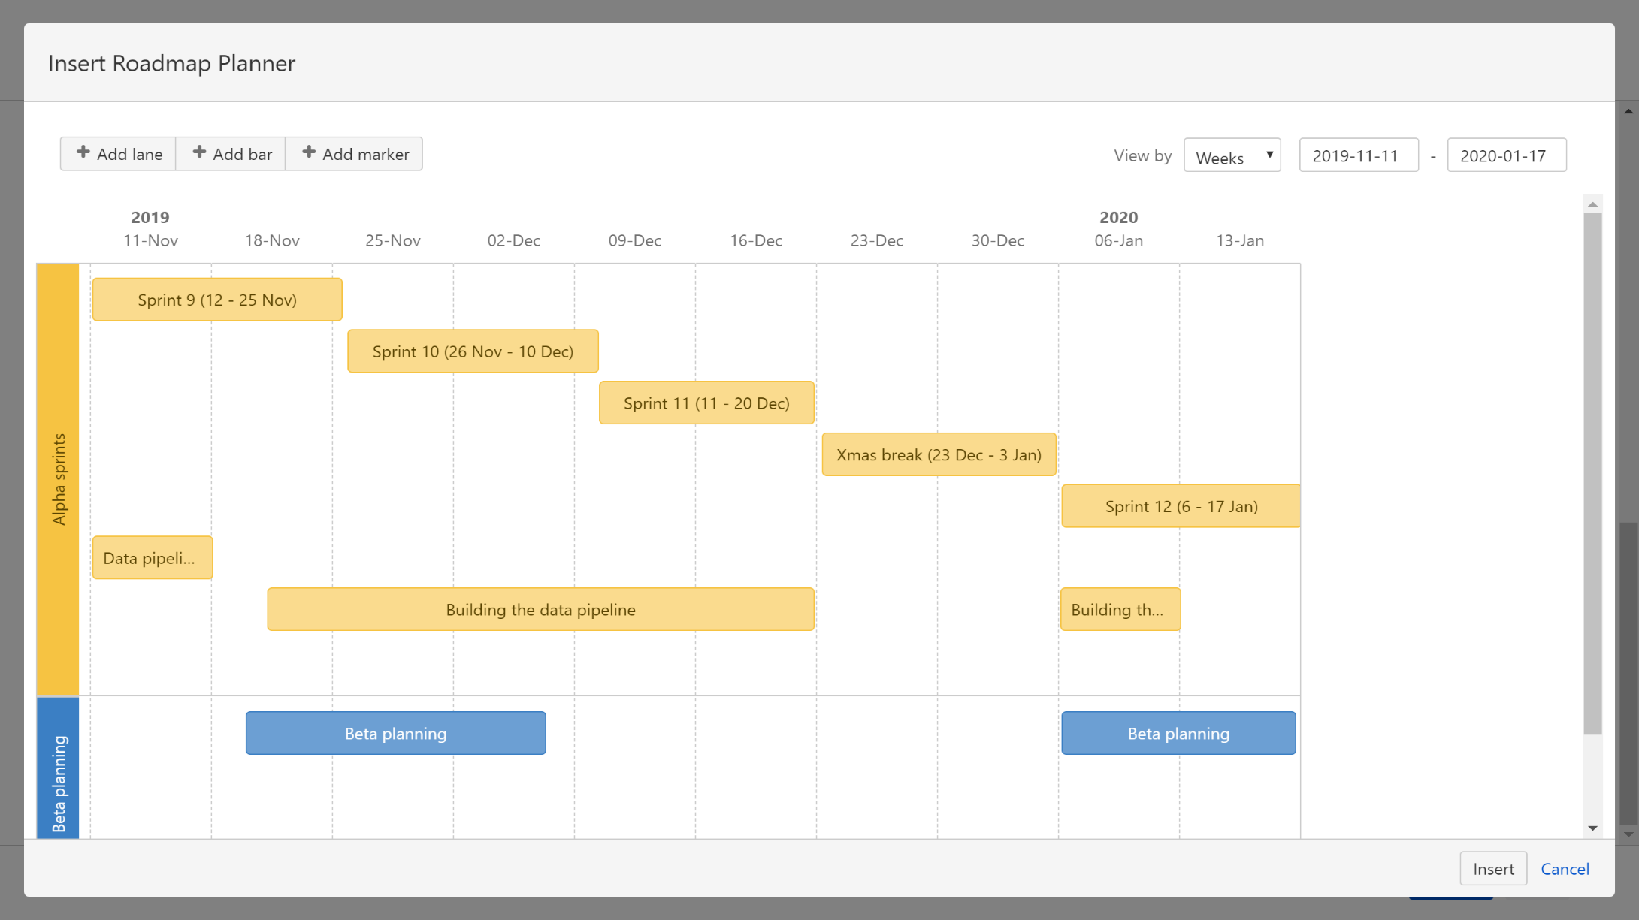
Alpha road map

Slide 6
Sprint goals
Sprint goals:
Tickets in the Hub backlog to build the data pipeline – ON COURSE
All names pseudonymised and cleansed ready for the local data pipeline – ON COURSE
Complete JSONS for Broker 1 - ON COURSE
Complete manual mapping of data from Brokers 4 and 6 - ON COURSE
Have a clear understanding of what is required for the DPIA - ON COURSE

Slide 7
Progress on manual validation and mapping
Validation
Broker 1 | Broker 2 | Broker 3 | Broker 4 | Broker 5 | Broker 6
Mapping
Broker 1 | Broker 2 | Broker 3 | Broker 4 | Broker 5 | Broker 6
Notes:
Have updated. add traffic lights for JSONS work - Anushka

Slide 8
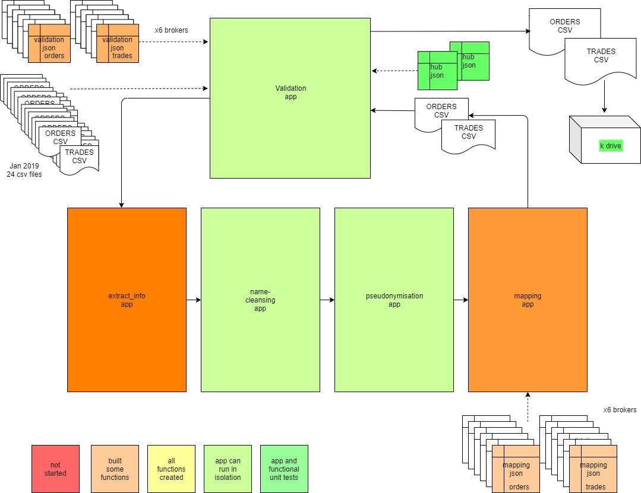
Local pipeline update

Slide 9
Company names cleansing and standardising
Company name: Marks. & Spencers Limited (citi group3)
Cleanse name
marks and spencers ltd (citi|group3)
Reference List
Variation | Standard 1 | Standard 2
Sainsburys limited uk | Sainsburys uk | Sainsburys
Substring in name, split
citi | group3
Standardised name split
marks | spencers | ltd |(citi |group3)|
Substring in name fuzzy string matching
citi group3 similar to…
Max score of similarity (>50)
Name fuzzy string matching
marks and spencers ltd (citi group3) similar to …..
Max score of similarity

Slide 10
Json progress – team effort!
Raw validation jsons
Orders
Broker 1 | Broker 2 | Broker 3 | Broker 4 | Broker 5 | Broker 6
Broker 1 | Broker 2 | Broker 3 | Broker 4 | Broker 5 | Broker 6
Trades
Mapping jsons
Broker 1 | Broker 2 | Broker 3 | Broker 4 | Broker 5 | Broker 6
Orders
Trades
Broker 1 | Broker 2 | Broker 3 | Broker 4 | Broker 5 | Broker 6
Hub validation jsons
Orders
Orders
Trades
Trades
Notes:
JSONS – recipes for our data Raw validation jsons – testing whether we can use just two jsons for all brokers – one for orders and one for trades – Rory currently reviewing
Mapping jsons – Kathy has worked on putting broker specific mapping into a json – Anushka is writing code off this json we are testing this with broker 1 Hub jsons – have been checked by everyone in the MIO data team and two engineers from the hub – they are ready for use to help us ingest data into the hub

Slide 11
DPIA
DPIA
Placed “on hold” for now
Will finalise it when we have a clearer idea of what the final solution will look like
Aim of DPIA is to identify, evaluate and proportionally address all risks related to the data which will be transported into the HUB

Slide 12
Stay connected
Stand-ups
Show & Tell
Confluence workspace
Daily: 9:45 AM (LON-HUB-WEST2)
Every other Thursday - next on 24th Oct, 3pm (LON-HUB-WEST2)
https://ofgemsousd.atlassian.net/wiki/spaces/MDP/overview
Jira backlog & sprint boards
https://ofgemsousd.atlassian.net/secure/RapidBoard.jspa?projectKey=DP

Slide 13
Thank you
Any questions?

