Slide 1


SOFTWARE ENGINEERING
Final Project
Trần Thị Mỹ Nhi
Vi Thị Ngọc Yến

Slide 2
Content
Lifecycle model used
Use case diagram
Class Diagram
Sequence Diagram
Database Design
Demo

Slide 3
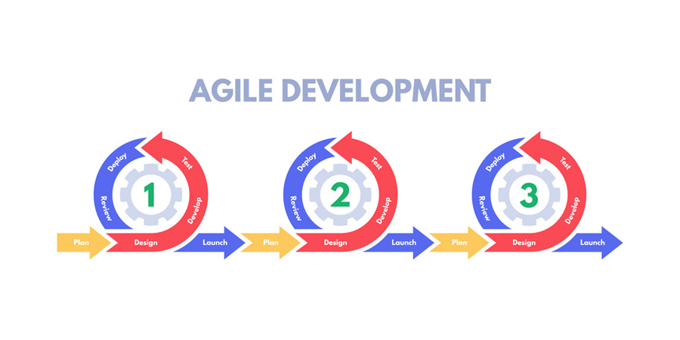
LIFECYCLE MODEL

Slide 4
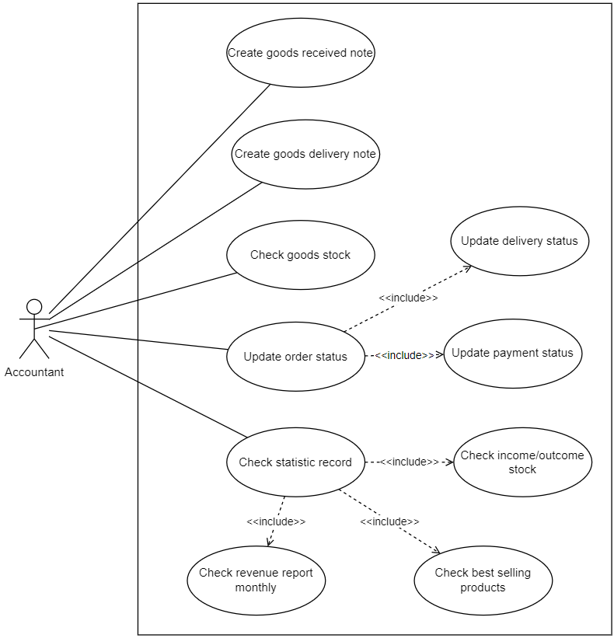
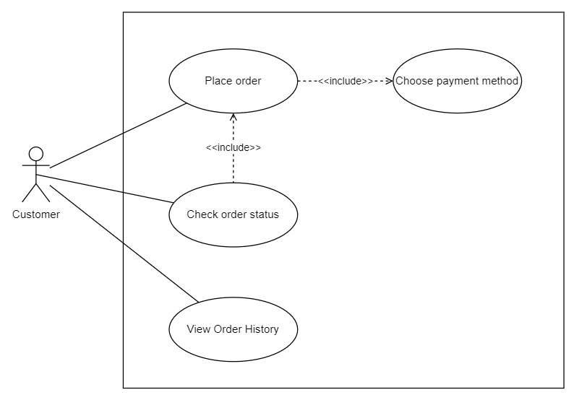
USE CASE DIAGRAMS
Usecase Diagram for Accountant
Usecase Diagram for Agent/Customer

Slide 5
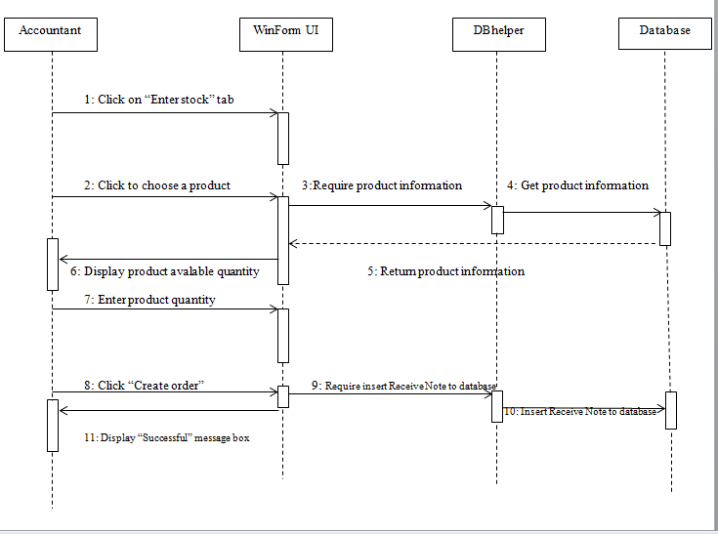
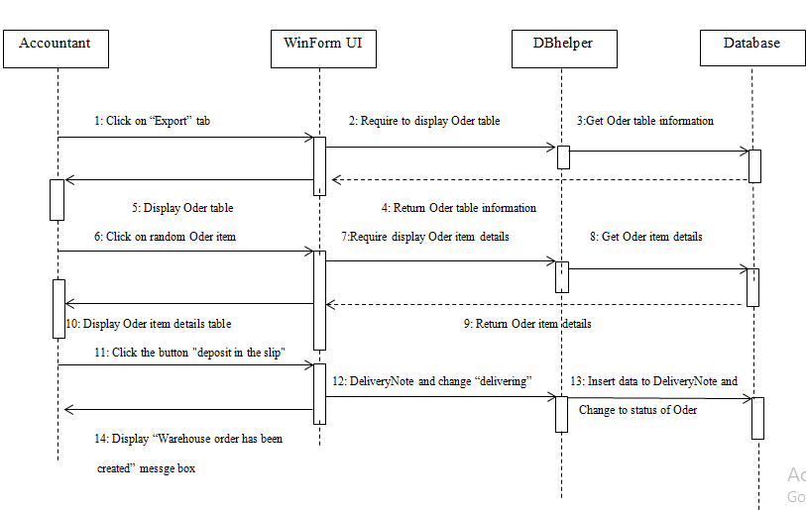
SEQUENCE DIAGRAMS
Sequence Diagram – Create Goods Receive Note
Sequence Diagram – Create Goods Delivery Note

Slide 6
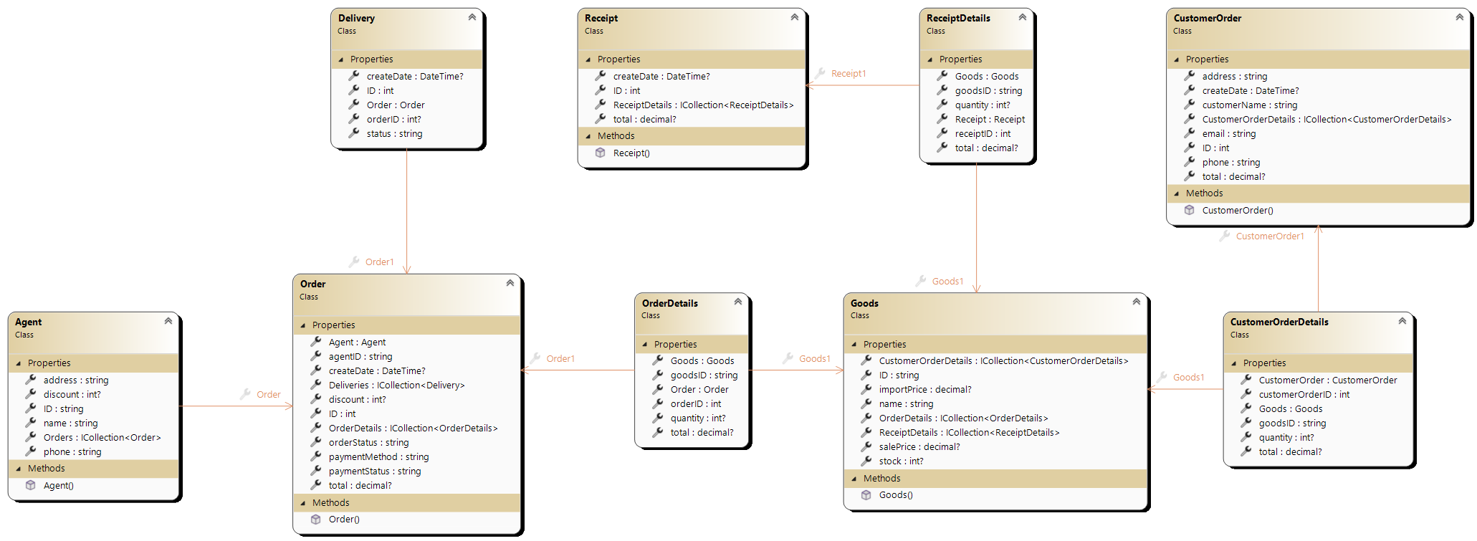
CLASS DIAGRAMS

Slide 7
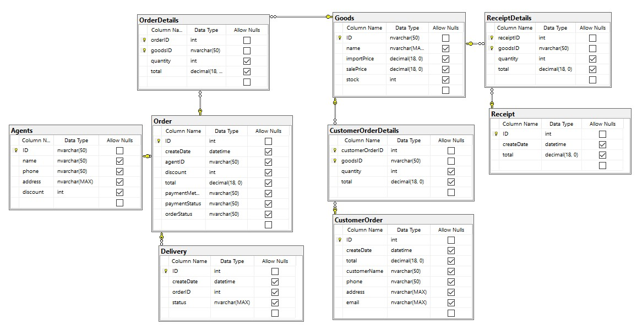
DATABASE DESIGN

