Slide 1

PIN Security
Rosa Francesco Pietro
Technologies for Advanced Programming

Slide 2
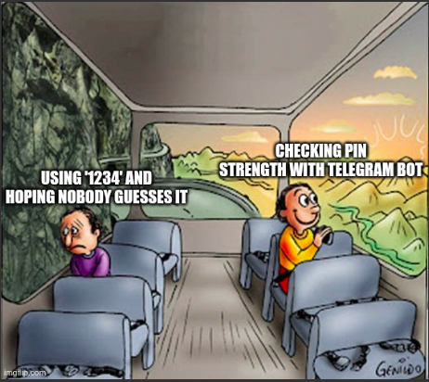

Slide 3
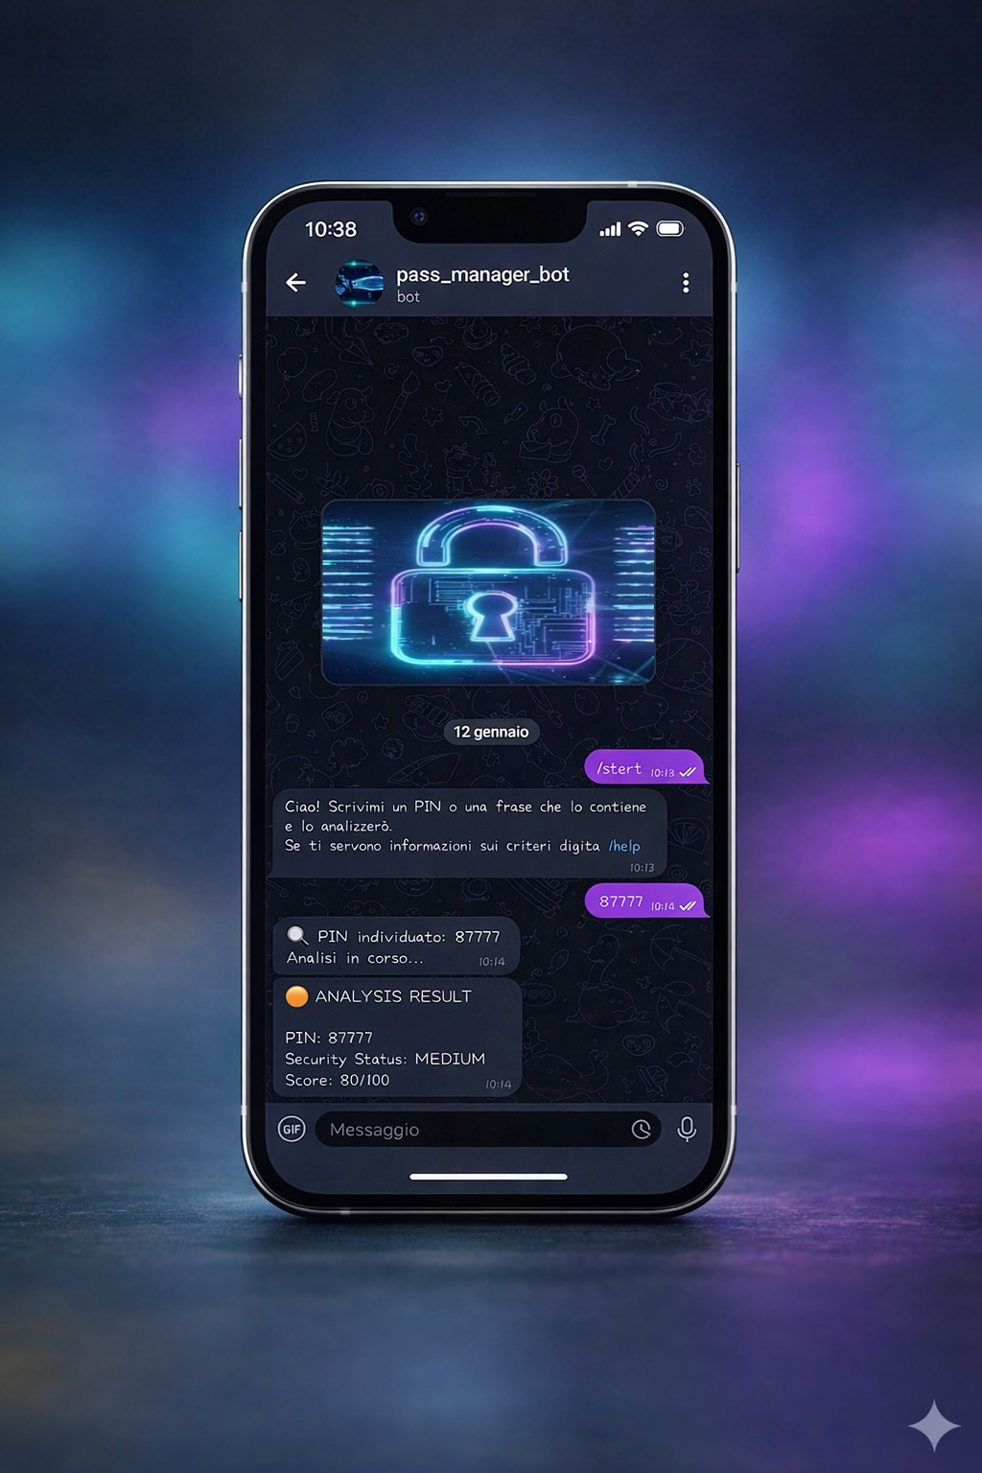
This project aims
to help users discover
the security level
of a crucial secret code...

Slide 4


User sends PIN via Telegram Bot API

Slide 5

Decoupling producer and consumer with Kafka topics.

Slide 6

Spark Streaming processes data

Slide 7

Data is indexed for fast search.

Slide 8

Real-time Dashboard & Analytics

Slide 9
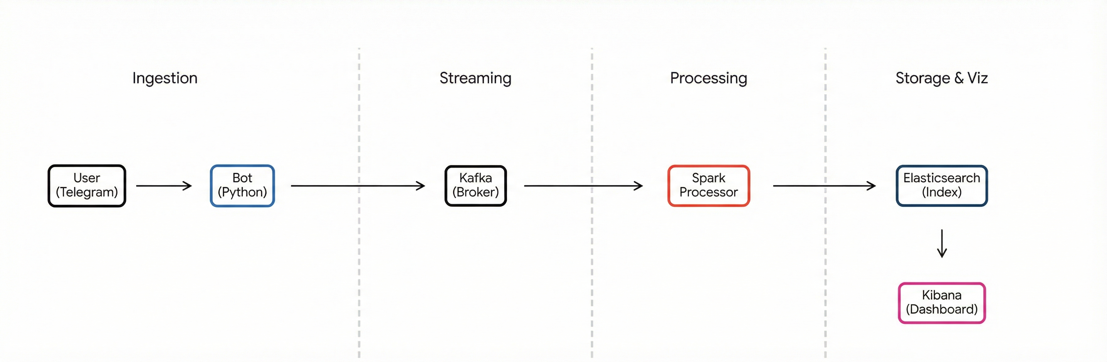

Slide 10

infrastructure
Docker encapsulates Bot, Kafka, and Spark into isolated containers. It ensures the entire architecture runs identically on any PC

Slide 11


