Slide 1
YACC

Slide 2
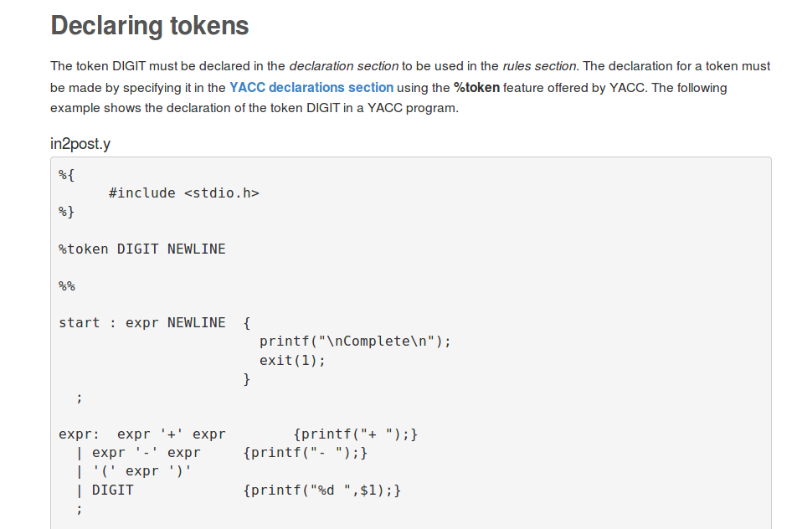

Slide 3
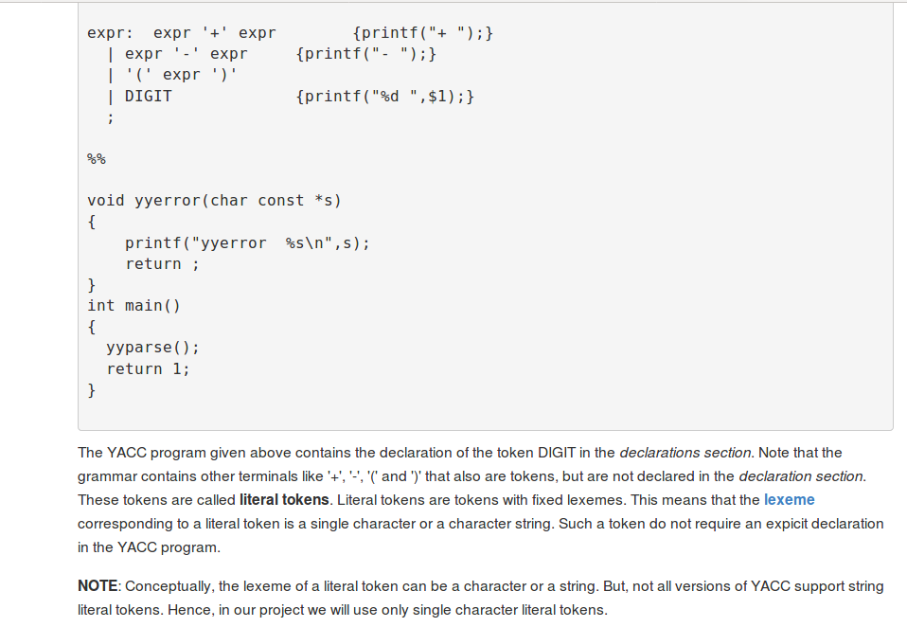

Slide 4
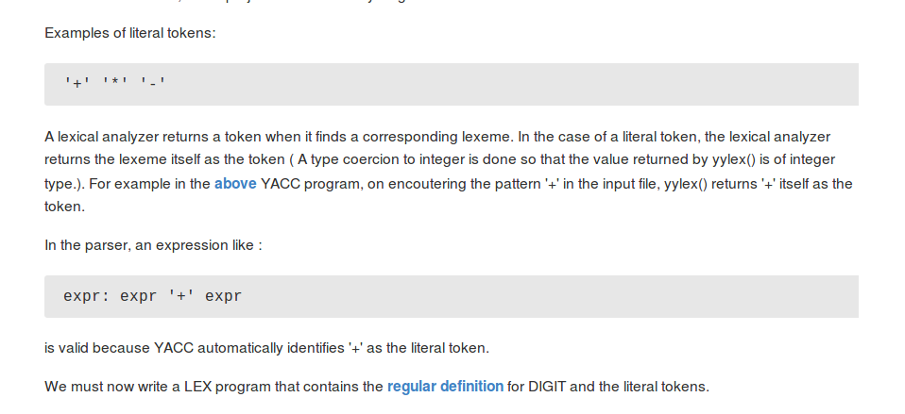

Slide 5
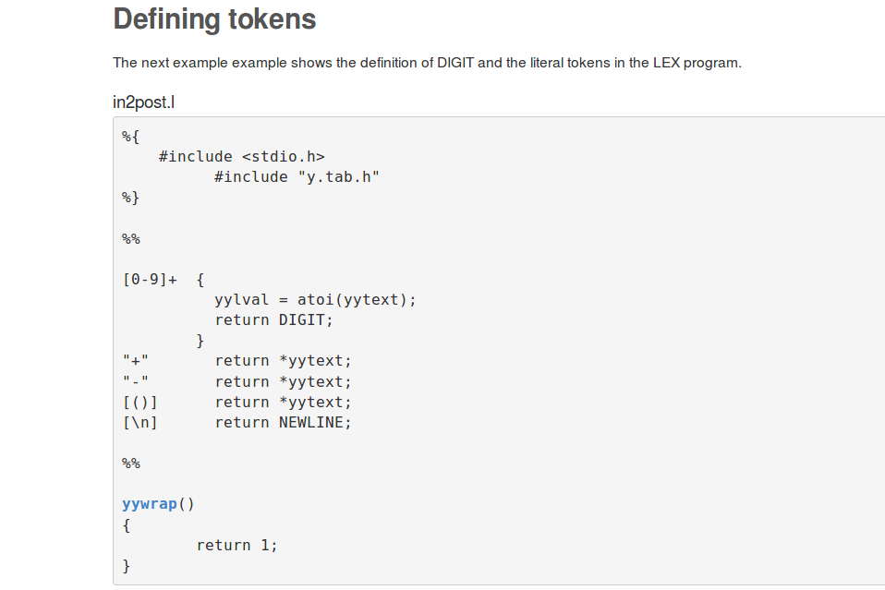

Slide 6
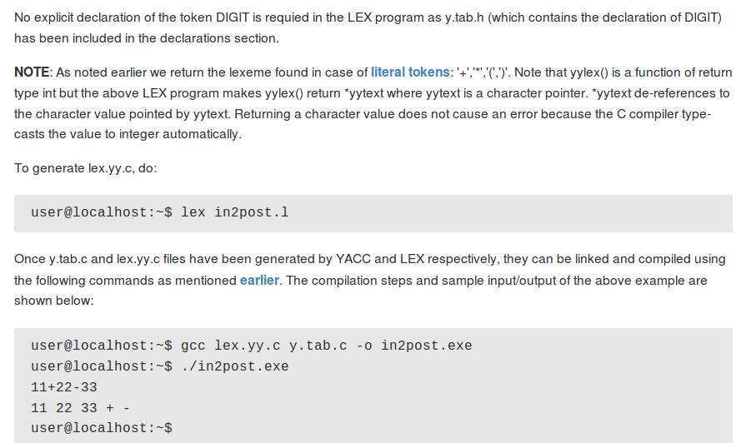

Slide 7
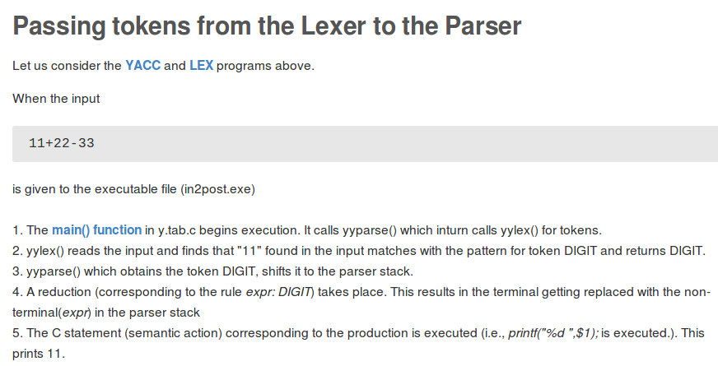

Slide 8
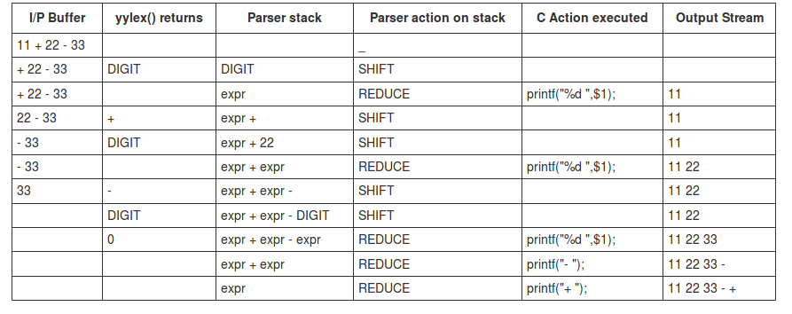

Slide 9
Contd...
Note that yylex() makes a call to yywrap(), when 'End of file' is encountered. We have defined yywrap() to return 1 (We have provided the definition for yywrap() in our LEX file). Recall that when yylex() receives non-zero value from yywrap(), it returns zero to yyparse(). Also recall that yyparse() does not call yylex() once it has returned 0. It return zero to main() function to indicate successful parsing.
We have noted how to integrate the lexical analyzer generated by LEX with the parser generated by YACC. Now, we will learn more about managing attributes using LEX and YACC.

Slide 10
Introduction to Attributes
It is possible to pass values associated with tokens from yylex() to yyparse(). We had described the term 'attribute' as a value associated with a token.
YACC uses yylval to facilitate passing values from the lexical analyzer to the parser.

Slide 11
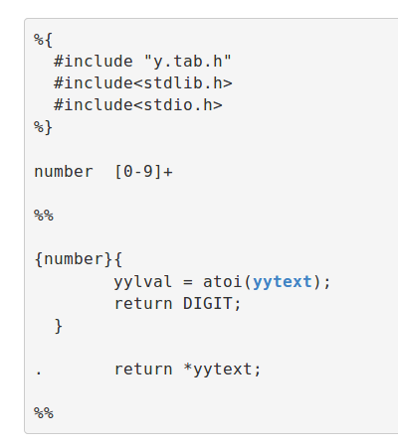
Contd...

Slide 12
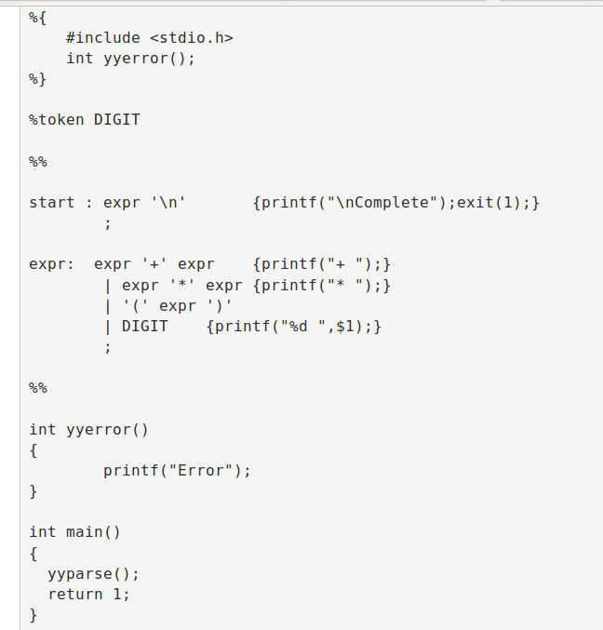

Slide 13
Contd..
Note the semantic action for the production
expr:DIGIT
DIGIT {printf("%d ",$1);}
The value corresponding to the token DIGIT, that was assigned to yylval by lex is accessed in YACC using the symbol $1.

Slide 14
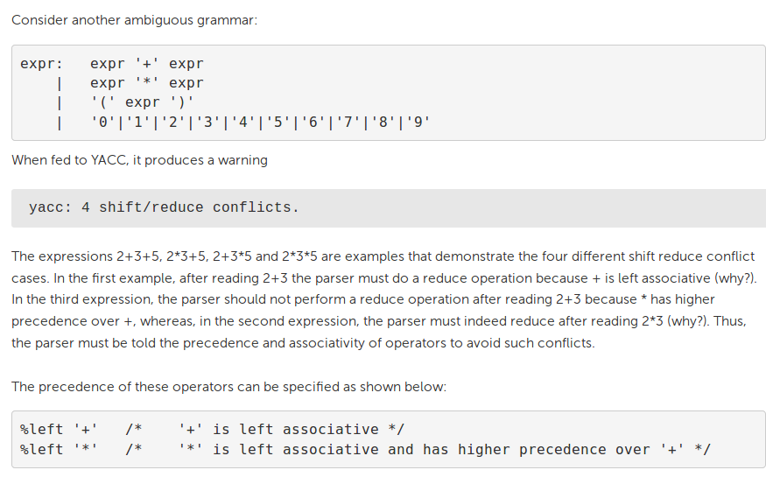

Slide 15
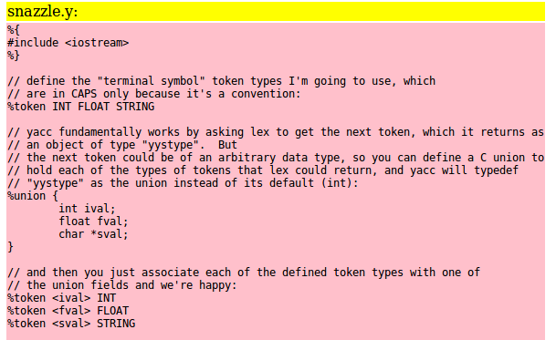

Slide 16
