Slide 1
Exercise class 10
(week 17)
Introduction to Programming and Numerical Analysis
Class 4 and 8
Rosa Haslund Meyer
Spring 2024

Slide 2
Feedback on the Inaugural Project
Dynamic programming
Problem set 7

Slide 3
Feedback on the Inaugural Project
You should all have received feedback by now! If you haven’t, and expect me to give you feedback, please message me ASAP.
In general, regarding your answers:
Everyone did well on question 1 and 2
Question 3 was ok – most people simply printed the errors, consider plotting them instead
Question 4a-b and 5a-b was hard
Question 6a-b and 7 were alright
Question 8 was hard
Remember to always show/write your reflections about your chosen method!
I suggest that you set a seed for the random number generators, such that you’ll always generate the same “random” numbers.

Slide 4
Feedback on the Inaugural Project – in general
A couple of things I think a lot of you could improve:
Collect all your main code in one single module (.py-file)
Remember to document your module – have a look at this notebook on coding practice and documentation
Remember to write comments to your results and your way of thinking in markdown cells
Only hand in three documents: your notebook, your module and your README
Never simply print a long list of numbers. Instead think about how you could illustrate them or perhaps only print the first five and last 10. Merely printing numbers, doesn’t necessarily show that you know what you're doing
Remember to add your names and UCPH-id’s (or if the exam is anonyms, write your exam number)

Slide 5
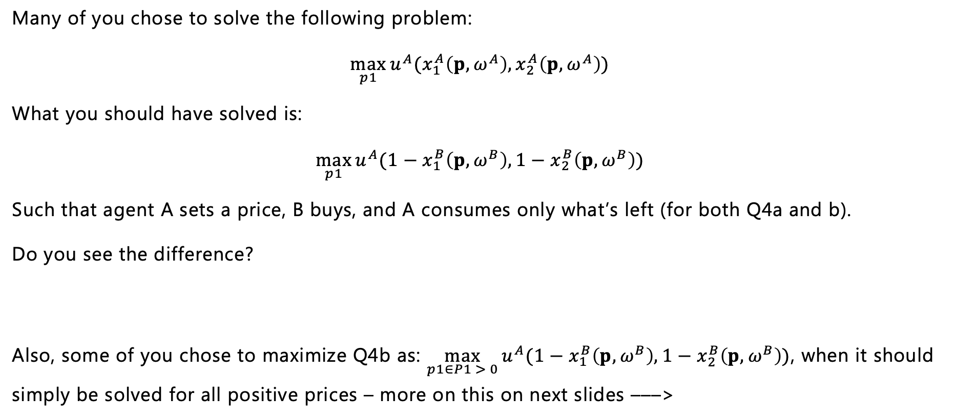
Question 4a-b: Assume that A chooses the price to maximize her own utility
Many of you chose to solve the following problem:
$$\max_{p1}{u^{A}(x_{1}^{A}\left(p,ω^{A}\right),x_{2}^{A}\left(p,ω^{A}\right))}$$
What you should have solved is:
$$\max_{p1}{u^{A}({1−x}_{1}^{B}\left(p,ω^{B}\right),1−x_{2}^{B}\left(p,ω^{B}\right))}$$
Such that agent A sets a price, B buys, and A consumes only what’s left (for both Q4a and b).
Do you see the difference?
Also, some of you chose to maximize Q4b as: $\max_{p1∈P1 > 0}{u^{A}({1−x}_{1}^{B}\left(p,ω^{B}\right),1−x_{2}^{B}\left(p,ω^{B}\right))}$, when it should simply be solved for all positive prices – more on this on next slides –––>

Slide 6
Recap on optimisation: Grid search vs. numerical optimiser/solver
One thing that made question 4 and 5 hard, were choosing the right method for optimization.
Grid search / looping:
When you want to search over a discrete set, i.e. points in a grid or looping over some list
Will not get the exact solution to the problem (as you only search in a specific domain, the grid), but will get you close
Quite secure against non-global minima
Numerical optimiser / solver:
Searches over a continuous set/range
The solution can be very precise
Can be sensitive to initial guesses/choice of starting value – less secure against non-global minima

Slide 7
Question 4-5
Question 4a and 5a ask you to search for an optimum/solution within a specific, discrete sets – lists of potential optima – prices in Q4a and consumption bundles in Q5a:
Which method would be appropriate here? –––> grid search / looping
On the contrary, question 4b and 5b doesn’t limit the solution to specific discrete sets:
Which method would be appropriate here? –––> numerical optimiser / solver

Slide 8
Tips: choosing numerical optimiser / solvers
As said, sometimes solvers are sensitive to the choice of starting values etc. This can be because:
Best case: the function is flat making it difficult to find the precise optimum/solution
Worst case: multiple minima!
(Therefore, remember to check whether the optimum depends on the initial guesses – might be the case in especially Q5b!)
How to deal with this?
Always try different starting values – if the solution changes, be aware of non-local minima!
Think strategically when choosing your starting values/initial guesses – is it possible you already know a point close to the solution or do you have a well justified guess?

Slide 9
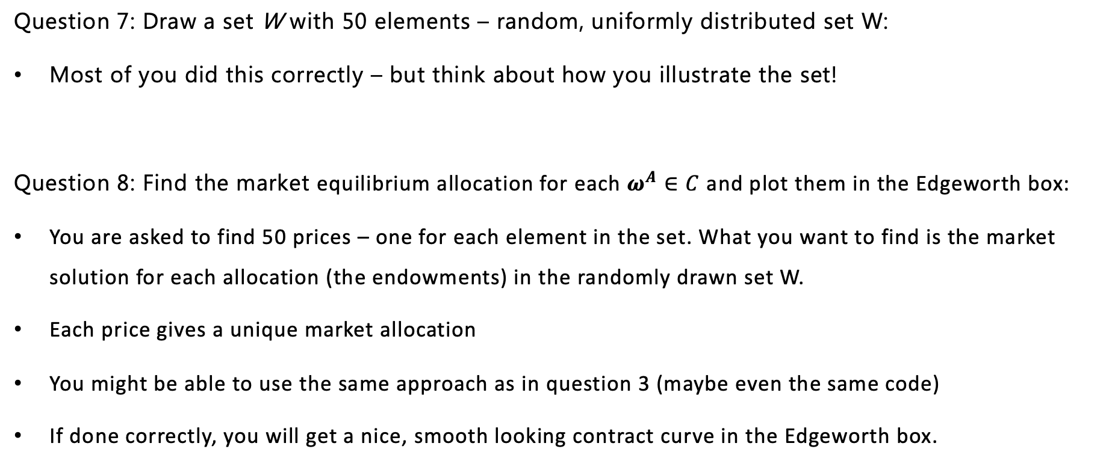
Question 7-8
Question 7: Draw a set W with 50 elements – random, uniformly distributed set W:
Most of you did this correctly – but think about how you illustrate the set!
Question 8: Find the market equilibrium allocation for each $ω^{A}∈C$ and plot them in the Edgeworth box:
You are asked to find 50 prices – one for each element in the set. What you want to find is the market solution for each allocation (the endowments) in the randomly drawn set W.
Each price gives a unique market allocation
You might be able to use the same approach as in question 3 (maybe even the same code)
If done correctly, you will get a nice, smooth looking contract curve in the Edgeworth box.

Slide 10
Practicalities for the Inaugural Project
I might have been a little hard on whether I chose to approve your projects or not... If you feel like your project should have been approved (and wasn’t) please message me and I’ll have another look.
The reason why I’ve been a bit hard is because answers (and mostly correct) to all questions is technically mandatory for passing the exam.
If your project was not approved, you should hand in again before May 10th if you want to be approved for the exam.
The Inaugural Project (as with all other projects) will be part of your exam portfolio. You can and should incorporate feedback from me (and maybe your peers) before handing in the final version for examination.

Slide 11
Dynamic programming
Dynamic programming is a method used to solve complex problems, mostly optimisation problems, by breaking them down into simpler subproblems. By solving each subproblem (typically recursively) only once and storing the results, it avoids redundant computations, leading to more efficient solutions for a wide range of problems.

Slide 12
Terminology
State variable: a variable determining a state of the world as it is when I make my decision. State variable evolve over time according to the transition process.
Example: Cash-on-hand in consumption-saving models.
Choice variable: the variable I choose to maximise utility (also control variable).
Example: Consumption in consumption saving models.
Policy function: the optimal choice as a function of state.
Value function: the total value of today’s state: utility today + discounted value of tomorrow’s state.
Solution: set of approximate policy and value functions describing optimal behaviour as a function of the state.

Slide 13
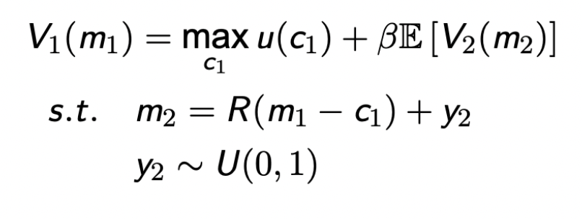
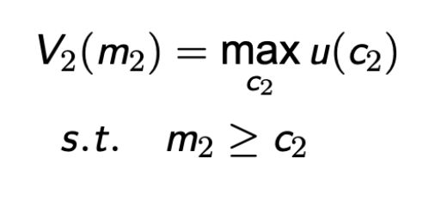
Example of a two-period consumption-savings model
In the first period, the agents solve:
In the second period the agents solve:
Let’s have a look at the variables –––>

Slide 14
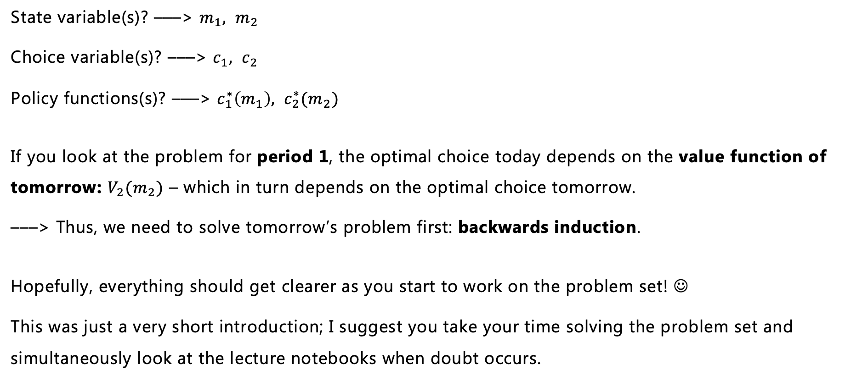
Variables in the two-period consumption-savings model
State variable(s)? –––> $m_{1}, m_{2}$
Choice variable(s)? –––> $c_{1}, c_{2}$
Policy functions(s)? –––> $c_{1}^{∗}\left(m_{1}\right), c_{2}^{∗}(m_{2})$
If you look at the problem for period 1, the optimal choice today depends on the value function of tomorrow: $V_{2}(m_{2})$ – which in turn depends on the optimal choice tomorrow.
–––> Thus, we need to solve tomorrow’s problem first: backwards induction.
Hopefully, everything should get clearer as you start to work on the problem set! ☺
This was just a very short introduction; I suggest you take your time solving the problem set and simultaneously look at the lecture notebooks when doubt occurs.

Slide 15
Next time...
Video lectures:
Structural estimation
Ramsey
OLG
Physical lectures:
The model analysis project will be introduced Monday April 29th
Exercises – Work on your model analysis project!
Your last project, the model analysis project, should be handed in May 10th and you should give peer feedback before May 19th.

