Slide 1
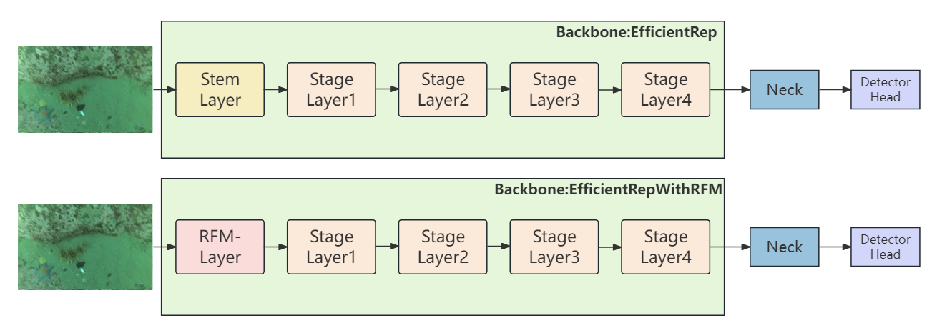
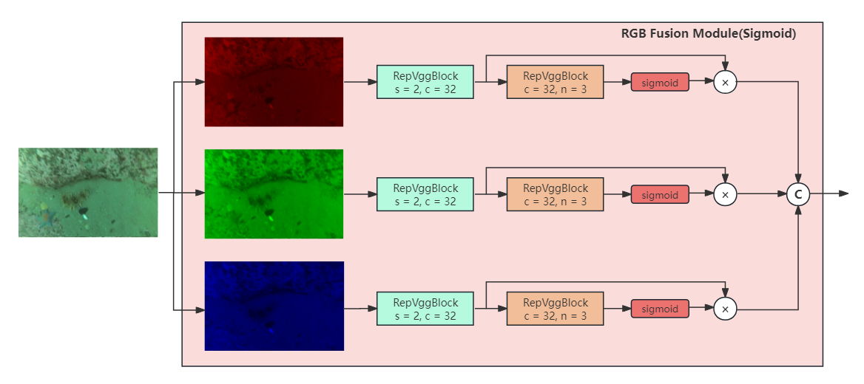
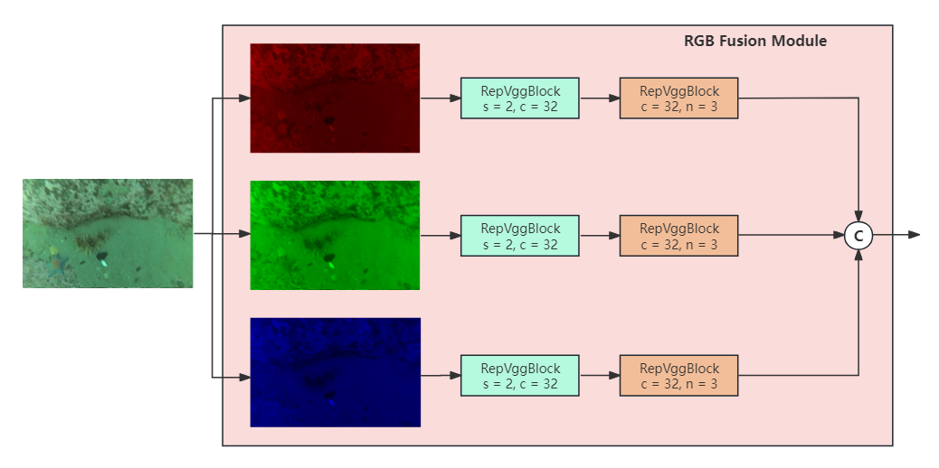
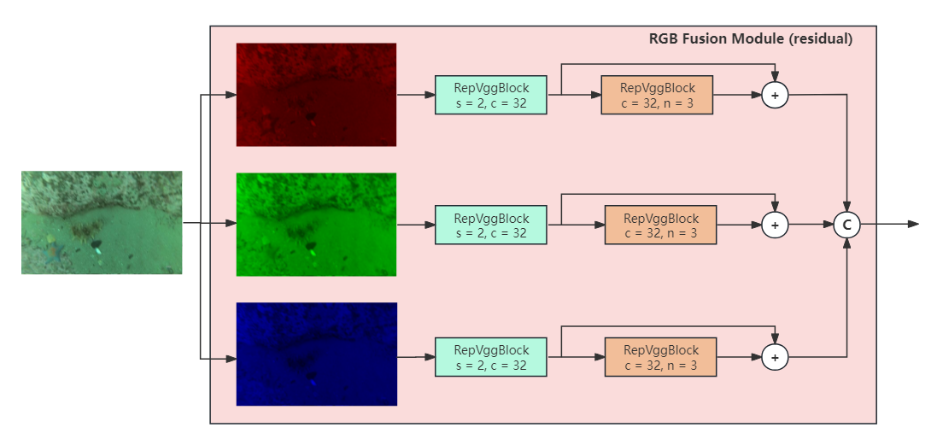

Slide 2
作用：修改张量的尺寸和通道数
640*640*3 —> 320*320*32
保证后续操作的相同，也需要更改通道数。
操作：更改通道数+特征学习
640*640*3 —> 320*320*32

Slide 3
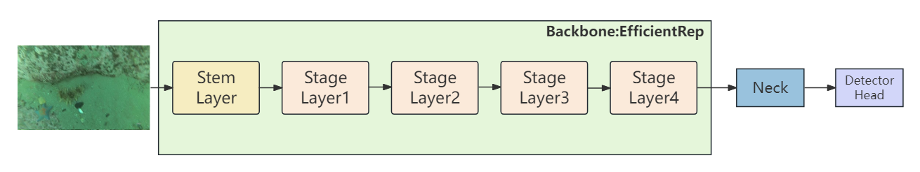
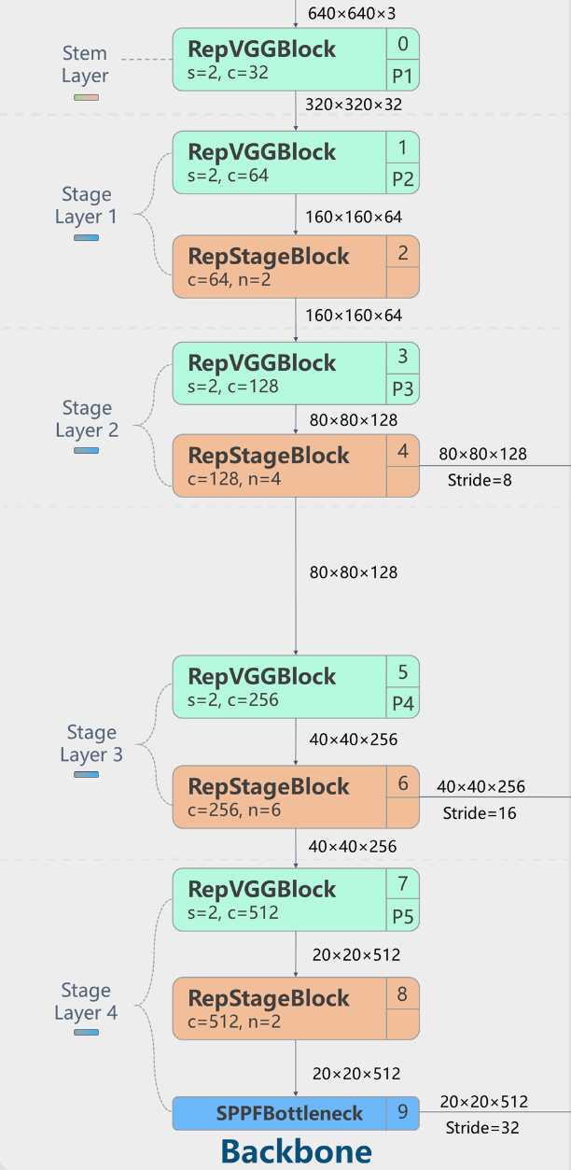
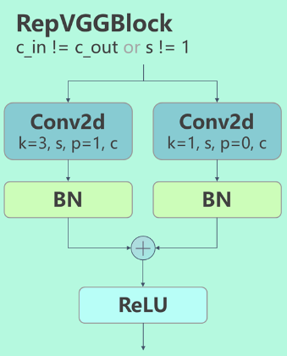
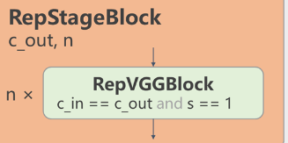
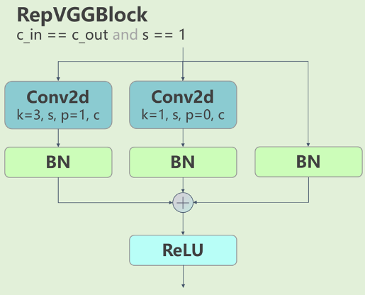
640*640*3 —> 320*320*32
作用：对张量进行通道和尺寸的变化。
使用模块：
RepVGGBlock(k=3,s=2,p=1)
H_{n}*W_{n}*C_{n} —>H_{n+1}*W_{n+1}*C_{n+1}
作用：对张量进行通道和尺寸的变化+特征学习。
使用模块：
RepVGGBlock(k=3,s=2,p=1)
RepStageBlock(k=3,s=1,n)

Slide 4
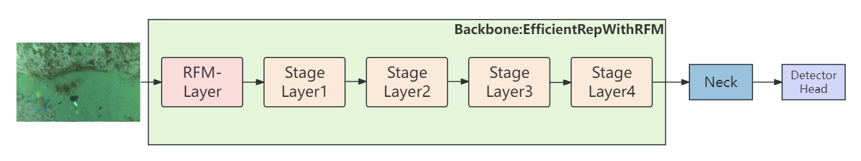
基于水下图像的特性（色彩失真，整体图像偏蓝绿），从模型骨干网络最开始的输入部分对RGB三个通道分别进行学习。
想法：
输入 ——> 将三个通道分开 ——> 形状变化 ——> 学习特征 ——> 融合

Slide 5
Methods | AP | AP₅₀ | holothurian | echinus | scallp | starfish | Params
Gold-YOLO | 64.9 | 84.2 | 64.5 | 72.7 | 48.7 | 73.5 | 21.51M
+RFM(sigmoid) | 66.0 (+1.1) | 84.9 (+0.7) | 66.0 (+1.5) | 73.3 | 50.5 | 74.4 | 21.63M

Slide 6
Methods | AP | AP₅₀ | holothurian | echinus | scallp | starfish | FPS | Params
Gold-YOLO | 64.9 | 84.2 | 64.5 | 72.7 | 48.7 | 73.5 |  | 21.51M
+RFM | 66.1 (+1.2) | 84.9 (+0.7) | 66.7 (+2.2) | 73.5 | 50.0 | 73.9 |  | 21.63M

Slide 7
Methods | AP | AP₅₀ | holothurian | echinus | scallp | starfish | Params
Gold-YOLO | 64.9 | 84.2 | 64.5 | 72.7 | 48.7 | 73.5 | 21.51M
+RFM(residual) | 66.2 (+1.3) | 85.1 (+0.9) | 66.5 (+2.0) | 73.5 | 50.0 | 74.7 | 21.63M

Slide 8
数据集：DUO 训练集：6671 测试集：1111 epoch：400
Methods | AP | AP₅₀ | holothurian | echinus | scallp | starfish | Params
Gold-YOLO | 64.9 | 84.2 | 64.5 | 72.7 | 48.7 | 73.5 | 21.51M
+RFM(sigmoid) | 66.0 (+1.1) | 84.9 (+0.7) | 66.0 (+1.5) | 73.3 | 50.5 | 74.4 | 21.63M
+RFM | 66.1 (+1.2) | 84.9 (+0.7) | 66.7 (+2.2) | 73.5 | 50.0 | 73.9 | 21.63M
+RFM(residual) | 66.2 (+1.3) | 85.1 (+0.9) | 66.5 (+2.0) | 73.5 | 50.0 | 74.7 | 21.63M

Slide 9
数据集：DUO epoch：400
Methods | AP | AP₅₀ | holothurian | echinus | scallp | starfish | Params
Gold-YOLO | 64.9 | 84.2 | 64.5 | 72.7 | 48.7 | 73.5 | 21.51M
+RFM(s)/+Fusion | 66.0/66.2 (+1.1)/(+1.3) | 84.9/84.8 (+0.7)/(+0.6) | 66.0/66.3 (+1.5)/(+1.8) | 73.3/73 (+0.6)/(+0.3) | 50.5/51.3 (+0.8)/(+1.6) | 74.4/74.2 (+0.9)/(+0.7) | 21.63M/ 23.93M
+RFM/+Fusion | 66.1/66.2 (+1.2)/(+1.3) | 84.9/85.0 (+0.7)/(+0.8) | 66.7/66.2 (+2.2)/(+1.7) | 73.5/73.5 (+0.8)/(+0.8) | 50.0/50.6 (+0.3)/(+0.9) | 73.9/74.4 (+0.4)/(+0.9) | 21.63M/ 23.93M
+RFM(r)/+Fusion | 66.2/66.6 (+1.3)/(+1.5) | 85.1/85.4 (+0.9)/(+1.2) | 66.5/66.7 (+2.0)/(+2.2) | 73.5/73.5 (+0.8)/(+0.8) | 50.0/51.2 (+0.3)/(+1.5) | 74.7/74.9 (+1.2)/(+1.4) | 21.63M/ 23.93M

Slide 10
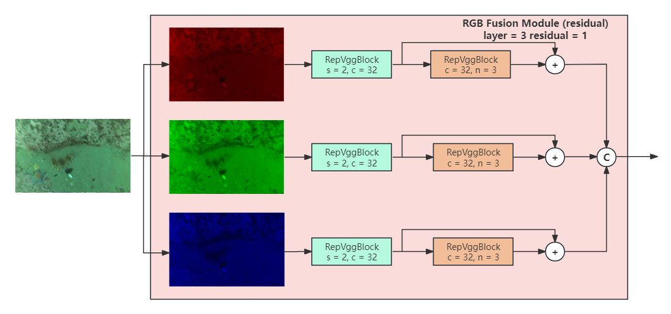

Slide 11
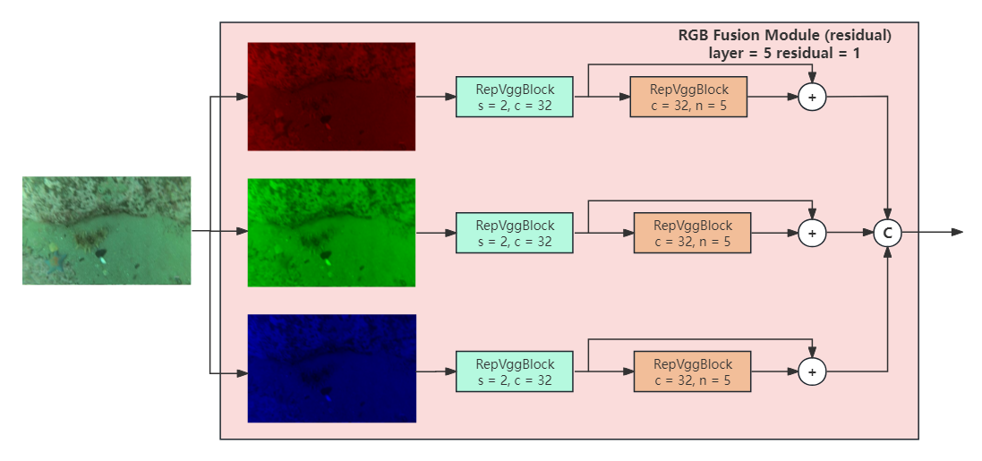

Slide 12
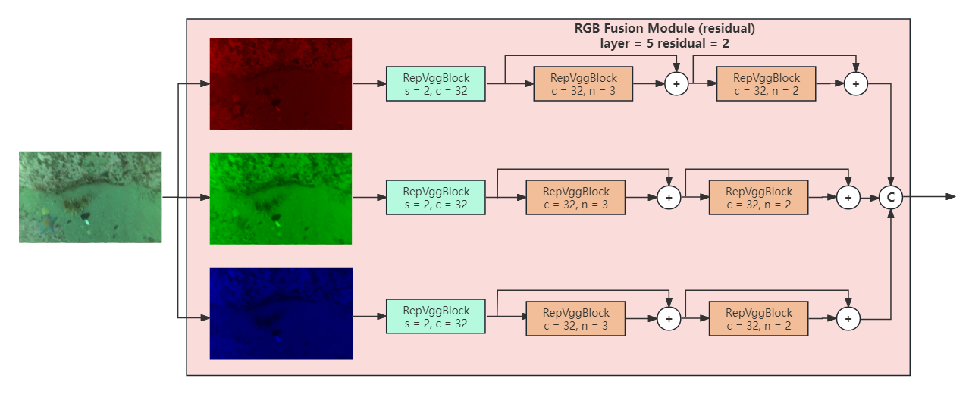

Slide 13
数据集：DUO epoch：400
Methods | AP | AP₅₀ | holothurian | echinus | scallp | starfish | Params
Gold-YOLO | 64.9 | 84.2 | 64.5 | 72.7 | 48.7 | 73.5 | 21.51M
+RFM(residual) layer=3 residual=1 | 66.2 (+1.3) | 85.1 (+0.9) | 66.5 (+2.0) | 73.5 (+0.8) | 50.0 (+1.3) | 74.7 (+1.2) | 21.63M
+RFM(residual) layer=5 residual=1 | 66.5 (+1.6) | 85.2 (+1.0) | 67.1 (+2.6) | 73.5 (+0.8) | 50.0 (+1.3) | 75.3 (+1.8) | 21.68M
+RFM(residual) layer=5 residual=2 | 66.5 (+1.6) | 85.3 (+1.1) | 67.0 (+2.5) | 73.6 (+0.9) | 50.6 (+1.9) | 74.6 (+1.1) | 21.68M

Slide 14
在其他数据集上的效果：
数据集：UODD 训练集：2688 测试集：506 epoch：250
Methods | AP | AP₅₀ | holothurian | echinus | scallp | Params
Gold-YOLO | 51.6 | 89.9 | 43.1 | 53.9 | 57.9 | 21.51M
+RFM(sigmoid) | 52.0 (+0.4) | 90.2 (+0.3) | 44.0 (+0.9) | 53.6 (-0.3) | 58.4 (+0.5) | 21.65M (+0.14)
数据集：URPC2020 训练集：5543 测试集：800 epoch：350
Methods | AP | AP₅₀ | holothurian | echinus | scallp | starfish | Params
Gold-YOLO | 40.3 | 72.1 | 41.0 | 41.6 | 45.8 | 32.7 | 21.51M
+RFM(r) | 42.4 (+2.1) | 75.4 (+3.3) | 43.1 (+2.1) | 45.0 (+3.4) | 47.3 (+1.5) | 34.1 (+1.4) | 21.63M

Slide 15
在其他模型上的效果：
数据集：DUO epoch：400
Methods | AP | AP₅₀ | holothurian | echinus | scallp | starfish | Params
YOLOv6 | 64.6 | 83.9 | 64.7 | 72.6 | 47.2 | 73.8 | 20.11M
YOLOv6+RFM(r) | 66.0 (+1.4) | 85.0 (+1.1) | 65.8 (+1.1) | 72.9 (+0.3) | 50.6 (+3.4) | 74.5 (+0.7) | 20.24M
YOLOv8 | 69.0 | 85.9 | 68.7 | 76.6 | 52.9 | 78.1 | 21.5M
YOLOv8+FRM(r)【conv】 | 69.4 | 86.5 | 69.0 | 76.5 | 54.2 | 77.9
YOLOv8+FRM(r)【RepVGGBlock】 | 69.4 (+0.4) | 86.4 (+0.5) | 69.9 (+1.2) | 76.3 (-0.3) | 53.5 (+0.6) | 78 (-0.1) | 21.8M

