Slide 1



BUILD FOR THE MODERN TRAVELER
Traventure
An AI-Powered Smart Travel Planning Platform
One conversation. Every travel decision — destinations, weather, food, and routes — brought together in a single AI-first assistant.
traventure-4m5a.onrender.com
github.com/Rosalia-06/Traventure
TRAVENTURE
1

Slide 2




THE PROBLEM
Trip planning is scattered across too many tabs
Planning a trip today means bouncing between five or six different platforms — and every extra tab adds friction, inconsistency, and wasted time.
Information Overload
Wasted Time
A traveler typically has to:
Too many sources, too little clarity.
Hours lost cross-checking platforms.
Search destinations
Check weather forecasts
Find tourist attractions
Inconsistent Advice
No Personalization
Discover nearby restaurants
Recommendations that don't line up.
One-size-fits-all suggestions.
Plan travel routes
Ask travel questions, one site at a time
Most travel platforms specialize in one slice of the journey — none plan the whole trip with you.
TRAVENTURE
2

Slide 3





THE SOLUTION
One AI travel companion, instead of six browser tabs
Traventure centralizes travel planning behind a single conversational AI assistant — users describe what they need, and the platform organizes the rest.
AI Chatbot Interaction
Destination Recommendations
Weather Information
Natural-language travel assistant users can ask anything
Suggestions based on traveler interests
Forecasts that inform smarter planning
Tourist Attractions
Restaurant Suggestions
Route Guidance
Curated highlights for chosen destinations
Nearby food discovery while planning
Help identifying suitable travel routes
TRAVENTURE
3

Slide 4
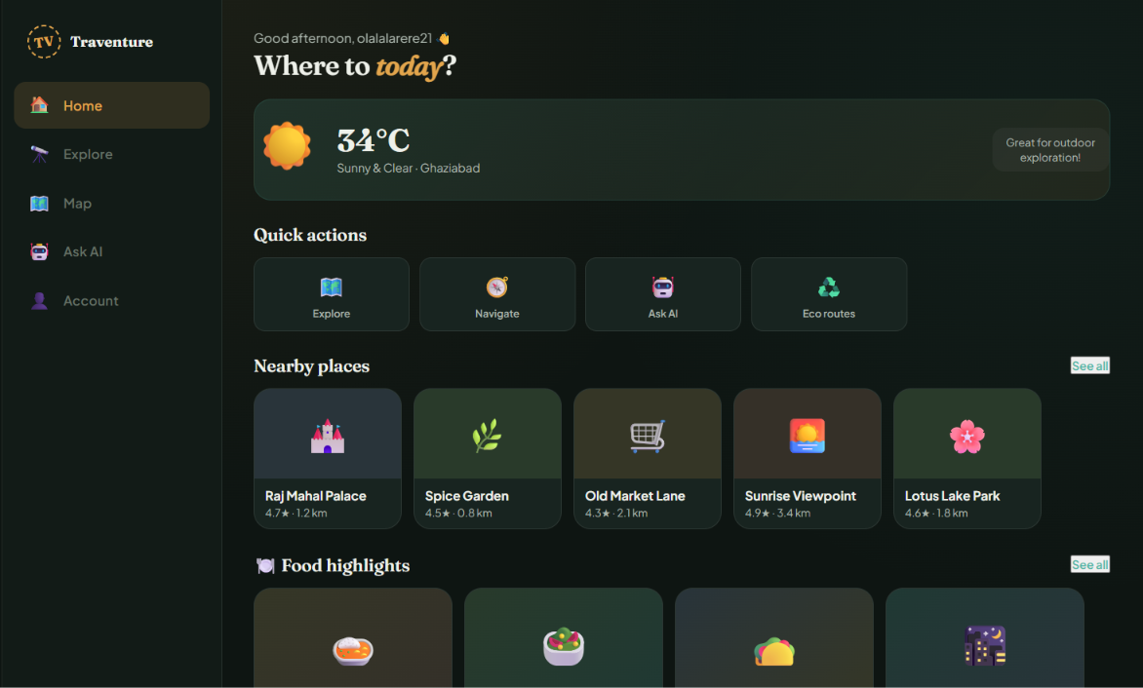
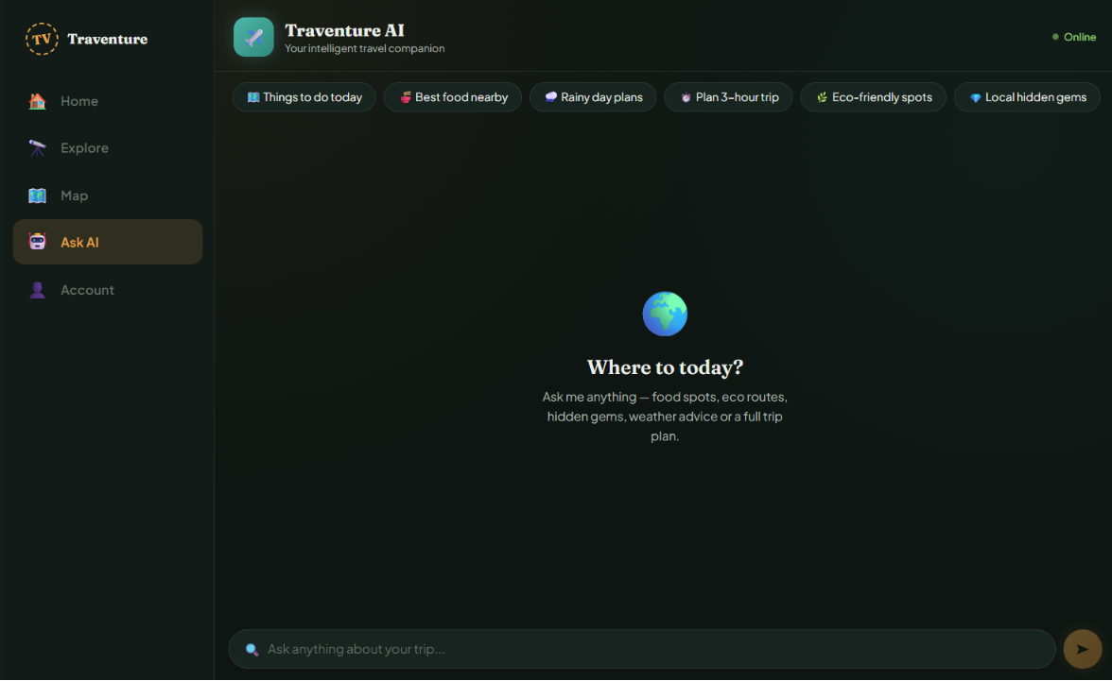
SEE IT LIVE
Not a mock-up — the actual product
Live screens pulled directly from traventure-4m5a.onrender.com, no placeholders.
HOME — SMART DASHBOARD
ASK AI — TRAVEL CHATBOT
Greets the traveler, pulls live weather for their city, and ranks nearby places & food by real ratings and distance.
An easy-to-use AI/ML travel bot — tap a quick prompt or type naturally, and it plans the trip on the spot.
Two screens, one goal: replace six browser tabs with a single conversation.
TRAVENTURE
4

Slide 5
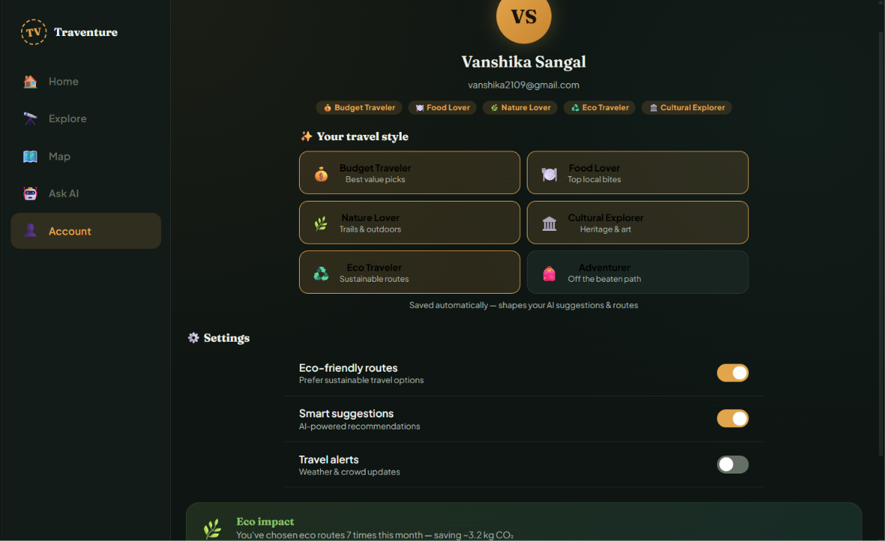
PERSONALIZATION
Every recommendation adapts to the traveler
The Account screen shows how stated preferences quietly reshape suggestions everywhere else in the app.
ACCOUNT — TRAVEL STYLE & IMPACT
Travel-style tags
Budget Traveler, Food Lover, Nature Lover, Eco Traveler and more feed straight into the AI's suggestions.
Eco impact tracking
Real usage stats — like eco-routes chosen and CO₂ saved — keep sustainable choices visible, not abstract.
Smart suggestions, on your terms
Toggles for smart suggestions and travel alerts let each traveler control how much AI personalization they want.
Generic platforms give one-size-fits-all suggestions — Traventure listens, and adapts.
TRAVENTURE
5

Slide 6

DOMAIN & AUDIENCE
Where Traventure fits, and who it's built for
DOMAIN / SECTOR
TARGET USERS
Travel Technology (TravelTech)
Solo travelers
Students
Artificial Intelligence
Families
Tourists
Tourism
Web Application Development
Backpackers
Vacation planners
Smart Travel Assistance
First-time travelers
Frequent travelers
Traventure sits at the intersection of TravelTech and applied AI — using a conversational assistant, not a search form, as the primary planning interface.
TRAVENTURE
6

Slide 7
UNDER THE HOOD
Tech stack & high-level architecture
BUILT NOW
HIGH-LEVEL ARCHITECTURE
React
Frontend framework
User
Vite
Build tool
React + Vite Frontend
JavaScript
Core language
Deployed on Render
CSS
Custom styling
Node.js + Express Backend
Planned
PLANNED
Node.js + Express (backend)
MongoDB
External APIs
MongoDB Atlas (database)
Database · Planned
Weather · Maps · Places · AI
Open-Meteo API (weather)
OpenStreetMap / Overpass (places)
TRAVENTURE
7

Slide 8
THE PAYOFF
From hours of tab-switching to one focused session
Independent travel-industry research shows how much time typical planning takes — and why one AI conversation changes that math.
THE OLD WAY
WITH TRAVENTURE
10–18 hrs
20–45 min
Average time travelers spend researching and booking a trip across multiple sites and apps (Priceline/Harris Poll and GoCity/Talker Research surveys).
Traventure's target for a complete, personalized plan — destinations, weather, food and routes — in a single conversation.
Budget-aware suggestions tuned to travel-style tags like Budget Traveler and Food Lover
Nearby places & food ranked by real ratings (4.3★–4.9★) and distance, not guesswork
One AI chat replaces manual research across six-plus browser tabs
All-in-one place to plan your whole trip in minutes
Less time spent searching means more time actually traveling.
TRAVENTURE
8

Slide 9
WHERE WE ARE
Current progress — real, not padded
Frontend and deployment are live today. Backend, AI integration, and live data are the next milestones.
✓ COMPLETED
→ IN PROGRESS / PLANNED
Project idea finalized
Backend development (Node/Express)
UI / UX designed
AI integration via backend API
React frontend developed
Database connectivity (MongoDB)
User authentication
AI chatbot interface implemented
Live weather & places API integration
Responsive design completed
Dynamic travel recommendations
Deployed successfully on Render
Route optimization
GitHub repository created & maintained
Saved trips & user profiles
TRAVENTURE
9

Slide 10

PROOF OF DEVELOPMENT
It's live — see it for yourself
traventure-4m5a.onrender.com
GitHub Repository
Rosalia-06/Traventure
React + Vite codebase, public and actively maintained — 98.6% JavaScript.
WHY IT MATTERS
Live AI Travel Assistant UI
Travel planning should be simple, not stressful. Traventure's AI-first, unified approach — one assistant instead of six tabs — is what makes it worth building further.
Deployed, responsive, and reachable at the link below — not a mockup.
Visit → traventure-4m5a.onrender.com
Thank you.
TRAVENTURE
10

