Slide 1
Student Academic
Performance Prediction
Using Machine Learning
Machine Learning (CRN 21633 ) | 2026
Chukwunonyelum Rosalyn Ezeako
Kavya Kalidindi
Ruyi Gai
Supervisor: Dr. Yu Luo
Student Data
ML Classification
Academic Performance
Early Warning

Slide 2
The Problem: Early Signals, Late Intervention
Background & Motivation
Background & Key Statistics
~40% of college students do not complete their degree on time (National Center for Education Statistics)
Education outcomes are influenced by multiple factors, including study habits, attendance, and family background
Predicting student academic performance remains complex due to these interacting variables
Machine learning enables the analysis of these patterns to support data-driven decision-making
Related Work
Cortez & Silva (2008) applied data mining techniques to predict student performance using the Student Performance Dataset
Their study demonstrated that prior academic performance and study-related factors strongly influence final outcomes
This work serves as a foundation for applying machine learning to early academic risk detection
Concepts
Machine Learning: learning patterns from data to make predictions
Supervised Learning: training models using labeled data
Classification: predicting categories such as pass/fail
Features & Target: input variables and predicted outcome
Problem Statement
Predict student academic performance using machine learning
Identify students at risk of failure early
Enable timely intervention to improve outcomes

Slide 3
System Workflow
Project Outline
1
2
3
4
5
3
DATA COLLECTION
& CLEANING
FEATURE ENGINEERING
TRAIN TEST SPLIT
MODEL TRAINING
DECISION SUPPORT
Student dataset containing demographic, academic, and behavioral features. Data was checked for missing values, consistency, and correctness.
Categorical variables encoded using One-Hot Encoding.
Features prepared and structured for machine learning models.
Dataset split into training and testing sets.
5-fold cross-validation applied for reliable and unbiased evaluation.
Multiple machine learning models were trained, including Logistic Regression, Decision Tree, and Random Forest, to learn patterns in students’ performance.
Model predictions used to identify at-risk students and provide early-warning insights for academic intervention.
Closing the Gap Between Complex Data Analysis and Timely Human Action

Slide 4
Data Overview: Student Performance Data
Data & Features
Student Data
Kaggle Student Performance Dataset; based on Cortez & Silva (2008)
Dataset Name
Dataset Source
395
33
Target
CSV
Format
Observations/rows
collected from two Portuguese secondary schools
Features/Columns
Demographic, academic & behavioral
Binary target G3
converted to Pass / Fail
age - Student's age
sex - Gender
address - Urban or rural home
famsize - Family size
Pstatus - Parents living together or apart
Medu / Fedu - Mother’s/ Father's edu level
Mjob / Fjob - Mother’s/ Father’s job
famrel - Quality of family relationships
guardian - Who the student lives with
nursery - Attended nursery school
reason - Reason for choosing this school
traveltime - Home to school travel time
G1 - First period grade
G2 - Second period grade
failures – No. of past class failures
studytime - Weekly study time
schoolsup - Extra edu support from school
famsup - Family edu support
paid - Extra paid tutoring
higher - Wants to pursue higher edu
absences - No. of school absences
goout - Freq of going out with friends
freetime - Free time after school
activities - Extracurricular activities
romantic - In a romantic relation
internet - Internet access at home
Dalc - Workday alcohol consumption
Walc - Weekend alcohol consumption
health - Current health status
Demographics & Family
Academic Performance
Behavioral & Lifestyle

Slide 5
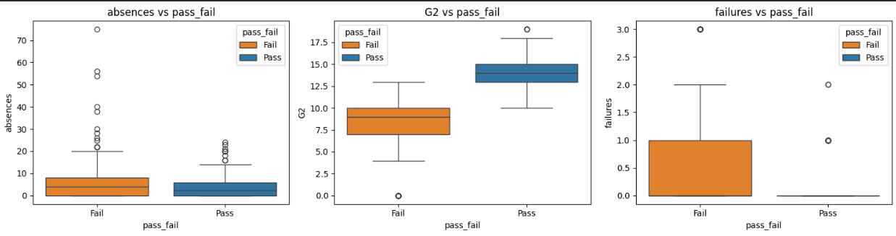
Data Cleaning
Data Quality Assessment
MISSING VALUES & ERRORS
OUTLIERS
Dataset contained no missing values
No imputation or removal was required
Data types were verified for correctness
No inconsistencies or invalid entries were found
Outliers were identified using statistical methods
These values were retained, as they represent real student behavior
Removing them could distort real-world patterns
Figure 1: Feature Distributions and Outliers Across Pass/Fail Outcomes

Slide 6
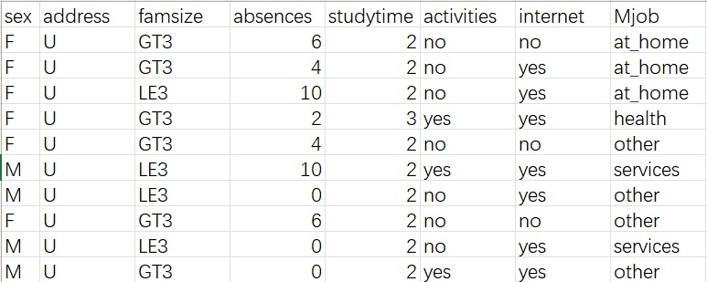
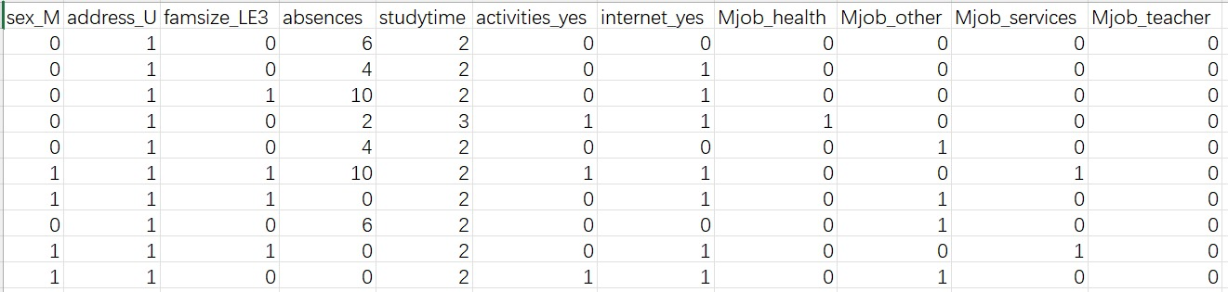
Modeling
Modeling Approach
Data Preprocessing
Data Split
Methodology
Supervised Binary Classification: Predicting student outcomes - Pass / Fail
Model Comparison: Logistic Regression, Decision Tree, Random Forest
Fair Evaluation Strategy: Same preprocessing, 5-fold cross-validation, and metrics
Evaluation Metrics: Accuracy, Precision, Recall, F1 Score
One-Hot Encoding with get_dummies()
Converted categorical text variables into 0/1
Used drop_first=True to reduce redundancy
Created pass_fail from G3/label_y (>=12, Pass)
Used 5-fold cross-validation
4-folds for training, 1-fold for testing
Repeated 5 times for reliable evaluation
More stable than a single train-test split
Raw data
Turning student data into meaningful signals
…
Encoded data
…

Slide 7
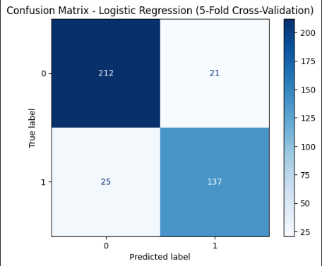
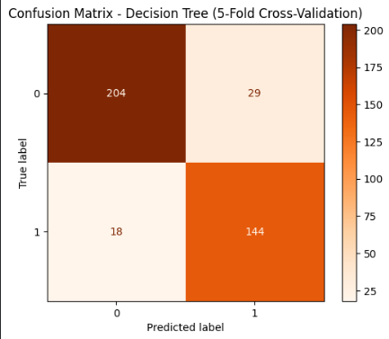
Modeling
5-Fold Cross-Validation
Logistic Regression — Baseline classification model
Decision Tree — Rule-Based Classification Model
Simple, efficient, and easy to interpret
Used StandardScaler before training
Mean Accuracy: 88.4% (349 / 395 students correctly classified)
Key issue: 21 actual Fail students predicted as Pass
Overall: Good performance, but as a linear model, LR may miss complex nonlinear patterns
Learns decision rules using feature thresholds
Captures nonlinear relationships and feature interactions
No StandardScaler needed (feature split threshold)
Mean Accuracy: 88.1% (348 / 395 students correctly classified)
Key issue: 29 actual Fail students predicted as Pass
Overall: Good performance, but slightly more errors and less stable than Random Forest
Figure 2: Logistic Regression Confusion Matrix
Figure 3: Decision Tree Confusion Matrix

Slide 8
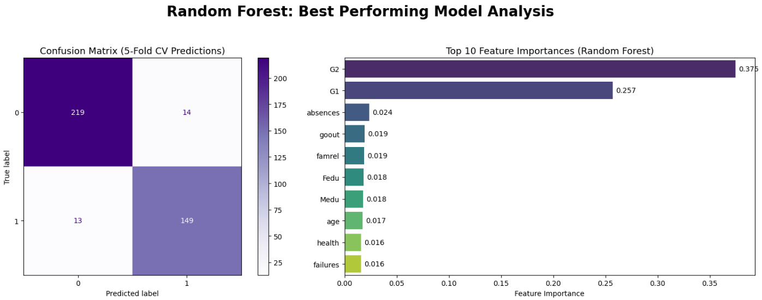
Random Forest: 93.2% Overall Accuracy
Best Model Analysis
How it was obtained
• Ensemble model composed of multiple Decision Trees
• Uses majority voting to obtain the final prediction
• More stable and helping reduce overfitting
• Don’t require StandardScaler (feature split thresholds)
93.2%
~93%
Overall Accuracy
Recall (At-Risk Students)★
~94 - 95%
~94%
Precision
F1 Score
★ Critical for Early Warning
Figure 4: Feature Importances for Random Forest
• Achieved the best overall performance: 93.2% accuracy
• Reduced both false positives and false negatives
• Capture more complex relationships among students’ academic history, behavioral features, and family background
• Help identify at-risk students earlier for provide timely intervention
Used the feature_importances_ attribute in the Random Forest model to analyze feature importance. The results show that G2 and G1 are the most important predictors. Other factors, such as absences, family relationships, and parents’ education levels, also had some influence on the prediction results.

Slide 9
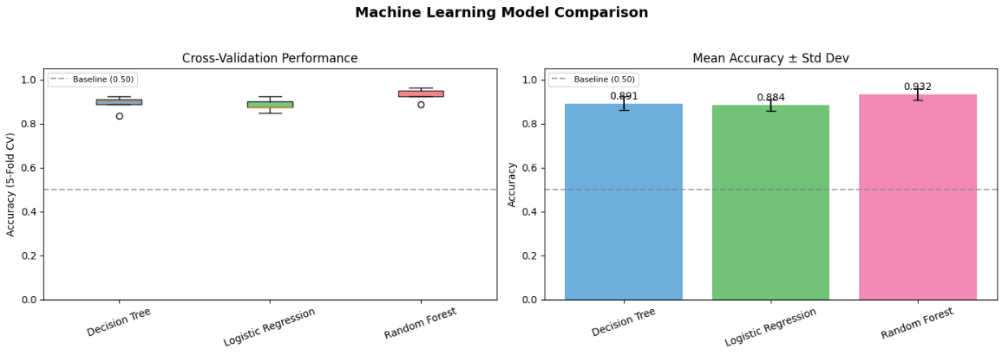
Which Model Works Best? Comparative Evaluation
Experiment/Comparison
How it was obtained
• Compare the three models
• Used 5-fold cross-validation to obtain the accuracy of each fold
• Calculated the Mean Accuracy and Standard Deviation
Model | Mean Accuracy | Std Dev
Random Forest ⭐ | 0.932 | ±0.026
Logistic Regression | 0.884 | ±0.025
Decision Tree | 0.881 | ±0.023
Key Insight
Figure 5: 5-fold cross-validation comparison across three ML models
Random Forest has the highest Mean Accuracy, and its standard deviation is close to the other models. This indicates that it performs relatively stably across different data splits and has the best overall performance.
Visualization Summary
The boxplot shows the accuracy distribution of the three models across the five folds, while the bar chart shows the mean accuracy and standard deviation of each model. The dashed baseline 0.50 represents the random guessing level. All three models performed clearly above this baseline, which means they learned useful patterns from the data.

Slide 10
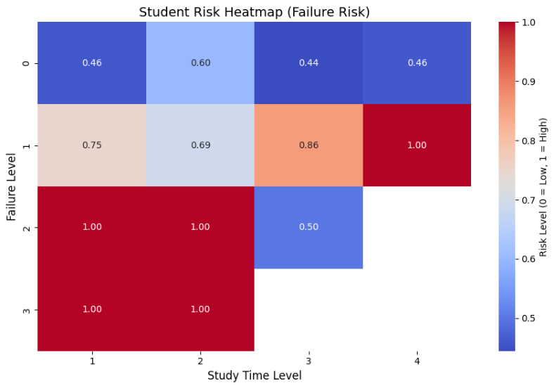
Student Risk Pattern
Insights & Analysis
How it was obtained
Heatmap created using grouped averages of student failure risk across study time levels and prior failure history. Values represent probability of academic risk (0 = Low, 1 = High).
Key Insights
Study Time → Lower Risk
Higher study time reduces the risk of failure but does not completely eliminate it for students with prior failures.
Failure History Matters
Students with previous failures consistently show higher risk, even at higher study levels.
Critical Observation
The highest-risk group is students with low study time and high failure history, indicating compounding academic risk factors.
Figure 6: Failure risk heatmap

Slide 11
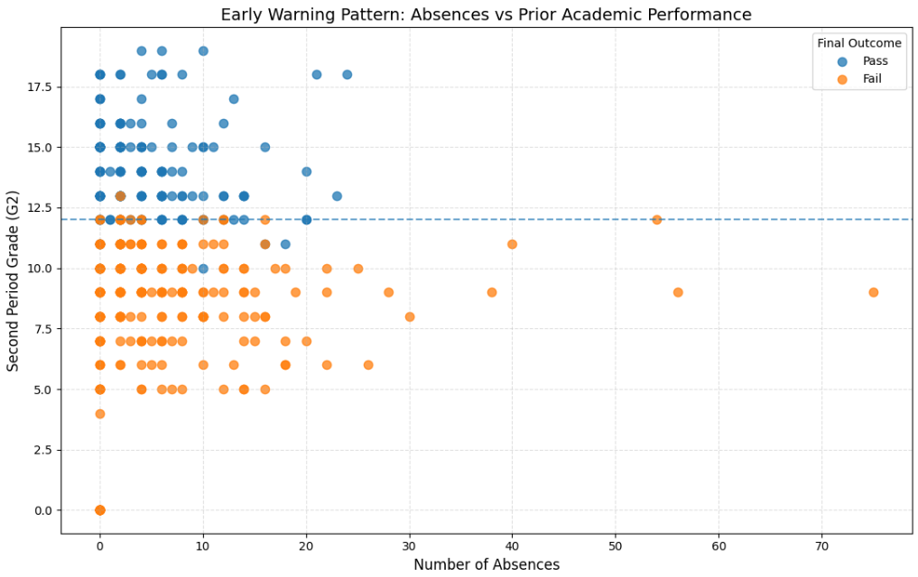
Early Warning Signal:
Absences vs Academic Performance
Insights & Analysis
How it was obtained
Scatter plot of student absences against second-period grades (G2), colored by final outcome (Pass/Fail).
Key Insights
Absences → Risk
Higher number of absences is strongly associated with lower academic performance and an increased likelihood of failure.
Performance Threshold
A clear boundary exists around G2 ≈ 12 — students below this threshold are more likely to fail.
Early Intervention Opportunity
Students with rising absences and declining grades can be identified early for academic support.
→ The model identifies which students are at risk and which factors drive failure, enabling targeted academic intervention.
Figure 7: Early Warning Pattern

Slide 12
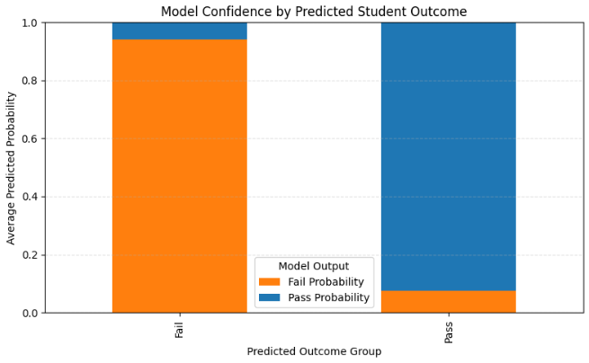
Model Confidence
In Predicting Student Outcomes
Insights & Analysis
How it was obtained
Model prediction probabilities were averaged across all students and grouped by predicted outcome (Pass vs Fail).
Key Insights
Strong Separation
The model assigns high probability to the correct class - Fail predictions show high failure probability, while Pass predictions show high success probability.
Low Ambiguity
Very little overlap between pass and fail probability distributions, indicating clear decision boundaries.
Reliability
This strong confidence separation indicates that the model has learned consistent patterns and makes reliable predictions, with minor uncertainty in borderline cases.
Figure 8: Model Confidence (Predicted Pass vs Fail Risk)
→ The model is confident overall, with slight uncertainty for students near the pass/fail boundary.

Slide 13
Conclusions
Key Findings
Limitations
Future Work
Random Forest achieved the highest performance (~93% accuracy), outperforming Logistic Regression, and Decision Tree
Class imbalance (more “Pass” than “Fail”) may affect detection of minority failure cases
Incorporate real-time student monitoring systems (attendance tracking, LMS activity)
Dataset limited to one student population, reducing generalizability to other schools or regions
Expand dataset across multiple schools or regions for better generalization
Academic history (G1, G2) are the strongest predictors of final student outcomes
Absences and behavioral factors (goout, studytime) significantly influence performance
Correlational analysis only - does not establish causation between factors and performance
Explore time-series models (LSTM) to track student performance trends over time
Students with prior failures show consistently higher risk, even with increased study time
Static dataset - lacks real-time academic tracking (e.g., weekly performance updates)
Integrate additional features (psychological, socio-economic, engagement metrics)
Model effectively captures non-linear relationships, making it suitable for early academic risk detection
Limited external factors (e.g., mental health, financial status, teaching quality not included)
Develop an early-warning dashboard for educators to intervene proactively
Cortez, P., & Silva, A. (2008). Using Data Mining to Predict Secondary School Student Performance. Proceedings of the 5th Future Business Technology Conference (FUBUTEC 2008).

