Slide 1
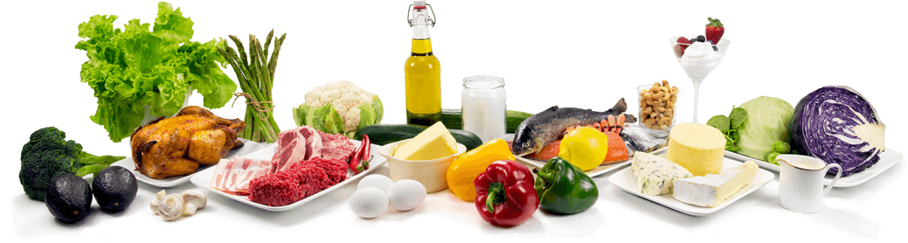
SpeechBasedGroceries
Enterprise Application Integration
Semester Project
Rosario, Tobias, Roman

Slide 2
Components

Slide 3
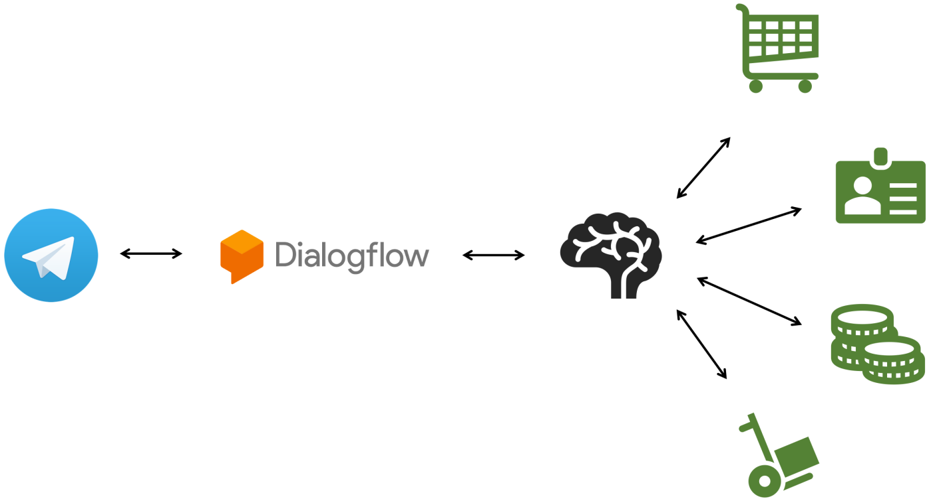

Slide 5
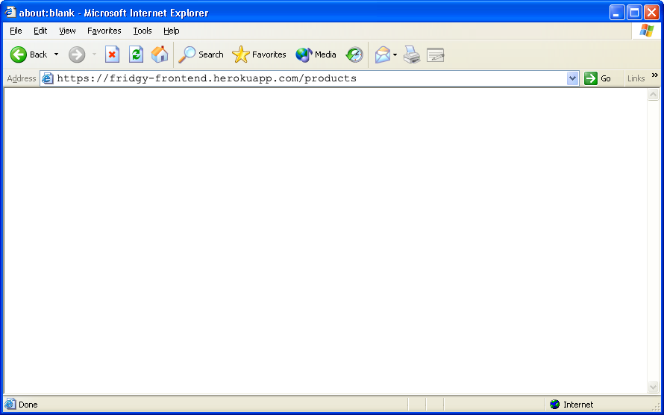
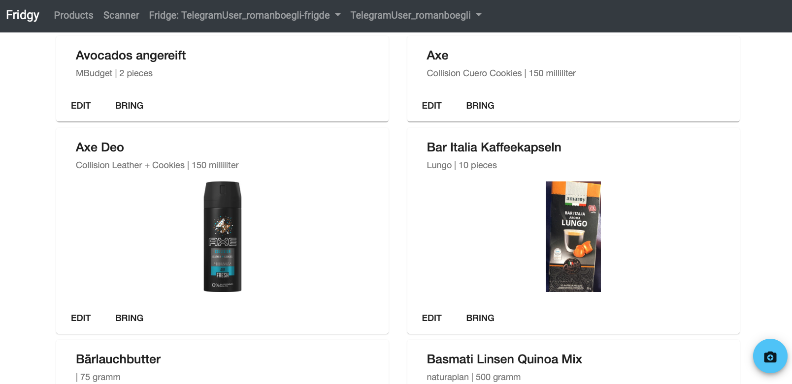

Slide 9
Interactions

Slide 10
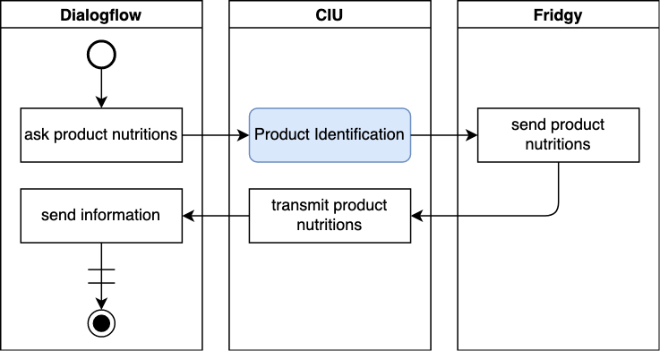
Querying Nutrition Facts

Slide 11
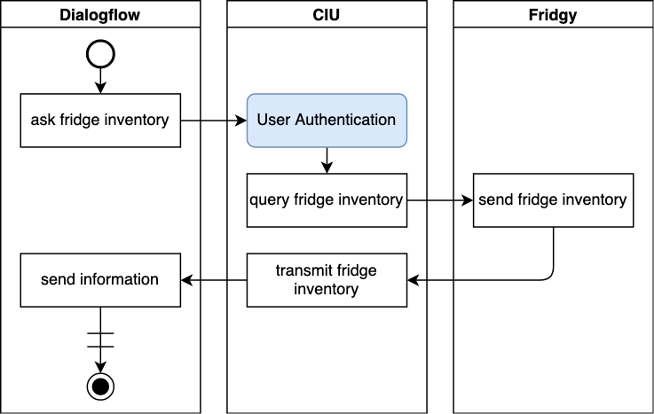
Querying Fridge Inventory

Slide 12
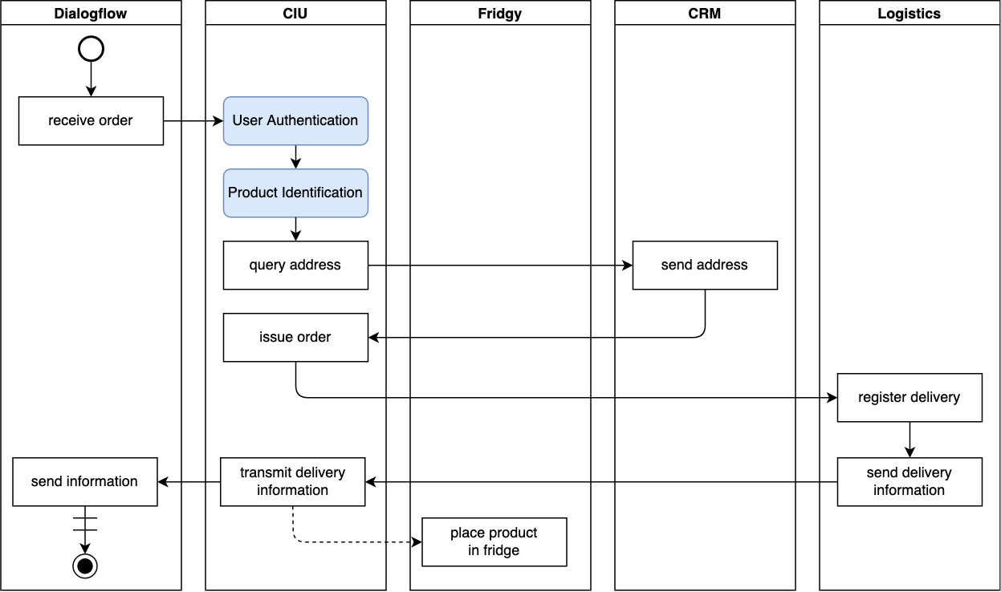
Ordering Food

Slide 13
Architecture

Slide 14

Different models
Customer
Customer
Customer
Customer

Slide 15
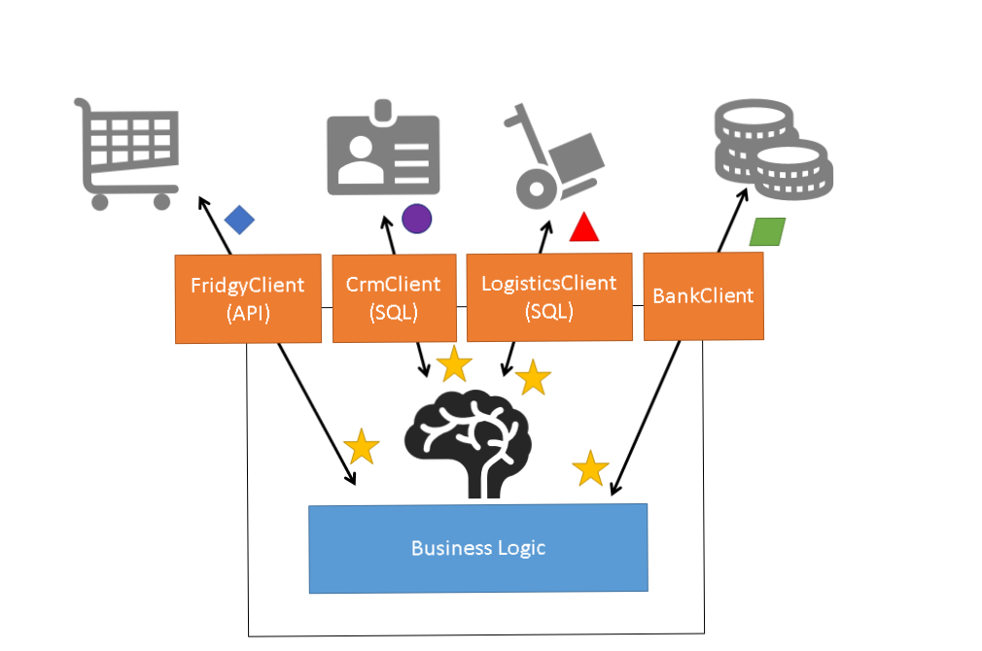
Clients

Slide 16



API Client
- Client
OpenAPI Specification

Slide 17
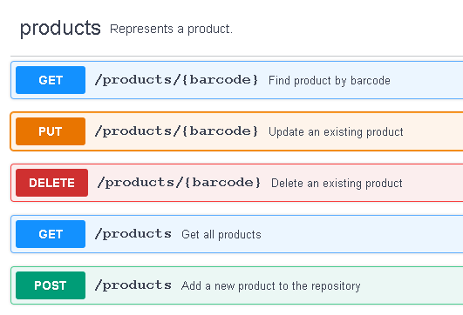
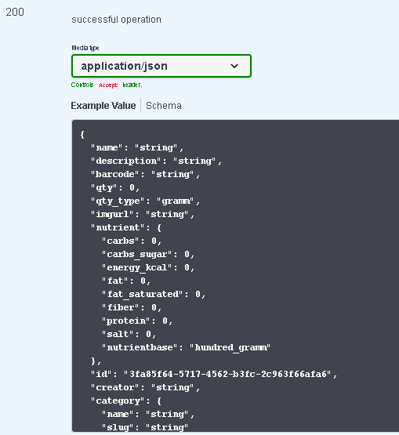
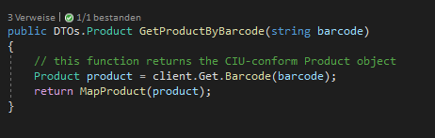
API Client - Example
MapProduct( )
> Returns

Slide 18
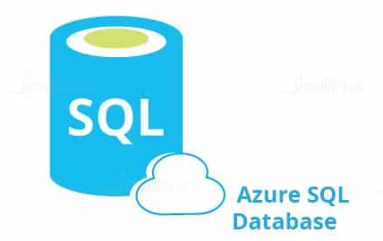
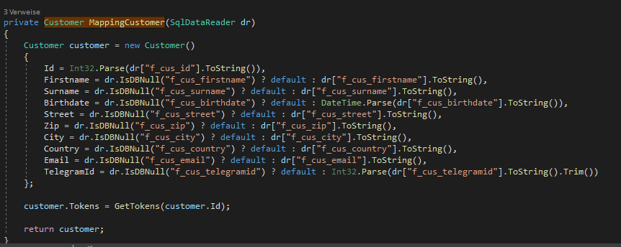
SQL Client
- Client

