Slide 1
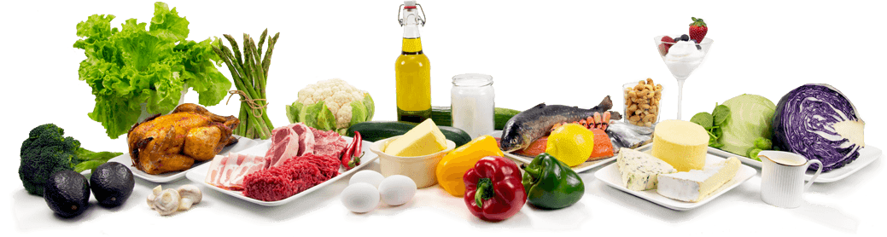
SpeechBasedGroceries
Enterprise Application Integration
Semester Project
Rosario, Tobias, Roman

Slide 2
Components

Slide 3
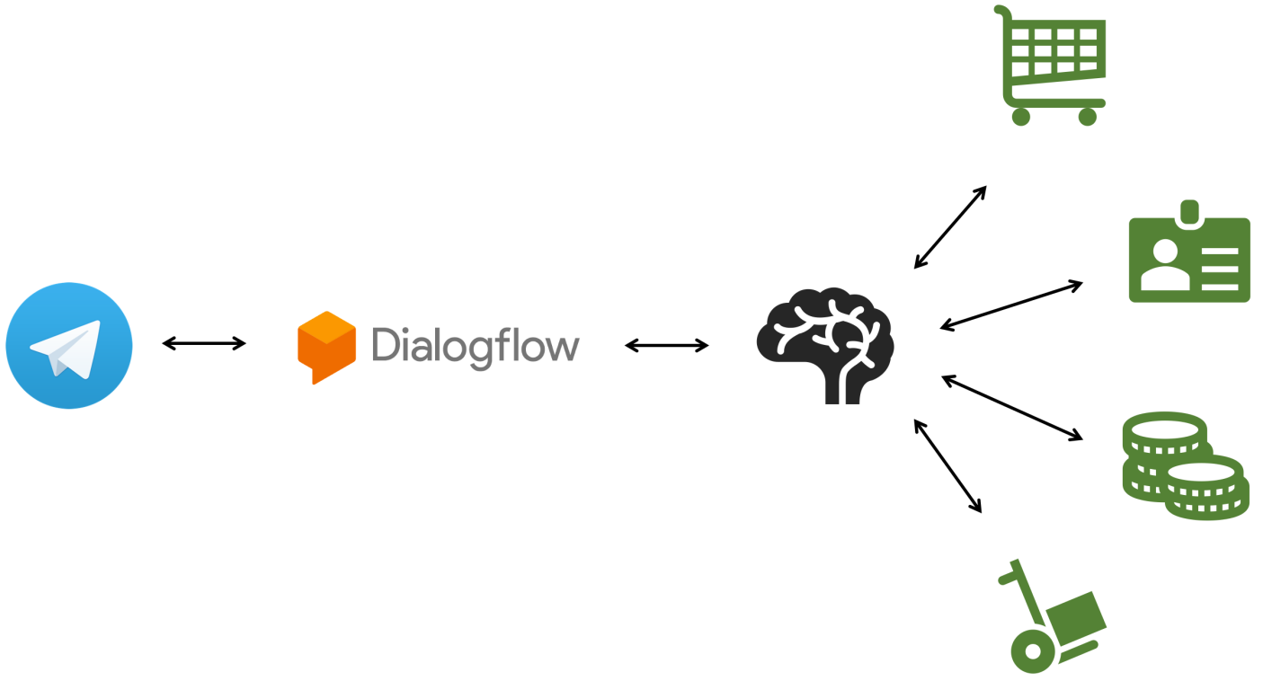

Slide 5
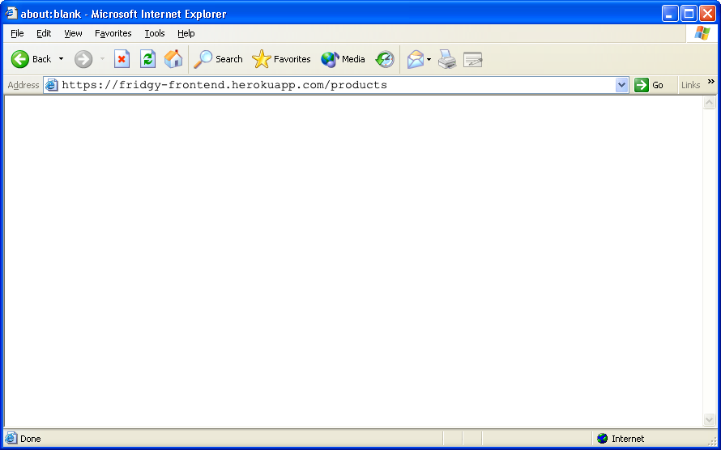
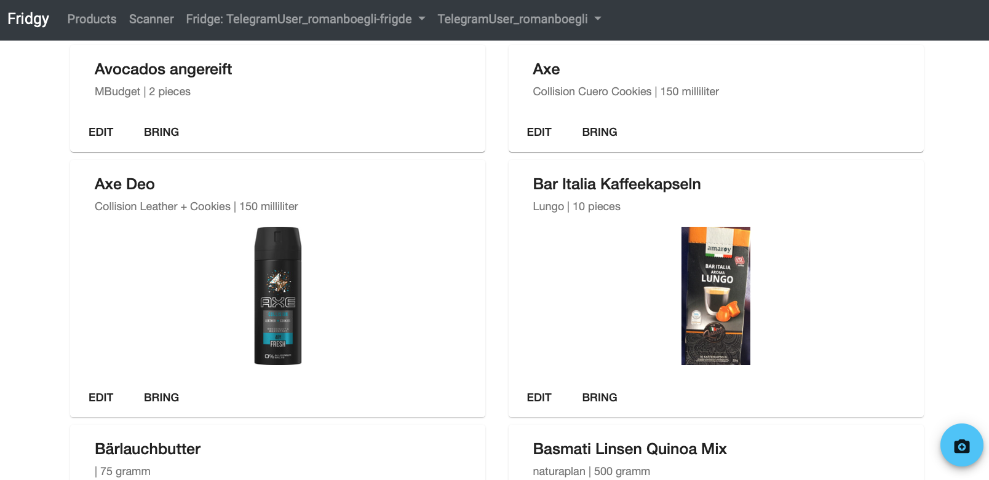

Slide 9
Interactions

Slide 10
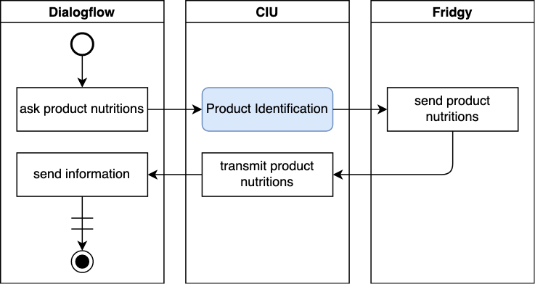
Querying Nutrition Facts

Slide 11
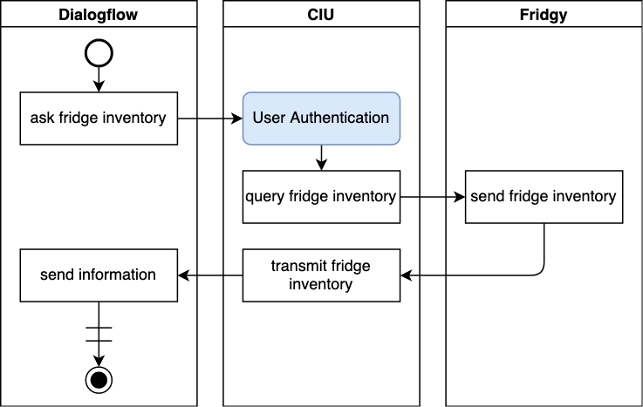
Querying Fridge Inventory

Slide 12
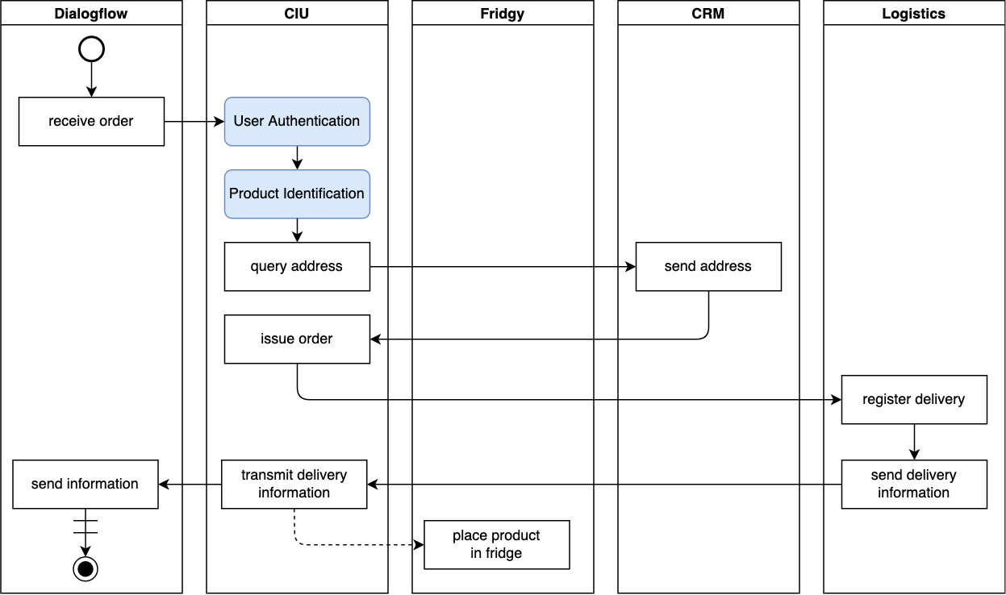
Ordering Food

Slide 13
Architecture

