Slide 1
A Copy-Augmented Generative Model for Open-Domain Question Answering
Shuang Liu¹, Dong Wang², Xiaoguang Li¹, Minghui Huang², Meizhen Ding²
¹ Huawei Noah’s Ark Lab
² AI Application Research Center (AARC), Huawei Technologies Co., Ltd
ACL 2022

Slide 2
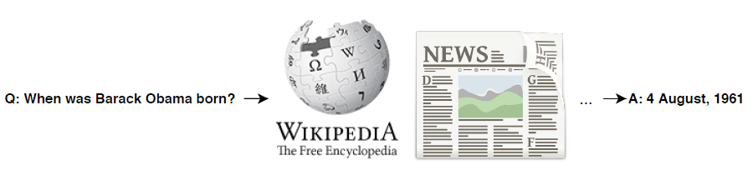
Open-Domain QA – Problem Setup
Open-Domain QA
Answering natural language factoid question from an open set of domains
Characteristics
Wikipedia as knowledge source
Factoid question answering
Short and concise answer
Textual QA
Datasets
NaturalQuestions [Kwiatkowski et al., 2019]
TriviaQA [Joshiet al., 2017]
Figure source: [Zhu et al., 2021]

Slide 3
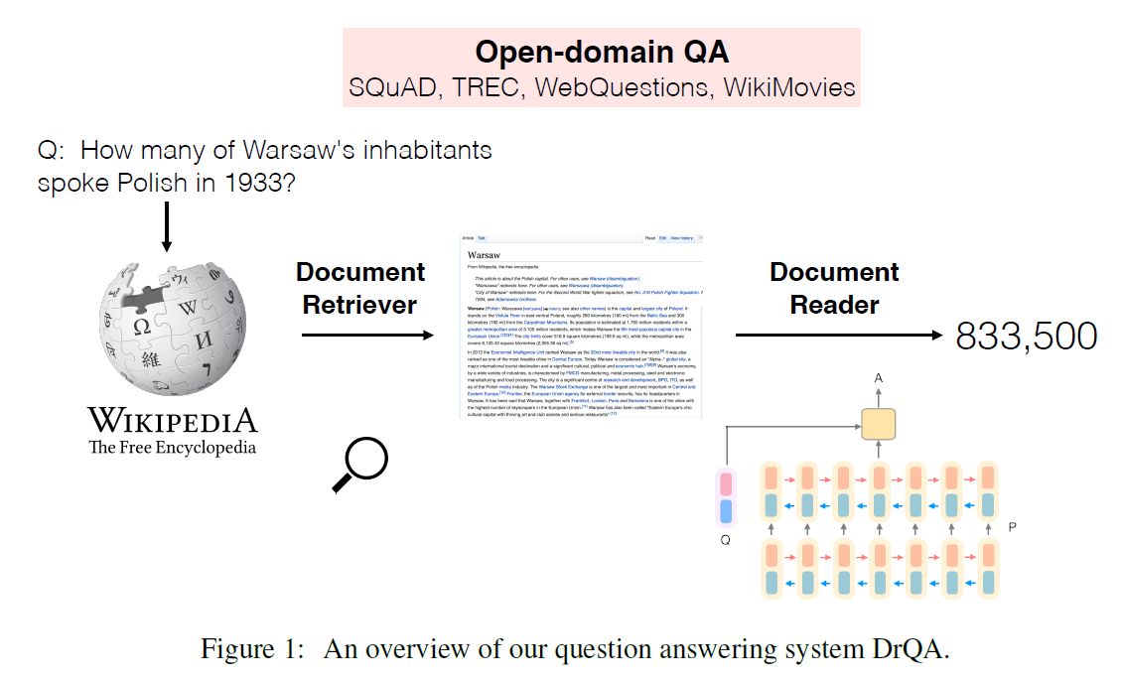
Open-Domain QA – Two-stage Approach
Retriever
Reader
Sparse
Dense
Extractive
Generative
TF-IDF
BM25
BERT
BERT
ELECTRA
BART
T5
GPT3
Figure source: [Chen et al., 2017]

Slide 4
Open-Domain QA – Two-stage Approach
Retriever
Reader
Sparse
Dense
Extractive
Generative
TF-IDF
BM25
BERT
BERT
ELECTRA
BART
T5
GPT3
Figure source: [Chen et al., 2017]

Slide 5
Open-Domain QA – Two-stage Approach
Retriever
Reader
Sparse
Dense
Extractive
Generative
TF-IDF
BM25
BERT
BERT
ELECTRA
BART
T5
GPT3
Figure source: [Chen et al., 2017]

Slide 6
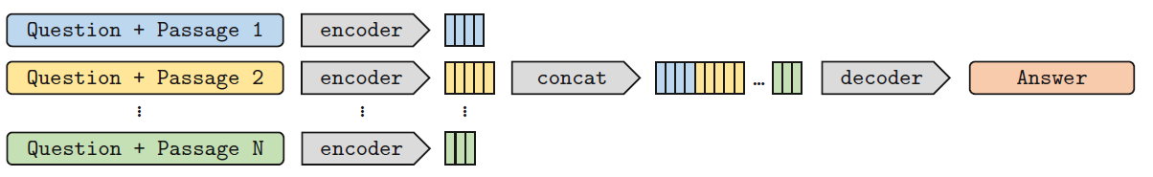
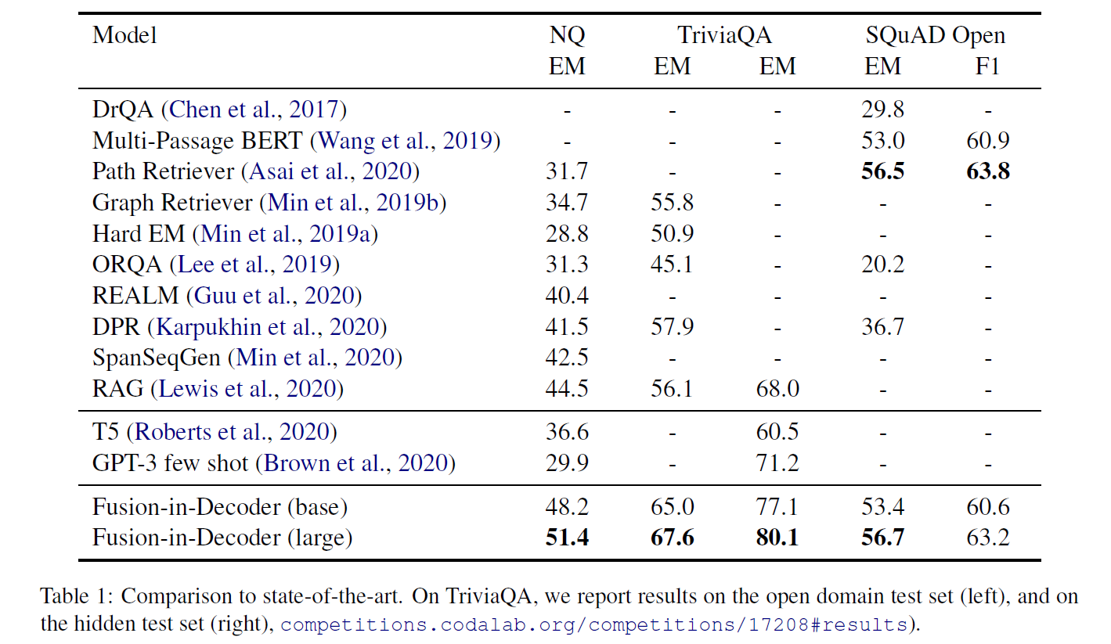
Related Work
FiD [Izacard et al., 2020a]
Fusion-in-Decoder
Retriever: DPR
Reader: T5
Generative model works well on aggregating evidence from multiple passages
[Izacard et al., 2020a]

Slide 7
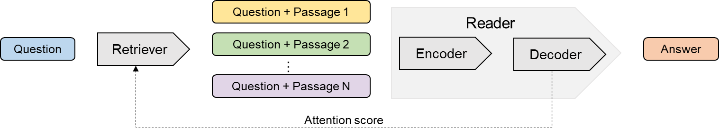
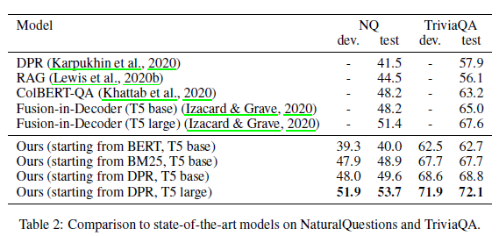
Related Work
FiD-KD [Izacard et al., 2020b]
Fusion-in-Decoder
Retriever: DPR
Reader: T5
Leverage attention scores of reader model as synthetic labels for retriever system
[Izacard et al., 2020b]

Slide 8
Related Work
Question + Passage 1
Reader
Question
Retriever
Question + Passage 2
Encoder
Decoder
Answer
…
Question + Passage N
Attention score
FiD-KD [Izacard et al., 2020]
Fusion-in-Decoder
Retriever: DPR
Reader: T5
Leverage attention scores of reader model as synthetic labels for retriever system

Slide 9
Motivation
Question: where was a hologram for the king filmed?
Title: A Hologram for the King (film)
Production was set to begin in first quarter of 2014. Principal photography commenced on March 6, 2014 in Morocco. Filming also took place in Hurghada in Egypt, as well as in Berlin and Düsseldorf in Germany. Shooting wrapped in June 2014.
Answer: Hurghada in Egypt, Berlin and Düsseldorf in Germany
FiD generated: Dubai in Germany

Slide 10
Motivation
Generative reader
Pros
Has the ability to generate answer that does not appear in retrieved passages
Integrates multi-passages information
Cons
Hallucination problem (generated text might be factually incorrect or not faithful to the input)
Out-of-vocabulary (OOV)
Extractive reader
Consistent with inputs
Can we combine the extractive and generative readers?

Slide 11
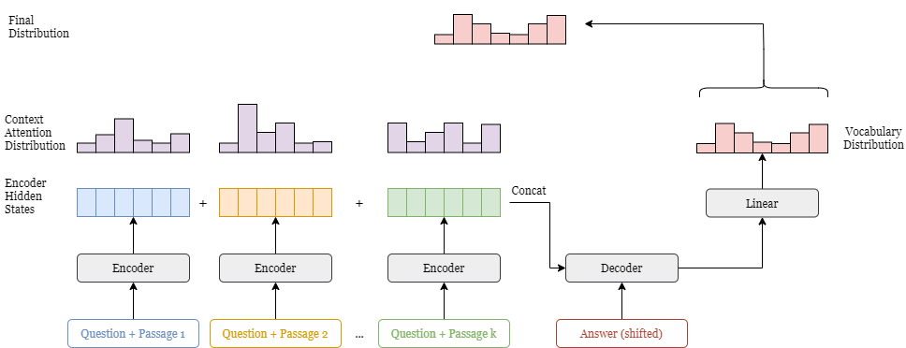
Model – FiD
Model architecture of FiD [Izacard et al., 2020]

Slide 12
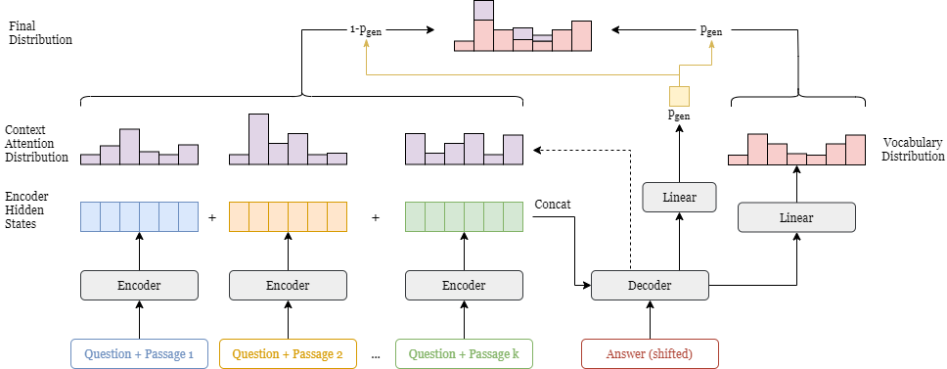
Model – Our Approach
Take advantages of attention scores to help to extract answers from passages
Adopt Pointer-generator network [See et al., 2017]

Slide 13


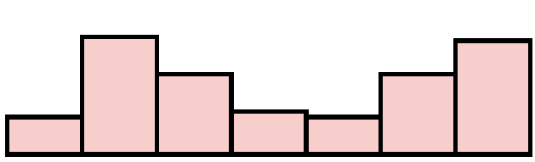



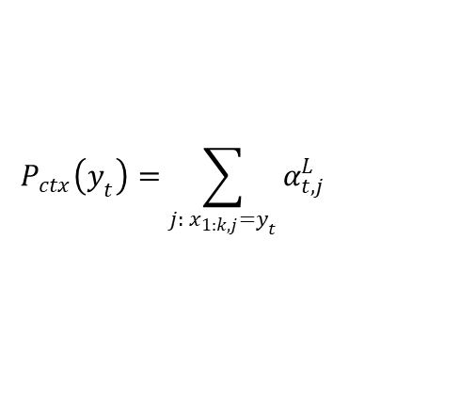

Model – Our Approach
Probability of $y_{t}$
$$P\left(y_{t}\right)=p_{gen}P_{vocab}\left(y_{t}\right)+\left(1−p_{gen}\right)P_{ctx}(y_{t})$$
$$p_{gen}=σ(w_{e}^{T}e_{t}+w_{s}^{T}s_{t}^{L}+b)$$
$$P_{vocab}\left(y_{t}\right)=softmax(W_{E}s_{t}^{L})$$
$$P_{ctx}\left(y_{t}\right)=\sum_{j:{ x}_{1:k,j}=y_{t}}{α_{t,j}^{L}}$$

Slide 14
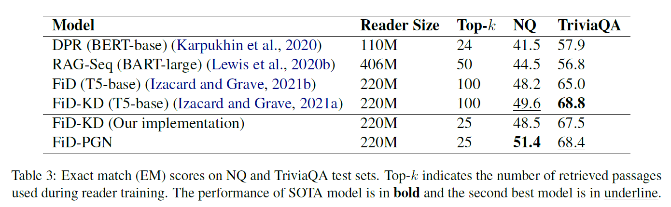
Experiments – Main Results
Exact Match (EM) accuracy on NQ and Trivia datasets
Achieve SOTA result on NQ and comparable result on Trivia using only ¼ of data as in FiD-KD
Pointer-generator helps to generate answer accurately from limited number of passages

Slide 15
Experiments – Main Results
Exact Match (EM) accuracy on NQ and Trivia datasets
Achieve SOTA result on NQ and comparable result on Trivia using only ¼ of data as in FiD-KD
Pointer-generator helps to generate answer accurately from limited number of passages

Slide 16
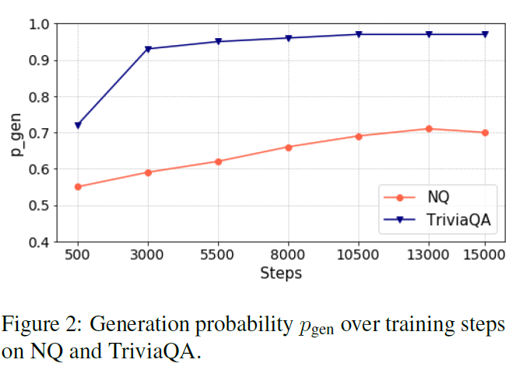
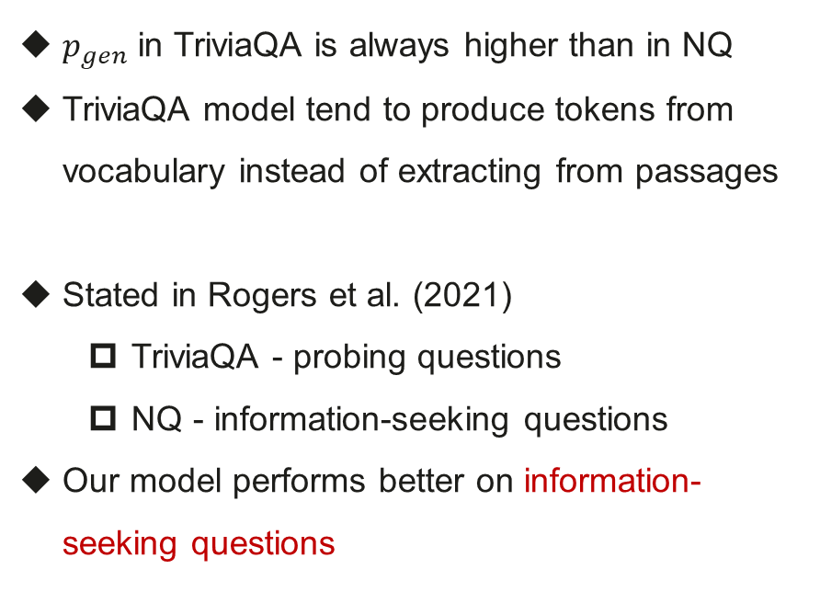
Experiments – Generation Probability
$p_{gen}$ in TriviaQA is always higher than in NQ
TriviaQA model tend to produce tokens from vocabulary instead of extracting from passages
Stated in Rogers et al. (2021)
TriviaQA - probing questions
NQ - information-seeking questions
Our model performs better on information-seeking questions

Slide 17
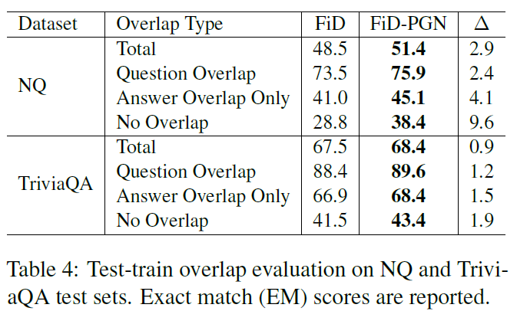
Experiments – Test-train Overlap
Our approach improves most over FiD reader on "No Overlap" category
Better generalization ability to question answering

Slide 18
Thanks!

