Slide 1
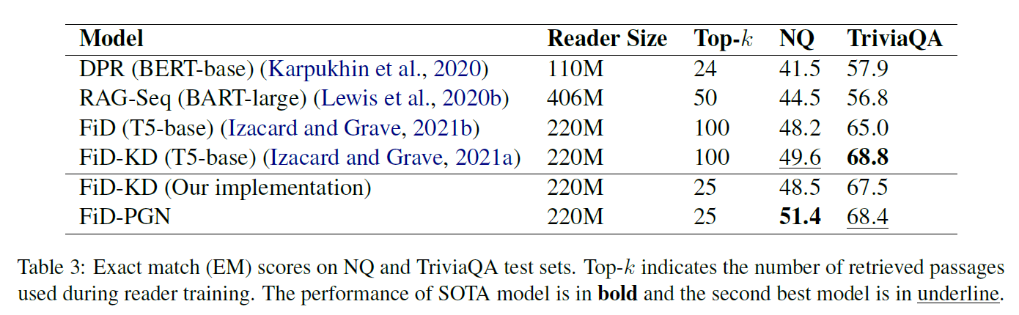
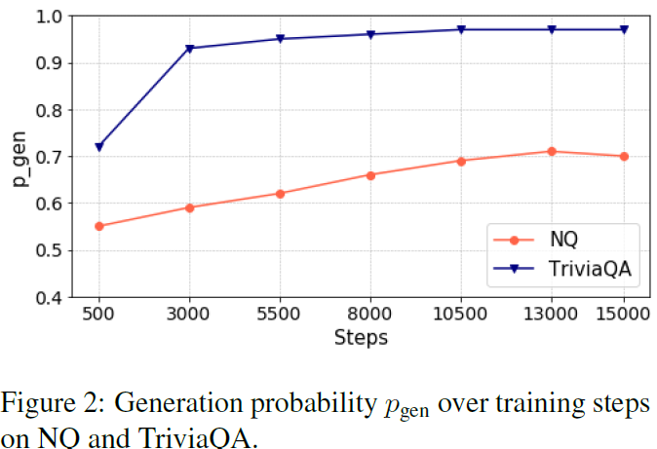
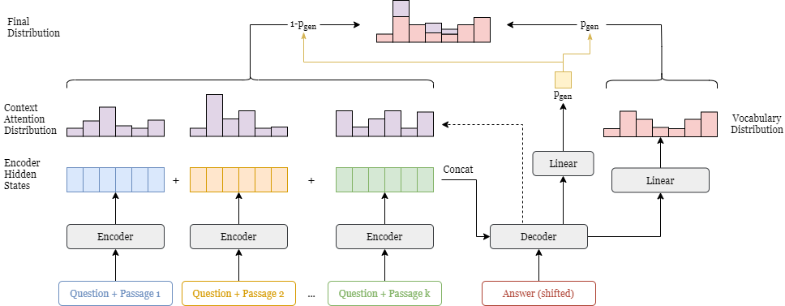
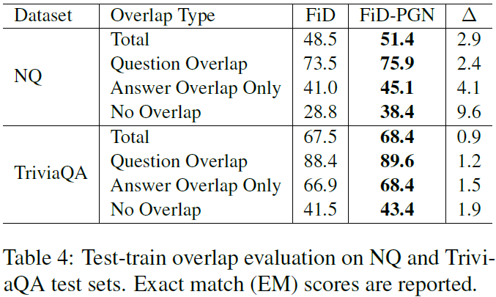
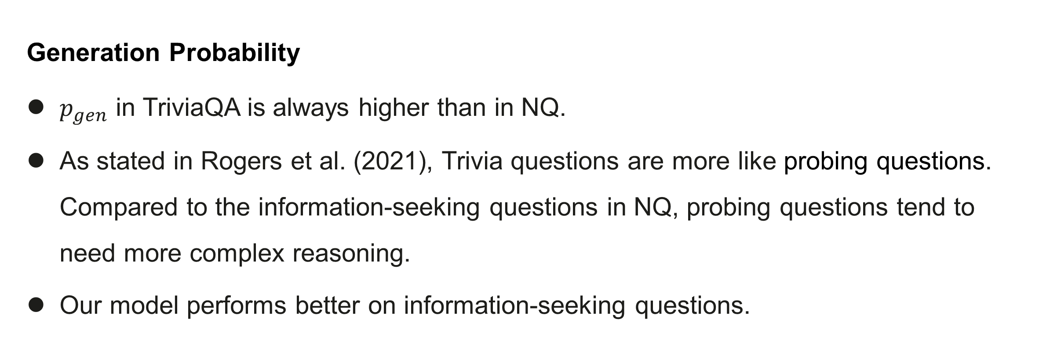
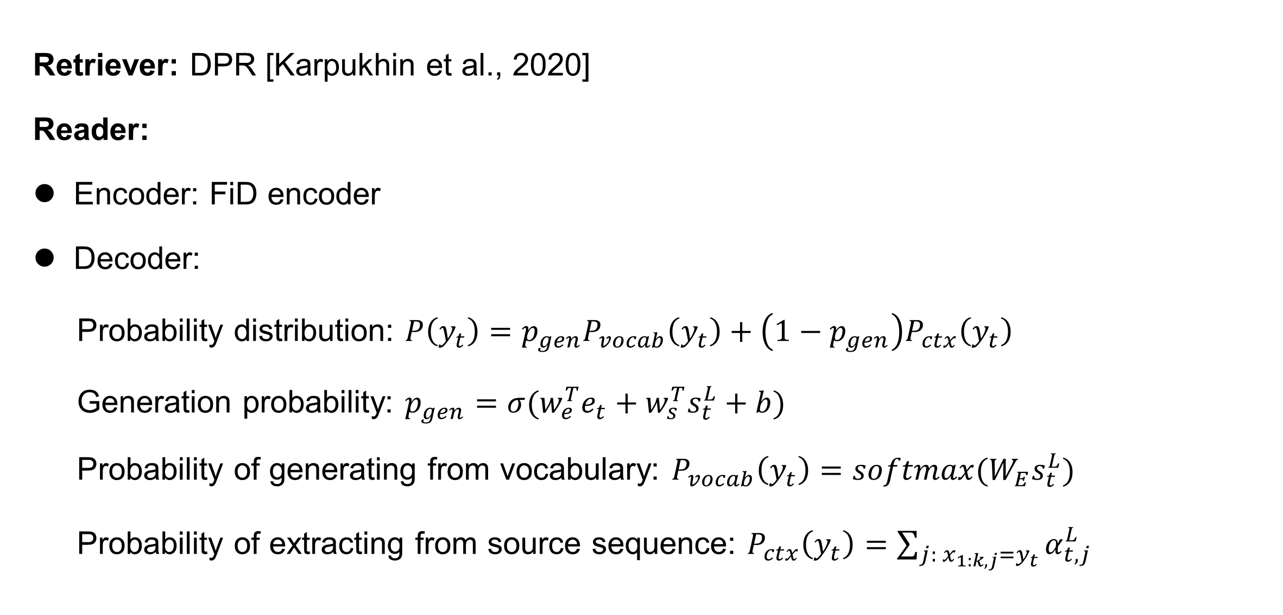
A Copy-Augmented Generative Model for Open-Domain Question Answering
Shuang Liu¹, Dong Wang², Xiaoguang Li¹, Minghui Huang², Meizhen Ding²
¹ Huawei Noah’s Ark Lab
² AI Application Research Center (AARC), Huawei Technologies Co., Ltd
Introduction
Results
Open-domain question answering is a challenging task with a wide variety of practical applications. Existing modern approaches mostly follow a standard two-stage paradigm: retriever then reader. We focus on improving the effectiveness of the reader module and propose a novel copy-augmented generative approach that integrates the merits of both extractive and generative readers.
Exact Match (EM) accuracy on NQ and Trivia datasets.
Achieve SOTA result on NQ and comparable result on Trivia using only ¼ of data as in FiD-KD [Izacard et al., 2020b].
Only 1537 extra parameters are added.
Motivation
Currently, generative models achieve in general better performance than extractive
methods. However generative model often suffer from the problem of producing hallucinated text that is factual inaccuracy or inconsistent to the input. For example, in the table below, the answer generated by FiD [Izacard et al., 2020a] model, “Dubai in Germany” is factual incorrect.
Question: where was a hologram for the king filmed?
Title: A Hologram for the King (film) Production was set to begin in first quarter of 2014. Principal photography commenced on March 6, 2014 in Morocco. Filming also took place in Hurghada in Egypt, as well as in Berlin and Düsseldorf in Germany. Shooting wrapped in June 2014.
Answer: Hurghada in Egypt, Berlin and Düsseldorf in Germany
FiD generated: Dubai in Germany
Generation Probability
$p_{gen}$ in TriviaQA is always higher than in NQ.
As stated in Rogers et al. (2021), Trivia questions are more like probing questions. Compared to the information-seeking questions in NQ, probing questions tend to need more complex reasoning.
Our model performs better on information-seeking questions.
Our Method
Take advantages of attention scores to help to extract answers from passages.
Adopt Pointer-generator network [See et al., 2017].
Architecture of Our Model
Test-Train Overlap Evaluation
Our approach improves most over FiD reader on "No Overlap" category, the most challenging setting, indicating a better generalization ability to question answering.
Retriever: DPR [Karpukhin et al., 2020]
Reader:
Encoder: FiD encoder
Decoder:
Probability distribution: $P\left(y_{t}\right)=p_{gen}P_{vocab}\left(y_{t}\right)+\left(1−p_{gen}\right)P_{ctx}\left(y_{t}\right)$
Generation probability: $p_{gen}=σ(w_{e}^{T}e_{t}+w_{s}^{T}s_{t}^{L}+b)$
Probability of generating from vocabulary: $P_{vocab}\left(y_{t}\right)=softmax(W_{E}s_{t}^{L})$
Probability of extracting from source sequence: $P_{ctx}\left(y_{t}\right)=\sum_{j:{ x}_{1:k,j}=y_{t}}{α_{t,j}^{L}}$
Conclusion
Experiments
We propose a novel FiD-PGN approach for the reader module of ODQA under the standard retriever-reader framework. Specifically, we integrate a pointer network into the FiD reader to allow the model to directly select words from the retrieved passages. Experimental results show that our model outperforms FiD-KD on two benchmark datasets under the same setting, demonstrating the advantages of our method.
Datasets
NaturalQuestions [Kwiatkowski et al., 2019]
TriviaQA [Joshiet al., 2017]

