Slide 1

Python 3.x -Advanced
Python 3.0 final was released on December 3rd, 2008.
Python 3.0 (a.k.a. "Python 3000" or "Py3k") is a new version of the language that is incompatible with the 2.x line of releases.
Rosary / Sep 16th 2018

Slide 2
Contents
Introduction
Multi-Threading
Files I/O
Accessing SQL (Oracle)
Accessing NoSQL (MongoDB)
XML Processing (DOM & SAX)
JSON Processing

Slide 3
Python vs Java Syntax
Python Syntax compared to other programming languages:
It uses new lines to complete a command, (other programming languages which often use semicolons or parentheses).
It uses indentation (space) to indicate a block of code. (Other programming languages often use curly-brackets for this purpose.)
Python:
x = 10
print(x)
Java:
int x =10;
System.out.println(x);
Python:
if x > 10
print(x)
print(x+1)
print(‘helo’)
Java:
If(x > 10) {
System.out.println(x);
System.out.println(x);
}
System.out.println(“helo”);

Slide 4
Python vs Java Syntax (contd.)
Method:
Class and Constructor:
Inheritance:
Python:
def my_func:
print(‘helo’)
Java:
public void myFunc(){
System.out.println(x);
}
Java:
class Employee{
String empName;
public Employee(String empName){
this.empName = empName;
}
}
Python:
class Employee:
def __init__(self,empName):
self.empName = empName
Python:
class ChildClass(ParentClass):
……………………..
Java:
class ChildClass extends ParentClass {
…………………………
}

Slide 5
Python - Threads
There are two modules which support the usage of threads in Python3:
1) _thread - 'thread' in Python2 has been "deprecated". In Python 3, the module "thread" is not available but it has been renamed to "_thread" for backwards compatibilities.
2) threading - In Python3, 'threading' is used to spawn new threads.
Using _thread module to create Thread:
Syntax: _thread.start_new_thread ( function, args[, kwargs] )
where-
function - user defined method
args - args is a tuple of arguments; use an empty tuple to call function without passing any arguments
kwargs is an optional dictionary of keyword arguments. (kwargs - key worded args)

Slide 6
Python – Threads (contd.)
Using threading module to create thread:
'threading' module exposes all the methods of the thread module and provides some additional methods-
threading.activeCount()
threading.currentThread()
threading.enumerate() - Returns a list of currently active thread objects
'threading' module has the Thread class that implements threading.
The methods provided by the Thread class are as follows -
run() - The run() method is the entry point for a thread.
start() - The start() method starts a thread by calling the run method.
join([time]) - The join() waits for threads to terminate.
isAlive() - The isAlive() method checks whether a thread is still executing.
getName() - The getName() method returns the name of a thread.
setName() - The setName() method sets the name of a thread.

Slide 7
Python – Threads (contd.)
Creating Thread Using Threading Module:
The Thread class in Threading Module represents an activity that is run in a separate thread of control.
There are two ways to specify the activity:
by overriding the run() method in a subclass or
by passing a callable object to the constructor
i) By overriding the run() method in a subclass : (Steps)
Define a new subclass of the Thread class.
Override the __init__(self [,args]) method to add additional arguments.
Then, override the run(self [,args]) method to implement what the thread should do when started.
ii) By passing a callable object to the constructor:
E.g.:
t = threading. Thread(name='Thread-Name', target = FunName)

Slide 8
Python – Threads (contd.)
Synchronizing Threads Using Lock Class:
Locks are the most fundamental synchronization mechanism provided by the threading module.
Lock() class - returns a new lock.
E.g.: threadLock = threading.Lock()
Lock() class has following two methods-
acquire(blocking) - of the new lock object is used to force the threads to run synchronously
release() - to release the lock when it is no longer required.
where-
The optional blocking parameter enables you to control whether the thread waits to acquire the lock.
If blocking is set to 1, the thread blocks and wait for the lock to be released.
If blocking is set to 0, the thread returns immediately with a 0 value if the lock cannot be acquired and with a 1 if the lock was acquired.

Slide 9
Python – Threads (contd.)
Synchronizing Threads In Python:
Following are used for thread synchronization in Python-
Locks
RLocks
Semaphores
Events
Conditions
Barriers
Synchronizing Threads Using Lock Class (contd.):
Steps:
# Create a lock
lock = Lock()
# Get lock to synchronize threads
lock.acquire()
... Code to access shared resource
# Free lock to release next thread
lock.release()

Slide 10
Python – Files I/O Methods
open():
Syntax : fileObject = open(file_name [, access_mode][, buffering]
where-
access_mode –
The access mode determines the mode in which the file to be opened, i.e., read, write, append, etc.
Default file access mode is read (r).
buffering –
0 - no buffering takes place
1 - line buffering is performed while accessing a file
greater than 1 - then buffering action is performed with the indicated buffer size
If negative, the buffer size is the system default
Python File Modes
Mode | Description
'r' | Open a file for reading. (default)
'w' | Open a file for writing. Creates a new file if it does not exist or truncates the file if it exists.
'x' | Open a file for exclusive creation. If the file already exists, the operation fails.
'a' | Open for appending at the end of the file without truncating it. Creates a new file if it does not exist.
't' | Open in text mode. (default)
'b' | Open in binary mode.
'+' | Open a file for updating (reading and writing (e.g.: r+ - Opens a file for both reading and writing.)

Slide 11
Python – Files I/O Methods (Contd.)
write():
Syntax: fileObject.write(string)
method writes any string to an open file
The write() method does not add a newline character ('\n') to the end of the string
read():
Syntax: fileObject.read([count])
where-
count - number of bytes to be read from the beginning of the file
if count is missing, then it tries to read as much as possible
File Positions:
tell():
tells you the current position within the file
seek()
changes the current file position
Syntax: seek(offset[, from])
where-
offset - the number of bytes to be moved
from - the reference position from where the bytes are to be moved
where-
0 - the beginning of the file is used as the reference position.
1 - the current position is used as the reference position
2 - the end of the file would be taken as the reference position

Slide 12
Python – Files I/O Methods (Contd.)
Renaming File :
Syntax: os.rename(current_file_name, new_file_name)
Deleting File :
Syntax : os.remove(current_file_name, new_file_name)
Directory access:
os module has several methods that help you create, remove, and change directories
mkdir() - of the os module to create directories in the current directory
Create Directory:
Syntax : os.mkdir("mydir")
Change Directory:
chdir() - to change the current directory
Syntax : os.chdir("mydir")
current working directory name:
getcwd() - to get the current working directory name
Syntax : os.getcwd()
Deleting Directory:
rmdir() - deletes the directory
Syntax : os.rmdir('mydir')

Slide 13
Python – XML Processing
Python provides SAX and DOM APIs to process XML.
A general difference Between SAX and DOM:
Document Object Model (DOM) API | Simple API for XML (SAX)
Tree model parser (Tree of nodes) | Event based parser (Sequence of events)
Loads the file into the memory and then parse- the file | SAX parses the file as it reads it, i.e. parses node by node
Has memory constraints since it loads the whole XML file before parsing. | No memory constraints as it does not store the XML content in the memory.
DOM is read and write (can insert or delete nodes) | SAX is read only i.e. can’t insert or delete the node
Used when XML content is small | Used when XML content is large
Backward and forward navigation possible | Backward navigation not possible, as it reads the XML file from top to bottom
Slower at run time | Faster at run time

Slide 14
Python – XML Processing (Contd.)
XML Processing Using SAX API:
SAX is for event-driven XML parsing.
We have to create own ContentHandler by subclassing xml.sax.ContentHandler
ContentHandler handles XML tags and attributes
The SAX API defines four kinds of handlers:
content handlers (xml.sax.handler.ContentHandler)
DTD handlers (xml.sax.handler.DTDHandler)
entity handlers (xml.sax.handler.EntityResolver)
error resolvers (class xml.sax.handler.ErrorHandler)
ContentHandler class:
ContentHandler has several methods called by the parser on the appropriate events in the input document.
Following are few important methods in ContentHandler class-
startDocument() - Receive notification of the beginning of a document.
endDocument() - Receive notification of the end of a document.
startElement(name, attrs) - Signals the start of an element in non-namespace mode.
endElement(name) - Signals the end of an element in non-namespace mode.
characters(content) - Receive notification of character data.

Slide 15
Python – XML Processing (Contd.)
XML Processing Using SAX API (Contd.):
The ContentHandler is called at the start and end of each XML element.
If the parser is not in namespace mode, the methods startElement(tag, attributes) and endElement(tag) are called;
If the parser is in namespace mode, the corresponding methods startElementNS and endElementNS are called.
Methods to create SAX Parser and Parse XML:
make_parser ():
It creates a new parser object.
Syntax: xml.sax.make_parser()
parse():
To to parse a XML document
Syntax: xml.sax.parse( xmlfile, contenthandler[, errorhandler])
Steps:
Subclass xml.sax.ContentHandler to create our own handler
Override xml.sax.ContentHandler methods - startDocument,endDocument,characters
Create SAX Parser and Parse XML

Slide 16
Python – XML Processing (Contd.)
XML Processing Using DOM API :
A DOM implementation presents an XML document as a tree structure
The DOM is extremely useful for random-access applications.
DOM XML Parse with minidom:
objectName = xml.dom.minidom.parse(“xml file name")

Slide 17
Python – JSON Processing
JSON Processing Methods in ‘json’ module:
json.dumps() - Convert Python object (e.g.: Dict) to a JSON string
json.loads() - Convert from JSON to Python dictionary
json.dump() - To write the JSON (in the form of Python Dict) to the output file. It transforms Python Dict object into the serialized JSON string.
json.load() - It reads the string from the file, parses the JSON data and populates as a Python Dict object.
When we convert from Python to JSON, Python objects are converted into the JSON equivalent
Python | JSON
dict | Object
list | Array
tuple | Array
str | String
int | Number
float | Number
True | true
False | false
None | null

Slide 18

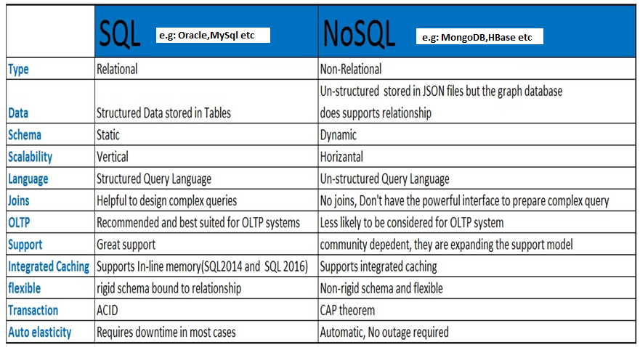
MongoDB Basics
MongoDB is one of the NoSQL database.
Comparing SQL and NoSQL Databases:

Slide 19
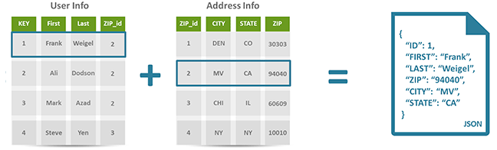
MongoDB Basics (contd.)
Differences between SQL (Table) and NoSQL (JSON) schema design:

Slide 20
MongoDB Basics (contd.)
MongoDB Features:
MongoDB is a NQSQL database.
It is a document oriented database
It stores data in collections (like Tables in a RDBMS) made out of individual documents (like Rows in a RDBMS) .
It uses JSON documents (called BSON) to store data
BSON (short for Bin­ary JSON ) is a binary representation of JSON document and built specifically for MongoDB.
A MongoDB database is broken up into a series of BSON files on disk, with increasing size up to 2GB
Each document (called as Row in RDBMS) in MongoDB has unique “‘_id” field
If an '_id' field is not provided, then MongoDB will create an '_id' field and assign a unique _id for each document(s)
MongoDB Connection URL: http://<host>:27017/
MonoDB Data-Types:
String,Integer,Boolean,Double,Min/Max, Keys, Arrays, Object, Null, Symbol, Date

Slide 21
MongoDB Basics (contd.)
Comparing MongoDB and RDBMS Objects
RDBMS (SQL) | MongoDB (NoSQL)
Database | Database
Table | Collection
Tuple/Row | Document
column | Field
Table Join | Embedded Documents
Primary Key | Primary Key (Default key _id is provided by MongoDB)
Partition | Sharding . Sharding is a type of database partitioning that separates very large databases the into smaller, faster, more easily managed parts called data shards. The word shard means a small part of a whole.

Slide 22
PYTHON - Accessing MongoDB
Accessing MongoDB With Python:
In this demo we will use the MongoDB driver "PyMongo“
We can use PIP to install "PyMongo“ driver
E.g.: C:\Python\Python36-32\Scripts> python -m pip install pymongo
Sample Code:
try: # Step1: we create a MongoDB Client myMongodbClient = pymongo.MongoClient("mongodb://localhost:27017/") # Step2: Create a database e.g.: "mydatabase" myMongodb = myMongodbClient["mydatabase"] # Step3: Create a collection e.g.:"customers" myCollection = myMongodb["customers"]
# Step3: Create a document e.g.: myDictionary # If a '_id' field is not provided,then MongoDB will assign a unique _id for each document(s) myDictionary = { "_id": 3, "name": "Dinesh3", "address": "Bengaluru3" } # Step4: Insert the ‘myDictionary ‘ document into ‘customers’ collection myInsertedId = myCollection.insert_one(myDictionary) print("unique id: ",myInsertedId.inserted_id) print() except pymongo.errors.DuplicateKeyError as dke: print("ERROR:“, dke)

Slide 23
PYTHON - Accessing Oracle
Accessing Oracle With Python:
In this demo we will use the Python driver " cx_Oracle“
'cx_Oracle' is a Python extension module that allows access to Oracle databases.
https://cx-oracle.readthedocs.io/en/latest/
Using the cx_Oracle Python module from Computronix, we can take command over the Oracle query model while maintaining compatibility with Python Database API Specification v2.0.
Python Database API Specification v2.0:
This API has been defined to achieve a consistency, code that is generally more portable across databases, and a broader reach of database connectivity from Python
https://www.python.org/dev/peps/pep-0249/
Install " cx_Oracle“ driver:
E.g.: C:\Python\Python36-32\Scripts> pip install cx_Oracle

Slide 24
PYTHON - Accessing Oracle (Contd.)
Accessing Oracle With Python:
Sample Code:
import cx_Oracle
try:
#Step1: Create Connection (2 ways)
#dsn_tns = cx_Oracle.makedsn('localhost', '1521', service_name='xe')
#conn = cx_Oracle.connect(user='system', password=‘xyz', dsn=dsn_tns)
# Syntax: connection = cx_Oracle.connect('user_name/password@host_name/service_name')
conn = cx_Oracle.connect('system/ xyz @localhost/xe')
#Step2: Create Cursor
cur = conn.cursor()
#Step3: Execute
resultSet = cur.execute('select * from emp')
#Step4: Iterate
for record in resultSet:
print(record)
except cx_Oracle.DatabaseError as de:
print('Database connection error:', de)
finally:
if conn is not None:
conn.close()

Slide 25
References
https://docs.python.org/3/tutorial/index.html
https://www.python.org/dev/peps/pep-0249/
https://cx-oracle.readthedocs.io/en/latest/
http://api.mongodb.com/python/current/tutorial.html

Slide 26
Appendix

Slide 27
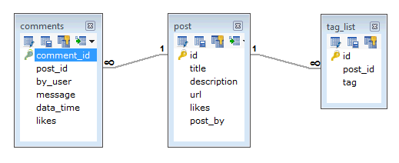
MongoDB - Data Modelling:
Some considerations while designing Schema in MongoDB-
Design schema according to our requirements.
We can combine objects into one document (we must not use joins).
We can duplicate the data (but limited) because disk space is cheap as compared to compute time.
We can do joins while write, not on read.
Differences between RDBMS and MongoDB schema design:
For example: Let us consider a Blog site having Post, Comment and Tag features.
In a RDBMS schema, we will end up having following three tables (Post table, Comments table and Tag table)

Slide 28
MongoDB - Data Modelling: (contd.) :
But in MongoDB schema design, we can have one collection Post and with the following structure −
{
_id: POST_ID
title: TITLE_OF_POST,
description: POST_DESCRIPTION,
by: POST_BY,
url: URL_OF_POST,
tags: [TAG1, TAG2, TAG3],
likes: TOTAL_LIKES,
comments: [
{
user:'COMMENT_BY',
message: TEXT,
dateCreated: DATE_TIME,
like: LIKES
},
{
user:'COMMENT_BY',
message: TEXT,
dateCreated: DATE_TIME,
like: LIKES
}
]
}

Slide 29
ACID (for SQL database) vs CAP (for NoSQL database)
CAP is basically a continuum along which BASE and ACID are on opposite ends.
CAP is Consistency, Availability, and Partition tolerance. Basically you can pick 2 of those but you can't do all 3.
ACID focuses on Availability ,Consistency ,Isolation and Durability.
BASE (Basic Availability, Soft-state ,Eventual consistency) focuses on Partition tolerance and availability and throws consistency out the window.

