Slide 1

Python 3.0
Python 3.0 final was released on December 3rd, 2008.
Python 3.0 (a.k.a. "Python 3000" or "Py3k") is a new version of the language that is incompatible with the 2.x line of releases.
Rosary / Sep 16th 2018

Slide 2
Python Introduction
What is Python?
Python is programming language created in 1991 by Guido van Rossum.
It is used for:
web development (server-side),
software development,
Mathematical and scientific,
etc
What can Python do?
web applications
workflows
read and modify files
handle big data and perform complex mathematics

Slide 3
Python Introduction (contd.)
Why Python?
It works on different platforms (Windows, Mac, Linux, Raspberry Pi, etc).
Write programs with fewer lines.
It runs on an interpreter system, this means that prototyping can be very quick.
It can be treated in a procedural way, an OO way or a functional way.
Polyglot Developer – a developer who is familiar with several programming languages. ☺

Slide 4
Contents
Introduction
Environment Setup
Python -Frameworks ,Libraries,IDEs
Basic Python Syntax
Variables and Operators
Loops and Decision Making
Numbers and Strings
Built-in Functions
Collections – List,Tuples,Set,Dictionary
Functions and Lambda
Classes , Modules and Packages
Exception Handling
Date and Time
Multi-Threading
Files I/O
Accessing NoSQL (MongoDB)
XML Processing (DOM & SAX)

Slide 5
Python Environment Setup
Link to download-
https://www.python.org/downloads/
Python versions:
There are two major Python versions, Python 2 and Python 3.
Python 3.0 (a.k.a. "Python 3000" or "Py3k") is a new version of the language that is incompatible with the 2.x line of releases.
Python IDE:
PyCharm (select community edition which is free)
https://www.jetbrains.com/pycharm/download/#section=windows

Slide 6
Python Introduction (contd.)
Python Frameworks:
Django - https://www.djangoproject.com/
Bottle - http://bottlepy.org/
Flask - http://flask.pocoo.org/
etc.
Python Libraries for Data Science:
NumPy - http://www.numpy.org/
SciPy - - https://www.scipy.org/
Pandas - https://pandas.pydata.org/
etc.
Graphical User Interfaces:
Tk GUI toolkit
PyGUI
Python IDE:
PyCharm (community edition)
Eclipse with Python plugin like PyDev
Visual Studio Code

Slide 7
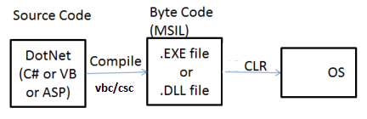
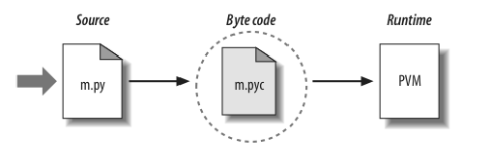
JVM vs. CLR vs. PVM (Python Virtual Machine)
JVM
CLR
PVM

Slide 8
Python vs Java Syntax
Python Syntax compared to other programming languages:
It uses new lines to complete a command, (other programming languages which often use semicolons or parentheses).
It uses indentation (space) to indicate a block of code. (Other programming languages often use curly-brackets for this purpose.)
Python:
x = 10
print(x)
Java:
int x =10;
System.out.println(x);
Python:
if x > 10
print(x)
print(x+1)
print(‘helo’)
Java:
If(x > 10) {
System.out.println(x);
System.out.println(x);
}
System.out.println(“helo”);

Slide 9
Python vs Java Syntax (contd.)
Method:
Class and Constructor:
Inheritance:
Python:
def my_func:
print(‘helo’)
Java:
public void myFunc(){
System.out.println(x);
}
Java:
class Employee{
String empName;
public Employee(String empName){
this.empName = empName;
}
}
Python:
class Employee:
def __init__(self,empName):
self.empName = empName
Python:
class ChildClass(ParentClass):
……………………..
Java:
class ChildClass extends ParentClass {
…………………………
}

Slide 10
Python Naming Convention
joined_lower for functions, methods, attributes, variables
e.g. emp_count
joined_lower or ALL_CAPS for constants
e.g. emp_count
Caps for classes
e.g. Emp
camelCase only to conform to pre-existing conventions

Slide 11
Python Variables
Creating variables:
a = 10
c = 20.1
e = ‘hello’
Assignments can be done on more than one variable simultaneously:
e.g.
a, b = 10, 20
print(a + b)
There are three numeric types in Python:
int e.g.: x = 15
float e.g.: x = 15.2
complex e.g.: x = 17j ( with a "j" as the imaginary part)
Integer can be positive or negative and of unlimited length.
Float can be positive or negative containing one or more decimals.
Float can also be scientific numbers with an "e" to indicate the power of 10.
Complex numbers are written with a "j" as the imaginary part

Slide 12
Python - Casting Variable Type
Python is an OO language, and as such it uses classes to define data types including its primitive types.
int() , float(), str()
Integer examples:
x = int(11) Output: 11
y = int(24.8) Output 24
z = int("2") Output z 2
Float Example:
x = float(15) Output 15.0
y = float(21.8) Output 21.8
z = float("5") Output 5
w = float("1.2") Output 1.2
String Example:
x = str("a1") Output ‘a1'
y = str(21) Output '21'
z = str(22.0) Output ‘22.0'

Slide 13
Python operators
Arithmetic operators
Assignment operators
Comparison operators
Logical operators
Identity operators
Membership operators
Bitwise operators

Slide 14
Arithmetic operators:
Operator Name Example
+ Addition x + y
- Subtraction x - y
* Multiplication x * y
/ Division x / y
% Modulus x % y
** Exponentiation x ** y
// Floor division x // y
(i e: integer division)

Slide 15
Assignment operators:
Operator Example Same As
= x = 5 x = 5
+= += 3 x = x + 3
-= x -= 3 x = x - 3
*= x *= 3 x = x * 3
/= x /= 3 x = x / 3
%= x %= 3 x = x % 3
//= x //= 3 x = x // 3
**= x **= 3 x = x ** 3
&= x &= 3 x = x & 3
|= x |= 3 x = x | 3
^= x ^= 3 x = x ^ 3
>>= x >>= 3 x = x >> 3
<<= x <<= 3 x = x << 3

Slide 16
Comparison operators:
Operator Name Example
== Equal x == y
!= Not equal x != y
> Greater than x > y
< Less than x < y
>= Greater than or equal to x >= y
<= Less than or equal to x<= y

Slide 17
Logical operators:
Operator Description Example
and Returns True if both statements are true x < 5 and x < 10
or Returns True if one of the statements is true x < 5 or x < 4
Not Returns False if the result is true not(x < 5 and x < 10)
Identity operators:
It used to compare the objects are equal based on contents and memory location.
Operator Description Example
is Returns true if both variables are the same object x is y
is not Returns true if both variables are not the same object x is not y

Slide 18
Membership operators:
It used to test if a sequence is presented in an object.
Operator Description Example
in Returns True if a sequence with the specified value is present in the object x in y
not in Returns True if a sequence with the specified value is not present in the object x not in y
Bitwise operators:
Logical operators are used to combine conditional statements.
Operator Description Example
& AND Sets each bit to 1 if both bits are 1
| OR Sets each bit to 1 if one of two bits is 1
^ XOR Sets each bit to 1 if only one of two bits is 1
~ NOT Inverts all the bits

Slide 19
Arrays And Collections
Arrays:
Note: Python does not have built-in support for Arrays, but Python list
can be used instead.
Collections:
There are four collection data types-
List - ordered,changeable,allows duplicate.
Syntax: square brackets []
Tuple - ordered,unchangeable,allows duplicate.
Syntax: round brackets ()
Set - unordered,unindexed,no duplicate .
Syntax: curly brackets {}
Dictionary - unordered,changeable,indexed,no duplicate.
Syntax: curly brackets {} and they have keys and values.

Slide 20
Loops And Decision-Making
For loop:
Syntax:
for iterating_var in sequence:
statements(s)
While loop:
Syntax:
while expression:
statement(s)
If – elif – else Statement:
Syntax:
if expression1:
statement(s)
elif expression2:
statement(s)
elif expression3:
statement(s)
else:
statement(s)

Slide 21
Comments And Print
Single line comment:
# symbol
Multi line comment (called Docstrings):
""“ text…… """
Various print examples:
print('hello') print("hello") print("hello");
print(""" PyCharm Community Edition is totally free and open-sources""")

Slide 22
Defining functions
A function is defined using the "def" keyword. A function can have parameter, default parameter, return value
Syntax:
def function_name: statements
def function_name( parameters ):
"function_docstring"
function_suite
return [expression]

Slide 23
Lambda
A lambda function is an anonymous function. A lambda function can take many arguments, but can only have
one expression. It returns a function object which can be assigned to any variable. Syntax: lambda argument_list : expression
# Lambda example x = lambda y : y + 10
print(x(2)) # Output: 12
Why Use Lambda Functions?
It is useful when we use Lambda as an anonymous function
In Python, we generally use it as an argument to a higher-order
function (a function that takes in other functions as arguments).
Lambda functions are used along with built-in functions like
filter(), map() etc.

Slide 24
Built-in Functions
filter() vs map() functions:
The “filter” function operates on a list and returns a subset of that list after applying the
filtering rule.
The “map” function transforms a given list into a new list by transforming each element
using a rule.
filter() function:
It takes in a function and a list as arguments It offers an elegant way to filter out all the elements of a sequence
It returns iterator.
Syntax:
filter(function, sequence)
map() function:
It takes in a function and a list as arguments It returns a list of the results after applying the given function to each item of a given iterable (list,
tuple etc.)
Syntax:
map(fun, iter) where, fun : It is a function to which map passes each element of given iterable. iter :It is a iterable which is to be mapped.

Slide 25
Built-in Functions (contd.)
range() function:
Returns a sequence of numbers starting from 0 to stop - 1 Returns an empty sequence if stop is negative or 0.
All parameters must be integers. All parameters can be positive or negative.
Syntax:
range(stop)
range([start], stop[, step])
where-
start: Starting number of the sequence. stop: Generate numbers up to, but not including this number. step: Difference between each number in the sequence
Eg
for x in range(4): print(x) # output : 0 1 2 3
for x in range(2,10,3): print(x) # output: 2 5 8

Slide 26
Sample String Built-in Functions
In Python 3, all strings are represented in Unicode. (In Python 2 are stored internally as 8-bit ASCII)
capitalize() - Capitalizes first letter of string
E.g.:
str = ‘python’
print(str. Capitalize())
center(width, fillchar)
Returns a string padded with fillchar with the original string cantered to a total of width columns.
find(str, beg = 0 end = len(string))
Determine if str occurs in string or in a substring of string if starting index beg and ending index end are given returns index if found and -1 otherwise.
isdigit() - Returns true if string contains only digits and false otherwise.
islower() - Returns true if string has at least 1 cased character and all cased characters are in lowercase and false otherwise.
lower() - Converts all uppercase letters in string to lowercase.
strip([chars])
Performs both lstrip() and rstrip() on string.
chars − The charsto be removed from beginning or end of the string. (default whitespace chars)

Slide 27
String Special Operators
Operator | Description | Example a = 'Hello‘ b = ‘ Python'
+ | Concatenation - Adds values on either side of the operator | a + b will give HelloPython
* | Repetition - Creates new strings, concatenating multiple copies of the same string | a*2 will give HelloHello
[] | Slice - Gives the character from the given index | a[1] will give e
[ : ] | Range Slice - Gives the characters from the given range | a[1:4] will give ell
in | Membership - Returns true if a character exists in the given string | H in a will give True
% | Format - Performs String formatting | %c – character , %s - string , %s - string Refer below example-
print ("Python is %s based and latest version is %d !" % ('OOPs', 3)) Output: Python is OOPs based and latest version is 3 !
d

Slide 28
Python's object-oriented programming
Python's object-oriented programming support-
Class
Class variable
Data member
Function overloading
Instance variable
Inheritance
Instance
Instantiation
Method
Object
Operator overloading

Slide 29
Python Modules
A module is a file (.py) consisting of Python code
It can define functions, classes and variables.
It allows you to logically organize your Python code
modules help avoid collisions between global variable names,
Steps:
Create a module (i.e. a file with .py extension)
Import the module
Syntax:
Import complete module:
import module1[, module2[,... moduleN]
Import only specific attributes from a module:
from modname import name1[, name2[, ... nameN]]
Import all of a module:
from modname import *

Slide 30
Python Modules (contd.)
Locating Modules:
When we import a module, the Python interpreter searches for the module in the following sequences −
The current directory.
If the module is not found, Python then searches each directory in the shell variable PYTHONPATH.
If all else fails, Python checks the default path.
PYTHONPATH Variable for Win and Unix:
set PYTHONPATH = c:\python34\lib;
set PYTHONPATH = /usr/local/lib/python
sys.path:
The variable sys.path is a list of strings that determines the interpreter’s search path for modules.
It is initialized to a default path taken from the environment variable PYTHONPATH, or from a built-in default if PYTHONPATH is not set.
We can modify it using standard list operations-
>>> import sys
>>> sys.path.append('/ufs/guido/lib/python')

Slide 31
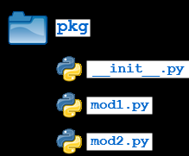
Python Package
A Package is a collection of modules
Python modules and Python packages, two mechanisms that facilitate modular programming.
Packages allow for a hierarchical structuring of the module namespace using dot notation
Packages help avoid collisions between module names.
We can import modules from packages using the dot (.) operator
We have to place the package folder in python’s lib folder

Slide 32
Python Package (contd.)
Steps:
Creating a Package-
Create a directory e.g.: pkg1
Create modules (i.e. a file with .py extension) in the directory
e.g.: mod1.py ,mod2.py etc
Create a __init__.py file in a package directory and add following-
import pkg.mod1, pkg.mod2
Using a Package:
import pkg1
print(pkg1.mod1.func_disp())

Slide 33
Python Class
A class keyword creates a new class definition
Syntax:
class ClassName:
'Optional class documentation string'
class_suite
where-
The class has a documentation string, which can be accessed via ClassName.__doc__.
The class_suite consists of all the component statements defining class members, data attributes and functions.
Constructor and Finalizer:
Constructor or initialization built-in method: (pre-fix and suffix with double underscores)
__init__(self)
Finalizer (Destroying Objects / Garbage Collection / Destructor) built-in method:
__del__(self)
Note: dunder methods : ie double underscore methods eg: __init__, __del__

Slide 34
Python Class (contd.)
Built-In Class Attributes
Every Python class keeps following built-in attributes-
__dict__ − Dictionary containing the class's namespace.
__doc__ − Class documentation string or none, if undefined.
__name__ − Class name.
__module__ − Module name in which the class is defined. This attribute is "__main__" in interactive mode.
__bases__ − A possibly empty tuple containing the base classes, in the order of their occurrence in the base class list.
Syntax:
objectName.attribute
E.g.:
emp. __dict__

Slide 35
Python Garbage Collection
Python deletes unneeded objects (built-in types or class instances) automatically to free the memory space.
Python's garbage collector runs during program execution and is triggered when an object's reference count reaches zero.
An object's reference count changes as the number of aliases that point to it changes.
An object's reference count increases when it is assigned a new name or placed in a container (list, tuple, or dictionary).
The object's reference count decreases when it is deleted with del, its reference is reassigned, or its reference goes out of scope.
When an object's reference count reaches zero, Python collects it automatically.

Slide 36
Python Exception Handling
Syntax of try – except - else block:
try:
Our operations here
except Exception 1 as e1:
If there is Exception 1, then execute this block.
except Exception2 as e2:
If there is Exception 2, then execute this block
finally:
This block is always executed, whether or not exception is created
Comparison between Python and Java:
Python:
try: int(‘helo’) except ValueError as ve: print(“exception info ", ve) finally: print("Inside finally ")
Java:
try {
Integer.parseInt("helo"); }catch(NumberFormatException nfe) {
System.out.println(nfe);
} finally{
System.out.println("Inside finally");
}

Slide 37
Python Exception Handling (contd.)
Various exception handling combinations:
try - except – finally
try - except
try - finally
try - except – else
where-
finally :
This block is always executed, whether or not exception is created
else :
If there is no exception then execute this block
Note:
We cannot use both else clause and finally clause.

Slide 38
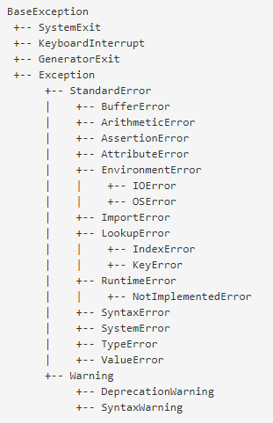
Python Built-in Exceptions and User-defined Exceptions
Below is the condensed version of the built-in exceptions hierarchy, sans many minor exceptions :
http://docs.python.org/library/exceptions.html
Note:
In Python, all exceptions must be instances of a class that derives from BaseException.
User Defined Exception:
When we define our own exception, we should extend Exception class or one of its subclasses, and not from BaseException.

Slide 39
Python - Threads
There are two modules which support the usage of threads in Python3:
1) _thread - 'thread' in Python2 has been "deprecated". In Python 3, the module "thread" is not available but it has been renamed to "_thread" for backwards compatibilities.
2) threading - In Python3, 'threading' is used to spawn new threads.
Using _thread module to create Thread:
Syntax: _thread.start_new_thread ( function, args[, kwargs] )
where-
function - user defined method
args - args is a tuple of arguments; use an empty tuple to call function without passing any arguments
kwargs is an optional dictionary of keyword arguments. (kwargs - key worded args)

Slide 40
Python – Threads (contd.)
Using threading module to create thread:
'threading' module exposes all the methods of the thread module and provides some additional methods-
threading.activeCount()
threading.currentThread()
threading.enumerate() - Returns a list of currently active thread objects
'threading' module has the Thread class that implements threading.
The methods provided by the Thread class are as follows -
run() - The run() method is the entry point for a thread.
start() - The start() method starts a thread by calling the run method.
join([time]) - The join() waits for threads to terminate.
isAlive() - The isAlive() method checks whether a thread is still executing.
getName() - The getName() method returns the name of a thread.
setName() - The setName() method sets the name of a thread.

Slide 41
Python – Threads (contd.)
Creating Thread Using Threading Module:
The Thread class in Threading Module represents an activity that is run in a separate thread of control.
There are two ways to specify the activity:
by overriding the run() method in a subclass or
by passing a callable object to the constructor
i) By overriding the run() method in a subclass : (Steps)
Define a new subclass of the Thread class.
Override the __init__(self [,args]) method to add additional arguments.
Then, override the run(self [,args]) method to implement what the thread should do when started.
ii) By passing a callable object to the constructor:
E.g.:
t = threading. Thread(name='Thread-Name', target = FunName)

Slide 42
Python – Threads (contd.)
Synchronizing Threads Using Lock Class:
Locks are the most fundamental synchronization mechanism provided by the threading module.
Lock() class - returns a new lock.
E.g.: threadLock = threading.Lock()
Lock() class has following two methods-
acquire(blocking) - of the new lock object is used to force the threads to run synchronously
release() - to release the lock when it is no longer required.
where-
The optional blocking parameter enables you to control whether the thread waits to acquire the lock.
If blocking is set to 1, the thread blocks and wait for the lock to be released.
If blocking is set to 0, the thread returns immediately with a 0 value if the lock cannot be acquired and with a 1 if the lock was acquired.

Slide 43
Python – Threads (contd.)
Synchronizing Threads In Python:
Following are used for thread synchronization in Python-
Locks
RLocks
Semaphores
Events
Conditions
Barriers
Synchronizing Threads Using Lock Class (contd.):
Steps:
# Create a lock
lock = Lock()
# Get lock to synchronize threads
lock.acquire()
... Code to access shared resource
# Free lock to release next thread
lock.release()

Slide 44
Python – Date And Time
Python's time and calendar modules are used for dates and times.
Time intervals known as Ticks , are floating-point numbers in units of seconds.
Particular instants in time are expressed in seconds since 12:00am, January 1, 1970 (epoch i.e. the point where the time starts)
TimeTuple:
Python stores time in tuples.
These python tuples are made of nine numbers.
Index | Field | Values
0 | 4-digit year | E.g.: 2018
1 | Month | 1 to 12
2 | Day | 1 to 31
3 | Hour | 0 to 23
4 | Minute | 0 to 59
5 | Second | 0 to 61 (60 or 61 are leap-seconds)
6 | Day of Week | 0 to 6 (0 is Monday)
7 | Day of year | 1 to 366 (Julian day)
8 | Daylight savings | -1, 0, 1, -1 means library determines DST

Slide 45
Python – Files I/O Methods
open():
Syntax : fileObject = open(file_name [, access_mode][, buffering]
where-
access_mode –
The access mode determines the mode in which the file to be opened, i.e., read, write, append, etc.
Default file access mode is read (r).
buffering –
0 - no buffering takes place
1 - line buffering is performed while accessing a file
greater than 1 - then buffering action is performed with the indicated buffer size
If negative, the buffer size is the system default
Python File Modes
Mode | Description
'r' | Open a file for reading. (default)
'w' | Open a file for writing. Creates a new file if it does not exist or truncates the file if it exists.
'x' | Open a file for exclusive creation. If the file already exists, the operation fails.
'a' | Open for appending at the end of the file without truncating it. Creates a new file if it does not exist.
't' | Open in text mode. (default)
'b' | Open in binary mode.
'+' | Open a file for updating (reading and writing (e.g.: r+ - Opens a file for both reading and writing.)

Slide 46
Python – Files I/O Methods (Contd.)
write():
Syntax: fileObject.write(string)
method writes any string to an open file
The write() method does not add a newline character ('\n') to the end of the string
read():
Syntax: fileObject.read([count])
where-
count - number of bytes to be read from the beginning of the file
if count is missing, then it tries to read as much as possible
File Positions:
tell():
tells you the current position within the file
seek()
changes the current file position
Syntax: seek(offset[, from])
where-
offset - the number of bytes to be moved
from - the reference position from where the bytes are to be moved
where-
0 - the beginning of the file is used as the reference position.
1 - the current position is used as the reference position
2 - the end of the file would be taken as the reference position

Slide 47
Python – Files I/O Methods (Contd.)
Renaming File :
Syntax: os.rename(current_file_name, new_file_name)
Deleting File :
Syntax : os.remove(current_file_name, new_file_name)
Directory access:
os module has several methods that help you create, remove, and change directories
mkdir() - of the os module to create directories in the current directory
Create Directory:
Syntax : os.mkdir("mydir")
Change Directory:
chdir() - to change the current directory
Syntax : os.chdir("mydir")
current working directory name:
getcwd() - to get the current working directory name
Syntax : os.getcwd()
Deleting Directory:
rmdir() - deletes the directory
Syntax : os.rmdir('mydir')

Slide 48
Python – XML Processing
Python provides SAX and DOM APIs to process XML.
A general difference Between SAX and DOM:
Document Object Model (DOM) API | Simple API for XML (SAX)
Tree model parser (Tree of nodes) | Event based parser (Sequence of events)
Loads the file into the memory and then parse- the file | SAX parses the file as it reads it, i.e. parses node by node
Has memory constraints since it loads the whole XML file before parsing. | No memory constraints as it does not store the XML content in the memory.
DOM is read and write (can insert or delete nodes) | SAX is read only i.e. can’t insert or delete the node
Used when XML content is small | Used when XML content is large
Backward and forward navigation possible | Backward navigation not possible, as it reads the XML file from top to bottom
Slower at run time | Faster at run time

Slide 49
Python – XML Processing (Contd.)
XML Processing Using SAX API:
SAX is for event-driven XML parsing.
We have to create own ContentHandler by subclassing xml.sax.ContentHandler.
ContentHandler handles XML tags and attributes
The SAX API defines four kinds of handlers:
content handlers (xml.sax.handler.ContentHandler)
DTD handlers (xml.sax.handler.DTDHandler)
error handlers (xml.sax.handler.EntityResolver)
entity resolvers (class xml.sax.handler.ErrorHandler)
ContentHandler class:
ContentHandler has several methods called by the parser on the appropriate events in the input document.
Following are few important methods in ContentHandler class-
startDocument() - Receive notification of the beginning of a document.
endDocument() - Receive notification of the end of a document.
startElement(name, attrs) - Signals the start of an element in non-namespace mode.
endElement(name) - Signals the end of an element in non-namespace mode.
characters(content) - Receive notification of character data.

Slide 50
Python – XML Processing (Contd.)
XML Processing Using SAX API (Contd.):
The ContentHandler is called at the start and end of each XML element.
If the parser is not in namespace mode, the methods startElement(tag, attributes) and endElement(tag) are called;
If the parser is in namespace mode, the corresponding methods startElementNS and endElementNS are called.
Methods to create SAX Parser and Parse XML:
make_parser ():
It creates a new parser object.
Syntax: xml.sax.make_parser()
parse():
To to parse a XML document
Syntax: xml.sax.parse( xmlfile, contenthandler[, errorhandler])
Steps:
Subclass xml.sax.ContentHandler to create our own handler
Override xml.sax.ContentHandler methods - startDocument,endDocument,characters
Create SAX Parser and Parse XML

Slide 51
Python – XML Processing (Contd.)
XML Processing Using DOM API :
A DOM implementation presents an XML document as a tree structure
The DOM is extremely useful for random-access applications.
DOM XML Parse with minidom:
objectName = xml.dom.minidom.parse(“xml file name")

Slide 52
Python – JSON Processing
JSON Processing Methods in ‘json’ module:
json.loads() - Convert from JSON to Python dictionary
json.dumps - Convert Python object (e.g.: Dict) to a JSON string
json.load() - It reads the string from the file, parses the JSON data and populates as a Python Dict object.
json.dump() - To write the JSON (in the form of Python Dict) to the output file file. It transforms your Python Dict object into the serialized JSON string.
When we convert from Python to JSON, Python objects are converted into the JSON equivalent:
Python | JSON
dict | Object
list | Array
tuple | Array
str | String
int | Number
float | Number
True | true
False | false
None | null

Slide 53

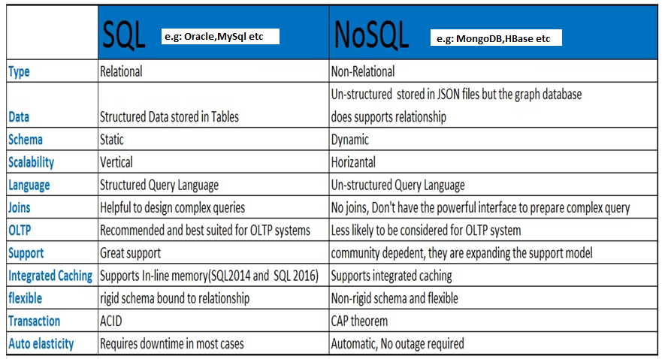
MongoDB Basics
MongoDB is one of the NoSQL database.
Comparing SQL and NoSQL Databases:

Slide 54
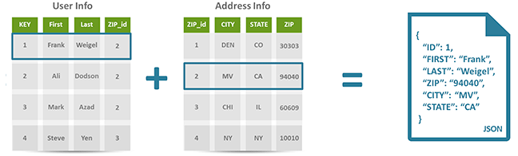
MongoDB Basics (contd.)
Differences between SQL (Table) and NoSQL (JSON) schema design:

Slide 55
MongoDB Basics (contd.)
MongoDB Features:
MongoDB is a NQSQL database.
It is a document oriented database
It stores data in collections (like Tables in a RDBMS) made out of individual documents (like Rows in a RDBMS) .
It uses JSON documents (called BSON) to store data
BSON (short for Bin­ary JSON ) is a binary representation of JSON document and built specifically for MongoDB.
A MongoDB database is broken up into a series of BSON files on disk, with increasing size up to 2GB
Each document (called as Row in RDBMS) in MongoDB has unique “‘_id” field
If an '_id' field is not provided, then MongoDB will create an '_id' field and assign a unique _id for each document(s)
MongoDB Connection URL: http://<host>:27017/
MonoDB Data-Types:
String,Integer,Boolean,Double,Min/Max, Keys, Arrays, Object, Null, Symbol, Date

Slide 56
MongoDB Basics (contd.)
Comparing MongoDB and RDBMS Objects
RDBMS (SQL) | MongoDB (NoSQL)
Database | Database
Table | Collection
Tuple/Row | Document
column | Field
Table Join | Embedded Documents
Primary Key | Primary Key (Default key _id is provided by MongoDB)

Slide 57
PYTHON - MongoDB
Accessing MongoDB With Python:
In this demo we will use the MongoDB driver "PyMongo“
We can use PIP to install "PyMongo“ driver
E.g.: C:\Python\Python36-32\Scripts> python -m pip install pymongo
Sample Code:
try: # Step1: we create a MongoDB Client myMongodbClient = pymongo.MongoClient("mongodb://localhost:27017/") # Step2: Create a database e.g.: "mydatabase" myMongodb = myMongodbClient["mydatabase"] # Step3: Create a collection e.g.:"customers" myCollection = myMongodb["customers"]
# Step3: Create a document e.g.: myDictionary # If a '_id' field is not provided,then MongoDB will assign a unique _id for each document(s) myDictionary = { "_id": 3, "name": "Dinesh3", "address": "Bengaluru3" } # Step4: Insert the ‘myDictionary ‘ document into ‘customers’ collection myInsertedId = myCollection.insert_one(myDictionary) print("unique id: ",myInsertedId.inserted_id) print() except pymongo.errors.DuplicateKeyError as dke: print("ERROR:“, dke)

Slide 58
References
https://docs.python.org/3/tutorial/index.html
http://book.pythontips.com/en/latest/map_filter.html
https://www.geeksforgeeks.org/python-map-function/
http://api.mongodb.com/python/current/tutorial.html

Slide 59
Appendix

Slide 60
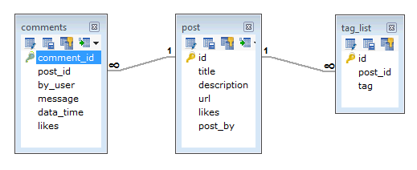
MongoDB - Data Modelling:
Some considerations while designing Schema in MongoDB-
Design schema according to our requirements.
We can combine objects into one document (we must not use joins).
We can duplicate the data (but limited) because disk space is cheap as compared to compute time.
We can do joins while write, not on read.
Differences between RDBMS and MongoDB schema design:
For example: Let us consider a Blog site having Post, Comment and Tag features.
In a RDBMS schema, we will end up having following three tables (Post table, Comments table and Tag table)

Slide 61
MongoDB - Data Modelling: (contd.) :
But in MongoDB schema design, we can have one collection Post and with the following structure −
{
_id: POST_ID
title: TITLE_OF_POST,
description: POST_DESCRIPTION,
by: POST_BY,
url: URL_OF_POST,
tags: [TAG1, TAG2, TAG3],
likes: TOTAL_LIKES,
comments: [
{
user:'COMMENT_BY',
message: TEXT,
dateCreated: DATE_TIME,
like: LIKES
},
{
user:'COMMENT_BY',
message: TEXT,
dateCreated: DATE_TIME,
like: LIKES
}
]
}

Slide 62
ACID (for SQL database) vs CAP (for NoSQL database)
CAP is basically a continuum along which BASE and ACID are on opposite ends.
CAP is Consistency, Availability, and Partition tolerance. Basically you can pick 2 of those but you can't do all 3.
ACID focuses on Availability ,Consistency ,Isolation and Durability.
BASE (Basic Availability, Soft-state ,Eventual consistency) focuses on Partition tolerance and availability and throws consistency out the window.

