Slide 1
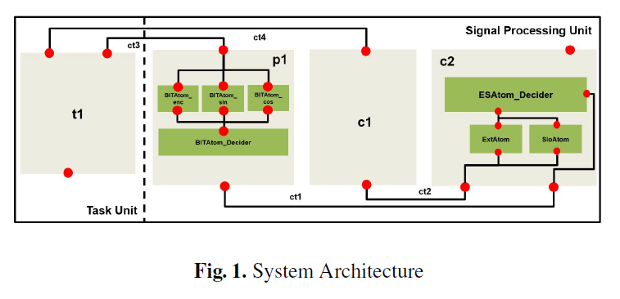
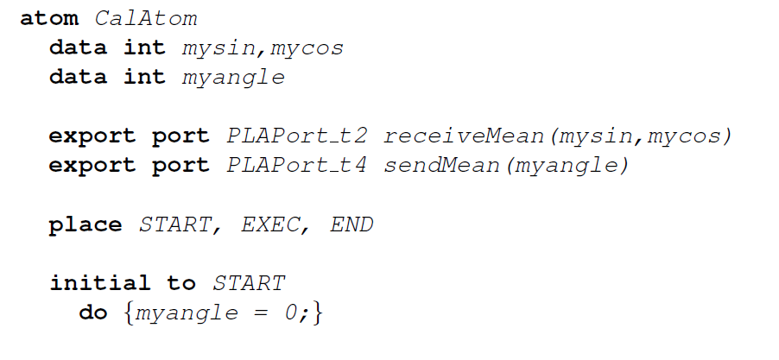
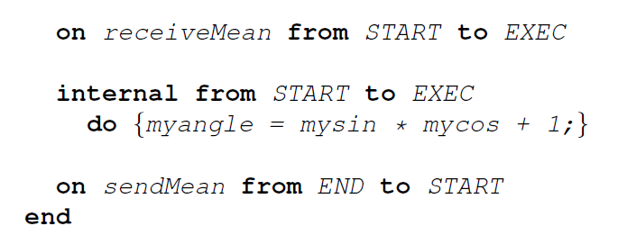
Technical Report
1. Introduction
2. Architecture in BIP
3. Case Study
-- Informal Description
-- Formal system model in BIP
-- Model Verification and Validation
4. Related Work
…
-- Model Verification and Validation
-> NuSMV
-> BIP2NuSMV

Slide 2
NuSMV Model
receiveBIT(PLA.sin, PLA.cos)
START
Transition | Guard | Action
1 | PLA.sin > 4000 | FlagQ:=False; q:=0
2 | PLA.sin >= 500 ∧ PLA.sin <= 4000 | FlagP:=False; p:=0;
3 | PLA.sin<500 | FlagP:=False; p:=0 FlagQ:=False; q:=0
4 | FlagP=True | null
5 | FlagQ=True | null
6 | p=5 | FlagP:=True; p:=0
7 | q=5 | FlagQ:=True; q:=0
8 | p<5 | null
9 | q<5 | null
10 | FlagP=False | p++
11 | FlagQ=False | q++
Diagnosis P1
Diagnosis P2
Diagnosis P3
Diagnosis Decider
p:=0; q:=0
output
WAIT
BIT Diagnosis
receiveBIT
③
sendBIT
EXEC
⑧
⑨
①
②
S1
S2
⑩
④
⑪
⑤
S11
S21
⑥
⑦
END

Slide 3
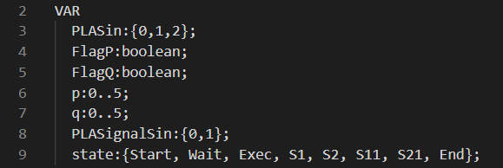
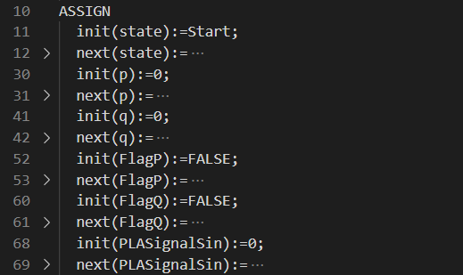
NuSMV Model
START
p:=0; q:=0
WAIT
receiveBIT
③
sendBIT
EXEC
⑧
⑨
①
②
S1
S2
⑩
④
⑪
⑤
S11
S21
⑥
⑦
END

Slide 4

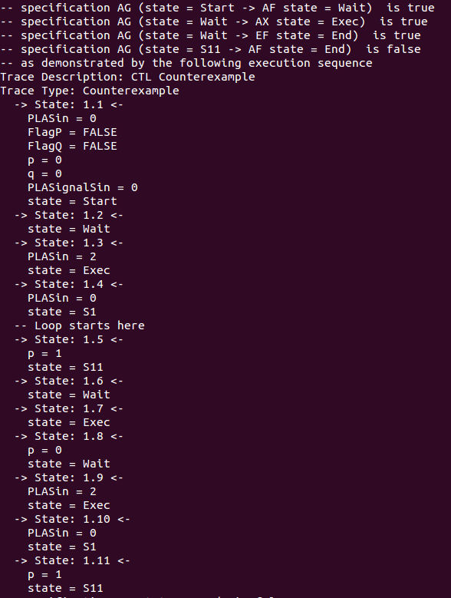
Properties
START
p:=0; q:=0
WAIT
receiveBIT
③
sendBIT
EXEC
⑧
⑨
①
②
S1
S2
⑩
④
⑪
⑤
S11
S21
⑥
⑦
END

Slide 5
Architecture model
PLA.sin := TPLA.sin; PLA.cos := TPLA.cos
PLA.sin := TPLA.sin; PLA.cos := TPLA.cos
ct4
ct3
Task
receiveBIT(PLA.sin, PLA.cos)
receiveMean(PLA.sin,
PLA.cos)
sendRes
sendMean
sendBIT
c2
Diagnosis P1
Diagnosis P2
Diagnosis P3
Diagnosis Decider
c1
Diagnosis P1
Diagnosis P2
Diagnosis Decider
t1
p1
sendBIT(PLA.Signal)
sendMean(PLA.CLB)
receiveMean
receiveBIT
produce(PLA.sin, PLA.cos)
ct2
BIT Diagnosis
ct1
Calibration Conversion
Extremum/Slope Diagnosis
Sensor Data
Data Processing Unit
Notes:
As a representation of the environment, compound component “sensor data” provides the input periodically. The component “Task” generates the four inputs, while the component “Cyclic trigger” gives the ‘start’ signal to send the inputs to data processing unit.
The compound automaton BIT Diagnosis receives two signal “PLA.sin” and “PLA.cos” and gives a valid/invalid signal of its input.
The component automaton Mean Data Calculation is used to convert the collected physical quantity to its original value.
The compound automaton Extremum/Slope Diagnosis integrates the signals and gives an overall judgment whether the input signal of system is valid or not.
//The component automaton Compensation & Filtering is used to give a standard output of collected data

Slide 6
Compound automaton —— BIT Diagnosis
receiveBIT(PLA.sin, PLA.cos)
Diagnosis P1
Diagnosis P2
Diagnosis P3
receive
receive
receive
BIT Diagnosis
Calibration Conversion
Extremum/Slop Diagnosis
send
send
send
Diagnosis Decider
receiveSignal
Data Processing Unit
output
BIT Diagnosis
As the first part of PLA signal processing, BIT Diagnosis consists of five parts: A diagnosis control module, three diagnosis parts and a diagnosis decider. A diagnosis control module is designed to control the other parts of system, it gives a “ready” signal with a certain delay after power on. The three diagnosis parts works in parallel to detect whether the two input signals “PLA.sin” and “PLA.cos” are valid or not, the results will be sent to the diagnosis decider, a total fault flag will be set “true” as long as one of the diagnosis part returns a fault flag of “true” value, otherwise this fault flag will be “false” indicating that the current signals is valid after BIT Diagnosis.
Notes:
TODO：分颜色画线

