Slide 1
DS · INTELLIGENT MODELING REPORT · 2025–2026
Lung Nodule
Prognostics
Multi-task deep learning with cross-talk for pulmonary nodule risk stratification
Raicu Maria
Roşca Eduard
Data Science · Group 245
Babeş-Bolyai University, Cluj-Napoca, România

Slide 2



THE CLINICAL PROBLEM
An indeterminate nodule is a clinical dilemma
Low-dose CT screening saves lives, but it surfaces many small lung nodules whose fate is uncertain — some stay harmless for years, others progress into aggressive cancer. Today, that call rests on a radiologist's subjective visual read.
THE CAUSE
FAILURE MODE 1
FAILURE MODE 2
Subjective assessment
Overtreatment
Undertreatment
Risk is judged by eye from size, shape and texture — vulnerable to human error and inter-reader variability.
Benign nodules sent for invasive, costly, stressful biopsies and repeated radiation exposure.
Malignant tumors missed and left to grow until intervention comes too late.
The underlying visual data is simply too high-dimensional for perfectly consistent human judgement.
Lung Nodule Prognostics · MultiTaskCrossTalkNet
2

Slide 3





WHY AN INTELLIGENT ALGORITHM
Beyond the limits of the human eye
High-dimensional imaging
3-D CT volumes hold tiny, complex patterns the human visual system cannot extract with perfect consistency.
Rules & linear models fall short
Progression depends on many interacting factors; rigid clinical guidelines and linear statistics cannot capture them.
THE CORE INSIGHT
Deep learning learns hierarchy
A multi-task model can learn several biologically linked properties of a nodule at once — texture, malignancy and growth — rather than treating them as separate problems.
CNNs automatically extract latent, hierarchical features straight from raw pixels and voxels.
Multi-task mirrors biology
Morphology, growth rate and malignancy are interdependent — not isolated variables to model in isolation.
Lung Nodule Prognostics · MultiTaskCrossTalkNet
3

Slide 4

THE CENTRAL HYPOTHESIS
Tasks that are biologically linked should be learned together.
Physical composition, malignancy risk and growth rate are interdependent. Sharing what each task learns should yield a more robust predictor than treating them in isolation — unlike single-task learning, which shares nothing.
Predict together
Let the tasks “talk”
Compared against isolation
One model predicts nodule texture and malignancy side by side, instead of one model per task.
Learnable links pass useful signal between the two tasks as the network trains — this is the “cross-talk”.
Single-task baselines learn each task on its own and share nothing — the benchmark to beat.
Lung Nodule Prognostics · MultiTaskCrossTalkNet
4

Slide 5


PREDICTION TARGETS
Three clinical tasks — one shared model
T1
T2
EXCLUDED
T3
Malignancy risk
Two-year progression
Radiological subtype
Binary target
Binary target
3-class target
0 · Benign
0 · Stable
0 · Solid
1 · Malignant
1 · Progressive
1 · Part-solid
2 · Ground-glass
Progression was dropped from every experiment. Its labels live in a clinical file with no shared identifier to join against the DICOM/XML imaging annotations — so they could not be matched to individual CT crops. All results use a two-task model: texture + malignancy.
Lung Nodule Prognostics · MultiTaskCrossTalkNet
5

Slide 6

DATA
508 nodule crops from LIDC-IDRI
508
128×128
157
≤ 4
nodule crops
px single-channel input
clinical records
radiologists per nodule
PREPROCESSING PIPELINE
1
2
3
4
5
Raw DICOM CT
Hounsfield Units
Clip & normalize
Crop ROI
Resize
512×512 axial slices, sorted on Z-axis
via RescaleSlope / Intercept
[−1000, 400] HU → [0, 1]
around annotated bounding box
to 128×128 px
Because nodules are reviewed by multiple radiologists, the dataset captures real-world inter-reader variability and uncertainty.
Lung Nodule Prognostics · MultiTaskCrossTalkNet
6

Slide 7
TARGETS & DATA REALITY
Simplified labels — and a severe imbalance
TEXTURE DISTRIBUTION · TEST SET (n = 101)
Texture score 1–5 → 3 subtypes
Ground-glass scores 1–2 Part-solid score 3
Solid scores 4–5
Malignancy → binary
0 · Benign 1 · Malignant
Test split: 41 benign / 60 malignant
96% solid. With 97 of 101 test nodules solid, the minority subtypes are almost unlearnable.
Lung Nodule Prognostics · MultiTaskCrossTalkNet
7

Slide 8


EXPERIMENTAL SETUP
How the models were trained
Data split — 60 / 20 / 20
Optimizer & selection
306 train 101 val 101 test
AdamW · the checkpoint with the lowest validation loss is kept and scored on the held-out test set.
Single-task baseline
Two sharing styles compared
Each task is trained on its own with the cross-talk switched off, so any difference comes from the sharing itself — not from a bigger model.
Cross-stitch — blends both tasks' features together.
Co-attention — lets each task pick out the other's useful signals.
A preliminary 15-sample run validated the full pipeline before scaling to 508 samples.
Lung Nodule Prognostics · MultiTaskCrossTalkNet
8

Slide 9
RESULTS · MALIGNANCY
Cross-talk did not beat the baseline
MACRO-F1 vs BENIGN RECALL
Model | Macro-F1 | Malig. F1 | Benign rec.
STL | 0.56 | 0.72 | 0.32
Cross-stitch | 0.55 | 0.74 | 0.24
Co-attention | 0.49 | 0.72 | 0.17
THE TRADE-OFF
Cross-stitch nudges malignant recall up to 0.90, but erodes benign recall — leaving macro-F1 flat. Co-attention is worse on every metric. No clear gain from sharing.
Lung Nodule Prognostics · MultiTaskCrossTalkNet
9

Slide 10



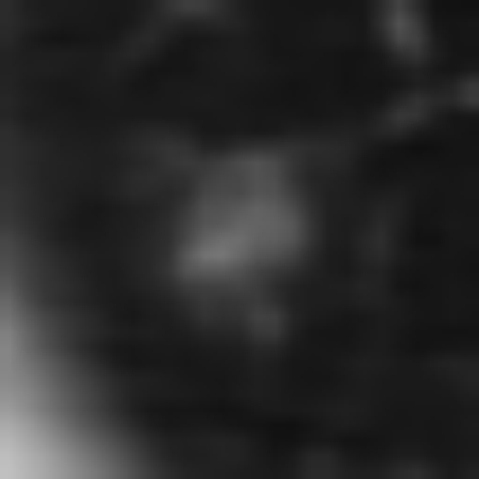


RESULTS · TEXTURE & QUALITATIVE
All models collapse to “solid”
For texture, STL, cross-stitch and co-attention give identical predictions — every nodule labelled solid (macro-F1 0.33) — because 97 of 101 test samples are solid. The four held-out crops below compare ground truth (GT) with the cross-stitch model's prediction (Pred).
GT: Solid · Benign
Pred: Solid · Malignant
GT: Solid · Malignant
Pred: Solid · Malignant
GT: Solid · Benign
Pred: Solid · Malignant
GT: Ground-glass · Malignant
Pred: Solid · Benign
Takeaway. With no learning gradient for the minority subtypes, the cross-talk signal carries no useful information — and can reinforce the existing majority-class bias.
Lung Nodule Prognostics · MultiTaskCrossTalkNet
10

Slide 11
THE HONEST NEGATIVE RESULT
The hypothesis was not supported — and that is a useful result.
01
02
03
Not the architecture — the data
Negative transfer
Honest reporting matters
The bottleneck was class distribution and label quality, not the cross-talk design itself.
A degenerate texture branch (“always solid”) passed no useful gradient and reinforced the malignant-majority bias.
A clear negative result is a real signal for others applying multi-task learning to small, imbalanced medical datasets.
Lung Nodule Prognostics · MultiTaskCrossTalkNet
11

Slide 12

LIMITATIONS & FUTURE WORK
What to fix, and what comes next
Limitations
Future work
Extreme class imbalance — 97 of 101 test nodules solid — minority subtypes cannot be meaningfully evaluated.
Balance the classes — Class-weighted loss, minority oversampling, or balanced sampling strategies.
Three tasks → two — Progression dropped for lack of a join key — the task most likely to benefit from sharing.
Go volumetric — 3-D convolutional inputs to capture full nodule morphology.
Modest scale — 508 samples strain multi-branch CNNs; the richer co-attention unit likely overfits.
Restore progression — Re-introduce the third task via a corrected clinical-to-imaging linkage.
2-D only — A single mid-slice discards the volumetric information radiologists rely on.
Better subtype coverage — A larger dataset with stronger ground-glass and part-solid representation.
Lung Nodule Prognostics · MultiTaskCrossTalkNet
12

Slide 13
CONCLUSION
Cross-talk is only as good as the supervision behind it.
MultiTaskCrossTalkNet jointly predicts nodule texture and malignancy through learnable cross-stitch and co-attention links. On 508 LIDC-IDRI crops under severe class imbalance, neither variant reliably beat the single-task baseline — the limiting factor was data quality and balance, not the architecture.
The path forward: balanced sampling · volumetric inputs · a restored progression task.
Raicu Maria · Roşca Eduard DS · Intelligent Modeling · 2025–2026

