Slide 1
COMPLEX NETWORKS
The Actor
Co-Appearance Network
Notes:
Hello, my name is REM and today I’ll be presenting my project on a Network based on ac tor co-appearances.

Slide 2
THE IDEA
What network is buried in the data?
We started with a spreadsheet of 2,998 top-rated IMDB movies.
Our choice of representation:
Each node is an actor.
Two actors are linked if they appeared in the same movie.
FROM MOVIES TO ACTOR LINKS
Movie
A
B
C
↓ project onto actors
A
One quirk worth knowing The data lists exactly 3 top-billed actors per film. So a link means “co-starred among the top 3”
B
C
2
Notes:
The data was first scraped from imdb top few thousands and then from a specialized api built for getting more details about movies. We ended up with around 3500 actors and 8500 links between them. The actors will be represented by nodes, and if 2 actors appear in the same movie, they get linked.

Slide 3
OUR QUESTIONS
What we set out to learn
Before we measured anything, we wrote down what we actually wanted to find out.
01
02
03
Who are the most connected actors?
Does the network split into distinct cinematic groups?
What type of network is it?
Beyond fame, who sits at the centre of the industry, and does "most connected" mean the same thing under every measure?
Can we recover meaningful clusters like Marvel-style franchises, genres or eras just from who worked with whom?
Random, scale-free, small-world, or something else? Which model best explains its shape, and where does reality go beyond the models?
3
Notes:
Some of the questions we set out to answer would be the following: - What actors sit at the center of the industry - Can we recover meaningful clusters like marvel-style franchises or genres just based on who worked with who - What type of network is it?

Slide 4
METHOD
Three networks, side by side
To judge whether the actor network is special, we compare it against two artificial networks of the same size.
REAL
RANDOM
SCALE-FREE
Actor Network
Erdős–Rényi
Barabási–Albert
The genuine co-appearance network built from IMDB films. This is what we want to understand.
Same nodes and edges, but every link placed by pure chance. A null model: what cinema would look like with no underlying structure.
Grown so new actors prefer to link to already-popular ones. A "rich-get-richer" model that naturally produces hubs.
4
Notes:
Our network is gonna get compared to the Random Erdos-Renyi and Scale-Free Barabasi-Albert networks.

Slide 5
RESULTS
Network properties at a glance
 | Real | Random (ER) | Scale-Free (BA)
Nodes | 3,446 | 3,446 | 3,446
Edges | 8,375 | 8,375 | 6,888
Average degree | 4.86 | 4.86 | 4.0
Maximum degree | 77 | 13 | 160
Connected components | 213 | 28 | 1
Largest component | 2,692 (78%) | 3,419 | 3,446
Average clustering | 0.72 | 0.001 | 0.01
Avg. path length (GC) | 4.59 | 5.33 | 4.59
Diameter (GC) | 15 | 11 | 8
HOW TO READ IT
Clustering 0.72 vs 0.001
The real network is ~700× more clustered than chance.
Max degree 77 vs 13
Real cinema has hubs that random wiring never produces.
213 components
The network is fragmented, but 78% sit in one giant piece.
5
Notes:
Here are all the key numbers side by side. Three things stand out. The maximum degree: the busiest actor has 77 co-stars in real life, but only 13 in the random network. Connected components: the real network breaks into 213 pieces which was expected since not all actors are connected. And clustering: 0.72 in the real network versus something closer to 0 in the other 2.

Slide 6
THE BIG PICTURE
Four numbers that define the network
0.72
4.6
77
30
Average clustering
Steps between any two actors
Co-stars of the top hub
Communities detected
Co-stars of co-stars are usually co-stars too
"Six degrees" — confirmed in our data
Tom Hanks, the most connected actor
Distinct working circles by era & genre
6
Notes:
Here are the main 4 numbers that define the network: Clustering of 0.72. 4.6 steps between any two actors. 77 co-stars for the top hub — with tom Tom Hanks at the top. And 30 distinct communities .

Slide 7
IMPORTANT NODES
Who are the most important actors?
"Important" depends on what you mean — so we measured it four ways. The lists overlap, but the differences are the insight.
Degree
Betweenness
Closeness
Eigenvector
MOST CO-STARS
BRIDGES BETWEEN WORLDS
BEST-POSITIONED
IN THE DENSE CORE
1
Tom Hanks
1
Tom Hanks
1
Robert De Niro
1
Robert De Niro
2
Robert De Niro
2
Robert De Niro
2
Matt Damon
2
Matt Damon
3
Nicolas Cage
3
Mark Wahlberg
3
Brad Pitt
3
Brad Pitt
Prolific — long careers, many films.
Connect otherwise-separate film circles.
Can reach everyone else in few steps.
Linked to other highly-connected actors.
7
Notes:
Who is the most important actor? That depends. We measured four ways. ---- With these answers, we can see that most names get repeated, giving us the following important actors: Tom Hanks, Robert De Niro, Matt Damon and Brad Pitt

Slide 8
IMPORTANT NODES
A handful of actors carry the network
WHAT IT MEANS
The average actor has just 5 co-stars — but the busiest has 77.
There is no "typical" actor.
A few hubs tower over a long tail of actors with only one or two connections. This heavy-tailed shape is the fingerprint of a scale-free-like network — and the opposite of the bell curve a random network would produce.
8
Notes:
Here are a few of the top nodes by degree. We can see that these values are all above 50, while the average sits at around 5. This might also be because of the used data, since for every movie we only had the top 3 highest paid actors.

Slide 9
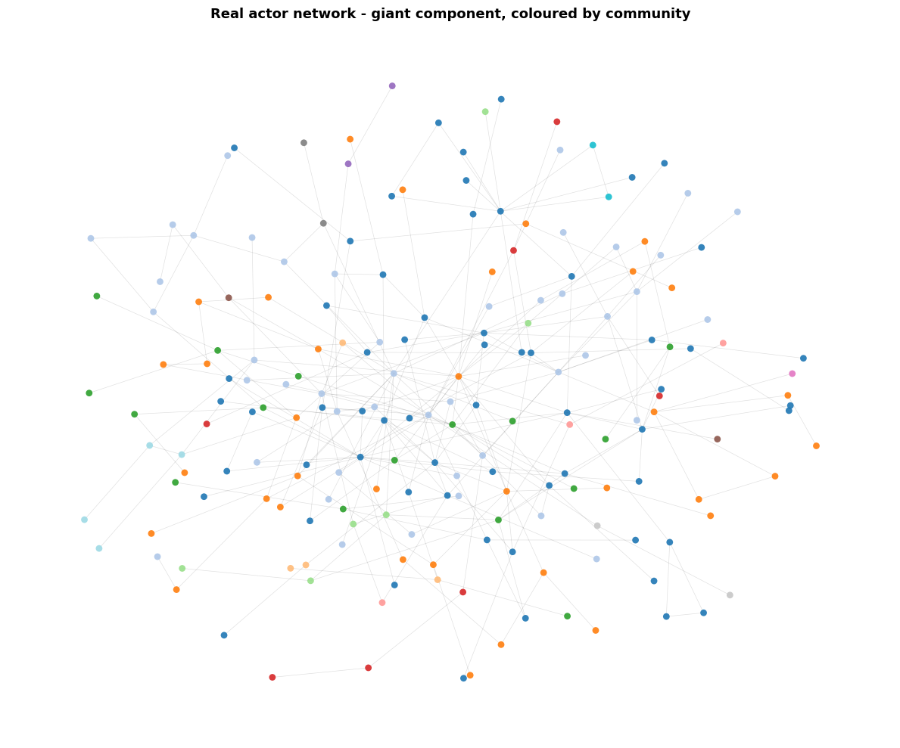
VISUALIZATION
The network, coloured by community
WHAT YOU'RE LOOKING AT
A sample of the giant component. Each dot is an actor; size reflects number of co-stars; colour marks the community it belongs to.
The eye can already see it: the network is not an even mesh. It clumps into dense, coloured neighbourhoods loosely stitched together — exactly the structure community detection picks up next.
9
Notes:
This is a sample of the network, drawn with each community in its own color.

Slide 10
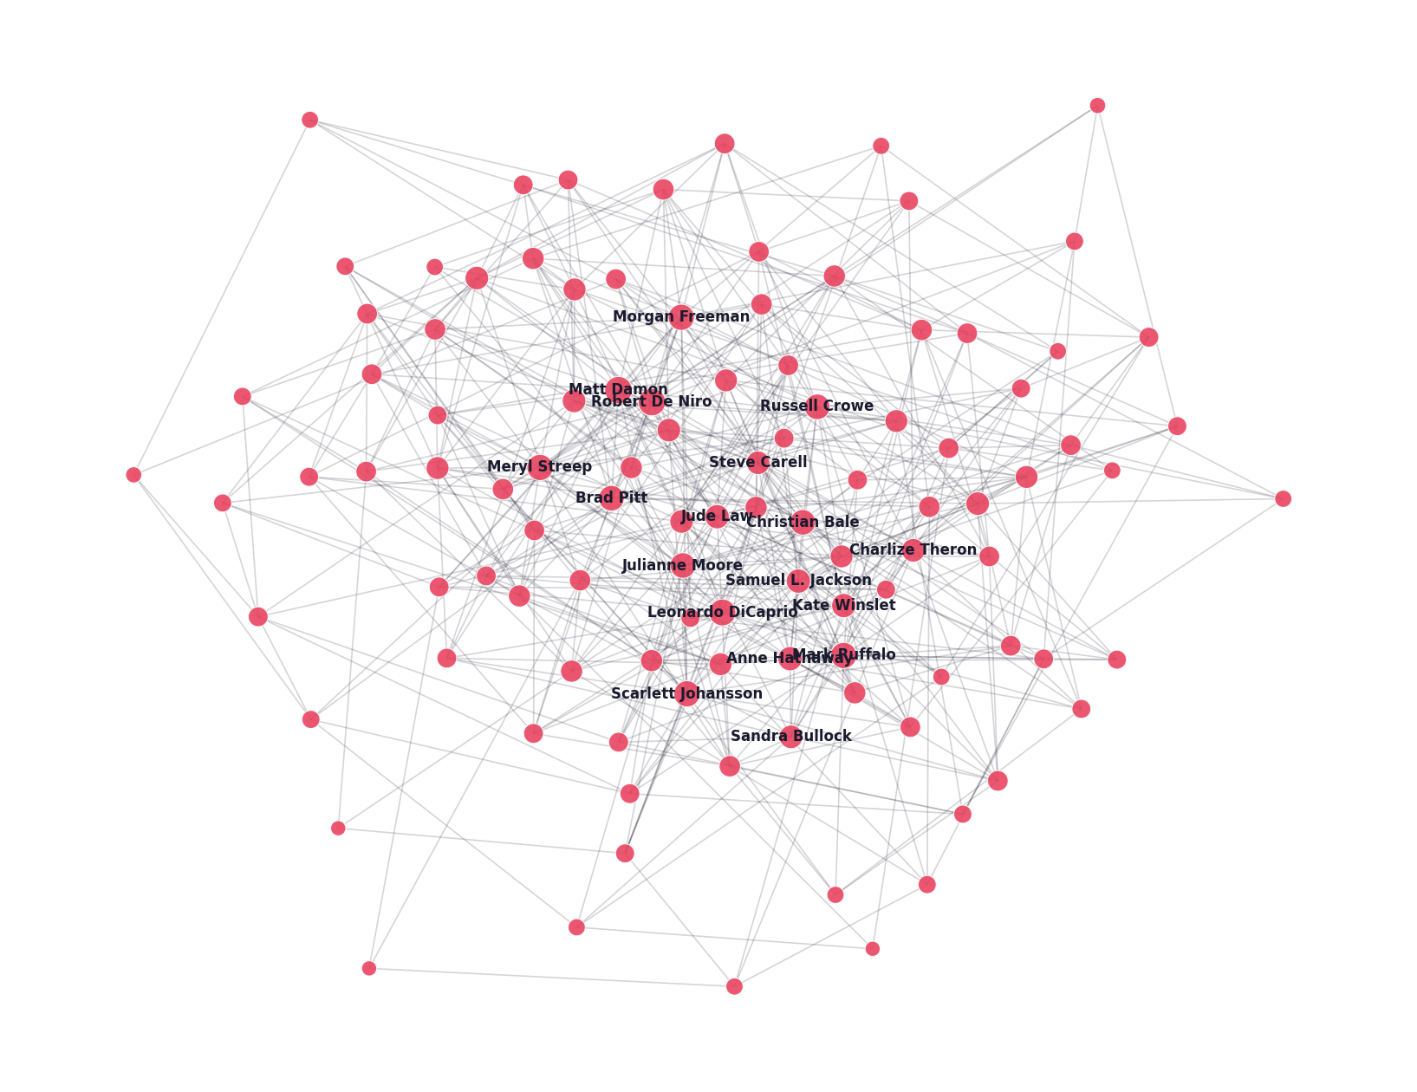
VISUALIZATION
The core — actors with 25+ co-stars
THE INNER CIRCLE
Strip the network down to only its most-connected actors and 106 remain — and they are nearly all linked to each other.
This is the dense Hollywood core: the A-list works with the A-list. It is what gives the network short paths despite being split into hundreds of fragments elsewhere.
10
Notes:
Now we have the network down to only the most-connected actors those with 25 or more co-stars. Just 106 actors remain, and they're nearly all linked to each other. This is probably the dense Hollywood core.

Slide 11
COMMUNITIES
Distinct cinematic groups
We found 30 communities at modularity 0.55 — a clear sign of genuine grouping. The largest, named by their best-known members:
170
Old-Guard Drama & Crime
159
Modern Blockbuster
De Niro · Pacino · Hackman · Denzel Washington
S. L. Jackson · Scarlett Johansson · Chris Evans
ACTORS
ACTORS
144
Action Franchise
133
Prestige Drama
Dwayne Johnson · Vin Diesel · Jason Statham
DiCaprio · Cate Blanchett · Kate Winslet
ACTORS
ACTORS
11
Notes:
30 communities were found, and I tried to manually assign them some labels, and we have: ---

Slide 12
COMMUNITIES
Did we recover the "Marvel cast"?
MODULARITY — DOES IT PROVE STRUCTURE?
PARTLY — AND THE "WHY" MATTERS
The communities clearly track era and genre — old-guard drama, modern blockbusters, action franchises.
But they do not seal off a single franchise like Marvel. Marvel actors scatter across the blockbuster cluster instead of forming their own.
Why? With only 3 actors recorded per film, an actor like Scarlett Johansson is also tied to all her non-Marvel films — which stitches her cluster outward into the rest of cinema.
Even the random network scores 0.45. A high modularity number alone is not proof — any large sparse graph can be carved into plausible-looking groups. The real evidence is qualitative: our groups contain interpretable real-world patterns. The random network's do not.
12
Notes:
Was the Marvel cast recovered? Not really the separation was more on eras and genre groups.

Slide 13
STRUCTURE
A small world
Two actors, on average, are separated by fewer than five co-starring steps — yet the network is split into tight, cliquey groups. Having both at once is what makes a "small world."
AVERAGE PATH LENGTH
SMALL-WORLD RATIO σ
4.59
5.33
Real paths are even shorter than random.
≈ 880
REAL
RANDOM
AVERAGE CLUSTERING
0.65
0.001
Real clustering dwarfs the random baseline.
Far above 1 — the threshold for small-world structure. The actor network clears it by a wide margin.
REAL
RANDOM
13
Notes:
Now the small-world test. A small world means two things at once: any two nodes are only a few steps apart, AND the network is highly clustered. Our network has both. Path length 4.59 versus 5.33 random — actually shorter than random. Clustering 0.65 versus 0.001 random — far higher. The combined small-world ratio is around 880, way above 1. This is exactly the structure behind the six degrees of Kevin Bacon idea.

Slide 14
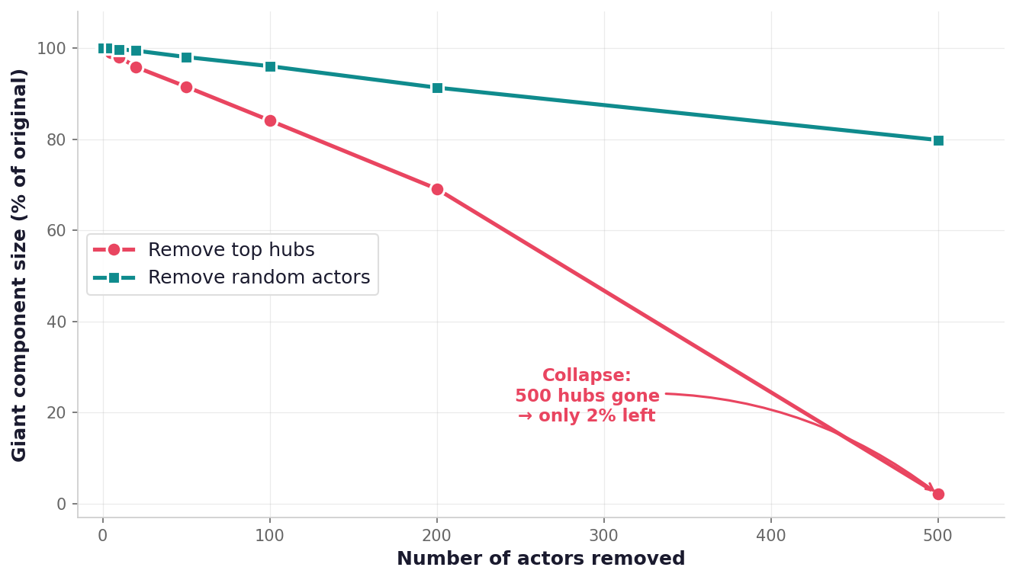
ROBUSTNESS
What happens if the hubs disappear?
An interesting question for any social network — how much does the structure depend on a few key players?
WHAT WE TESTED
We removed actors from the network in two ways and tracked the largest connected component.
Targeted:
remove the highest-degree actors first.
Random:
remove actors picked at random.
Remove 500 random actors — 80% of the network still connected. Remove the top 500 hubs — only 2% left. The network is fragile to targeted attacks, resilient to random loss. Classic scale-free behaviour.
14
Notes:
One additional question: What happens if the hubs disappear? This was tested in 2 ways: removing random actors and removing actors from top hubs. If we remove 500 actors at random, 80 percent of the network is still connected. But if we remove the 500 most-connected actors only 2 percent survives. The drop is drastic.

Slide 15
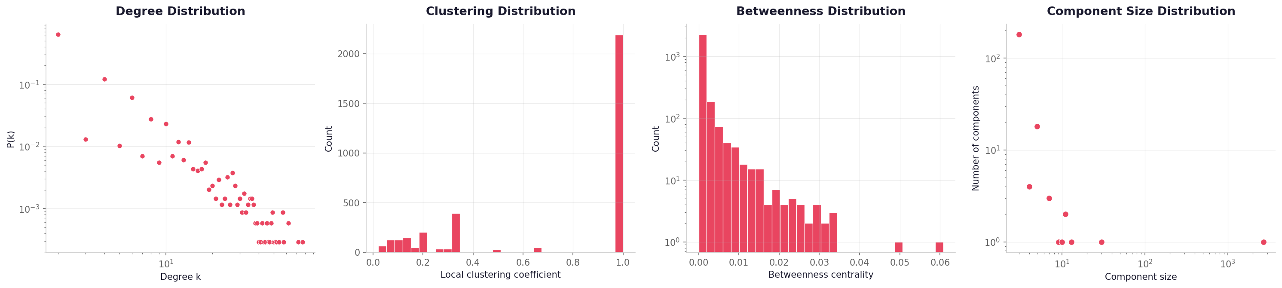
DISTRIBUTIONS
Real network — four distributions
READING THE ROW
Degree drops off steeply (heavy tail). Clustering spreads widely toward 1.0. Betweenness is heavy-tailed — a few critical bridges. Components: one giant, many tiny.
15
Notes:
Next up we’re gonna have the 4 distributions for each of the networks: Far left: degree distribution drops off steeply, like a power law. Most actors have few co-stars, a few have many. Second: clustering values spread all the way to 1.0, with lots of high values. Third: betweenness is heavy-tailed, meaning we have a few critical bridge actors. Far right: one giant component, plus many tiny ones from isolated 3-actor movies.

Slide 16
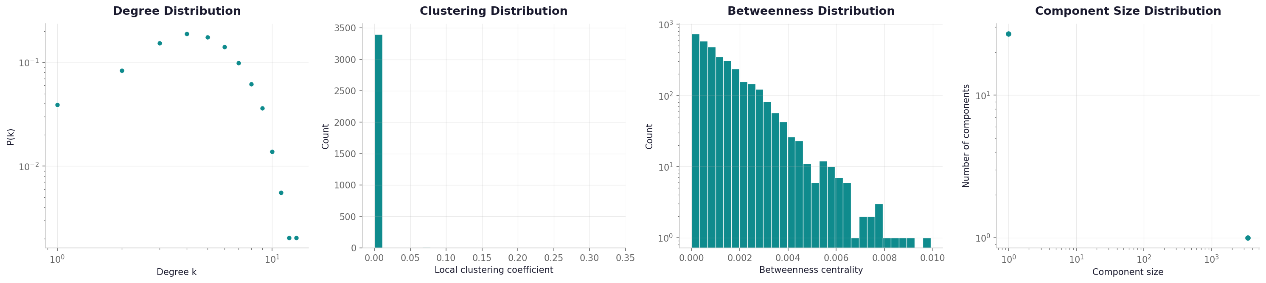
DISTRIBUTIONS
Random (ER) — four distributions
READING THE ROW
Degree is a tight bell curve — no hubs. Clustering is crushed near zero. Betweenness sits in a narrow band. Almost everything is in one component.
16
Notes:
Same four plots for the random network, and we can see that in comparison, Degree is a bell curve. Clustering is very close to zero. Betweenness is squeezed into a narrow range and we have just 1 big component Components.

Slide 17
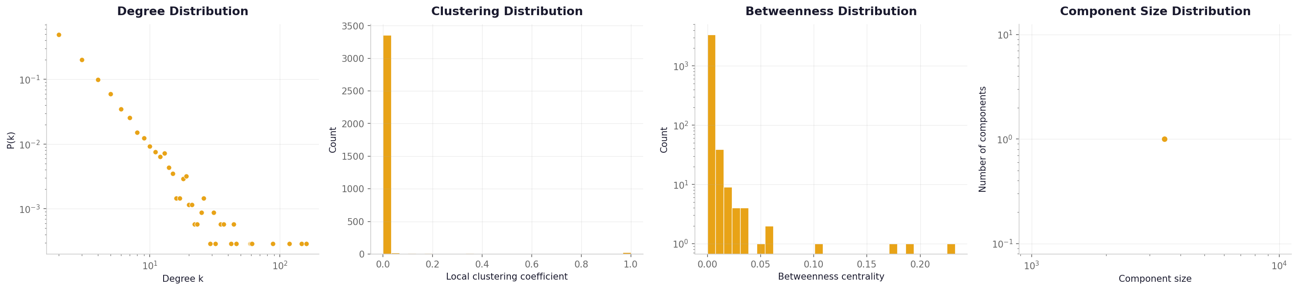
DISTRIBUTIONS
Scale-Free (BA) — four distributions
READING THE ROW
Degree shows a power-law tail — like the real network. But clustering is still near zero, and it forms a single component. BA captures hubs, not cohesion.
17
Notes:
And the scale-free network. Degree shows a clear power-law tail, like our real network, But clustering is still near zero. And it's a single connected component.

Slide 18
VERDICT
What type of network is this?
Small-world
Strong communities
Heavy-tailed degrees
CONFIRMED
CONFIRMED
YES, WITH NUANCE
Short paths (4.6) with very high clustering (0.72). σ ≈ 880.
30 interpretable groups organised by era, genre and franchise.
Power-law exponent ≈ 2.7 — but a log-normal fits marginally better.
THE CONCLUSION
The actor network is a small-world network with a heavy-tailed degree distribution and strong community structure. Neither model alone reproduces it — the random graph misses the hubs and the clustering; the scale-free graph misses the clustering and the communities. Real cinema borrows the hubs of one and far exceeds the clustering of both, because its shape is driven by something no model contains: the genuine working relationships of the film industry.
18
Notes:
So what type of network is this We have short paths with very high clustering. We have Strong communities: confirmed, with 30 interpretable groups. And we have Heavy-tailed degrees. The conclusion is that our actor network is a small-world network with hubs and strong community structure. One things I should have done, is also generate a mock small-world network to compare to.

Slide 19
REFLECTION
Expectation vs. result
What we measured | What we expected | What we found
Clustering | High — films make triangles | Very high (0.72) ✓
Hubs / max degree | A few dominant actors | Confirmed — Hanks at 77 ✓
Path length | Short — "six degrees" | Confirmed — 4.6 steps ✓
Communities | Clean franchise rosters | Era & genre groups; franchises blur
Degree distribution | A clean power law | Heavy-tailed; log-normal fits better
vs. random model | Very different | Confirmed — no hubs, no clustering ✓
The most useful lesson: real networks are never pure textbook models — the gaps between model and reality are where the insight lives.
19
Notes:
We also have a table of what was expected and what was actually discovered, about everything I’ve talked about so far.

Slide 20
THANK YOU
Actor Co-Appearance Network · Complex Networks Project

