Slide 1
COMPLEX NETWORKS • 2025–2026
SIR Spread Simulation
Across Network Topologies
Roşca Eduard-Mitruţ
Data Science • Babeș-Bolyai University, Cluj-Napoca
Notes:
------------------------. The framing throughout is mobile app adoption, but the dynamics are general.

Slide 2


Apps spread similarly to diseases
Both move person-to-person through a social graph.
Disease
Mobile App
Pathogen spreads through contact
Hosts infect, then recover or die
Outbreak shape depends on contact network
Install spreads via recommendation
Users install, then uninstall
Growth shape depends on social graph
Notes:
The core analogy: an app spreading through recommendations works just like a pathogen spreading through contact. People install instead of getting infected, and they delete instead of recovering. In both cases, the shape of the outbreak depends on who's connected to whom.

Slide 3


The SIR model
Three states, two transitions. Every user sits in exactly one compartment.
β
γ
Susceptible (S)
Infected (I)
Recovered (R)
Could install
Active user
Churned
Has not yet adopted the app, but could be reached by a recommendation.
Currently using the app and recommending it to neighbours at rate β.
Deleted the app at rate γ. Does not reinstall.
Notes:
The SIR model has three states. Susceptible: a person that could install but hasn't. Infected is an active user who recommends to neighbours at a rate beta. Recovered: has deleted the app at rate gamma and won't come back. Everyone is in exactly one box, and they only move from left to right: S to I to R.

Slide 4
Four canonical network topologies tested
Each captures one structural extreme of real social networks.
RANDOM
SCALE-FREE
Erdős–Rényi
Barabási–Albert
Every pair of nodes connected independently with probability p. Homogeneous degree, short paths, low clustering.
Preferential attachment produces a few hub nodes with very high degree. Power-law degree distribution.
SMALL-WORLD
REGULAR GRID
Watts–Strogatz
Square Lattice
Ring lattice with a few rewired shortcuts. High local clustering plus short global paths.
Each interior node has exactly four neighbours. No shortcuts; spreading proceeds as a spatial wave.
Notes:
I tested four network types: Random (Erdős–Rényi). Scale-free (Barabási–Albert). Small-world (Watts–Strogatz) and a square lattice grid.

Slide 5
Structural properties differ sharply
Measured on the generated graphs used in our simulations (N ≈ 200).
Topology | ⟨k⟩ | k_max | Clustering C | Avg path L | Diameter
Erdős–Rényi | 9.42 | 17 | 0.046 | 2.59 | 4
Barabási–Albert | 5.91 | 41 | 0.102 | 2.83 | 5
Watts–Strogatz | 6.00 | 8 | 0.438 | 4.42 | 8
Square Lattice | 3.71 | 4 | 0.000 | 9.33 | 26
HUB
CLUSTER
DISTANCE
BA's k_max = 41
WS C = 0.44
Lattice L = 9.3
One node connects to 21% of the network
Tight local communities
No shortcuts -> long paths
Notes:
These graphs have significant structural differences before even doing any simulation runs. For example: for the Barabasi network, one node touches 21% of the network while the others max out at around 9%. Watts–Strogatz has high clustering, even four times bigger than any other. And the lattice has long average path length and diameter, two and even three times bigger than the others

Slide 6
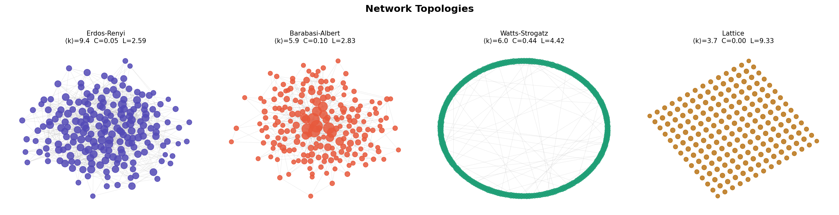
Visualization of the topologies
Snapshot of each topology before seeding
Notes:
Here’s a visualization of each topology as a graph before seeding any infections.

Slide 7
How the simulation runs
Synchronous discrete-time SIR on each topology — same dynamics, different graphs.
1
Seed
Start with 2% of nodes randomly marked Active. All others Susceptible.
2
Propagate
Each Active node infects every Susceptible neighbour with probability β and recovers with probability γ.
3
Stop
Run until no Active nodes remain. Repeat 30 times per topology to average over randomness.
Fixed parameters: β = 0.12 • γ = 0.05 • N ≈ 200 • 30 runs per topology
Notes:
For the mechanics, I Seeded 2% of nodes as active, then each step every active node tries to infect each susceptible neighbour with probability beta and recovers with probability gamma. Run until no active nodes remain, and repeat 30 times to average out randomness. Parameters are fixed across all topologies.

Slide 8
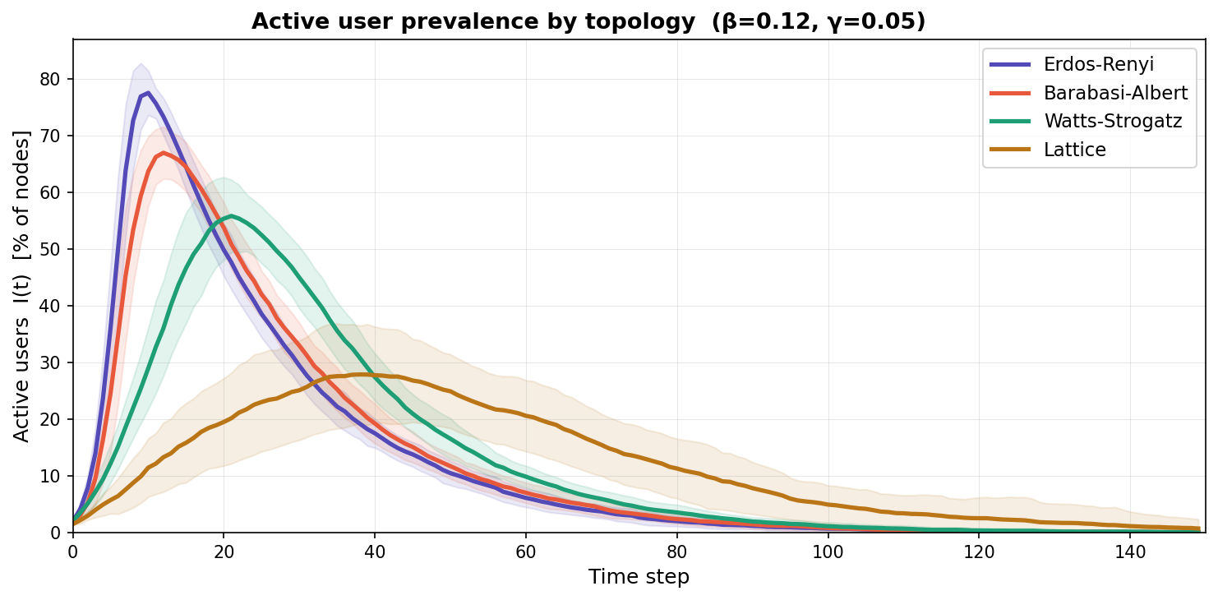
Topology shapes the epidemic curve
Active users I(t)/N over time, averaged over 30 runs per topology.
WHAT TO SEE
ER peaks earliest and highest.
BA closely follows — hubs ignite spread.
WS is slower — clustering traps spread locally.
Lattice crawls as a spatial wave.
Notes:
Even though we have the same dynamics, we also have very different curves. The random network peaks earliest and highest. Scale-free follows closely because hubs ignite the spread. Small-world is slower since clustering traps transmissions locally, and the lattice just crawls along as a wave.

Slide 9
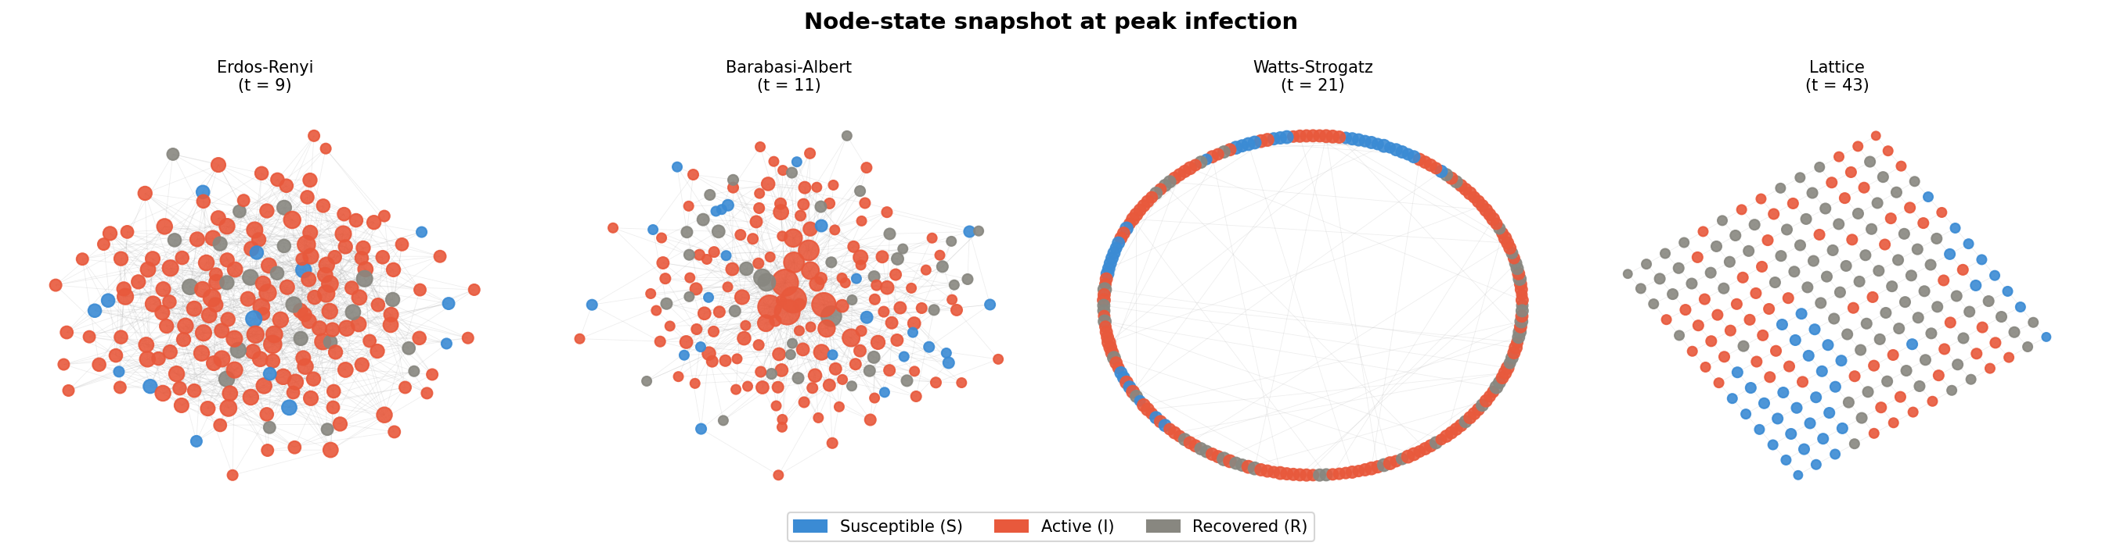
Peak infection snapshot
Snapshot of each topology at the peak of infection
Notes:
A snapshot of each network at peak infection, where you can see how “bad” the infection got in each structure at its busiest moment.

Slide 10
How big? How fast?
Peak active prevalence and time to peak across the four topologies.
Peak active prevalence (%)
Time to peak (simulation steps)
More than 2× difference in peak reach, and 4.5× difference in time to peak — driven by network structure.
Notes:
Quantifying the difference we can see more than 2x variation in peak reach and 4x in time to peak, all driven purely by structure, since the disease parameters were identical.

Slide 11
Why each topology behaves the way it does
Erdős–Rényi
High mean degree + uniformity -> every node has many simultaneous targets. Burns through the network fast.
Barabási–Albert
Hubs act as super-spreaders. A single high-degree node seeds dozens at once, compressing the timeline.
Watts–Strogatz
Tight clusters waste transmissions on already-infected friends. Long-range shortcuts eventually carry it everywhere.
Square Lattice
No shortcuts at all. Spread advances roughly one cell per step, kind of like a slow spatial wave that may not finish.
Notes:
The intuition for each. Random burns fast because every node has many targets. Scale-free hubs act as super-spreaders. Small-world wastes infections on already-infected friends but shortcuts eventually carry it across. The lattice advances one cell per step and may never finish.

Slide 12


Takeaways & limitations
What the model says, and what it cannot.
Takeaways
Limitations
Network structure is the dominant variable in adoption dynamics.
Hubs in scale-free graphs are leverage points for seeding growth.
High clustering slows but does not stop adoption.
Locally connected populations need multiple seeds to ensure reach.
β and γ are homogeneous — real users vary in influence.
Graphs are static; real social networks rewire constantly.
No reinstall (SIRS) and no external drivers (ads, media).
N = 200 is small; lattice results are especially variable.
Notes:
Takeaways: network structure is the dominant variable, hubs are leverage points for seeding growth, and clustering slows but doesn't stop spread. For the limitations Limitations : parameters are fixed while real users vary in influence, graphs are static while real networks rewire constantly, there's no reinstall or external advertising begin accounted, and N=200 is pretty small.

Slide 13
Thank you

