Slide 1
WIKIPEDIA vote network analysis

Slide 2
Wikipedia Voting System
A small part of Wikipedia contributors are administrators, with access to additional features that aid in maintenance
In order to become an admin, a request is issued by a user, and a public vote is held. With the result comes the decision to promote the user or not to the status of administrator

Slide 3
Wiki-Vote Dataset
Contains all election and vote history data, from the inception of Wikipedia up to January 2008
Nodes in the network represent users and a directed edge from node a to node b represents that user a voted for user b when the promotion vote was held for user b
~7000 Nodes
Over 100k Edges

Slide 4
The 3 Networks
Real Wiki-Vote
It represents the voting network for Wikipedia adminship
Random Erdos-Renyi
- Links are formed entirely by chance with a fixed probability. This acts as a null model, simulating what the Wikipedia community would look like if everyone just voted for random people without any underlying social structure or preference
Scale-Free Barabsi-Albert
- Formed using with the idea that new nodes are more likely to connect to nodes that already have many connections. This simulates a "rich-get-richer" dynamic, representing a scenario where already-popular Wikipedia candidates attract even more votes simply because they are highly visible

Slide 5
Degrees

Slide 6
Components

Slide 7
Shortest Path & Diameter

Slide 8
Average Clustering Coefficients
Notes:
Indicates a tighter network

Slide 9
Top 3 Most Important By Degree

Slide 10
Top 3 Most Important By PageRank

Slide 11
Top 3 Most Important By Betweenness
Notes:
Nodes that have higher control over the information flow

Slide 12
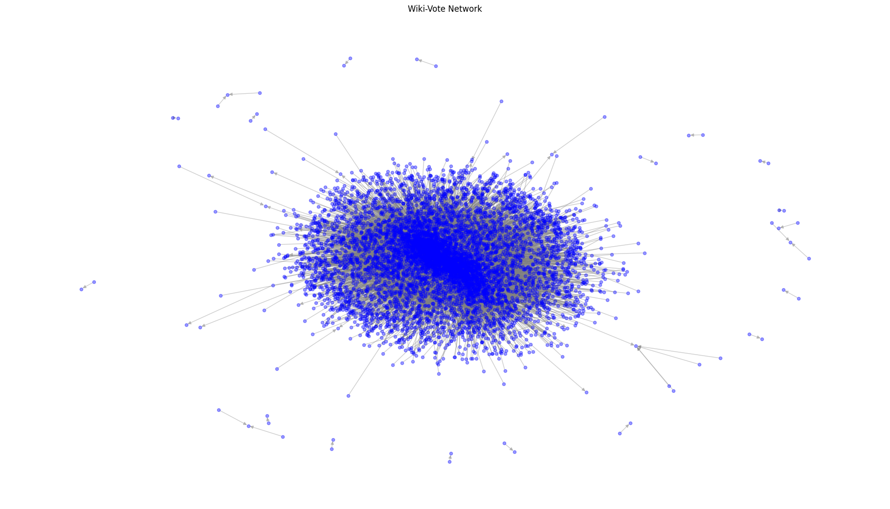
Visualization of the Network

Slide 13
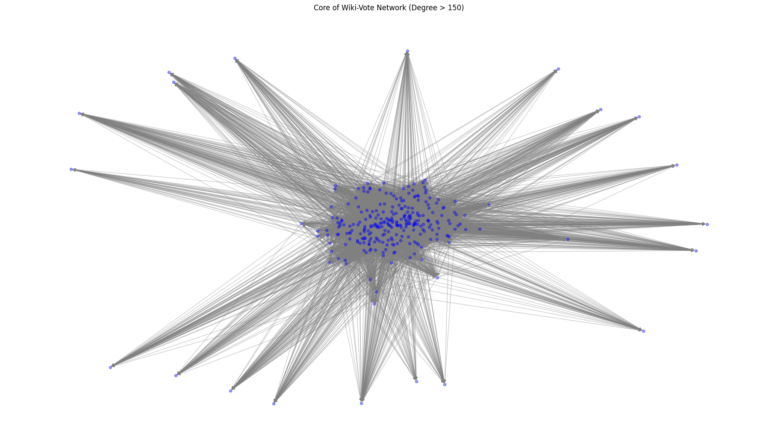
Visualization of the Network Core (Degree > 150)

Slide 14
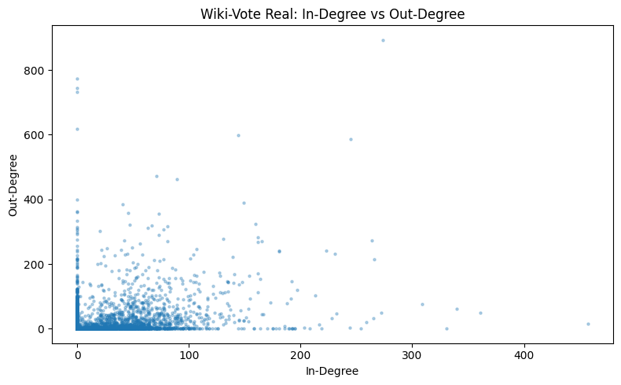
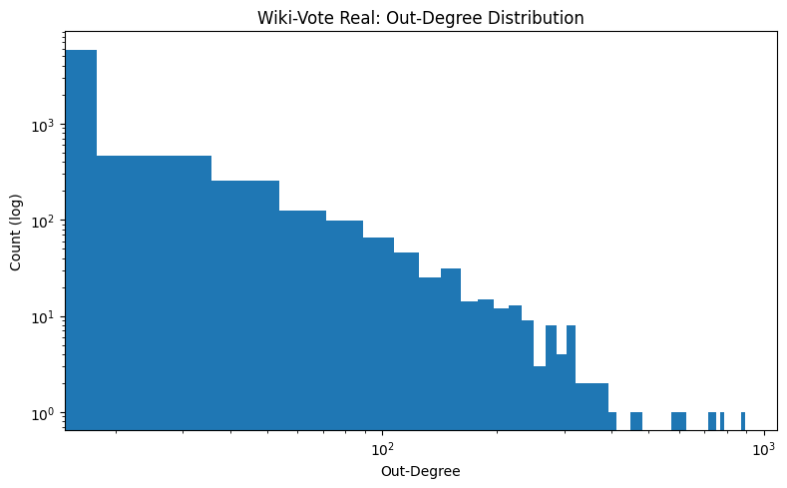
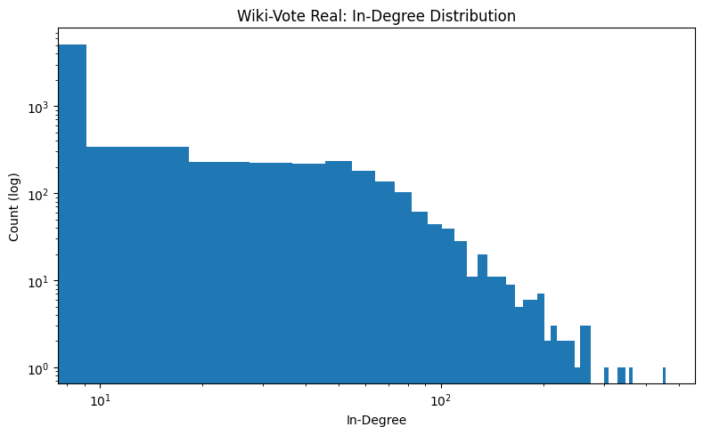
Wiki-Vote Plots

Slide 15
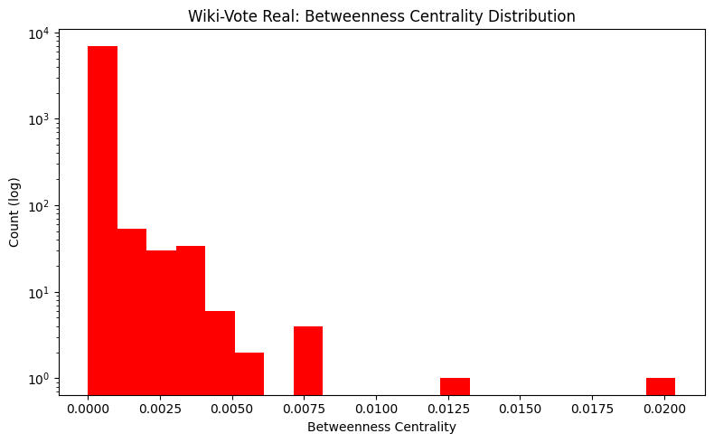
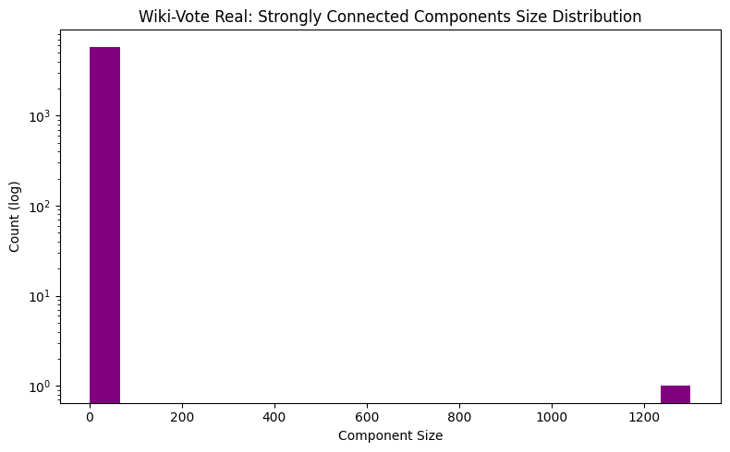
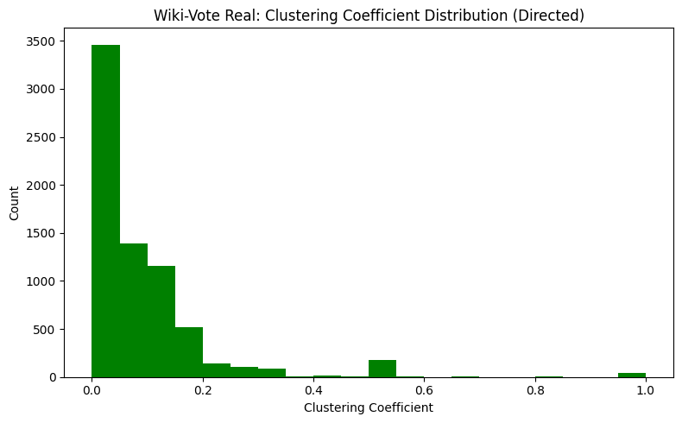
Wiki-Vote Plots

Slide 16
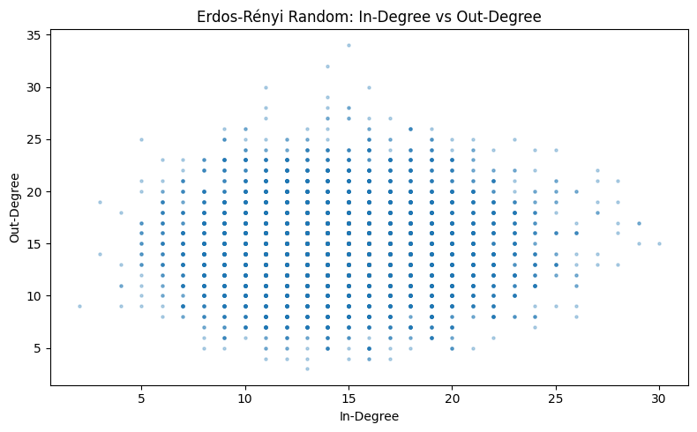
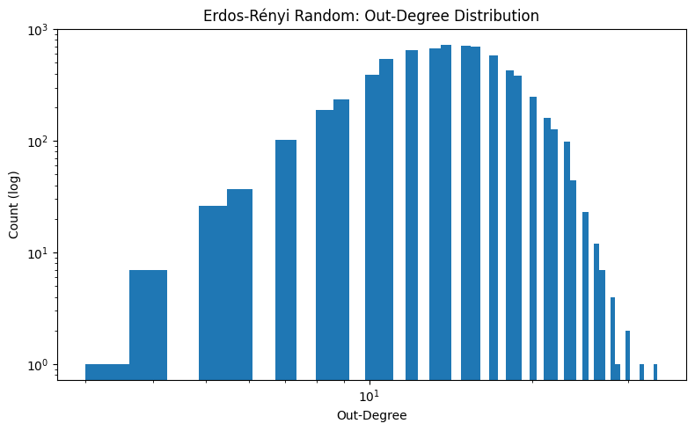
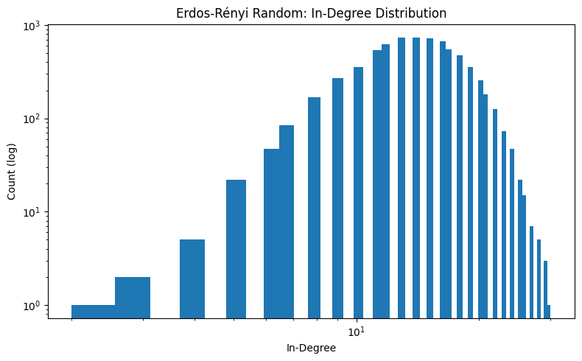
Erdos-Renyi Plots

Slide 17
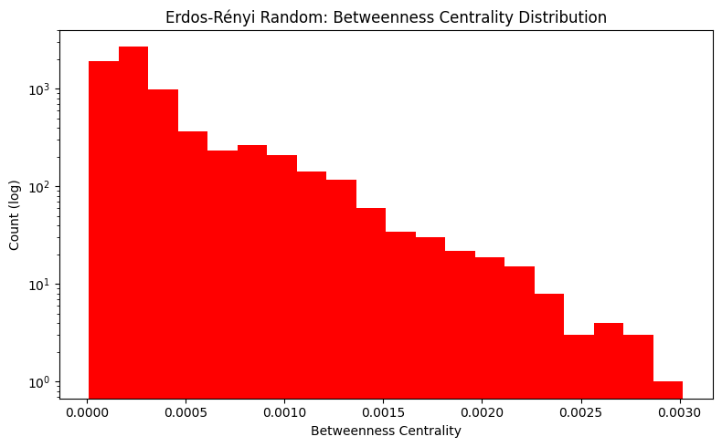
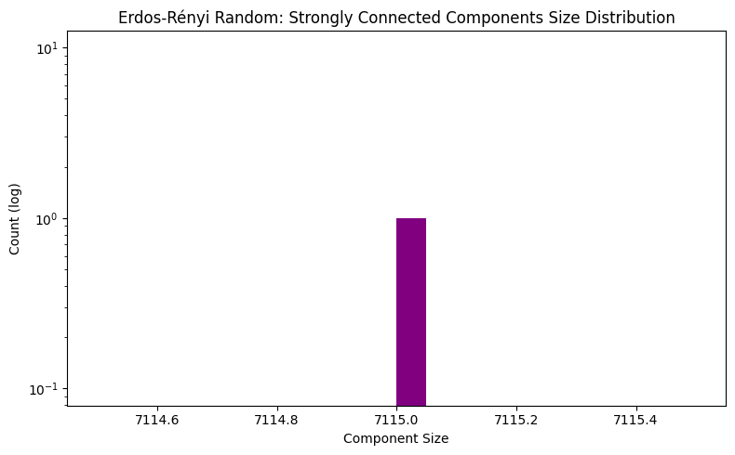
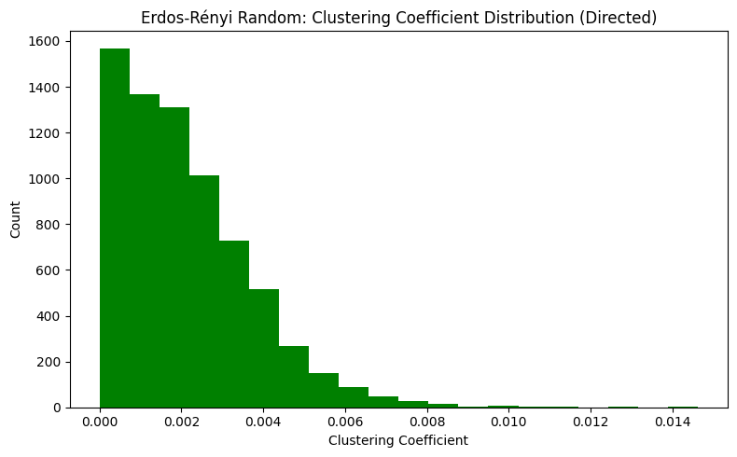
Erdos-Renyi Plots

Slide 18
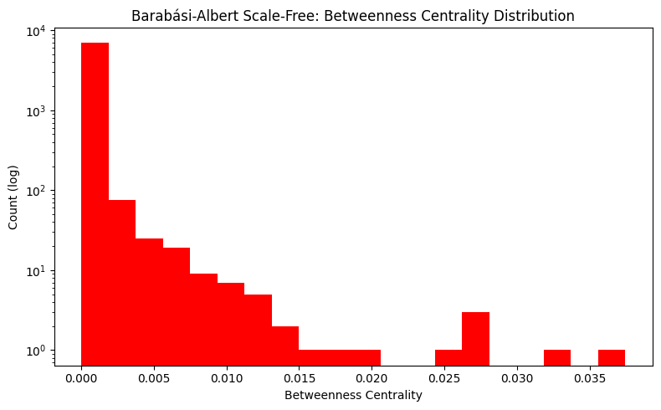
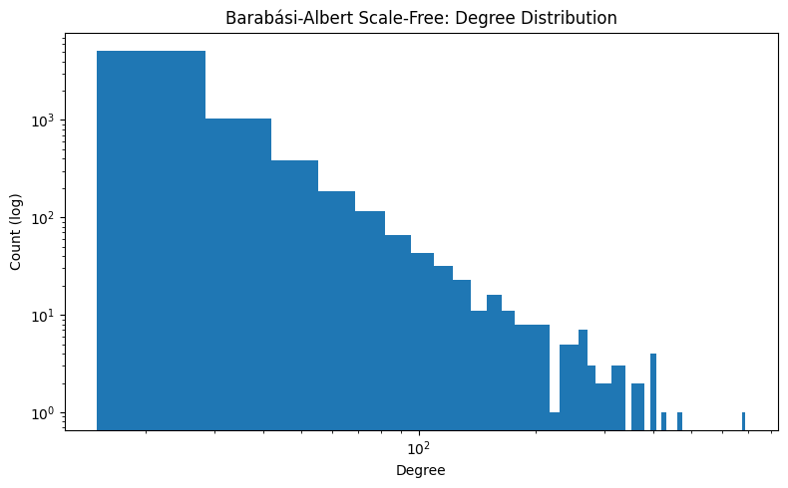
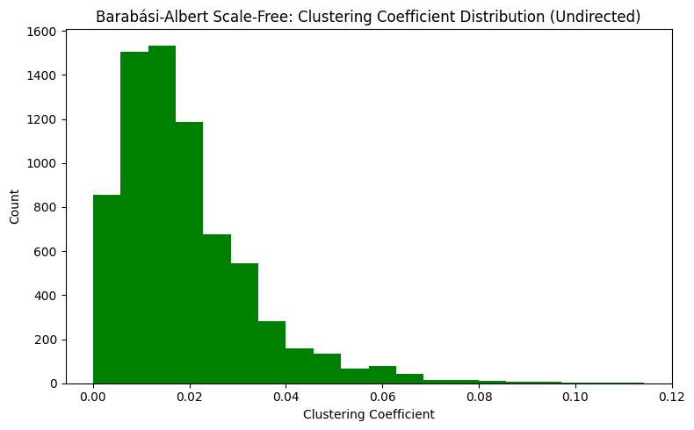
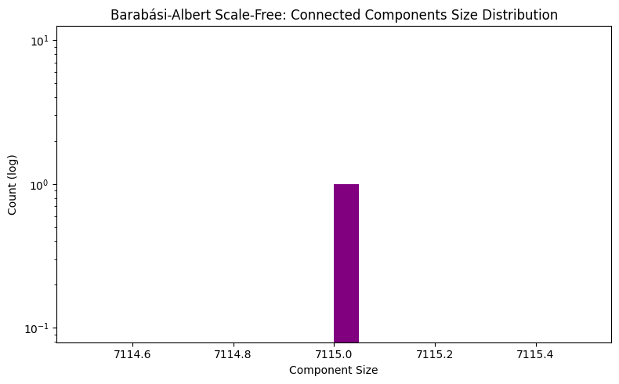
Barabasi-Albert Plots

Slide 19
What type of Network is Wiki-Vote?
When interpreting the results we got, we come to the conclusion that the Wiki-Vote network is a Scale-Free one, because of multiple factors

Slide 20
Degree Distribution
The plot doesn't look like a bell curve (like Erdos-Renyi network), it looks like a steep drop-off (a power-law distribution). Most Wikipedia users vote very few times, but a tiny group of voters (possibly already existing admins) cast hundreds of votes.

Slide 21
Clustering Coefficient Distribution
The real network has a wide, spread-out distribution reaching all the way to 1.0, with a notable mass of nodes having very high clustering. This means tightly-knit communities exist (groups of Wikipedia users who all voted for each other). The ER network's clustering is compressed near zero (max of 0.025), which is what you'd expect from random connections, which is the case for the BA network as well.

Slide 22
Betweenness Centrality Distribution
The real network has a heavy-tailed betweenness distribution, where a few nodes have extremely high betweenness, acting as critical bridges in the network. This is consistent with scale-free topology where hubs dominate information flow. Both the ER and BA networks have their betweenness values compressed into a narrower range.

Slide 23
Connected Components Size
The real network has many small components alongside one giant component (~1200 nodes). The ER and BA networks are essentially fully connected (single bars at ~7115), which makes sense since they were generated with enough edges to guarantee connectivity.

Slide 24
Real Data Analysis
The Reddit Hyperlink Network (Stanford SNAP)
~56k nodes ~860k edges
Maps every time one subreddit links to another subreddit
Edges also include a timestamp and a sentiment score, making it possible to tackle more interesting tasks
Some possible directions:
Use the sentiment data:
See if it’s more usual for smaller subreddits to attack bigger subreddits or of it’s the other way around
Use the temporal data:
See how volatile the top of the hierarchy is

Slide 25
THANK YOU

