Slide 1
Mealthyme
Darren Roscoe and Trevor Fox
Database Design CS3200

Slide 2
Significance
Mealthyme is a system to help users optimize their grocery shopping patterns for cost efficiency, nutritional value, and variety of cuisine.

Slide 3
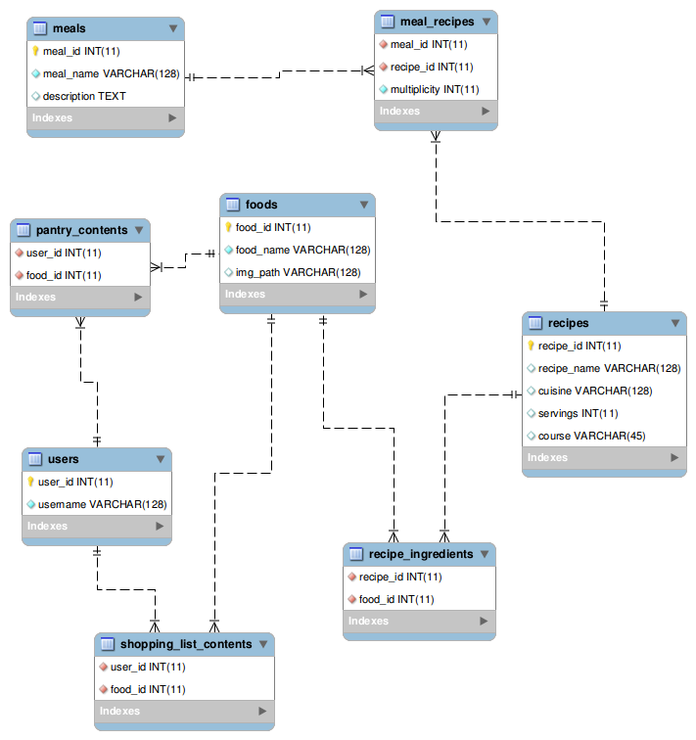

Slide 4
Challenges
Learning new languages as part of the building something new is fun but can be frustrating
At the early stages it is difficult to easily parallelize work
Finding the right API
Narrowing the (originally overzealous) scope of our project

Slide 5
Next Steps/Stretch Goals
Finding a way to represent amounts while being able to convert between amounts you buy (i.e. 2 lbs) and amounts you use (i.e. 1 cup)
Storing user-submitted images for foods (and possibly recipes)
Using amount and time data to suggest optimizations on cost and nutritional value of meals

