Slide 1
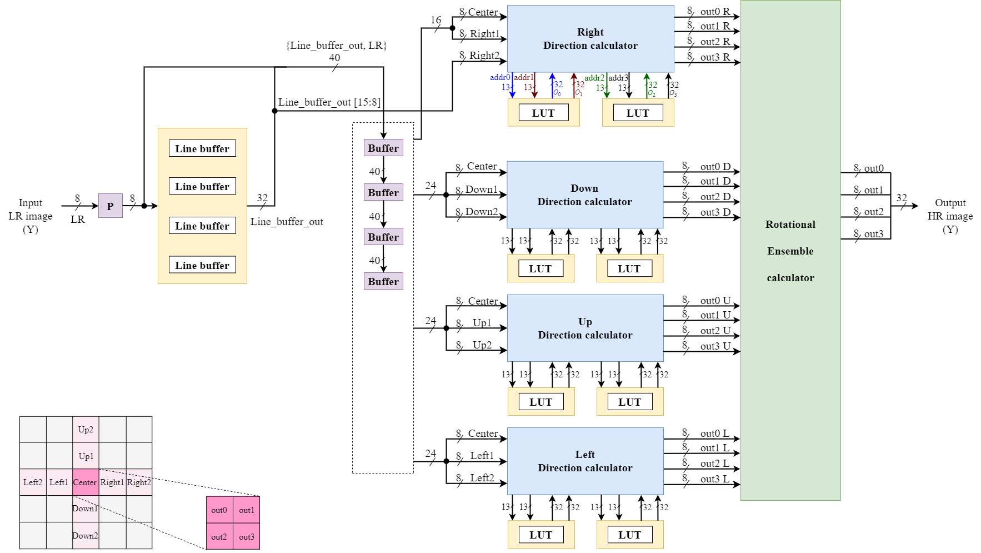
硬體整體架構圖

Slide 2
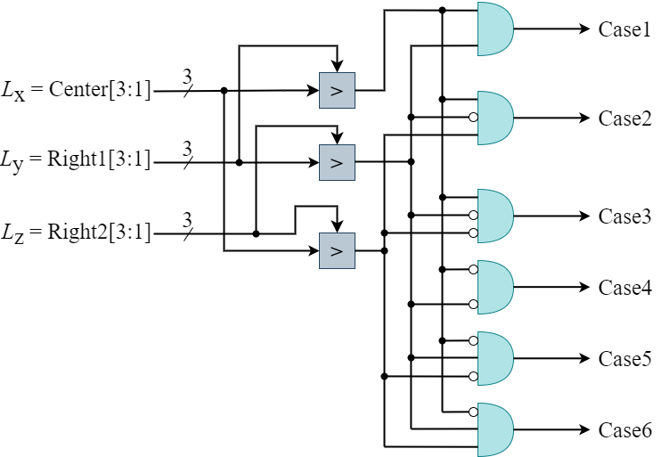
Direction_Calculator_Y_8: 用來作四面體插補

Slide 3
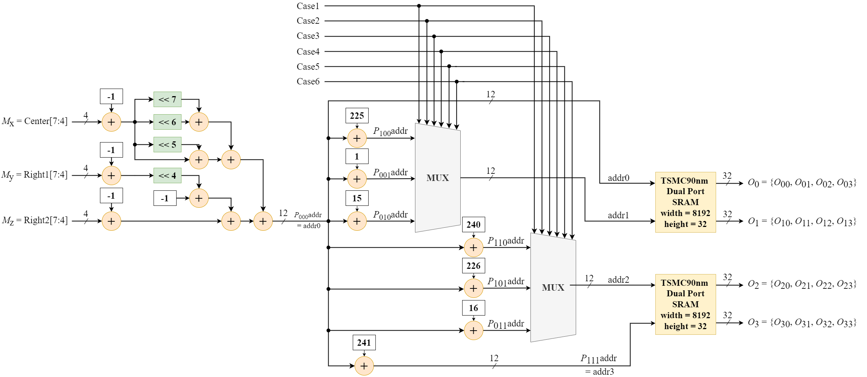
Direction_Calculator_Y_8

Slide 4
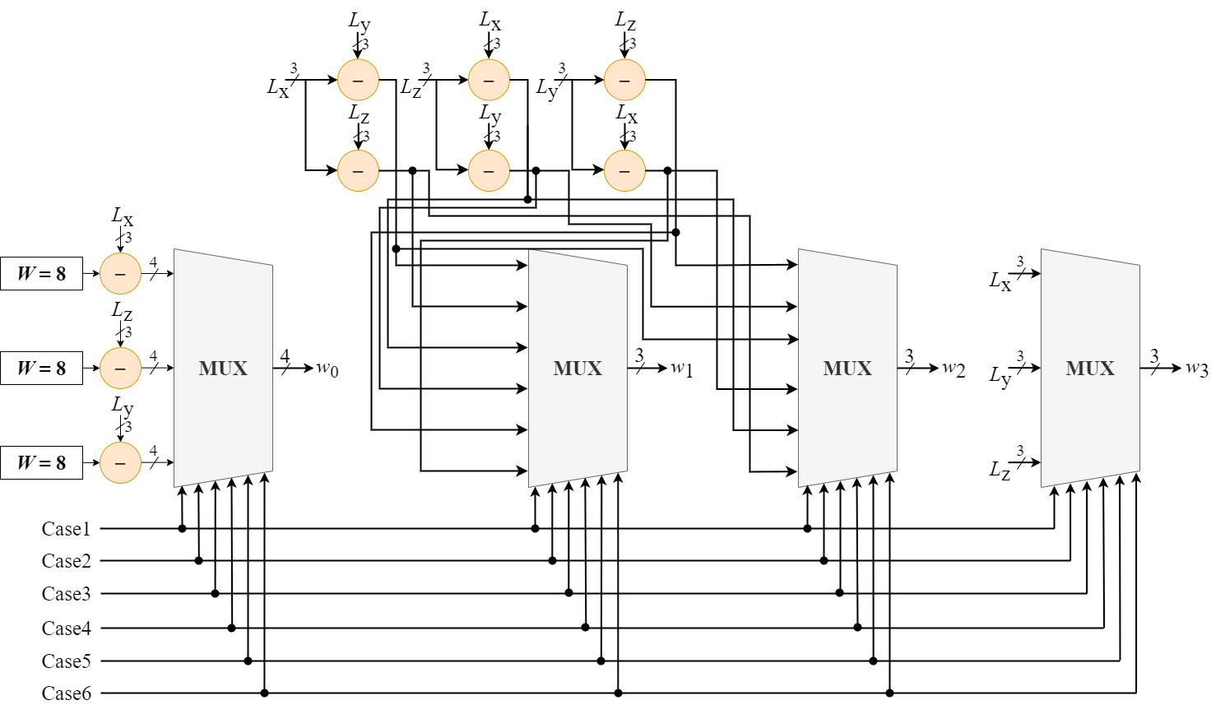
Direction_Calculator_Y_8

Slide 5
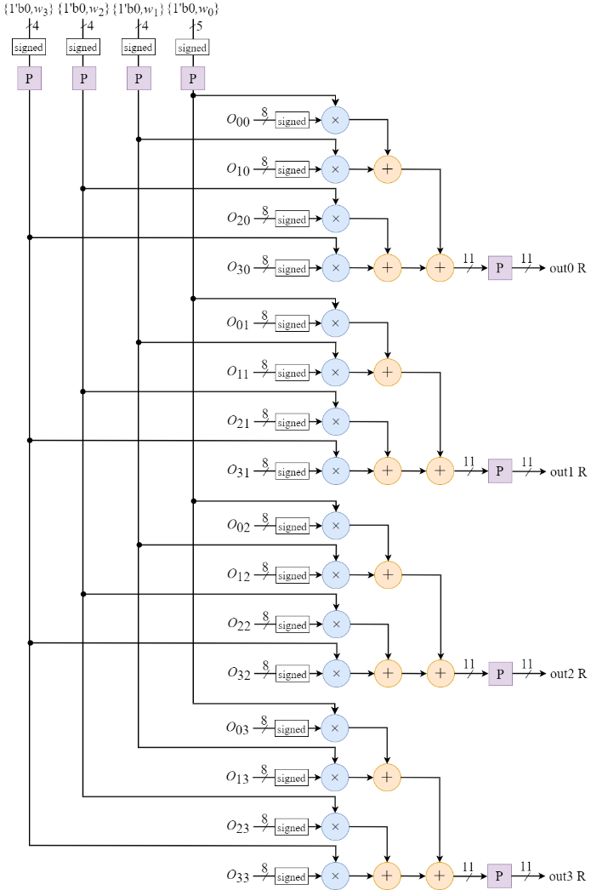
Direction_Calculator_Y_8

Slide 6
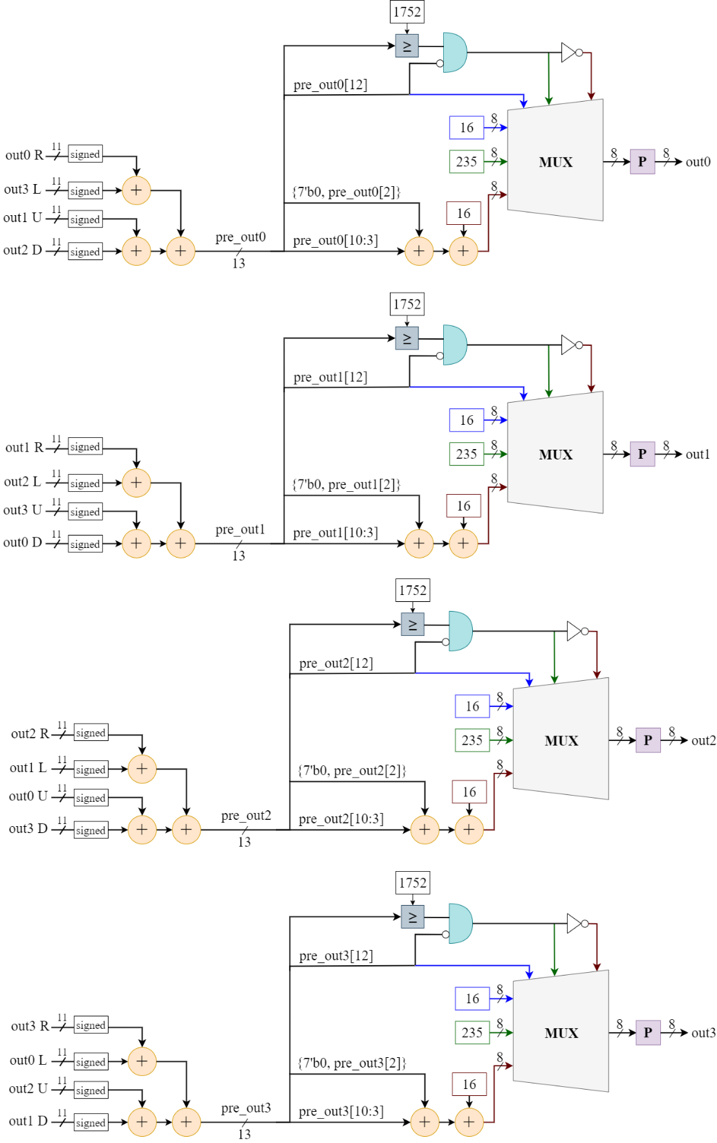
Rotational_Ensemble_calculator_Y_8_C.v

