Slide 1

Coffee and Coding
Room R103
27 Nov 2018
Luke Shaw David Pugh
coffee.coding@ons.gov.uk

Slide 2


What is Coffee and Coding?
About coding
Informal
A work in progress
Related to ONS / Gov work
… but also
A DAP help session
For people of a certain code standard
About encouraging a great coding community in ONS
Notes:
This session is a trial – it’s all a work in progress
DAP bullet point: people are moving to coding in DAP so that’s where a lot of the questions will be, and that’s not a bad thing!
Last bullet point: helping people in the community get to know each other and relative areas of expertise

Slide 3



Where to find us
GitHub is the first port of call:
https://github.com/datasciencecampus/coffee-and-coding
Email: coffee.coding@ons.gov.uk
Gov-wide slack (with dedicated channel #coffee-and-coding): https://govdatascience.slack.com/

Slide 4
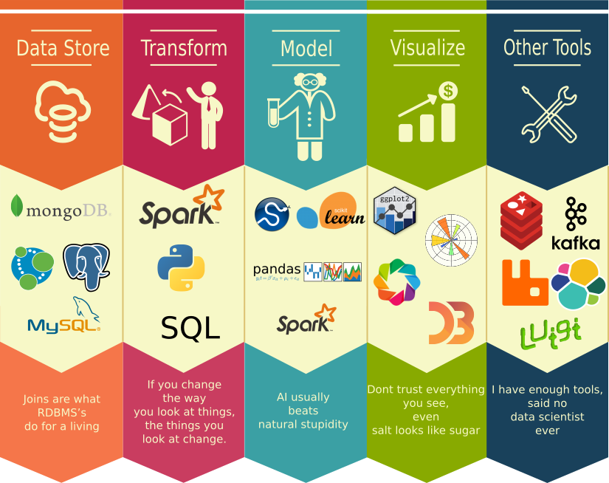
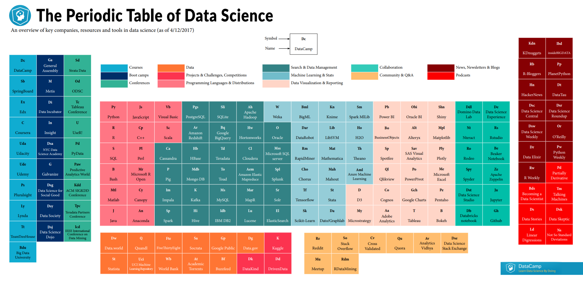
Data science ecosystem is broad

Slide 5
What tools do you currently use?
Think about
Spreadsheets
Languages
IDE
Code control and working in a team
Libraries
Packages
Do these currently fulfil your needs?
What extra things would be really useful?
List what current tools you might have used and collate answers on the flipchart
R Markdown
Beginner

Slide 6

You don’t necessarily need really advanced tools

Slide 7







Languages
There are many languages that can be used in datascience
Python, R, Julia, Scala, JS, Java, C#
Where do you start?
Which ones should you use?

Slide 8
R and Python
The majority of data scientists are using R or Python (or both!)
R |  | Python
Advantages | Disadvantages | Advantages | Disadvantages
Great for visualisation | Only really 1 dedicated IDE | General purpose language | Relatively new in the data arena, need to install a set of libraries to make it useful for data
Field specific packages | ‘Slower’ to execute | Easy to learn syntax | Many IDEs
Large support community | Non statistical tasks can be harder to implement | Good coding and debugging | Less libraries/packages for stats available
Huge number of readily available packages | Text handling can be difficult | Good integration with other systems
The closer you are to statistics, research and data the more you might prefer R
The closer you are to working in an engineering environment, the more you might prefer Python
Notes:
These will work together, and often can be seen as high level API – often the underlying libraries are written to be very efficient (often in C++)

Slide 9
What would influence your decision to choose a language
Experience and knowledge of the language
Existing libraries
Existing work or code base
The team involved
The stakeholder
Environment
Length of project
Project outcomes
Techniques being used
Think of a project and look at what language you might use and why
Learning some machine learning on your own laptop
Working with a company on an existing project

Slide 10


Packages and Libraries
Both R and Python have code you can re-use for popular tasks
These are generally available from central repositories – CRAN for R and using PIP for Python
Download -> import -> use

Slide 11
Packages and Libraries
Popular packages in R – CRAN | Popular Libraries in Python
Dplyr, plyr, data.table to easily manipulate data | Pandas to easily manipulate data
stringr for manipulating strings | SciPy/NumPy for scientific computing
zoo for working with time series | statsmodels to explore data and statistics
ggvis, lattice and ggplot2 for visualisation | matplotlib for graphics
caret for machine learning | scikit-learn for machine learning
tidyverse – collection of libraries for data science. If you are using R this is the place to start! | Spacy, nltk, gensim for nlp
Notes:
Libraries often written to be highly efficient in C++ - the language is just an high level interface to this

Slide 12
Libraries and Packages - Exercise
Go and find libraries/packages that help with the following:
Quality Control project for a manufacturing company in R
Weibull lifetime analysis in R
Computer vision in Python
Implementing Gradient Boosting Classifier in Python
Use whatever resources you think are useful and list what library/package options you can use
10 mins then feedback to class
Notes:
QCC
WeibullR, Weibull++
OpenCV, SimpleCV
Sckit-Learn, XGBoost

Slide 13




Tools to help write and manage code
Why do you need to manage code?
IDE – many to choose from. What do you currently use?

Slide 14


What editor to use?
There are many code editors and Integrated Development Environments.
What are the differences?
Which would you use for:
Simple quick code to generate some stats
More in depth R project
A simple project demo with some plots, code shared with others online
Production code for developing a text processing pipeline
Notes:
Personal preference and system/client constraints can affect choose.
Rstudio – a nice visual R Development environment, some built in tools
Notepad – code editor
Jupyter – mix code, text, links etc easy to share and follow simple code
Visual Studio – advanced integrated development environment

Slide 15

Code Control
Often you will develop different versions of your code
Working in a team different members will work on different parts – how do you merge these?
You may also wish to share your code online and allows to contribute
Code Control tools help manage and control this, as well as adding some issue and project management
Notes:
Working as a team and code control is probably a new thing fr you – but is very important

Slide 16
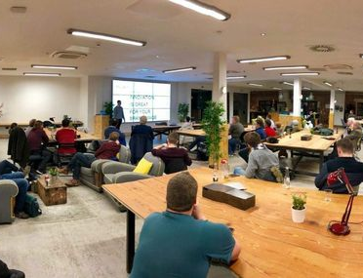
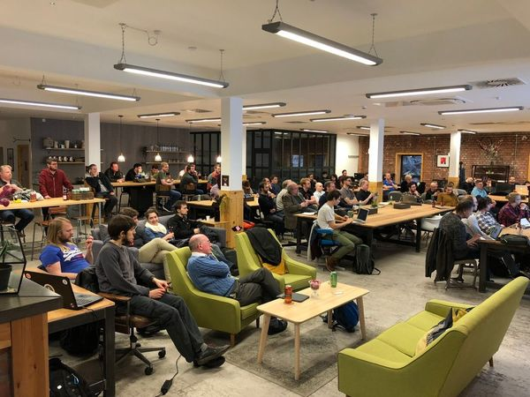
Networks and Community
Data science requires many skills, approaches and tools
Hence meeting many people of different business sectors and backgrounds can be very beneficial
Helps develop domain knowledge, exchange ideas and see what industries and sector are getting involved and what data sets and problems people have

Slide 17




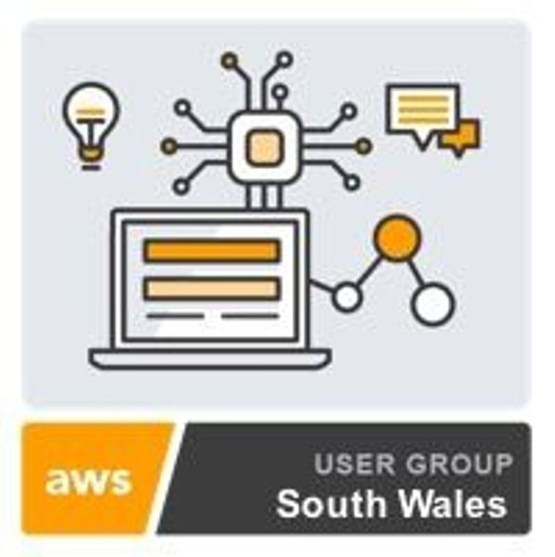
Support Networks
Regular free meetups with speakers, workshops and networking
Free beer and food!
www.meetup.com
PyData
AIWales
Google Developer Group
AWS SW User Group
Cardiff Digital Analytics
CaRdiff – R user group
Mailing lists:
ImportAI
DataScience Central
RBlog
DataMachina
PyData
Pystatsmodel
R-help
Stackoverflow

