Slide 1


Slide 2
Last Session
Filming: thank you
Feedback: thank you

Slide 3

Next Session
Reproducible Analytical Pipelines
22nd July
Catrin Cheung & Joshua Halls

Slide 4
Opportunities
We’re leaving :’(
RAS Newport.RAS@ons.gov.uk
Coffee and Coding coffee.coding@ons.gov.uk

Slide 5
This Session
Skevi Pericleous
Clean Code
No shouting

Slide 6
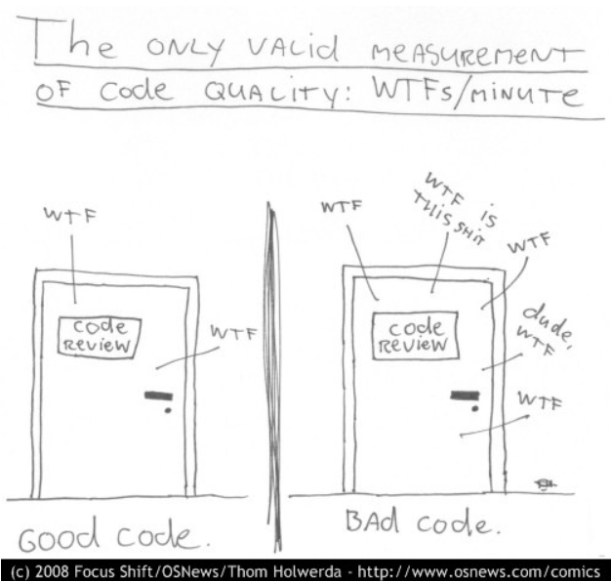

Slide 7
Initial Thoughts
What is bad coding practice?
What leads to good coding practice?
What leads to bad coding practice?

Slide 8
Viewing Skevi’s Materials
Google: ons coffee and coding
First link
Select today’s folder

