Slide 1

Coffee and Coding
Room R103
19 Feb 2019
Ian Grimstead
coffee.coding@ons.gov.uk

Slide 2
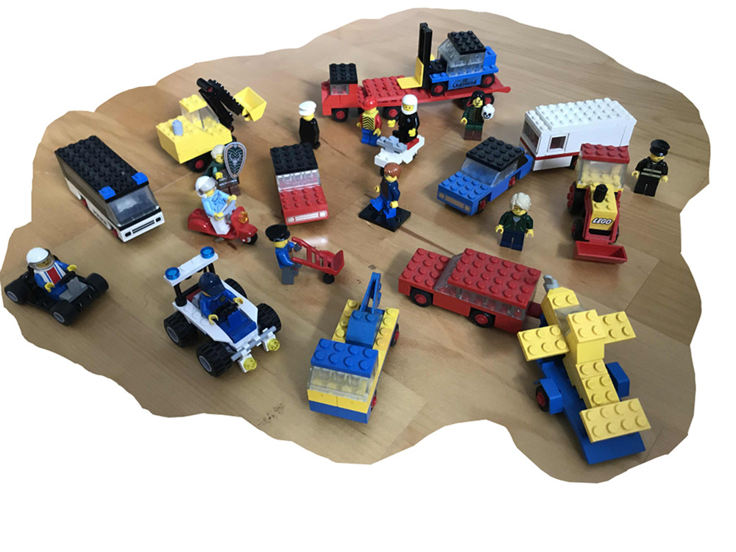
You want what by when?

Slide 3
Testing, testing, 1.. 2.. 3..
20
Steep camber;
45 degrees
20 bricks
Sharp bends;
road barriers 3 high;
road 6 wide
Low tunnel;
Max height 6
Route takes 15 hours to drive

Slide 4
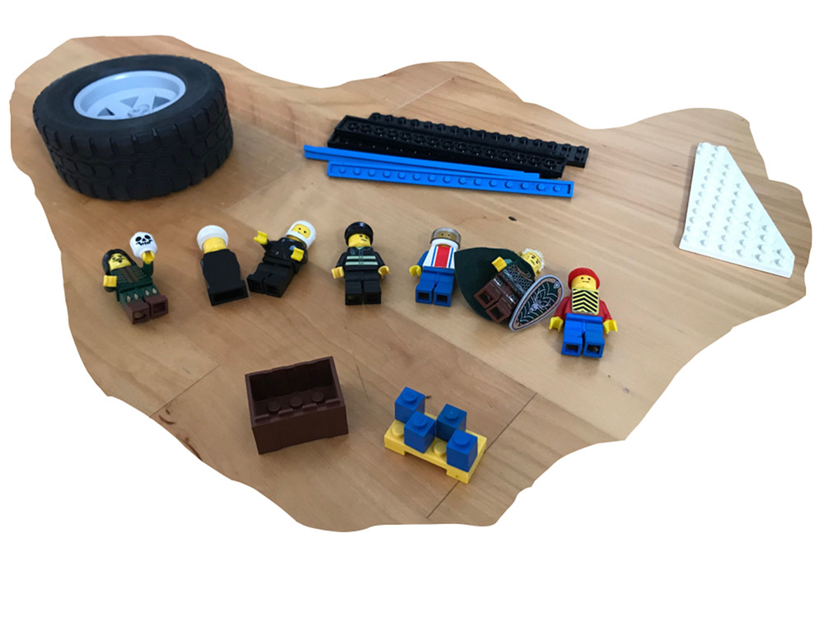
Extending with a KISS

Slide 5
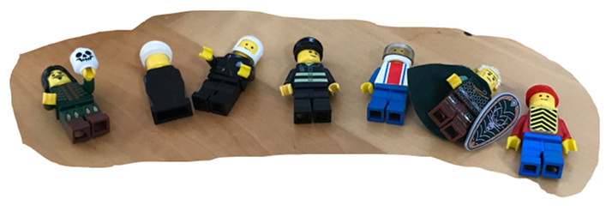
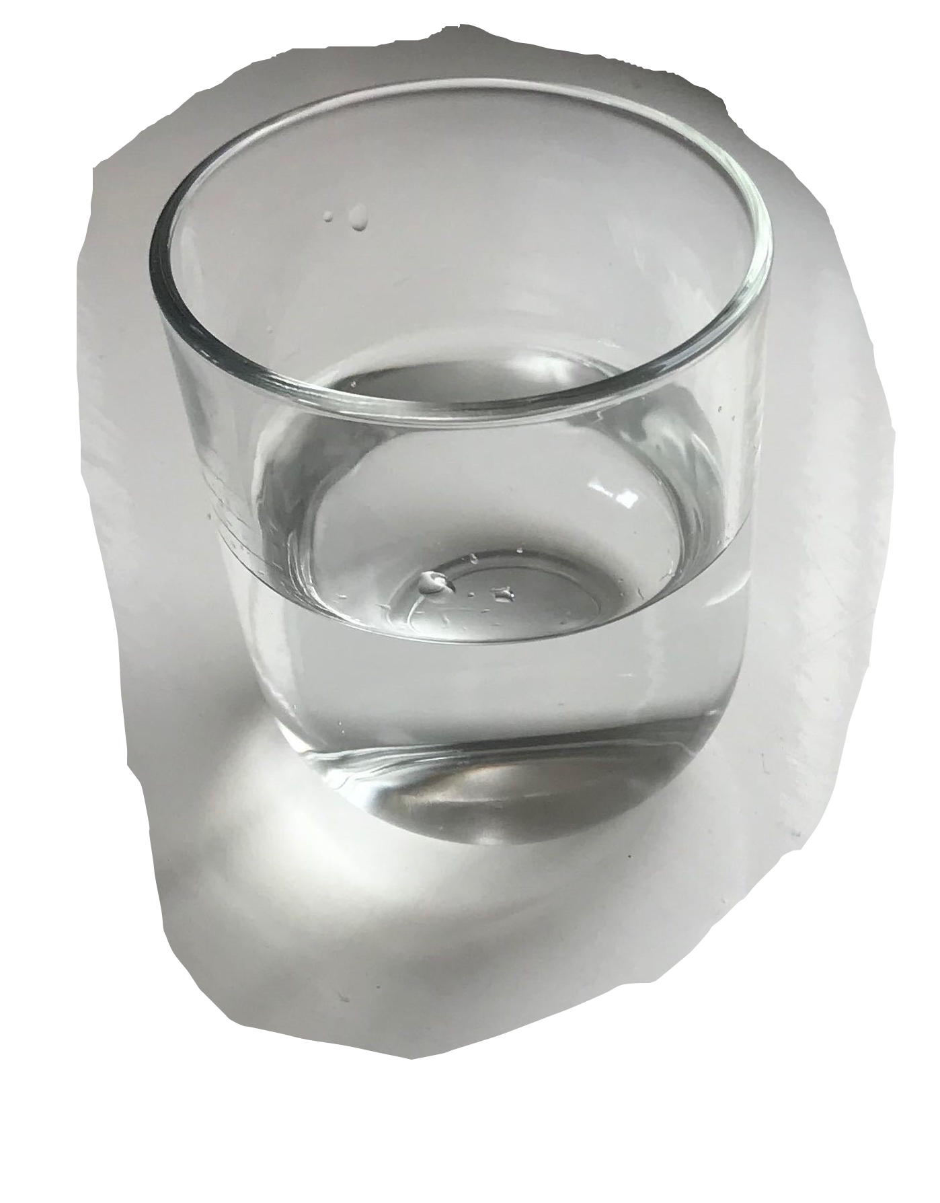
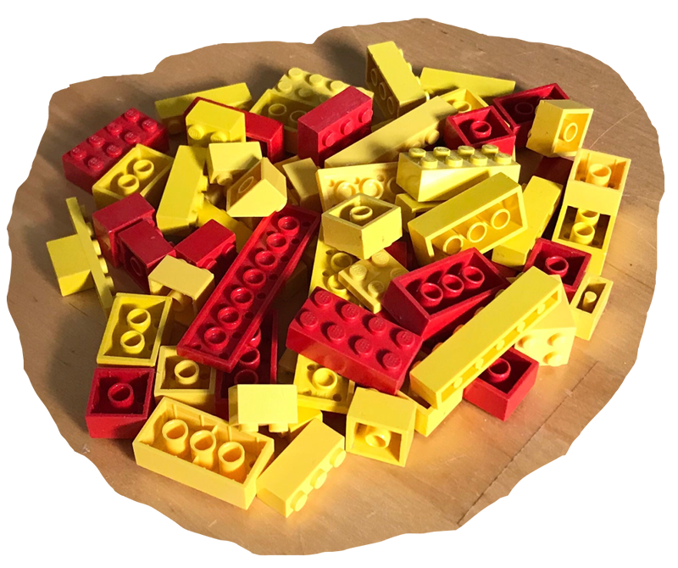
Blue Peter

