Slide 1

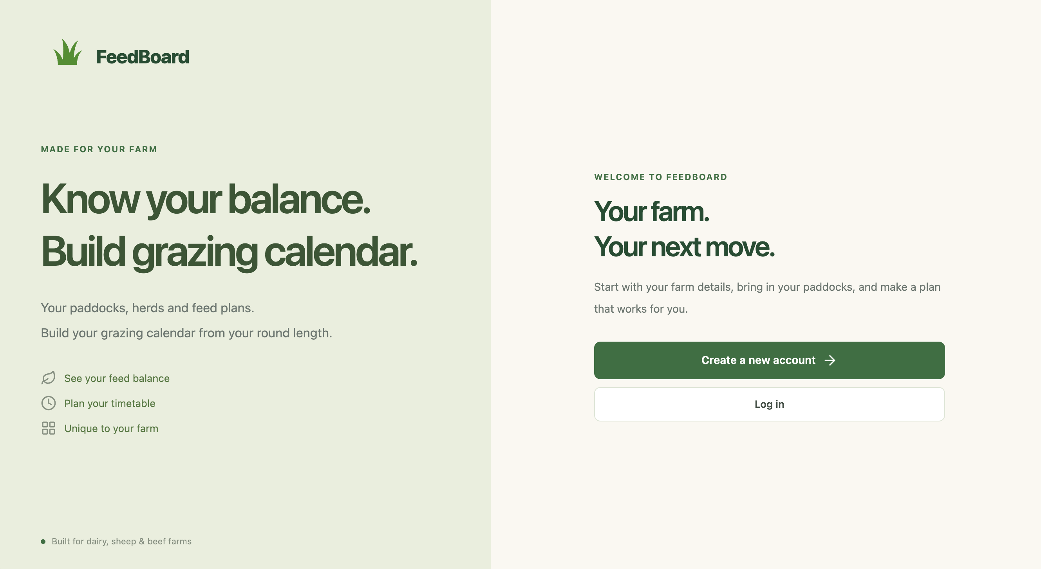
A clearer grazing plan, with math's built in.
PROJECT PRESENTATION
An alternative to handwritten paddock plans
Notes:
SLIDE 1: FeedBoard
PRESENTATION CUE: Point to the FeedBoard welcome screen rather than reading the title.
FeedBoard is a website I built for planning grazing and checking feed availability. The idea comes from the paddock whiteboards used on farms. My goal is to keep the familiar information, like the morning and afternoon breaks, while making the calculations easier to update. I will show the farming problem, the design, the frontend and backend, what I have tested, and what still needs to happen before the website goes live.
EVIDENCE / FILES: First Page.png; FeedBoard project source

Slide 2
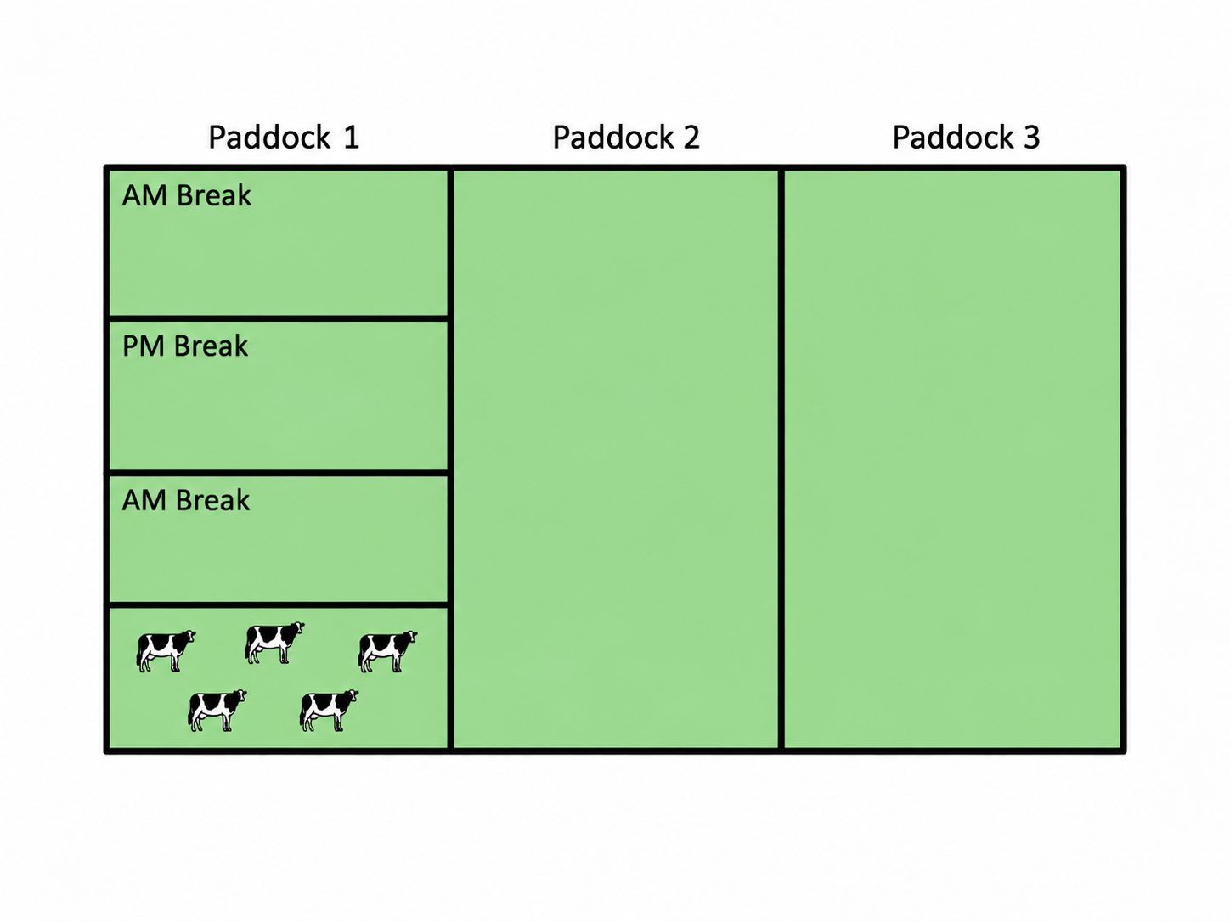
01 / DEFINE – Business context
FeedBoard
What is a grazing break?
One paddock can be grazed in smaller sections over several moves
One paddock can split into several breaks
AM and PM allocations.
Break
Farmer chooses paddock order
GRAZING + FEED PLANNING
Notes:
SLIDE 2: What is a grazing break?
PRESENTATION CUE: Use the cartoon as a visual explanation before discussing the planner screen.
A paddock is a field, but the herd does not always graze the whole field at once. A grazing break is the section available until the next move. The diagram shows paddock one divided into an AM break, a PM break and another AM break. FeedBoard calculates an area for each break and continues into the next paddock when there is not enough area left. This matters because the website is not just choosing paddock names: it is allocating how much land the herd needs.
EVIDENCE / FILES: Cartoon Break example.png; calculatePaddockPlan.js

Slide 3
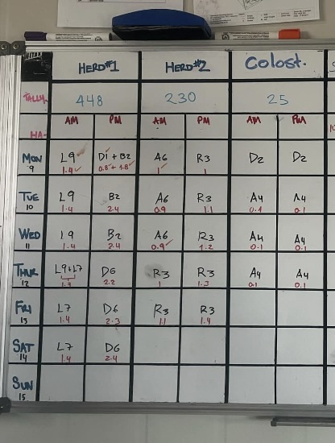
01 / DEFINE – Stakeholder problem
FeedBoard
How grazing is planned now
A practical workflow built around a whiteboard
1
Handwritten paddock plan
Paddock names, dates, herds and AM/PM breaks are recorded on a physical board.
2
Manual feed calculations
Changes to herd numbers, round length or grass length
The opportunity
Keep the familiar plan, but make it quicker to update.
GRAZING + FEED PLANNING
Notes:
SLIDE 3: How grazing is planned now
PRESENTATION CUE: Show the whiteboard photo and describe what its rows and columns mean.
This photo shows the sort of whiteboard used to plan grazing. A farmer can see which paddock each herd is moving to, on what day, and whether it is a morning or afternoon break. It works, but the numbers are entered manually. If the herd size or round length changes, someone has to work through the plan and feed figures again. I am not claiming measured time savings yet; the benefit FeedBoard is designed to provide is a clearer plan with less repeated manual work.
EVIDENCE / FILES: Photo of what farmers are currently doing instead of FeedBoard (whiteboard).jpeg

Slide 4
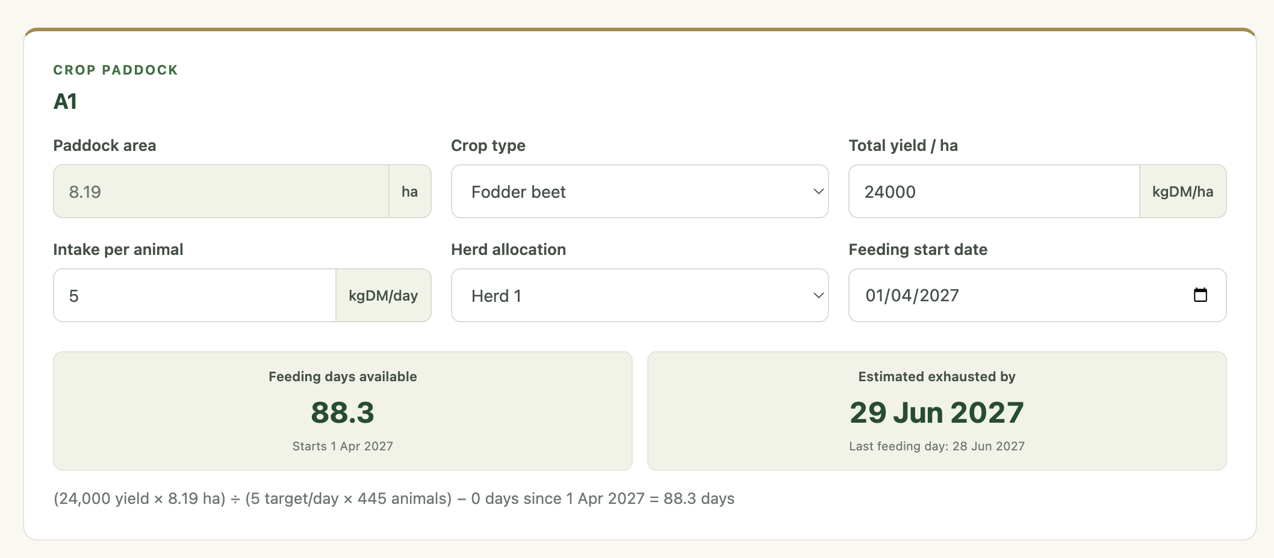
01 / DEFINE – Stakeholder
FeedBoard
Stakeholder understanding
My background: Bachelor of Agricultural Commerce at Lincoln University. I currently work as a Rural Banker and prior to this worked on various farms managing feed requirements.
Talked to farmers: Spoke to several farmers and queried their needs.
Outcomes:
-Show how the calculation works.
-Make it easy to use.
-Simple no frills design.
GRAZING + FEED PLANNING
Notes:
SLIDE 2: What is a grazing break?
PRESENTATION CUE: Use the cartoon as a visual explanation before discussing the planner screen.
A paddock is a field, but the herd does not always graze the whole field at once. A grazing break is the section available until the next move. The diagram shows paddock one divided into an AM break, a PM break and another AM break. FeedBoard calculates an area for each break and continues into the next paddock when there is not enough area left. This matters because the website is not just choosing paddock names: it is allocating how much land the herd needs.
EVIDENCE / FILES: Cartoon Break example.png; calculatePaddockPlan.js

Slide 5
01 / DEFINE – Stakeholder needs
FeedBoard
Who needs the information?
Designed to make the weekly grazing calculations on farm easier
1
2
3
Farm staff
Farm Grazing Manager
Farm owner / adviser
Clear move times and areas for the next break.
Improves:
-Lowering mistakes
Sets the grazing order and checks whether each herd is getting enough feed.
Improves:
-Mental fatigue
-Increasing time on other jobs
Can overview the plan and how feed availability is tracking.
Improves:
-Financial benefits from grazing efficiency & decreased labour
-Animal health
Current scope: one farm per account. Shared staff logins and role permissions are future work.
GRAZING + FEED PLANNING
Notes:
SLIDE 4: Who needs the information?
PRESENTATION CUE: Point to each role and explain its different view of the same farm plan.
The intended users are farm managers, staff and owners. Managers are responsible for planning and need to adjust the paddock order and see feed figures. Staff need to understand where animals should go for each break, and owners benefit from a simple view of the plan. These needs were shaped around the existing farm workflow and the inputs the calculations require. Formal user testing and feedback are still next steps, so I would not present those as completed stakeholder interviews. At this stage each account has one farm, rather than separate staff permissions.
EVIDENCE / FILES: Whiteboard photo; FarmInfoPage.jsx; PlannerPage.jsx; MySQL schema

Slide 6
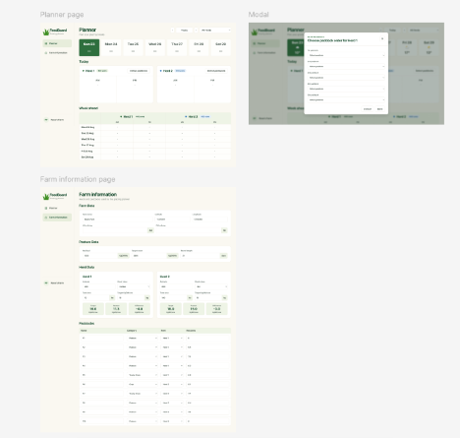
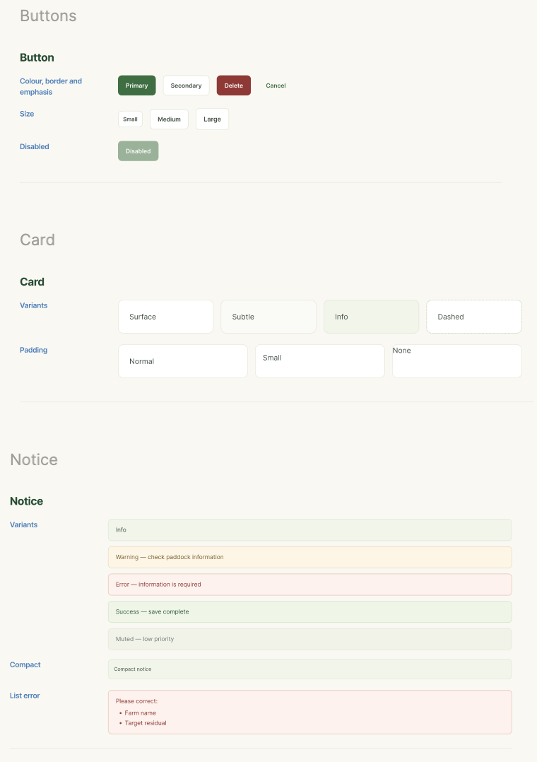
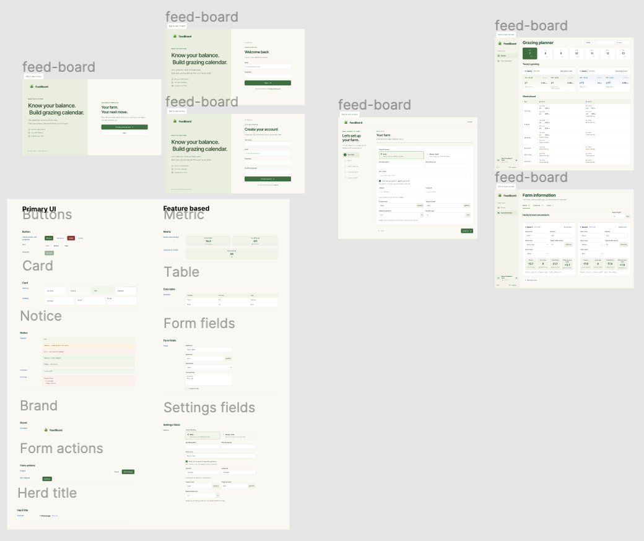
01 / DEFINE – planning
FeedBoard
Design
Previous Projects
Figma
Primary Ui
GRAZING + FEED PLANNING
Notes:
SLIDE 2: What is a grazing break?
PRESENTATION CUE: Use the cartoon as a visual explanation before discussing the planner screen.
A paddock is a field, but the herd does not always graze the whole field at once. A grazing break is the section available until the next move. The diagram shows paddock one divided into an AM break, a PM break and another AM break. FeedBoard calculates an area for each break and continues into the next paddock when there is not enough area left. This matters because the website is not just choosing paddock names: it is allocating how much land the herd needs.
EVIDENCE / FILES: Cartoon Break example.png; calculatePaddockPlan.js

Slide 7
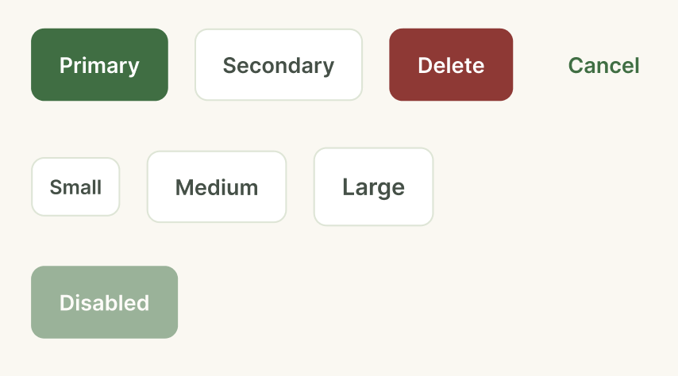
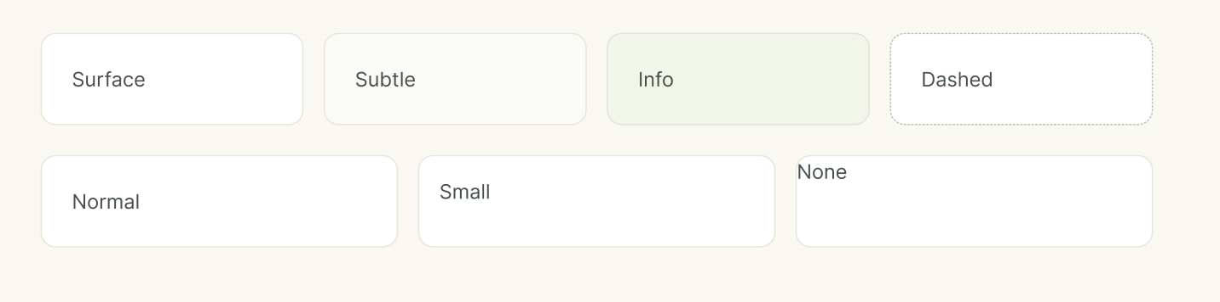
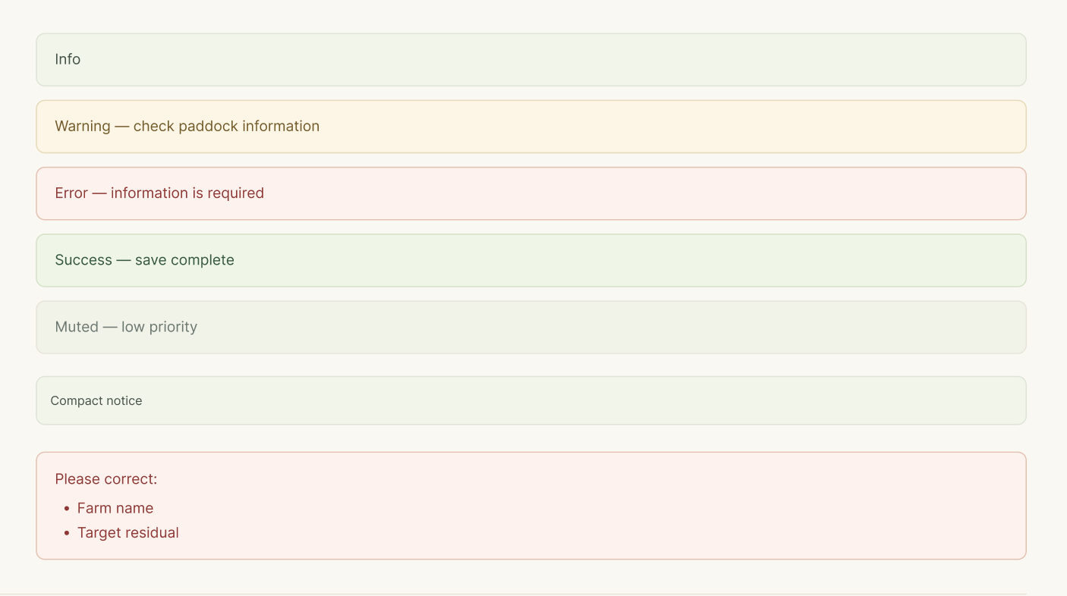
02 / DESIGN – design
FeedBoard
UI design and reusable components
Figma-inspired, consistent controls across the site
Design choices
Figma layouts
Simple layout
Clear hierarchy for busy farm days
Shared UI
Buttons, cards, forms and notices
CSS theme
GRAZING + FEED PLANNING
Notes:
SLIDE 7: UI design and reusable components
PRESENTATION CUE: Point out that the button colours and forms stay the same across different pages.
I first worked through the layout and visual style using Figma, then built the interface in React, Vite and Tailwind. A lot of the site is made from reusable components: the same buttons, cards, form inputs and notices are used in setup, Farm Information and the planner. That makes the design consistent and makes it easier to update a component without rewriting every page. I aimed for clear labels, sensible spacing and a familiar whiteboard-style planning view.
EVIDENCE / FILES: Buttons.png; Cards.png; Notices.png; ui/src/components/primaryUI

Slide 8
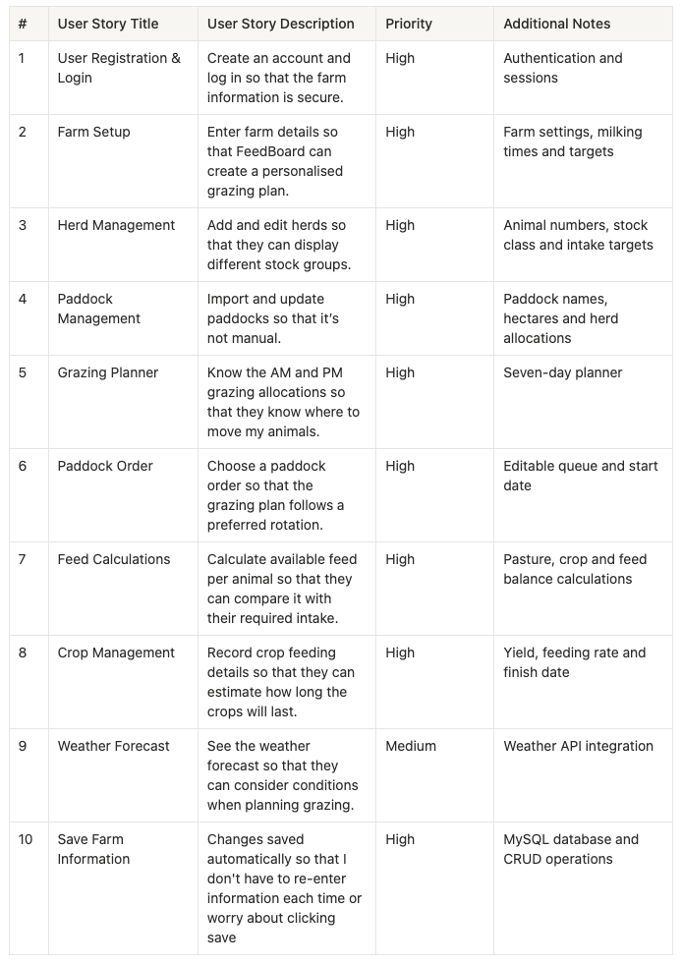
01 / Documentation – Stakeholder solution
FeedBoard
User stories
The key tasks farmers need the website to support
1
Set up the farm
Enter milking times, herds, paddock areas and grazing targets.
2
Plan the rotation
See AM/PM breaks and choose the order paddocks are grazed.
3
Check the feed
See pasture and crop feed per animal against target intake.
4
Keep changes
Save farm information and load it again later.
GRAZING + FEED PLANNING
Notes:
SLIDE 5: User stories
PRESENTATION CUE: The screenshot is the full set of ten stories; talk through only the four examples on the right.
I wrote user stories to turn the farming requirements into tasks the website had to perform. The high-priority stories cover setting up a farm, managing herds and paddocks, producing a grazing plan, working out feed availability, and saving changes. Weather is a medium-priority feature because it adds context but does not drive the calculations. I have put the full set of ten stories on the slide, but I would focus on these four because they describe the main user journey.
EVIDENCE / FILES: User story.png; FeedBoard user story table

Slide 9
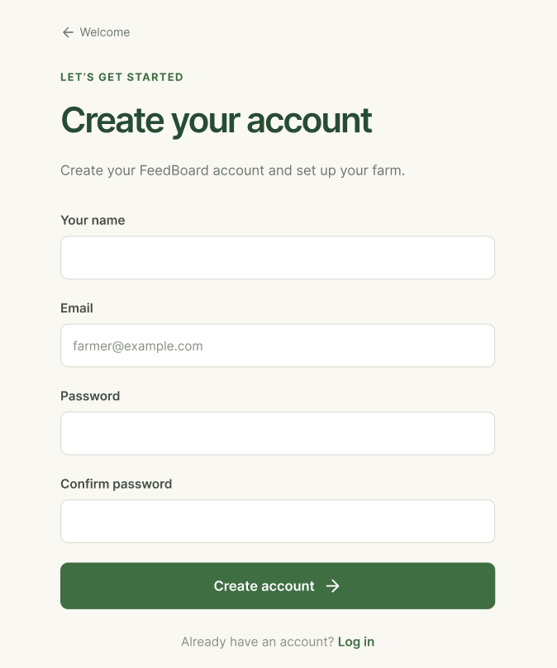
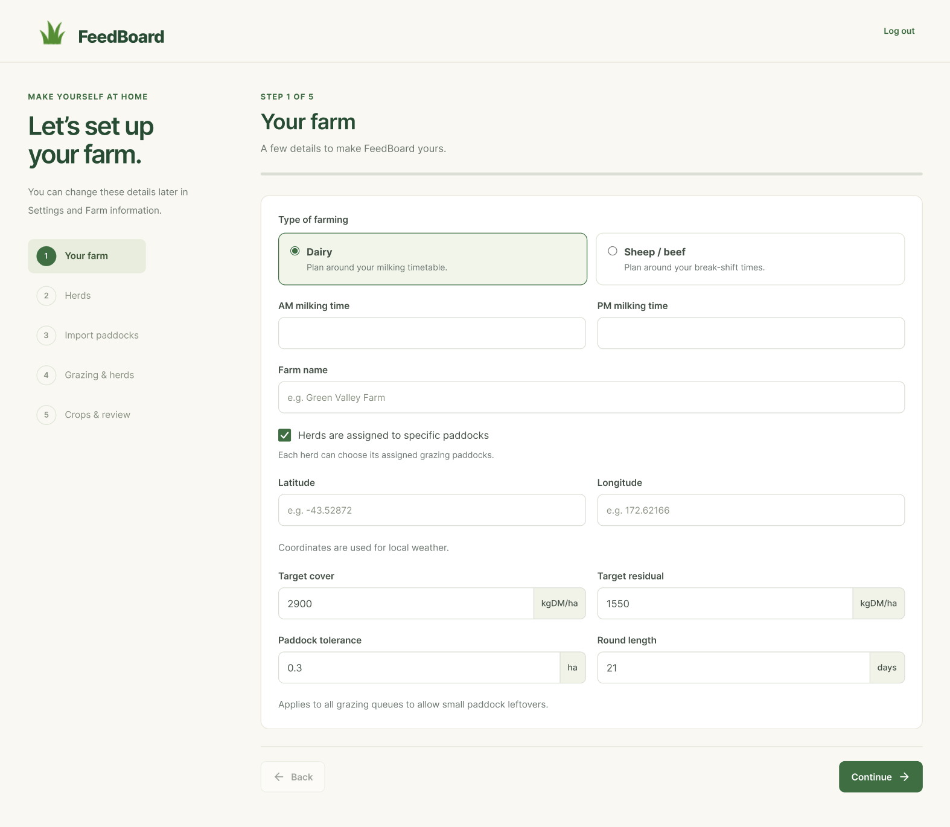
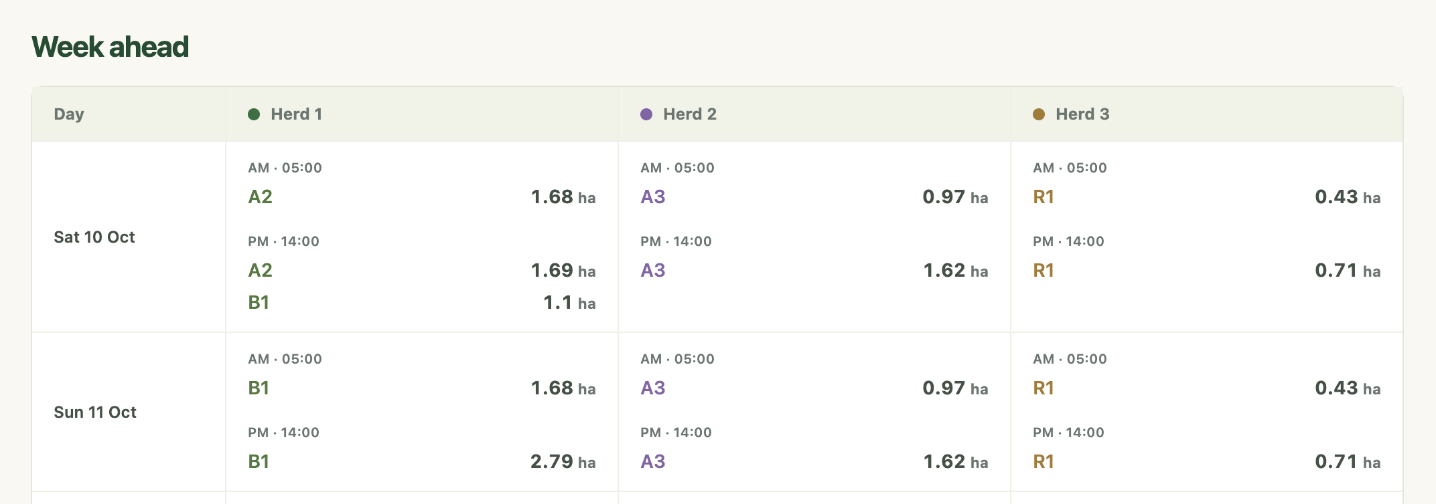
02 / DESIGN – User Journey
FeedBoard
From first visit to grazing plan
The farmer journey, from account setup to the daily plan
Welcome
→
Account
→
Farm setup
→
Farm info
→
Planner
Start
Sign in
Enter details
Make changes
See breaks
Create account
Set up farm
View grazing plan
GRAZING + FEED PLANNING
Notes:
User journey
A new farmer starts on the welcome page, creates an account or signs in, and completes the farm setup. Setup gathers targets, move times, herds and paddocks. Once setup is complete, the farmer can edit Farm Information and use the planner to review breaks and grazing order. An existing account with a saved farm loads that information after login.
This slide describes what the farmer sees. The Delivery section shows the underlying folder-level request and response path.
CODE REFERENCES: ui/src/App.jsx; ui/src/components/Workspace.jsx; ui/src/pages/Auth; ui/src/pages/Setup; ui/src/pages/FarmInfo; ui/src/pages/Planner.

Slide 10
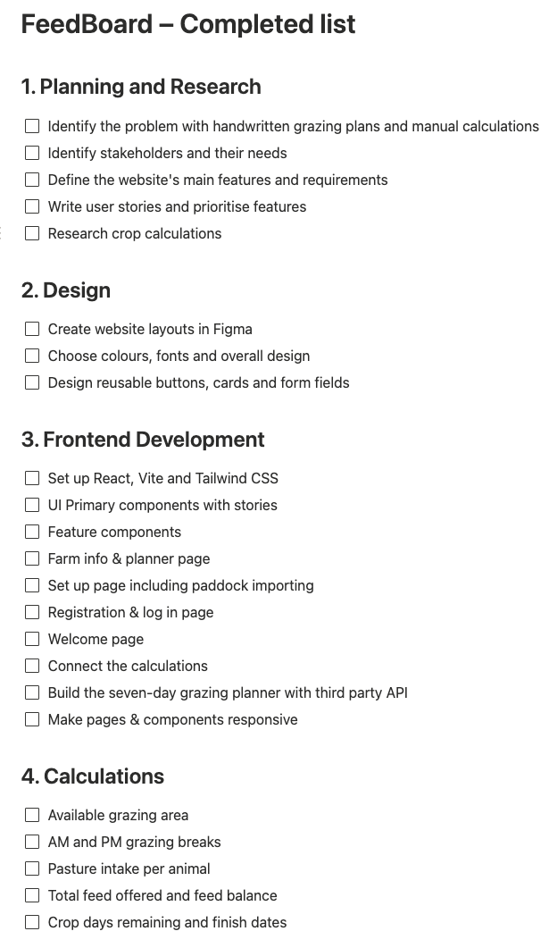
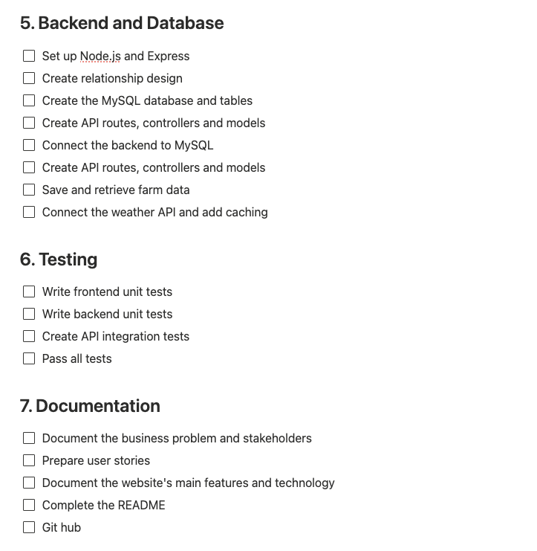
02 / DESIGN - Documenation
FeedBoard
Development checklist
Located in notion
✓
✓
GRAZING + FEED PLANNING
Notes:
Project planning
I broke the project into planning and research, interface design, frontend development, calculations, backend and database work, testing and documentation. The two checklist images show that breakdown. Separating calculations and shared components made it possible to work on and check each part.
The main implementation areas are visible in the current website. Remaining work includes completing the README and Git evidence, extending and documenting testing, and preparing production hosting. No measured time totals or completed Git milestones are claimed by this checklist.
EVIDENCE: both supplied development checklist images and the project source.

Slide 11
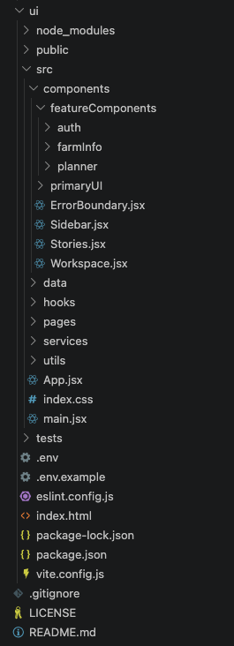
03 / DELIVERY – Frontend
FeedBoard
Frontend structure
Screens, shared components and data-handling code are separated
✓
Pages - 6
Welcome, setup, planner and Farm Information
✓
Components - 26
Reusable UI controls and farm-specific editors
✓
Hooks and services – 3 & 3
Farm state, calculations and API communication
React + Vite + Tailwind CSS
GRAZING + FEED PLANNING
Notes:
SLIDE 16: Frontend structure
PRESENTATION CUE: Point to the actual folders shown in the VS Code screenshot.
This is the structure of the frontend. The pages folder contains the main screens. Components are split between general-purpose controls such as cards and buttons, and feature components for authentication, farm information and planning. Hooks manage React data and interactions. Services handle API calls and related behaviour, so the components do not each have to duplicate that code. There are also utilities and tests. This separation made it possible to update the website while keeping the calculations and shared UI easier to maintain.
EVIDENCE / FILES: ui structure.png; ui/src/pages; ui/src/components; ui/src/hooks; ui/src/services

Slide 12
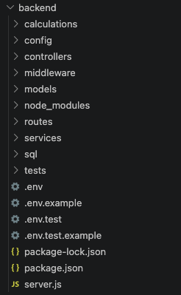
03 / DELIVERY – Backend
FeedBoard
Backend structure
MVC-style separation for API requests and business logic
Routes — post, get, patch, put, and delete.
Controllers — handle requests and responses
Models — read and write MySQL records
Services + calculations — business rules
Middleware: authentication, validation and safe error handling
GRAZING + FEED PLANNING
Notes:
SLIDE 17: Backend structure
PRESENTATION CUE: Describe the path of a request and show where the code lives.
I organised the Express backend with routes, controllers, models, middleware, services, calculations, SQL and tests. Routes decide which controller handles a request. Controllers manage the HTTP request and response. Models perform database work, including transactions, and the calculation modules keep the farming maths separate. Middleware handles common tasks such as authentication, validation, request limits and error responses. It is an MVC-style structure; I used functions and modules rather than adding classes where they did not add value.
EVIDENCE / FILES: backend structure.png; backend/routes; backend/controllers; backend/models; backend/middleware; backend/calculations

Slide 13
02 / Delivery - Features
FeedBoard
Highlighted features
How FeedBoard makes farm planning quicker to update
Paddock importer
Calculations
Custom JavaScript parser, prevents manual inputting
Shows 6 main feed calculations.
Autosave and browser drafts
Feed and crop calculations
See kgDM per animal and estimated crop finish dates.
Saves locally and automatically, uses custom react hook & services
Individual CRUD updates
Weather
Updates individual records, linked to seven entities
Integration with a third party.
GRAZING + FEED PLANNING
Notes:
SLIDE 7: UI design and reusable components
PRESENTATION CUE: Point out that the button colours and forms stay the same across different pages.
I first worked through the layout and visual style using Figma, then built the interface in React, Vite and Tailwind. A lot of the site is made from reusable components: the same buttons, cards, form inputs and notices are used in setup, Farm Information and the planner. That makes the design consistent and makes it easier to update a component without rewriting every page. I aimed for clear labels, sensible spacing and a familiar whiteboard-style planning view.
EVIDENCE / FILES: Buttons.png; Cards.png; Notices.png; ui/src/components/primaryUI

Slide 14






02 / Delivery - Security
FeedBoard
Security requirements
Security controls already implemented in FeedBoard
Argon2id — password hashing
Secure login sessions
Stores salted password hashes, not plain passwords.
Manages session with HttpOnly cookies; 8-hour limit.
Helmet — HTTP headers
Express Rate Limit
Restricts repeated login and excessive API requests.
Help protects unauthorised attacks.
CSRF protection
MySQL2 — data transactions
Random session tokens checked with timingSafeEqual(). Prevents unauthorised requests.
Supports saving linked farm records together.
GRAZING + FEED PLANNING
Notes:
Security requirements
PRESENTATION CUE: Explain that these protections are implemented in different parts of the backend and work together. You do not need to read all six cards.
Argon2id passwords: backend/controllers/authController.js imports the argon2 package and sets type to argon2.argon2id. At registration, it calls argon2.hash(password, hashOptions), then userModel stores only password_hash in MySQL. At login, argon2.verify compares the submitted password with that stored hash. Argon2id is a deliberately slow, memory-hard password algorithm, unlike general-purpose SHA-256.
Secure sessions: backend/config/session.js uses express-session and express-mysql-session with the MySQL sessions table. The browser receives a session cookie marked HttpOnly and SameSite=Lax; Secure is enabled in production. Successful login in authController.js regenerates the session ID and stores the user ID and authentication time. backend/middleware/middleware.js enforces an eight-hour absolute limit from login. This is not an eight-hour inactivity timer.
Helmet: backend/server.js calls app.use(helmet(...)) to add security-related HTTP response headers, including a Content Security Policy. upgradeInsecureRequests is disabled for local development. The server also configures CORS and checks the allowed frontend origin. CORS is not authentication; protected API routes still require an authenticated user.
Express Rate Limit: backend/middleware/middleware.js configures limits separately: general API 1,200 requests per 15 minutes; account attempts 30 per 15 minutes; email attempts 10 per 15 minutes (successful requests are skipped by this email limiter); weather 30 per minute; calculations 120 per minute per user. It uses the default in-memory store; distributed hosting would need an appropriate shared store.
CSRF tokens: middleware.js uses Node's crypto.randomBytes(32) to generate a random session token. The frontend includes it as X-CSRF-Token on changing requests. requireCsrf validates the format and uses crypto.timingSafeEqual() to compare it against the token stored in the session. This helps protect a logged-in farmer against unwanted cross-site writes.
MySQL2 data integrity: backend/config/db.js uses mysql2/promise for pooled connections and parameterised SQL. farmModel.js starts transactions with beginTransaction(), uses commit() after successful linked changes and rollback() when an operation fails. Saved farm ID and version checks block stale or mismatched edits. Protected routes also use session user identity to scope records to the current account.
Production: The local implementation is not by itself proof of production security. FeedBoard still needs correctly configured HTTPS, hosting secrets, backups, monitoring and further testing before deployment. The browser draft is stored locally and is not encrypted; database-at-rest encryption cannot be assumed from the source.
CODE REFERENCES: backend/server.js; backend/config/session.js; backend/controllers/authController.js; backend/models/userModel.js; backend/middleware/middleware.js; backend/config/db.js; backend/models/farmModel.js; ui/src/hooks/useFarmData.js; ui/src/services/api.js.

Slide 15
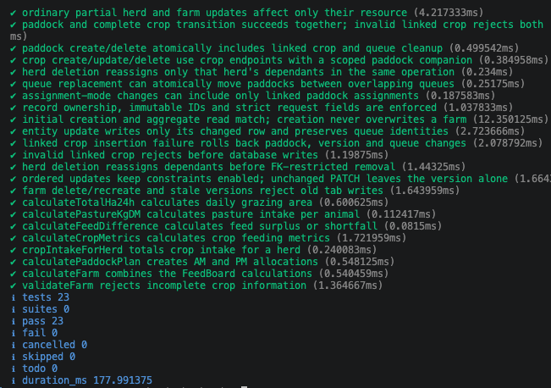
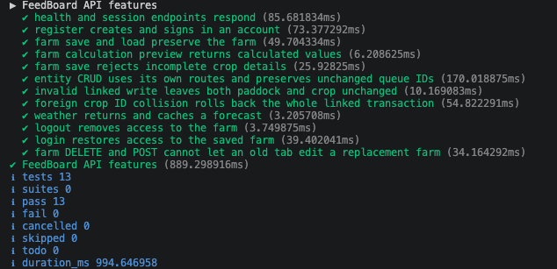
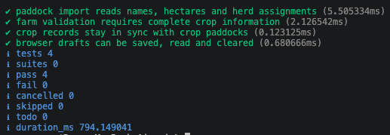
02 / DESIGN - Testing
FeedBoard
Testing and validation
Recorded unit, persistence and API integration test results
4
23
13
Frontend unit tests
Backend tests
API test entries
Node.js built-in test runner (node:test), assertions and fetch.
GRAZING + FEED PLANNING
Notes:
Testing and validation
The screenshots record four frontend unit tests, twenty-three backend tests and thirteen API test entries passing. Node.js provides node:test for running the tests and node:assert/strict for checking expected results. The API tests use built-in fetch to make real HTTP requests.
Frontend unit tests cover paddock importing, validation, linked crop records and browser draft storage. The backend total includes calculation and mutation unit tests plus database persistence tests using an in-memory SQLite database. The API integration suite starts Express and uses a separate MySQL test database. It checks login, saving and loading, resource CRUD, rejected invalid writes, rollback, weather caching and farm deletion/recreation. The thirteen reported entries include the parent test group.
These are the recorded results, not a claim that every possible user interaction is covered. Additional frontend test files exist in the supplied code and are not represented by the four-test screenshot. The test report should record the cases, expected results, actual results and any remaining gaps. Browser, mobile and farmer scenario testing remain part of release verification.
COMMANDS: ui: node --test tests/*.js; backend: npm test; backend API: npm run test:api.
EVIDENCE: the three supplied test screenshots and ui/tests; backend/tests.

Slide 16
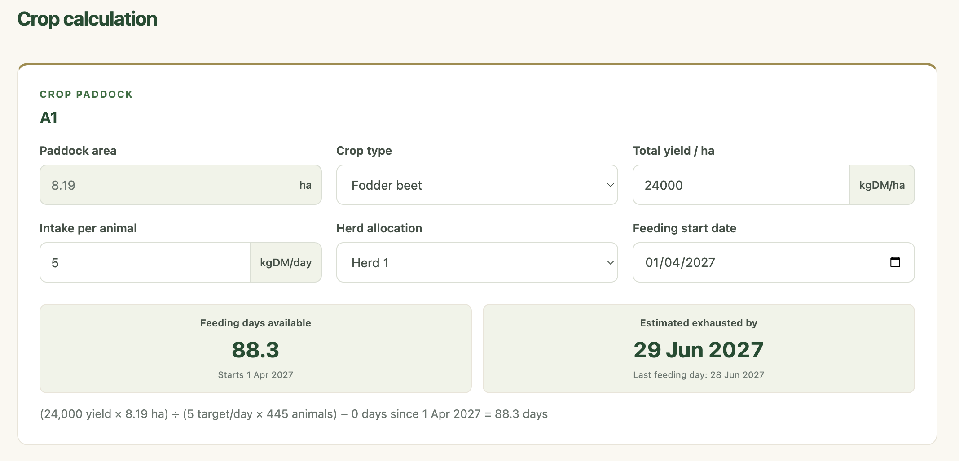
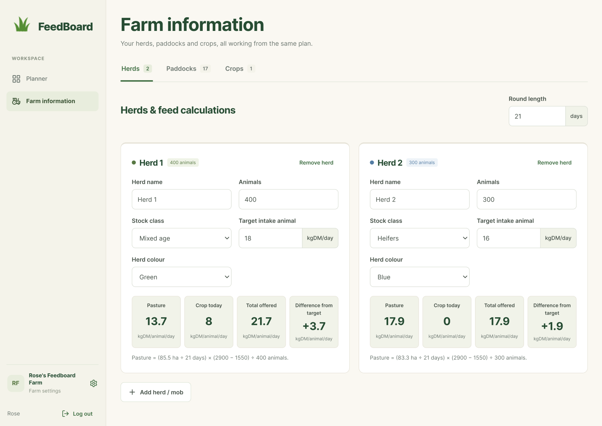
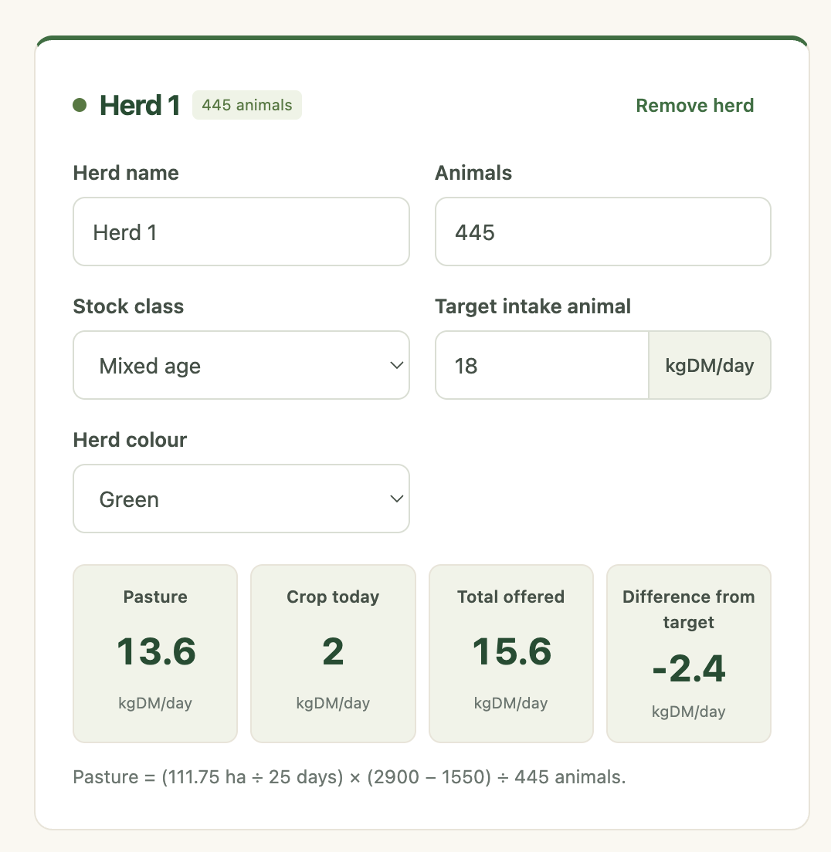
03 / DELIVERY – Backend
FeedBoard
Calculations
Herds, paddocks and crops connect to the feed balance
Daily grazing area | Hectares needed each day, based on grazing area and round length
Pasture intake | Pasture available per animal per day in kgDM
Feed surplus or shortfall | Feed offered compared with the herd’s target intake
Crop availability | Days remaining, finish date and today’s available crop feed
Crop intake per herd | Total crop kgDM per animal from the herd’s active crops
AM/PM paddock plan | Break sizes, paddock allocation and progression through the grazing queue
GRAZING + FEED PLANNING
Notes:
SLIDE 15: Farm information and feed calculations
PRESENTATION CUE: Explain the farm information cards, then show the crop feed section.
Farm Information lets the farmer add and edit herds, paddocks and crops. Each herd has animal numbers and a target intake. Paddocks have names, hectares and optionally a herd assignment. Crop records are linked to crop paddocks and include yield, feeding rate, receiving herd and start date. FeedBoard estimates pasture intake per animal and crop contribution, then compares the total with the target intake. Crop days remaining and the finish date are estimates based on the values entered, rather than measured feed on the day.
EVIDENCE / FILES: Full page farm information (herds).png; Crop calculation.png; calculateFeedMetrics.js; CropMetric.js

Slide 17
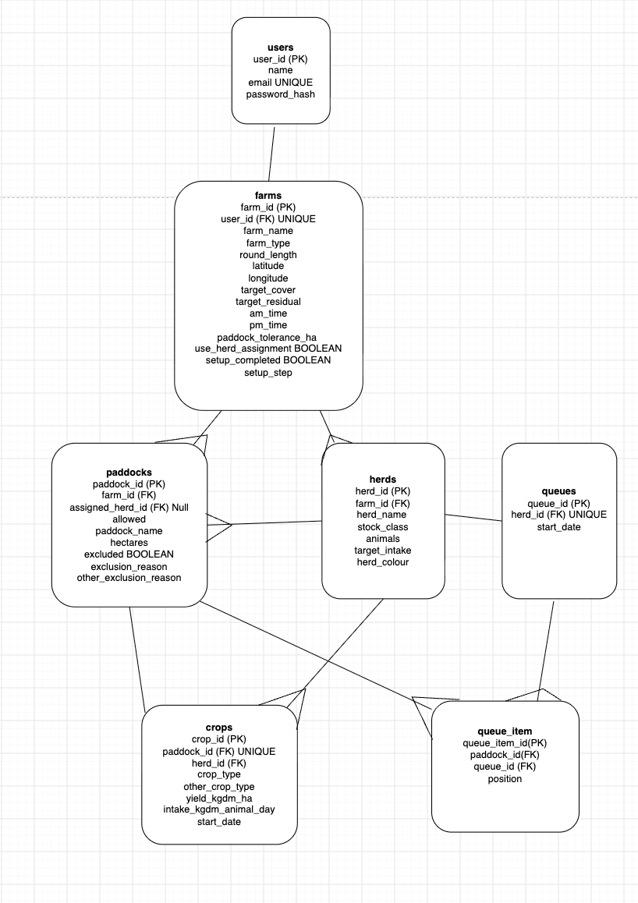
03 / DELIVERY - DATABASE AND CRUD
FeedBoard
MySQL and CRUD
Farm records are stored in linked tables
users + farms
An account owns one farm
herds + paddocks
Animal groups and land records
crops
Feed details linked to paddocks and herds
queues + queue_items
Saved grazing order and start date
GRAZING + FEED PLANNING
Notes:
SLIDE 19: MySQL and CRUD
PRESENTATION CUE: Use the entity diagram to explain relationships, not every column.
FeedBoard uses MySQL to persist farm information. The tables separate users and farms, herds, paddocks, crops and saved planner queues. The relationships use primary keys and foreign keys. Crop records link to a paddock and a receiving herd, and queues store the paddock order for each herd. The Express API supports create, read, update and delete operations for farm-related records. Mutations are validated and run in transactions so an invalid linked change can be rolled back. The website does not need a Delete Farm button for the backend to support safe farm recreation.
EVIDENCE / FILES: Entity diagram.png; backend/sql/001_initial.sql; farmModel.js; farmMutation.js

Slide 18
03 / DELIVERY - USER AND DATA FLOW
FeedBoard
User and data flow
Saving farm changes to MySQL and returning the confirmed result
REQUEST: USER TO DATABASE
RESPONSE: DATABASE TO USER
User
MySQL
Returns query results and confirms the write
ui/src/
backend/config → backend/models
Returns the saved farm
backend/server.js
backend/controllers
backend/routes + middleware
ui/src/services
Reads the response and acknowledges the save
backend/controllers
ui/src/hooks
Updates farm state
backend/models
ui/src/pages & components
React renders the updated information
MySQL
User
Stores the validated farm records
Sees the updated farm information
GRAZING + FEED PLANNING
Notes:
User and data flow
This diagram follows a successful save and its response. The user edits a page or component. Workspace shares the useFarmData hook with the pages. The hook updates local state and writes a browser draft immediately, then schedules valid changes for saving. ui/src/services/farmChanges.js chooses the relevant resource operation, while ui/src/services/api.js sends the HTTP request. Initial setup uses POST /api/farm. Later changes use the relevant POST, PATCH, PUT or DELETE resource route.
backend/server.js applies global middleware, including origin checks, rate limits, JSON parsing and sessions. backend/routes/farmRoute.js matches the endpoint and invokes route-specific backend/middleware checks. backend/controllers/farmController.js passes the authenticated user ID to the model. backend/models/farmModel.js checks ownership and the expected farm identity and version. It calls backend/services/farmMutation.js for resource change rules and uses the database pool from backend/config/db.js to read and write MySQL inside a transaction. Initial setup follows its own createFarm function.
On success, database results return to the model. The model returns the confirmed farm data, farm ID and version to the controller, which sends a JSON response. Frontend services acknowledge the save. The hook checkpoints the returned version and updates the visible state while preserving newer edits. React renders the pages and components, showing saved status to the user. The successful response does not travel backwards through route matching and authentication middleware.
Loading an existing farm uses GET /api/farm through the same protected server, route, controller and model layers. The model reads the user's records from MySQL and the response returns through the same frontend layers. Loading does not run the farm mutation service.
CALCULATIONS ARE A SEPARATE REQUEST: ui/src/hooks/useFarmCalculations.js calls ui/src/services/api.js, which posts the current farm draft to /api/farm/calculate. After route and middleware checks, backend/controllers/calculationController.js calls backend/calculations. It returns calculated JSON through frontend services and hooks to the active page. This calculation request does not write to MySQL. Weather also uses a separate request through backend/controllers and backend/services/weatherService.js to MET Norway, with caching.
CODE REFERENCES: ui/src/components/Workspace.jsx; ui/src/hooks/useFarmData.js; ui/src/hooks/useFarmCalculations.js; ui/src/services/farmChanges.js; ui/src/services/api.js; ui/src/services/draftStorage.js; backend/server.js; backend/routes/farmRoute.js; backend/middleware; backend/controllers/farmController.js; backend/controllers/calculationController.js; backend/models/farmModel.js; backend/services/farmMutation.js; backend/config/db.js.

Slide 19
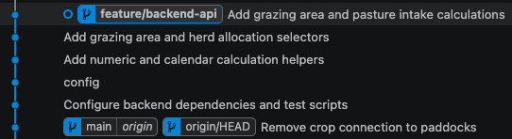
02 / DESIGN – Readme & Git documentation
FeedBoard
README, Git and documentation
Project context, installation instructions and version history
ReadMe complete
Git workflow
✓
Added Screenshots
Meaningful commits
Feature branches and merges.
✓
Code structure
Pages, components, routes and models
Git evidence: to document
GRAZING + FEED PLANNING
Notes:
README, Git and documentation
Project materials describe the problem, stakeholders, user stories, screen designs and code structure. A developer also needs clear setup and maintenance instructions.
The README still needs the FeedBoard description, prerequisites, UI and backend installation steps, environment variable examples, MySQL setup and the commands for development and testing. The README in the supplied project is still the starter template.
Git evidence should include meaningful commits, the feature branches and their merges, and a tagged release. The slides do not claim these have already been completed because the current repository history has not been verified. Add the actual repository link and evidence when ready.
EVIDENCE: supplied project README.md, frontend and backend folder structure, project planning materials.

Slide 20
02 / DESIGN - PLANNING AND NEXT STEPS
FeedBoard
Next steps to launch
Add additional features
-Consider multi users
-Flexible crop herd allocation.
-add a delete farm section
Simplify Controllers / mutations
-Use specific controller functions and keep only saving logic in mutateFarm.
Remove Stories.jsx
Complete final testing with additional features
Connect to Docker + AWS
Backend server + HTTPS domain
GRAZING + FEED PLANNING
Notes:
Planning and next steps
The next work includes documenting the project, recording Git evidence and completing a testing report. Browser and mobile testing should cover full user journeys, including setup, editing, saving, returning to an existing account and invalid input.
Future product improvements include shared farm access and more flexible crop-to-herd allocation. These require additional permissions, UI work and regression tests.
Production preparation includes packaging the app with Docker, configuring AWS hosting and a production MySQL database, and setting up the HTTPS domain. Backups, monitoring and recovery procedures need to be checked before launch. The deployed application should then be tested with farmer feedback.
These are planned tasks. The supplied code does not establish a completed FeedBoard deployment, a measured effort estimate or a fixed launch date.

Slide 21
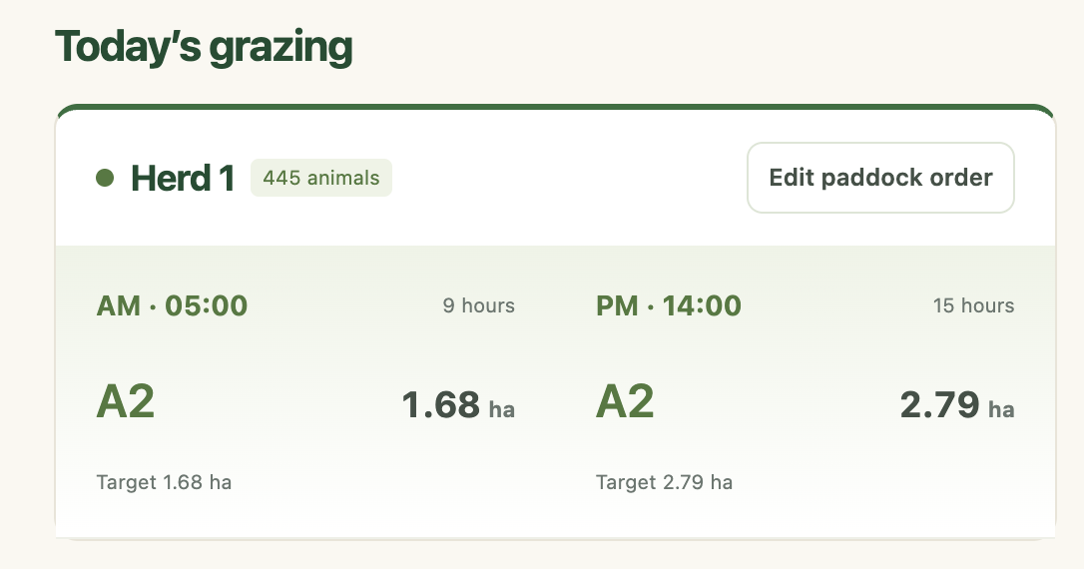
A clearer grazing plan,
with the maths built in.
Questions?
Notes:
SLIDE 20: Conclusion
PRESENTATION CUE: Return to the main purpose rather than listing every technology again.
The aim of FeedBoard was to take a familiar farm planning process and make it easier to update. The current application lets a farmer enter farm and herd information, plan the next grazing breaks, and review feed calculations. It has a React frontend, an Express API and MySQL storage, and the unit and API tests shown earlier are passing. It is not a production service yet. My next steps are to finish the developer documentation, test more thoroughly with users and prepare the hosting, backups and deployment. Thank you — I am happy to demonstrate a screen or take questions.
EVIDENCE / FILES: Today's grazing card.png; project code and test evidence

