Slide 1

Patrick, Johanna, Rose, Holly

Slide 2
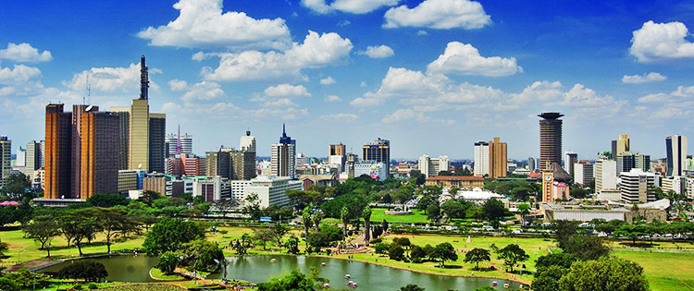




Aim
Analyze possible correlations in overall satisfaction ratings vs. price in four different cities across the world.
Amsterdam
Boston
Nairobi
San Francisco

Slide 3
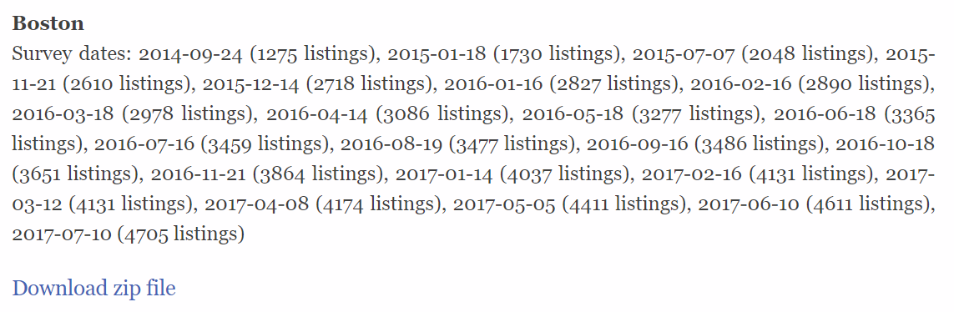

Source
http://tomslee.net/airbnb-data-collection-get-the-data
Used most recent (July 2017) CSV

Slide 4
Questions
For each city we aimed to:
Identify Room Type – Private Room, Shared Room, Entire Home/Apt
Identify relationship between:
Room Type vs. Average Price
Average Price by Neighborhood
Overall Satisfaction vs Price
Price Range vs Average Satisfaction

Slide 5
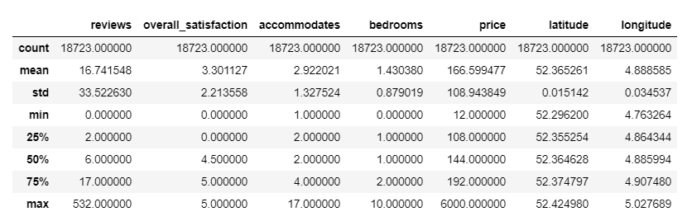
Data Cleanup & Exploration
Removed blank columns and rows
Dropped other not needed columns
.describe()
.count()

Slide 6

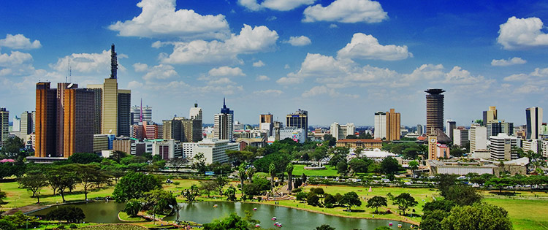
OBJECTIVE
Cities Analyzed
Amsterdam
Boston
Nairobi
San Francisco
Room Type Analysis
Aim: Identify room types per city
Task: Get count of each and make comparison of popularity
NAIROBI
San Francisco

Slide 7
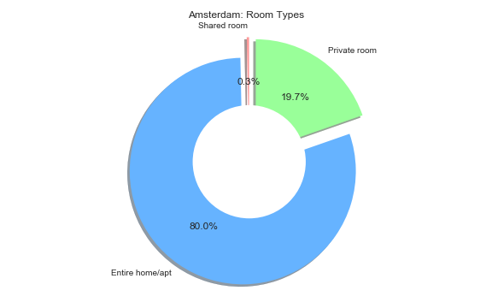
Room Type Analysis
More customers have chosen an entire home/apartment to rent in Amsterdam than a private room in an occupied residence. There are very few shared rooms rented in this city.
Entire Residence 80%
Private Rooms 19.7%
Shared Rooms 0.3%

Slide 8
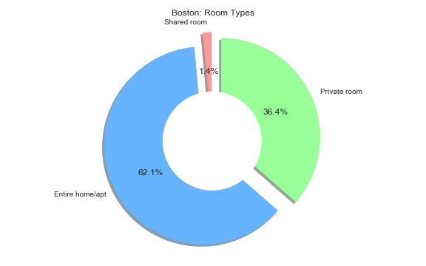
Room Type Analysis
The most popular choice in Boston is an entire home or apartment. Private rooms seem to be another well liked choice. Very few customers have rented shared rooms in this city.
Entire Residence 62.1%
Private Rooms 36.4%
Shared Rooms 14%

Slide 9
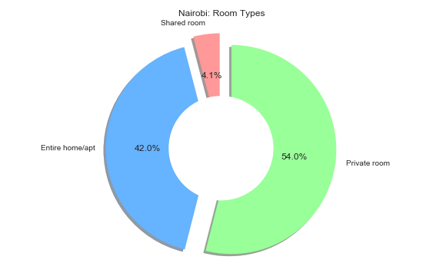
NAIROBI
Room Type Analysis
Private rooms in Nairobi seem to be the most popular. These are usually private rooms in an occupied residence. Entire homes or apartments are readily available followed by shared rooms.
Entire Residence 42.0%
Private Rooms 54%
Shared Rooms 4.1%

Slide 10
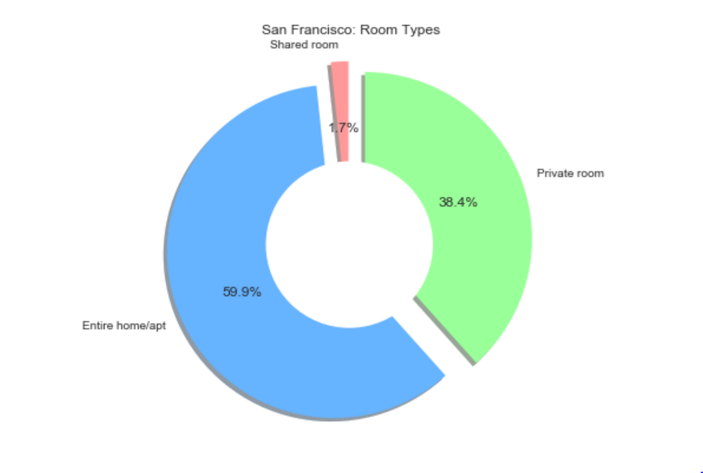
San Francisco
Room Type Analysis
The most popular choice for San Francisco is an entire home or apartment. Private rooms are rented very often as well. Shared rooms seem to be the least popular option.
Entire Residence 59.9%
Private Rooms 38.4%
Shared Rooms 1.7%

Slide 11
OBJECTIVE
Cities Analyzed
Amsterdam
Boston
Nairobi
San Francisco
Room Type vs Average Price
Aim: Identify average room price vs room types in each city
Task: Get average price of each and make comparison of room type
NAIROBI
San Francisco

Slide 12
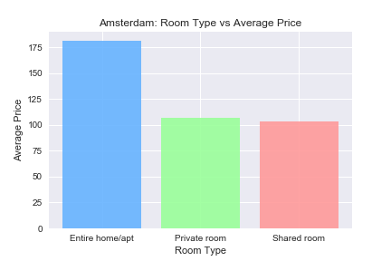
Room Type vs Average Price
Entire Residence $180
Private Rooms $110
Shared Rooms $105

Slide 13
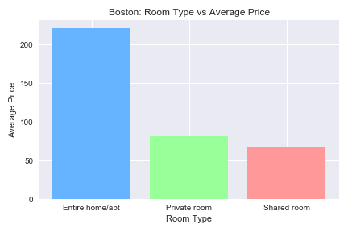
Room Type vs Average Price
Entire Residence $275
Private Rooms $75
Shared Rooms $65

Slide 14
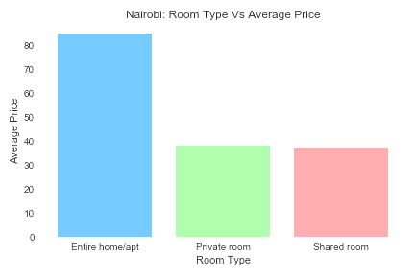
NAIROBI
Room Type vs Average Price
Entire Residence $90
Private Rooms $38
Shared Rooms $35

Slide 15
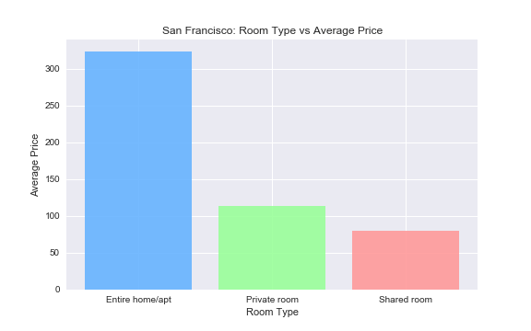
San Francisco
Room Type vs Average Price
Entire Residence $350
Private Rooms $110
Shared Rooms $75

Slide 16
OBJECTIVE
Average Price Per Neighborhood
Cities Analyzed
Amsterdam
Boston
Nairobi
San Francisco
Aim: Identify average room price vs room types in each neighborhood of the city
Task: Get average price of each neighborhood and make comparisons of the neighborhoods
NAIROBI
San Francisco

Slide 17
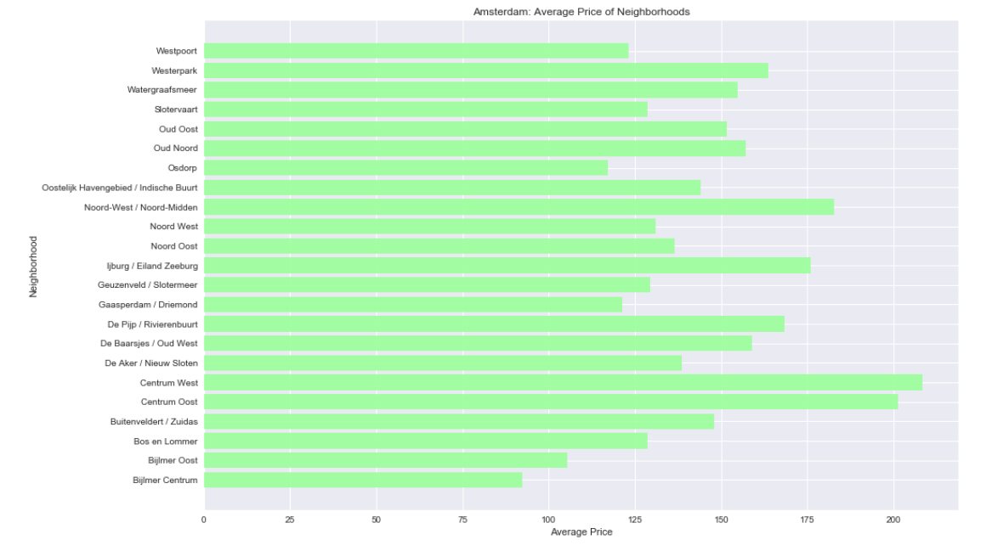
Average Price Per Neighborhood
Centrum West is the most expensive neighborhood in Amsterdam at an average of $210 a night.
Bijlmer is the least expensive at an average of $90 a night.

Slide 18
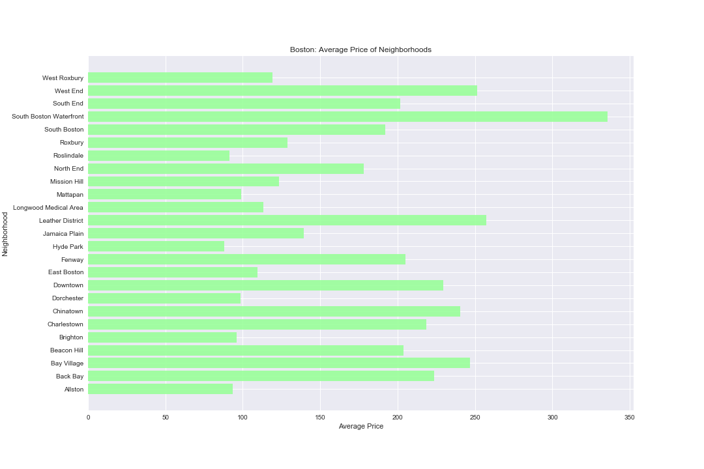
Average Price Per Neighborhood
South Boston Waterfront is the most expensive neighborhood in Boston at an average of $340 a night.
Hyde Park is the least expensive at an average of $85 a night.

Slide 19
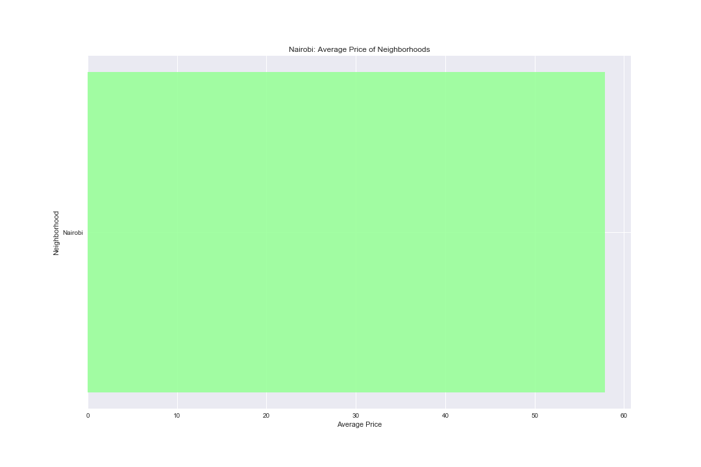
NAIROBI
Average Price Per Neighborhood
Nairobi does not list separate neighborhoods but the average price per night is $58.

Slide 20
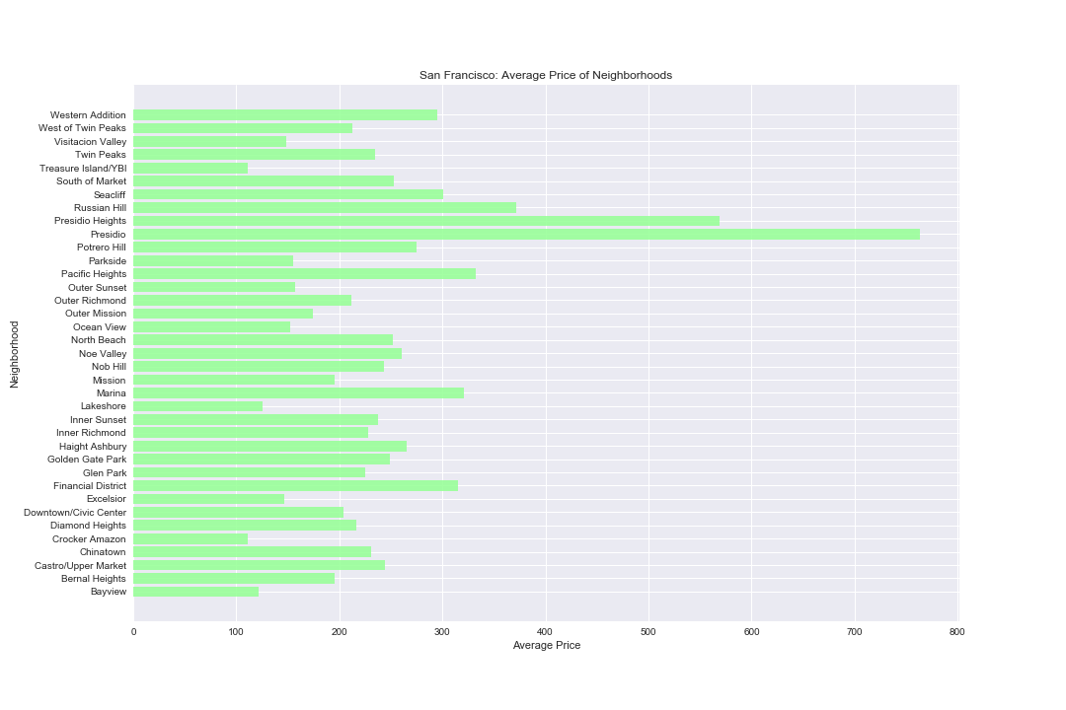
San Francisco
Average Price Per Neighborhood
Presidio is the most expensive neighborhood in San Francisco at an average of $760 a night.
Crocker Amazon is the least expensive at an average of $105 a night.

Slide 21
Summary of Findings

Slide 22
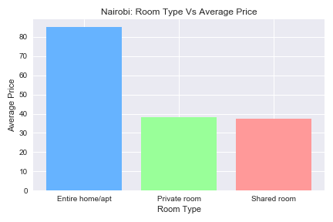
Breakdown Summary – Room vs Avg Price

Slide 23
Breakdown Summary - Avg Price by Neighborhood

Slide 24
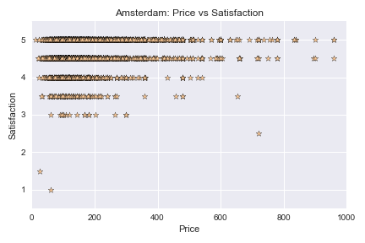
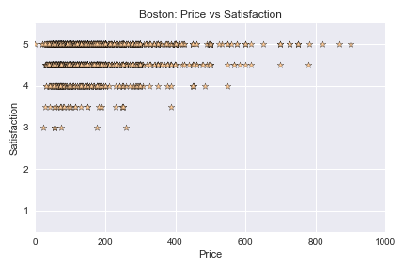
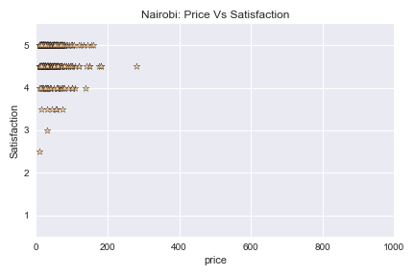
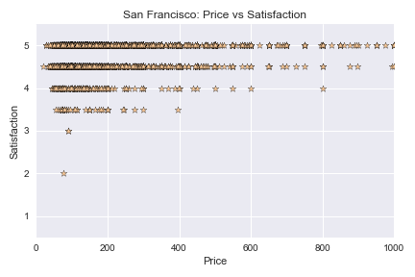
Breakdown Summary - Overall Satisfaction vs Price

Slide 25
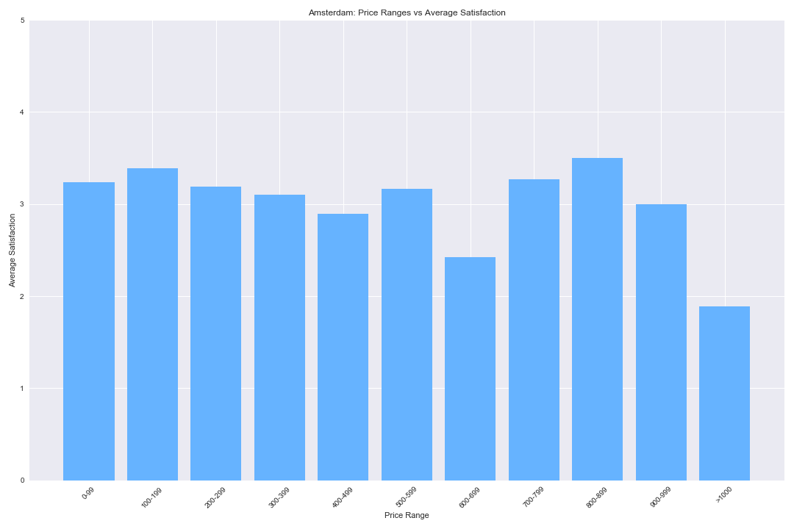
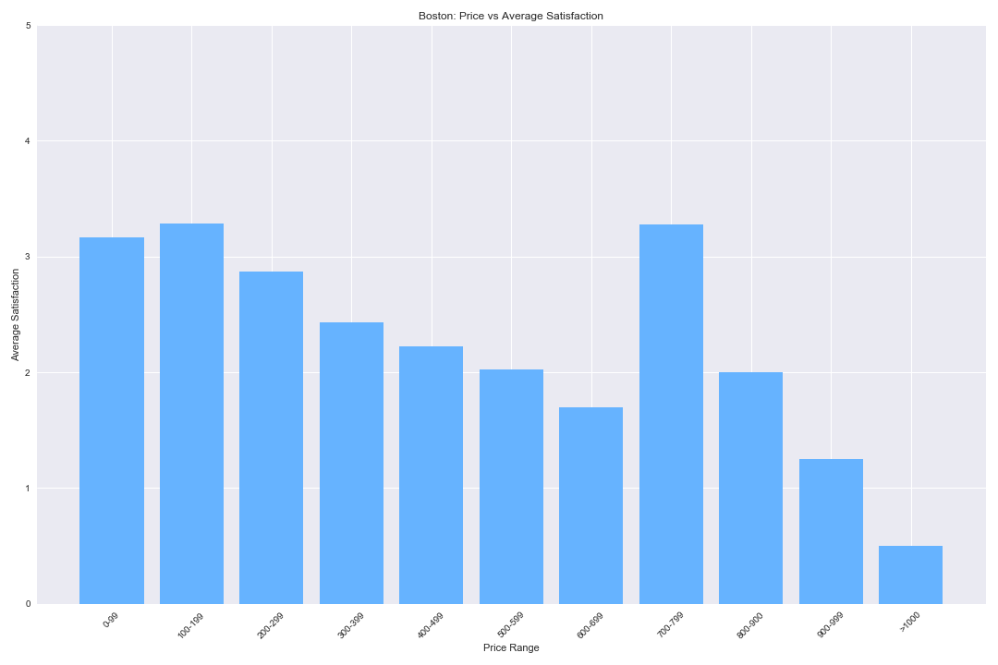
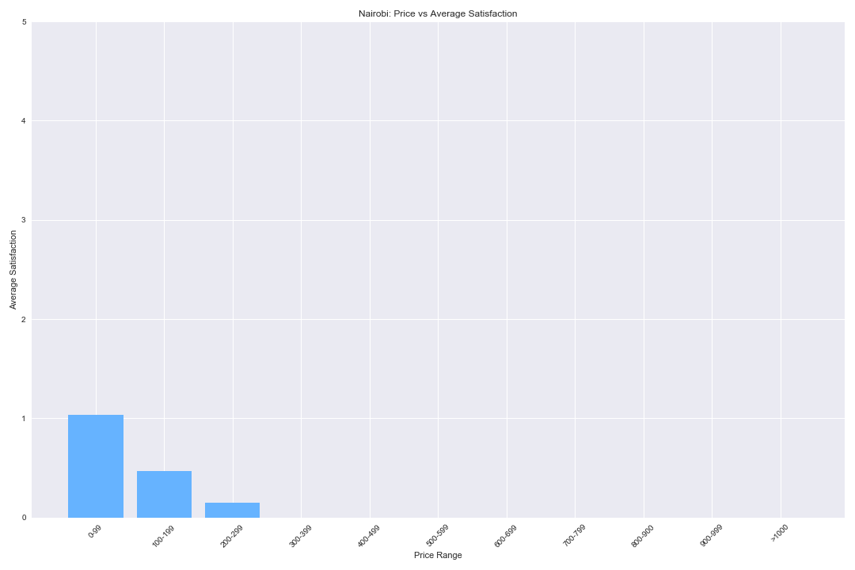
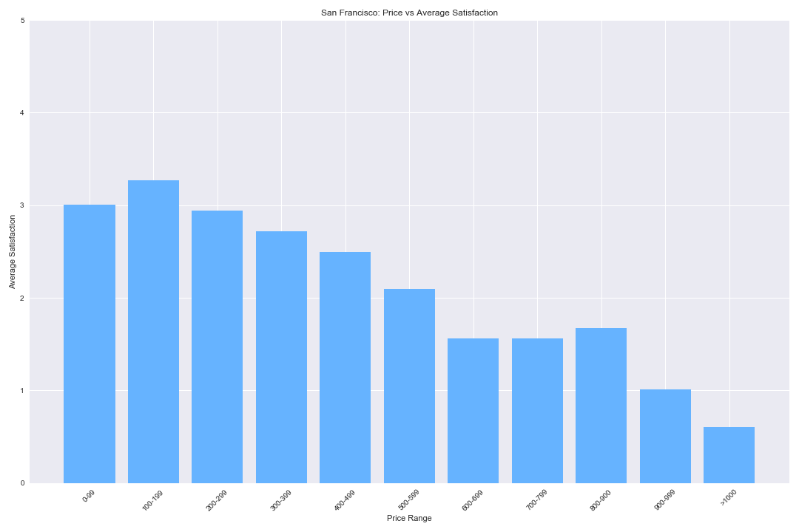
Breakdown Summary - Price Range vs Avg Satisfaction

Slide 26
Findings
Room Type Analysis
Each city had a different room preference Level. But Entire House was Most popular in all cities
Price By Neighbourhood
This is also varied except in Nairobi.
Satisfaction and Price
These greatly influenced the room choice

Slide 27
Limitations
Nairobi does not have neighborhoods so it was hard to give conclusive information on how each influenced the price.
The sample data was small so it cannot be duplicated to all cities in Airbnb
Data was only for one Year so it does not tell trends

Slide 28
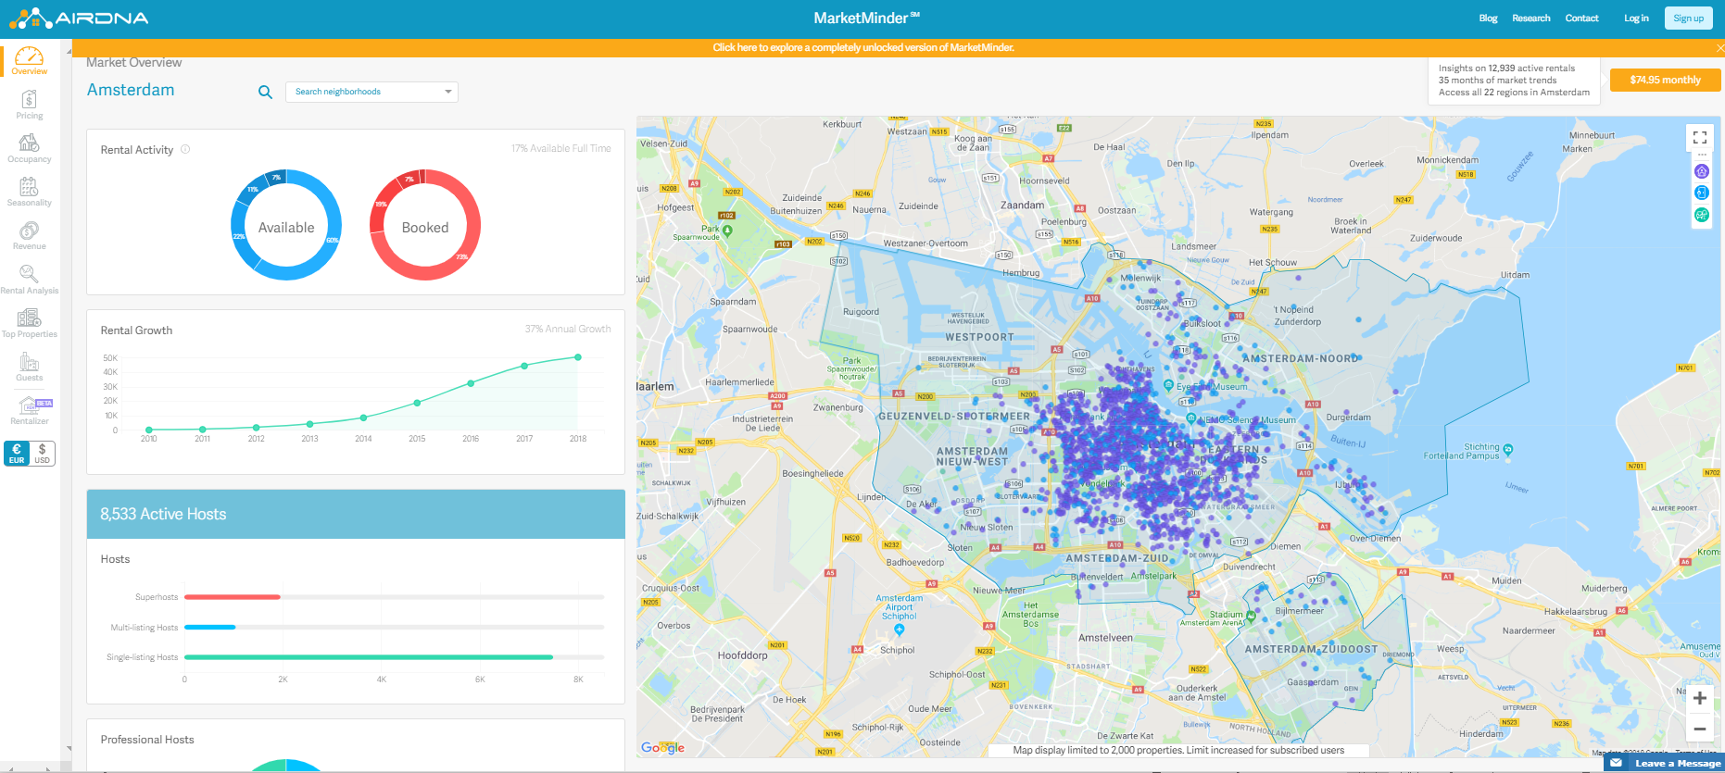
Difficulties and Opportunities
Data was pretty basic, limited exploration
Combine CSVs to track price/ratings over time
Other data sources – AirDNA
Map location with longitude
and longitude
Combine and compare all four
cities

Slide 29
Conclusions
Hotels
From the data it was not easy to know the hotels ratings
Tourism
The data did not elaborate how room types, price and ratings affected tourism in each city
Price
This was clearly answered as they all had the same room types in common.
Future Explorations are possible when hotels are included in the data.

Slide 30
HAKUNA MATATA
Future Explorations are possible when hotels are included in the data.

Slide 31
Previous idea
Title: twitter data analysis
Idea:
Find out the relationship of user age, location, content.
find the data from twitter API. The relationship of twit content from different age range.
What is the percentage user in different age range.
The user density by cities.
The age user density by cities
Reason for Change
We were unable to do this presentation due to time constraints in everyone receiving their Twitter API Keys.

Slide 32
Questions?

