Slide 1
Introduction to OpenGL Geometry and Transformation
Dr. Mekides Assefa Abebe and Dr. Fereshteh Mirjalili

Slide 2
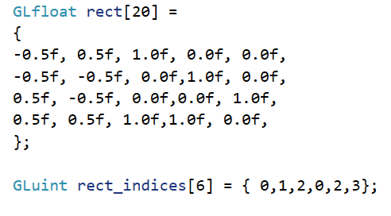
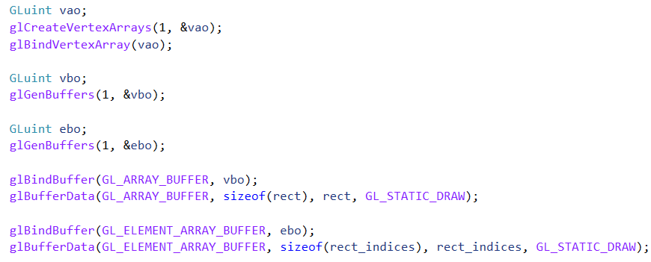
Vertex Buffer Objects (VBO), Vertex Array Objects (VAO), Index Buffer Object
Vertex data: containing position and color attribute values
It can contain more attributes such as texture coordinates, normal, tangent, …
Indexing the vertices for the primitives to be drown.
Index buffers: allow us to use vertices multiple time.
Creating 2 buffers of GPU memory, binding them with the current context, and uploading the vertex and index data on them.

Slide 3
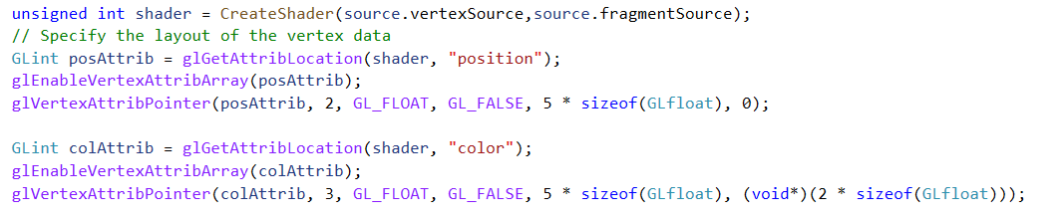
Vertex Buffer Objects (VBO), Vertex Array Objects (VAO), Index Buffer Object
Vertex Attribute and Layout specification
Index to the attribute location
Number of values for the attribute
The data type of the values
Value Normalization?
Stride: amount of byte between each vertex
Pointer: pointer off set position to the attribute, with in each vertex.

Slide 4
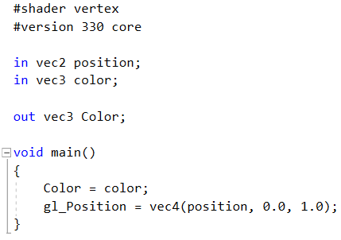
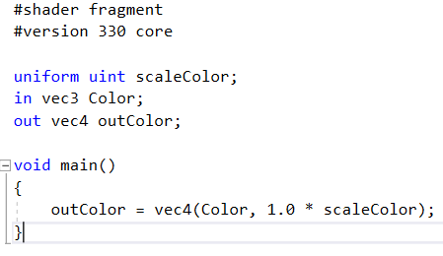
Shaders
Vertex Shaders
Specifies the vertex location in screen coordinate
Pass data to the next shaders
Fragment Shaders
Specifies color for each rasterized fragment
Uniforms
Used to pass data from CPU to shaders after the compilation of shaders
Control the behavior of shaders at run time
Are set per draw call
Used after the shader is bound
Notes:
Move the uniform variable to vertex shader, for performance purposes.
Modify the vertex shader with layout location of the attributes
Include the code for uniform value assignment and may be create animation of transparency

Slide 5
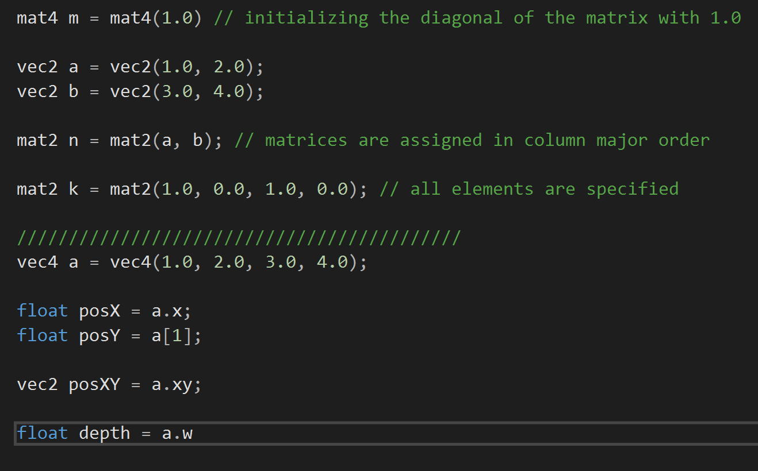
GLSL: OpenGL Shading Language
Data types
Simple: float, double, bool, int, uint
Vectors: vec{2,3,4}, dvec{2,3,4}, bvec{2,3,4}, ivec{2,3,4}, uvec{2,3,4}
Square matrices: mat2,dmat2, mat3,dmat3, mat4,dmat4
Non-sqauare matrices: mat{2,3,4}x{2,3,4}, dmat{2,3,4}x{2,3,4}
Other special types, arrays, structs, …
Variable declaration and initialization
Follows same syntax as C programing language
Variables can be used to initialize other variables
letters x,y,z,w are used to access vectors components. For colors - r,g,b,a and for texture coordinates the available selectors are s,t,p,q.

Slide 6
OpenGL Transformation
Object Coordinate
World Coordinate
Eye Coordinate
Clip Coordinate
Model
View
Projection
transforms a position in a model to the position in the world
If your vertices in world coordinates, then this matrix can simply be set to the identity matrix.
Specify camera transformation
The camera in OpenGL is fixed at (0,0,0) facing the negative Z direction.
To simulate a camera transformation, transform the world with the inverse of that transformation
Different projections can be applied
2D: orthographic
3D: perspective
Finally, clip coordinates should be normalized to device coordinates.
Transformation = Model x View x Projection

Slide 7
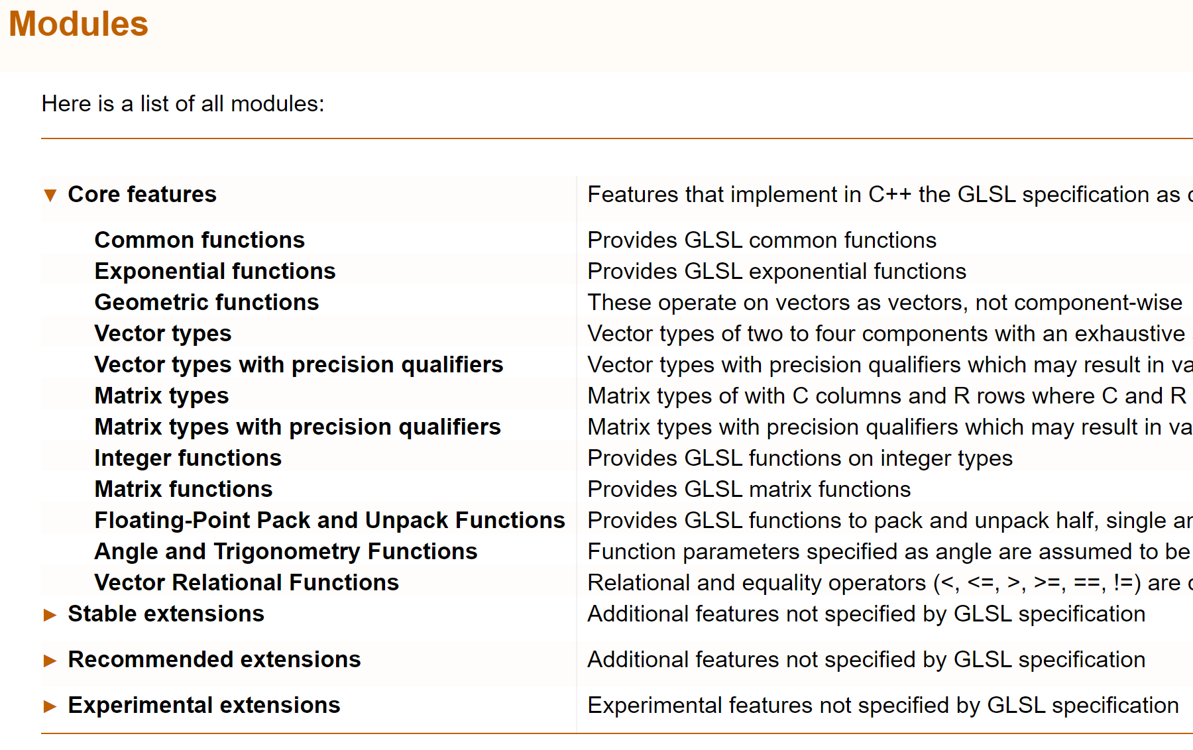
OpenGL Math: GLM
Header-only library based on GLSL specification.
only need to include it.
Contain extension system for more extended capabilities:
Matrix transformations
Data packing
Random number generation
Quaternions, …
For compilation efficiency, only include the required GLM features.

Slide 8
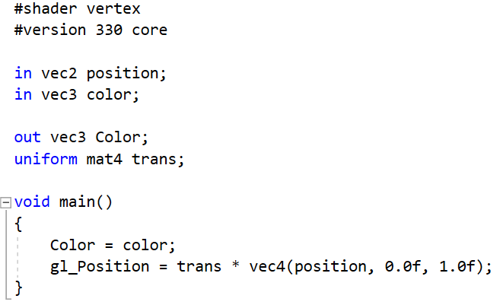
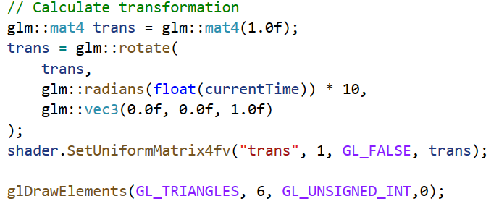
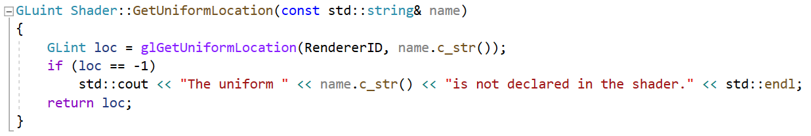
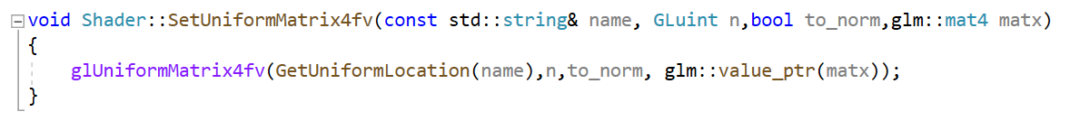
Basic Transformation
Modify the vertex Shader with
new uniform mat4 variable
Translate the vertex location attribute
Create a 4x4 identity matrix, rotate the matrix
Anti-clockwise on the z-axis, and pass it to the
Vertex shader.

Slide 9
Exercise
Use the code provided on whitebaord: folder named Lab03
Increase the GLFW window size and decrease the size of the rectangle by modifying the vertices coordinate.
Translate the rectangle to the right or left.
Scale the rectangle in the x, y and xy direction.
Commit your final code to your gitlab with in a folder named Lab03_opengl

Slide 10
References
GLM documentation: http://glm.g-truc.net/0.9.9/api/index.html
GLSL tutorial: https://www.lighthouse3d.com/tutorials/glsl-tutorial/
OpenGL functions: https://docs.gl/
OpenGL super bible book: http://www.openglsuperbible.com/
Other tutorials: https://open.gl/transformations
YouTube tutorial:
the Cherno: https://www.youtube.com/watch?v=W3gAzLwfIP0&list=PLlrATfBNZ98foTJPJ_Ev03o2oq3-GGOS2&ab_channel=TheCherno

