Slide 1
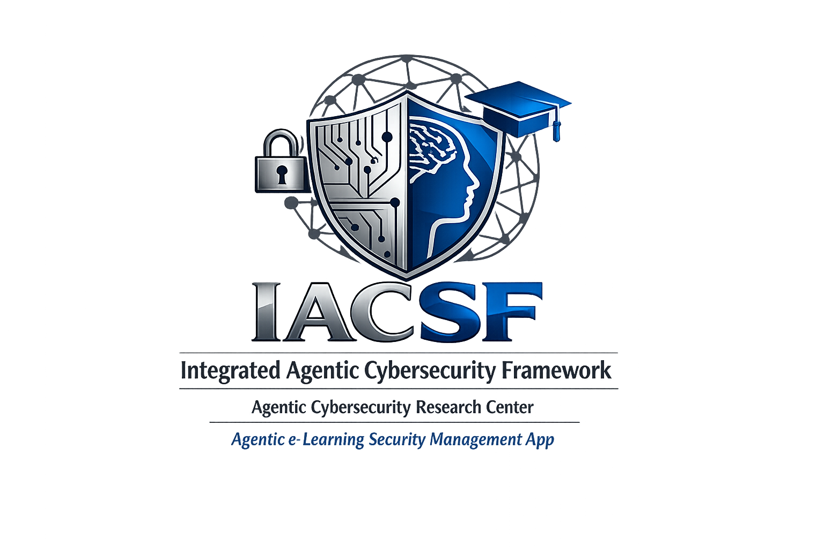
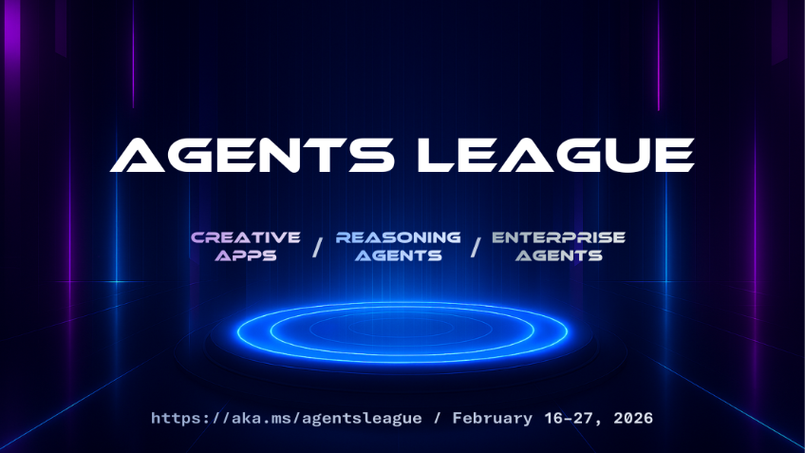
Integrated Agentic Cybersecurity Framework , Agentic Security Research Center & Agentic eLearning Security Mgt. App
Agents League
Hackathon
May, 2026
Starring:
Chinatu Uzuegbu
CCISO, CISSP, CISM, CISA, CEH,….
GitHub: RoseTechCyber

Slide 2
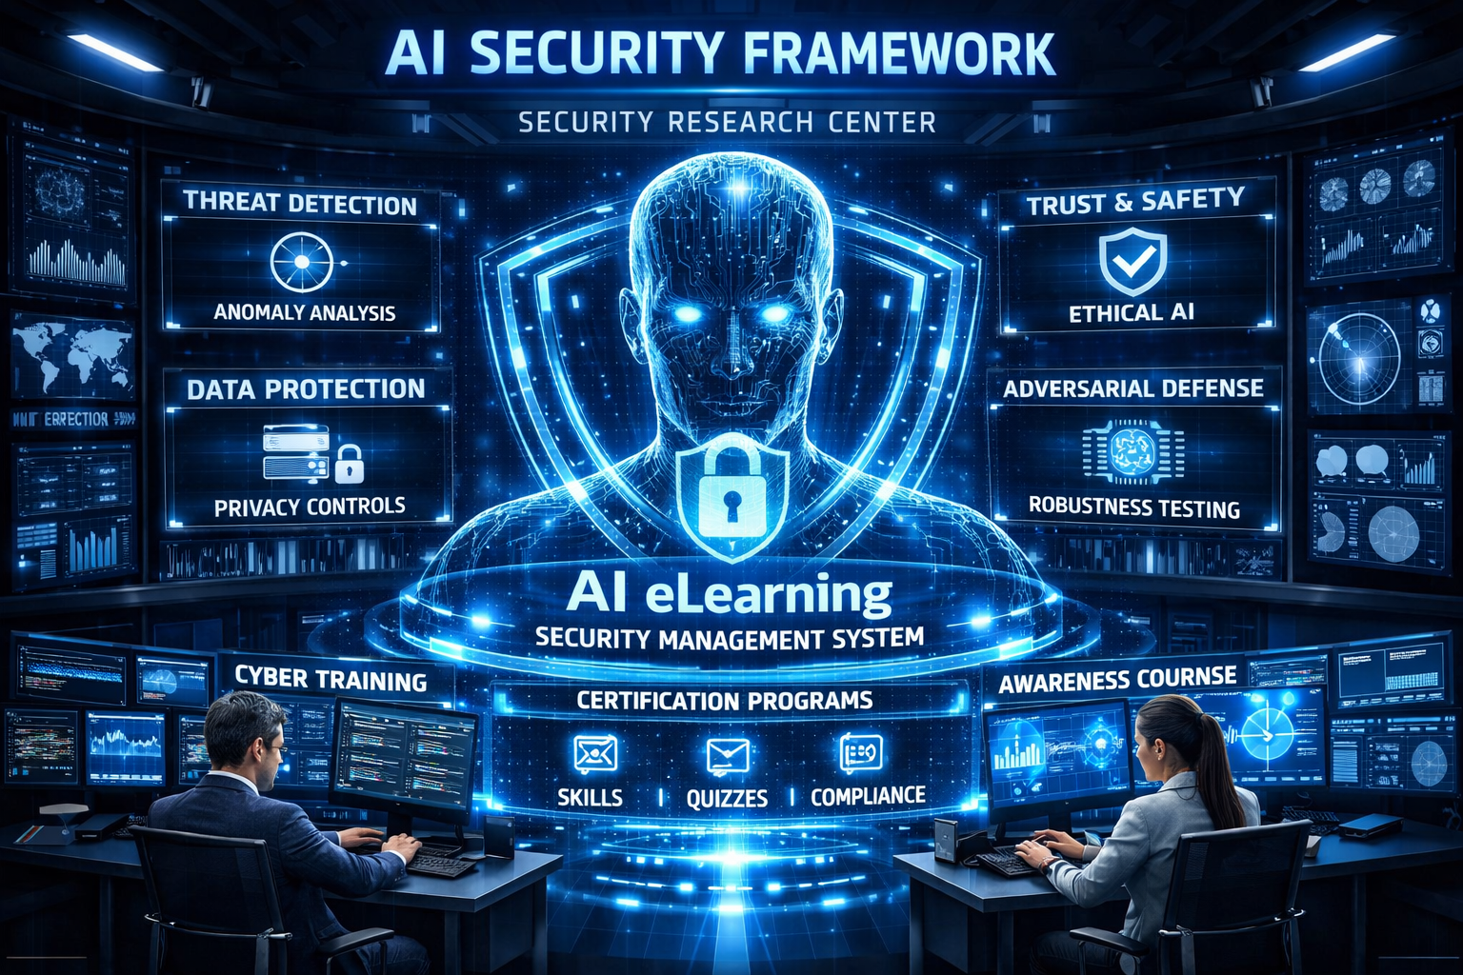
Our Goal
To build an Integrated AI Agentic Cyber Security Framework with automated Agentic Security Research Center and Agentic eLearning Security Management System.
To Tailour out a more proactive Security Solution across the entire Tech Stack (Infrastructures, Platforms/OS, Applications and Data Layers).​
To ensure that the IACSF does not end as just a holistic Security document, but practically implemented in lab demos and seamless Security Research Center with Realtime Agentic Security Operations, and Monitoring in realtime agentic threat protection.​
To leverage on the chain of agentic workflow to build a sustainable Elearning Security Management App, endisuring that all controls and modules in the IACSF are disseminated across Stakeholders and Entities through well packaged modular Security Traings and Certifications.​

Slide 3
Project Overview/Workflow
Reasoning Agent
Other Security Tools
AI Digital Forensic Tools
WorkIQ
Web IQ
Infrastructures Security
Foundry IQ
Copilot Office 365
Orchestrator
Integrated Agentic Cybersecurity Framework-IACSF
OS Security
WorkIQ
Orchestrator
Agentic Cybersecurity Research Center
Foundry IQ
Orchestrator
Application Security
Agentic eLearning Security Management App
Web IQ
Orchestrator
Data Security
Backend Data Retrieval and Vector Search Embedding.​​​
CosmosDb
Orchestrator

Slide 4

Integrated Cybersecurity Agentic Framework-IACSF (Main Orchestrator)
Documented IACSF as the Main Orchestrator and Pointer.
Customized Template with Entity Mapping across Infrastructures, Platforms, Applications and Data Layers.
Open for Contributions to ensure no control is missing.
Most Standard Security Frameworks must align with dpace to accommodate subsequent Frameworks:
ISO 27001
Center for Internet Security(CIS)
HIPAA
Microsoft Cybersecurity Benchmark
Zero Trust
ISO 42001
RMF 100
Others

Slide 5
Agentic Security Research Center
Reasoning agents
Ecurity Tool
Infrastructures Security Tools
Real‑time Detection, Alerting and Orchestration.
Interactive labs: forensic investigations, DLP simulations, workflow orchestration.
Forensic traceability with Autopsy
Web dashboard for monitoring threats.
Threat Protection
Vulnerability Scan
Security plug-ins
Platform/OS Security Tools
Application Security Tools
Data Sec

Slide 6
Agentic eLearning Security Management
Reasoning Agentic Workflow for adaptive learning
LMS dashboards for learner progress & research simulations.
Certification pathways across the Controls and the Security modules in each layer of Technology.
Realtime Agentic workflow through enrollment, on-boarding, learning, Self-Assessment to learning completion and certification.

Slide 7
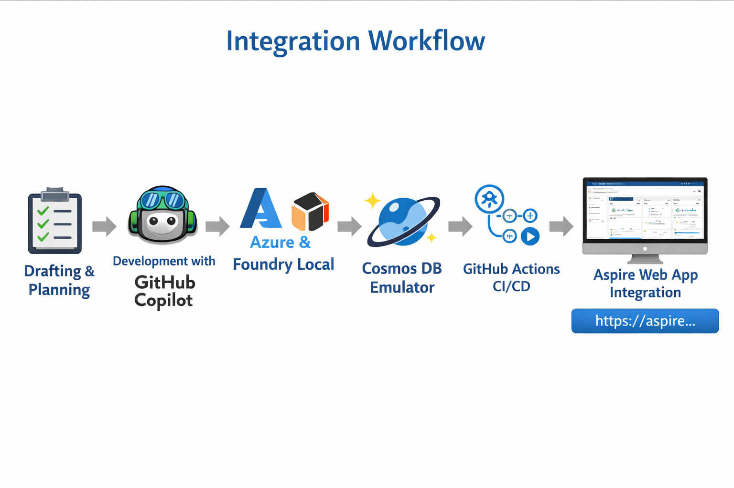

Slide 8
Impact & Next Steps
Strengthens proactive cybercrime defense and full alignment with the Standard Cybersecurity Frameworks such as ISO 27001, CIS, NIST-Cybersecurity, ISO 42001, RMF-100, CSA, CISA and others.​
Realtime automated Security Research and Monitoring Center with Threats Protection and triggers on anomalies.
Provides structured Agentic eLearning Security Management with certifications & hands‑on labs.​

Slide 9
Roadmap
10‑Day Build Plan (3-in-1 Integrated Agentic Cybersecurity Framework , Security Research Center and + LSMS)-IACSF
GitHub Copilot Implementation for modular coding & orchestration.
Reasoning Agent with Work IQ, Foundry IQ, Fabric IQ, Web IQ.
Expand certifications & labs as standards evolve.
Locally hosted on Aspire.

Slide 10
References
RRoseTechCyber/Integrated-Agentic-Cybersecurity-Framework-IACSF: All-in-One Holistic AI Agentic Cybersecurity Framework tailored for a more proactive protection across the Information Technology(IT) Layers covering Infrastructures, Platforms, Applications and Data. Practical Hands-On Security Tools that must align with the Standard Cybersecurity Frameworks such as Digital Forensics tools and others.
Integrated-Agentic-Cybersecurity-Framework-IACSF/docs at main · RoseTechCyber/Integrated-Agentic-Cybersecurity-Framework-IACSF
Integrated-Agentic-Cybersecurity-Framework-IACSF/README.md at main · RoseTechCyber/Integrated-Agentic-Cybersecurity-Framework-IACSF

Slide 11
Thank You! Please connect:
Chinatu Uzuegbu
Linkedin: https://www.linkedin.com/in/chinatu-uzuegbu-67593119/
GitHub: RoseTechCyber
Repo Name: Integrated-Agentic-Cybersecurity-Framework-IACSF.
Email: chinatu7000@gmail.com
Project Team:
Copilot Chat
Github copilot
Others would be updated.

