Slide 1
Cheese Production
Laura Hendley and Rose Wilson

Slide 2
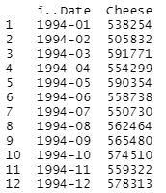
Background
Why Cheese?
Data obtained from USDA

Slide 3
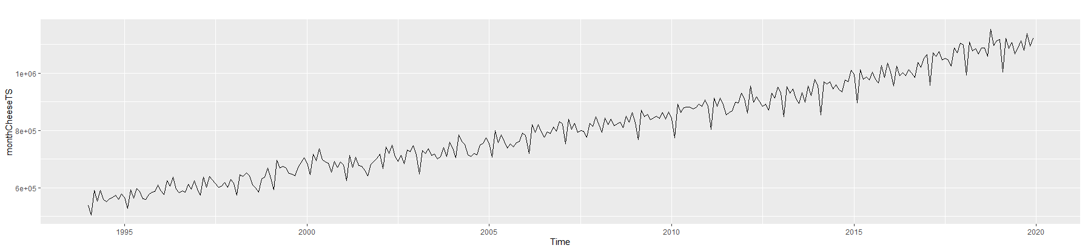
Initial Analysis
Notes:
Decrease in February

Slide 4
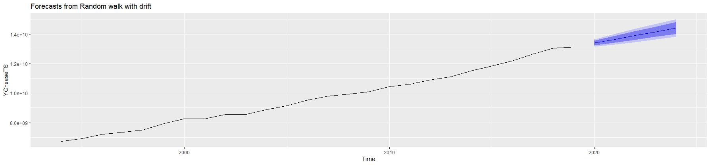
Yearly Analysis - Random Walk with Drift
Pass All Residual Checks
RMSE: 125,491,132 MAE: 106,493,990 MAPE: 1.119201
Notes:
Laura
Why drift - eventually it will stop increasing we would think - the technology can only get so good, demand so high
Passes check residuals

Slide 5
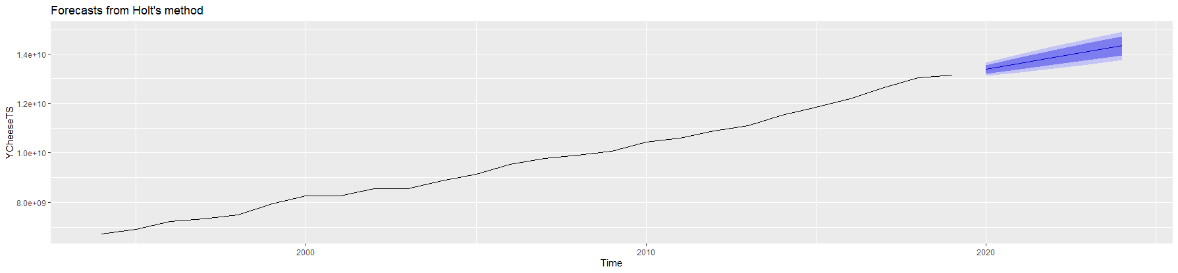
Yearly Analysis - Holt
Pass All Residual Checks
RMSE: 124,400,554 MAE: 106,400,001 MAPE: 1.11248
Notes:
Rose

Slide 6

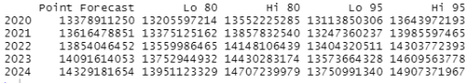
Yearly Forecast Comparisons
RWF - 5 year
Holt - 5 year
Notes:
Laura
Forecasts are similar
RMSE is in millions, Billions of pounds of cheese

Slide 7
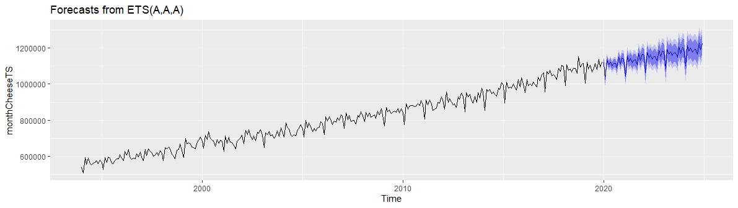
Monthly Analysis - ETS(A,A,A)
Fails Autocorrelation Check!
RMSE: 13,467.73 MAE: 10,837.25 MAPE: 1.11248
Notes:
Rose

Slide 8
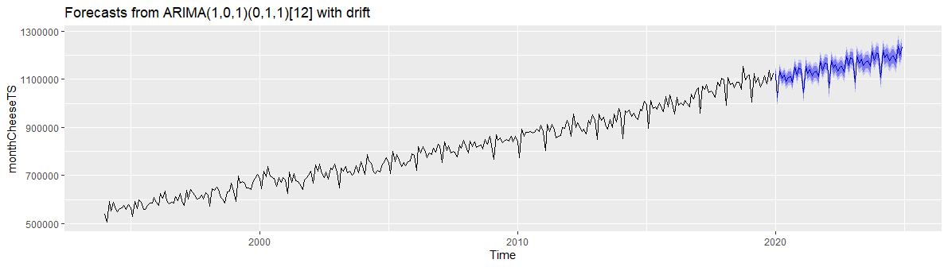
Monthly Analysis - ARIMA(1,0,1)(0,1,1)[12] w/ drift
Pass All Residual Checks
RMSE: 13,046.61 MAE: 10,160.61 MAPE: 1.28317

Slide 9
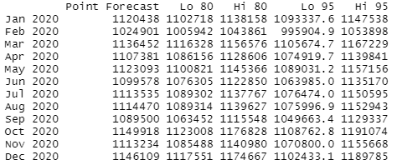
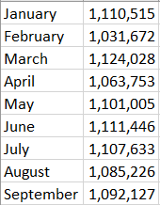
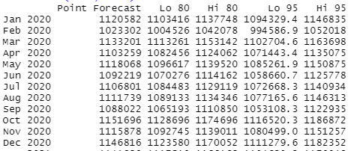
Monthly Forecast Comparisons
ETS - 1 year
Actual - 2020
Arima - 1 year
Notes:
Rose

Slide 10
Conclusions
Seasonality - exists
Trend - increasing
April
Notes:
Laura - seasonality
Rose - trend, April

Slide 11
Links
https://usda.library.cornell.edu/concern/publications/m326m1757?locale=en#release-items
https://curd-nerd.com/is-cheese-making-seasonal/
https://www.cheesesociety.org/covid-19-impact-survey/
Notes:
Rose

Slide 12
Thank You!
Notes:
Rose

