Slide 1
Martus
Information is Power
Mac Knight, Donovan Roseau, Miki Sugimoto

Slide 2
What is Martus?
Martus is a tool for individuals to store, protect, and share information about human rights abuses.
Martus is a free and open source piece of software
Martus encrypts all data that is uploaded to their network, so only authorized users can view the sensitive information
Notes:
Mac

Slide 3
First things First
Trouble downloading Ubuntu because our computers could only run the 64 bit version and not the 32
After downloading the repository, the first virtual machine slowed completely down and we had to make a new. And allocate more memory to it
Learn the different commands to navigate the Linux command line
Notes:
Donovan

Slide 4
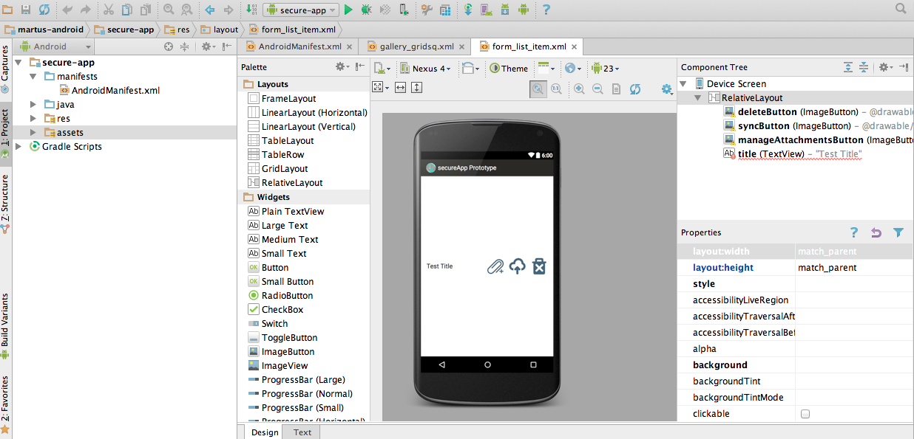
Hopeful Beginnings
After finalizing martus as our project, we wanted to try something new and explore the android platform for martus.
Building the android app was a very streamlined process using the gradle build system
We were able to get the app to run on a Nexus 4 emulator
Notes:
Miki
Talk about how the app would not connect to the server

Slide 5
Cruel realizations
Our original first five test cases were getter and onClick methods that related to the menu widgets in the application
It seemed rather easy on paper…
Figuring out a way to compile the dependencies became incredibly difficult and time consuming especially with the lack of documentation
On top of that we had to figure out a way to interact with the GUI to run several of the tests
Notes:
MAC

Slide 6
Rome wasn’t built in a day
We had to be Flexible…
..or should we say Flexidate
We moved our sights to starting small and testing the functionality of the a utility class Flexidate.java.
The class is used in the application to offer more functionality when recording dates as opposed to java’s built in calendar object
Notes:
Mention that having a flexible object for recording dates is important when reporting time sensitive human rights violations in different countries
Donovan
Flexidate is an improvment on javas calendar object

Slide 7
Let’s get flexible
The flexidate object takes in two calendar objects and sets the earlier date as the low date, and the other as the high.
With that in mind the we changed our first five test cases to test the getRange() method
The method returns the number of days between two dates
Proved to be very flexible, even recognizing the extra day from leap years
Notes:
Miki

Slide 8
Testing Framework
Small iterations that led to successful results were key in the development for our testing framework
We started with creating a simple test driver with hard coded inputs and method calls
The driver would write the result to a text file and we would compare it to the oracle ourselves
Once we knew our driver was behaving correctly we moved onto writing a script that would collect all the necessary information to run the tests from the testCase files
Notes:
Mac

Slide 9
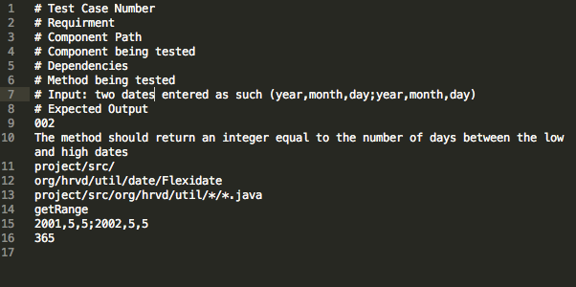
Testing Framework (cont.)
Below is an example of one of our test case files
Notes:
Talk about the the reason for each line
Talk about the importance of version control
Donovan

Slide 10
Testing Framework (cont.)
One issue that we ran into was that our script was re compiling the same java files over and over which significantly decreased the speed of the runAllTests script as more test cases were added.
This was an easy fix by keeping track of which java files were compiled and only compiling when necessary
Over the course of the semester we improved the runAllTests script and added more test cases.
Notes:
Miki

Slide 11
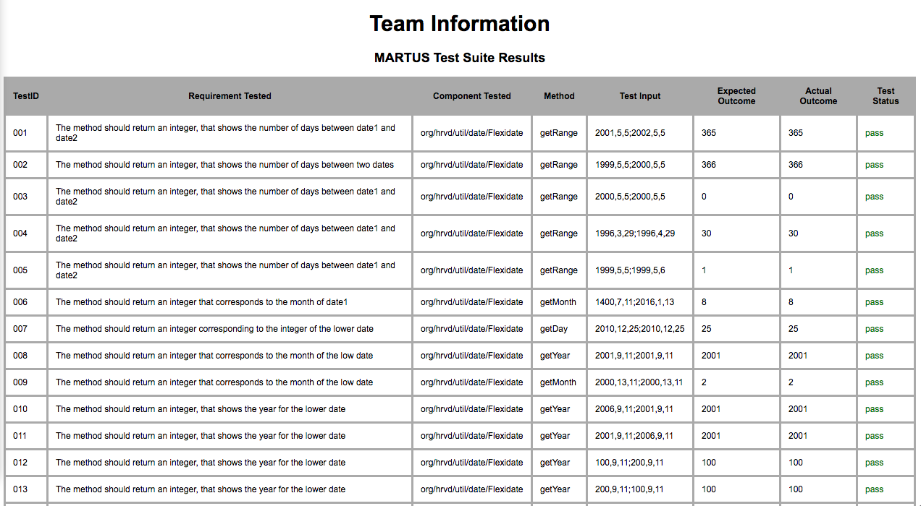
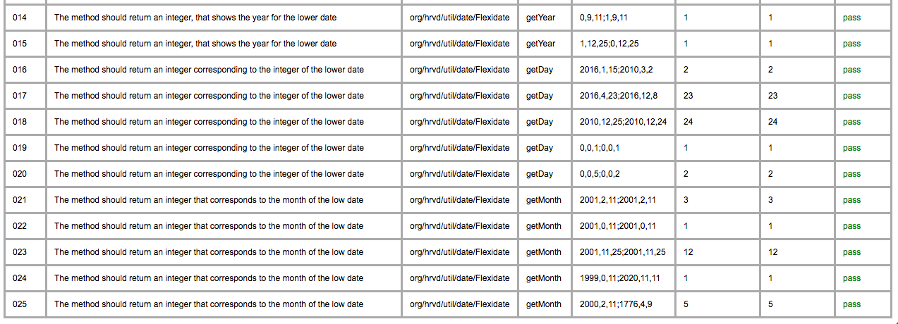

Slide 12
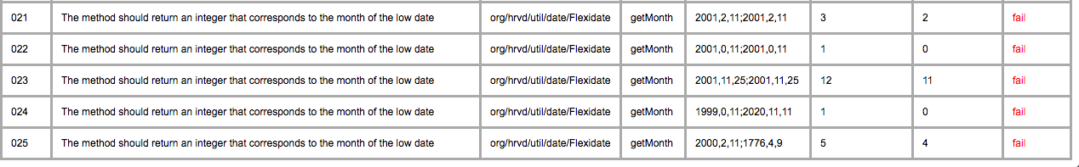
Fault Injections
Java’s Calendar object starts the month of january with 0, which made it an easy target for fault injection.
Notes:
Mac

Slide 13
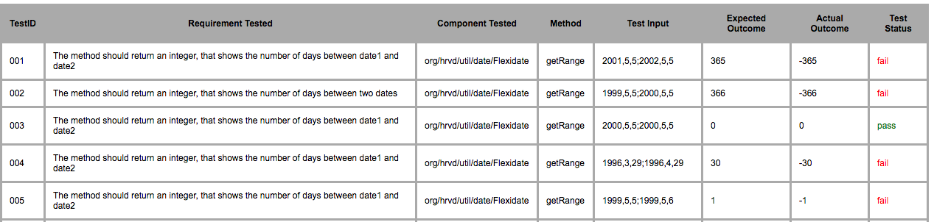
Fault Injections (cont.)
Another example of a fault injection we performed was switching the logic for setting the correct date as the low date
Notes:
Donovan

Slide 14
What did we learn?
Set small achievable goals and build on them
It will take longer than you think
Benefits of meeting face to face
Communication is key (SLACK)
Github is a valuable tool
Notes:
Miki

