Slide 1
Team Members: Peter Tsivis, John Murphy Kyle Norton, Sharda Raj
Data Science Capstone 2021 Project

Slide 2
What lifestyle or socioeconomic factors can help predict diabetes
Selected topic
Diabetes
Reason they selected the topic
To determine what lifestyle and socio-economic attributes indicate the likelihood of developing diabetes.
We found a robust data set that could help us achieve our goals.

Slide 3
Systems Used
Machine Learning
Postgres SQL, Tableau
Description of interactive elements-
Gender
Age
BMI
(the above based on linear regression/ logistical regression done)
Unsupervised Machine Learning to determine trends among Gender, Age and BMI.

Slide 4
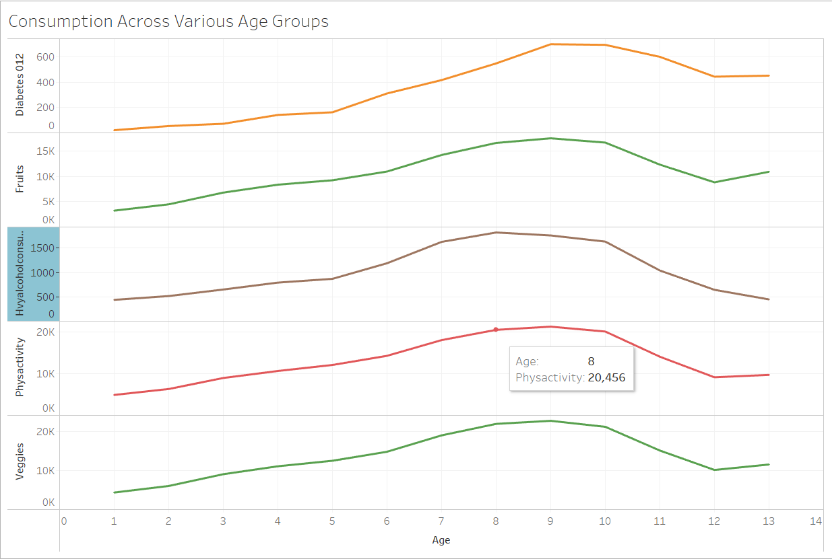
Age
Between ranges 7-10 (Ages 50-54, 55-59, 60-64 & 65-69) the highest amt of alcohol is consumed.
Diabetes is the highest amongst age group ranges 9-10 (60-64, & 65-69)
Fruit consumption decreases among ages 65-74 and increases among ages 75-80+.

Slide 5
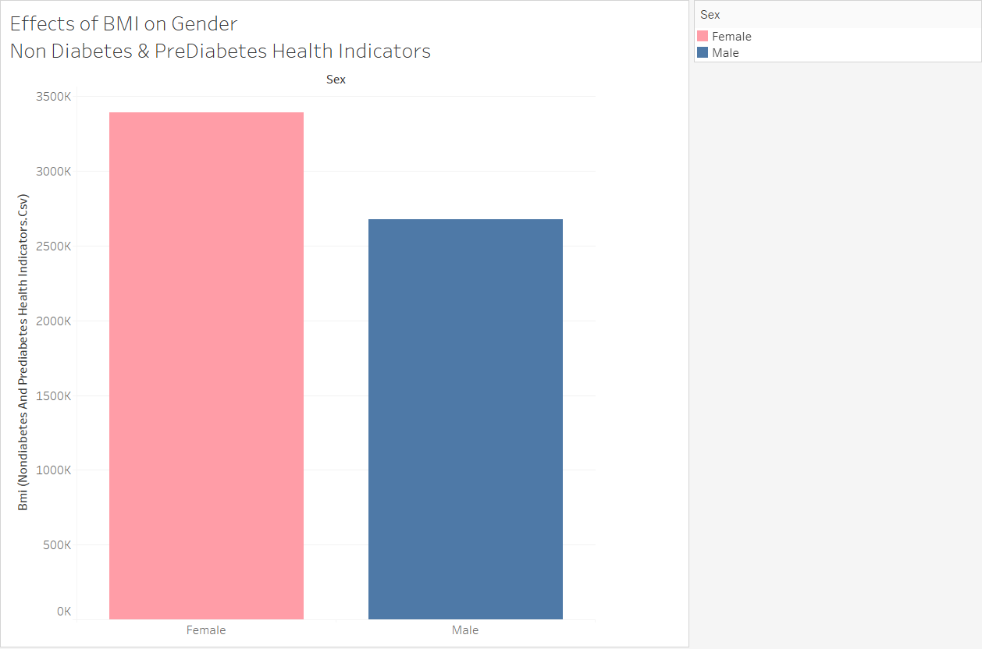
BMI- Nondiabetic & Prediabetic

Slide 6
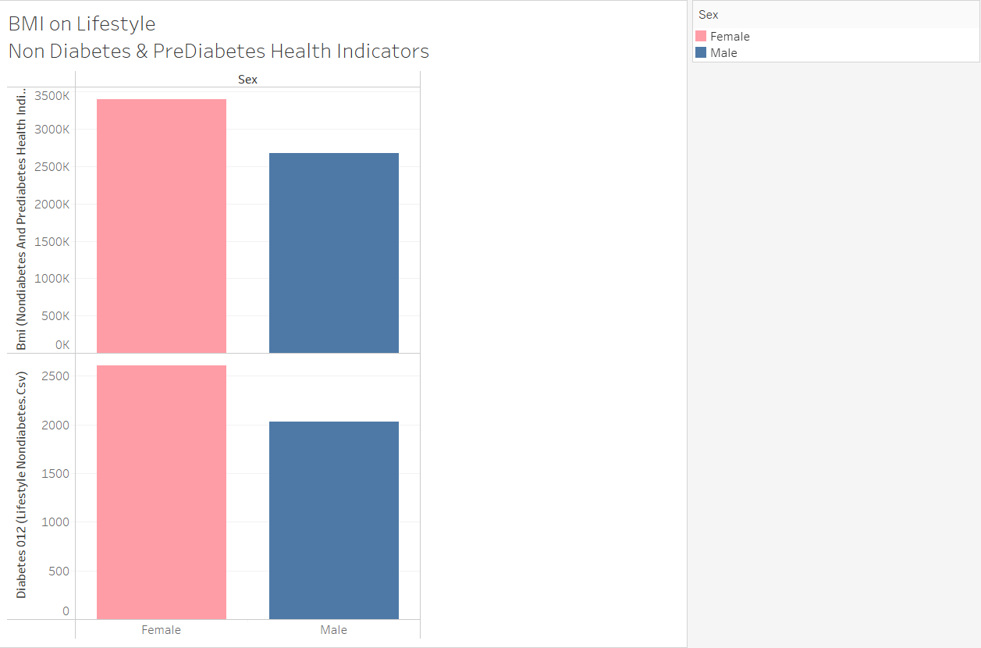
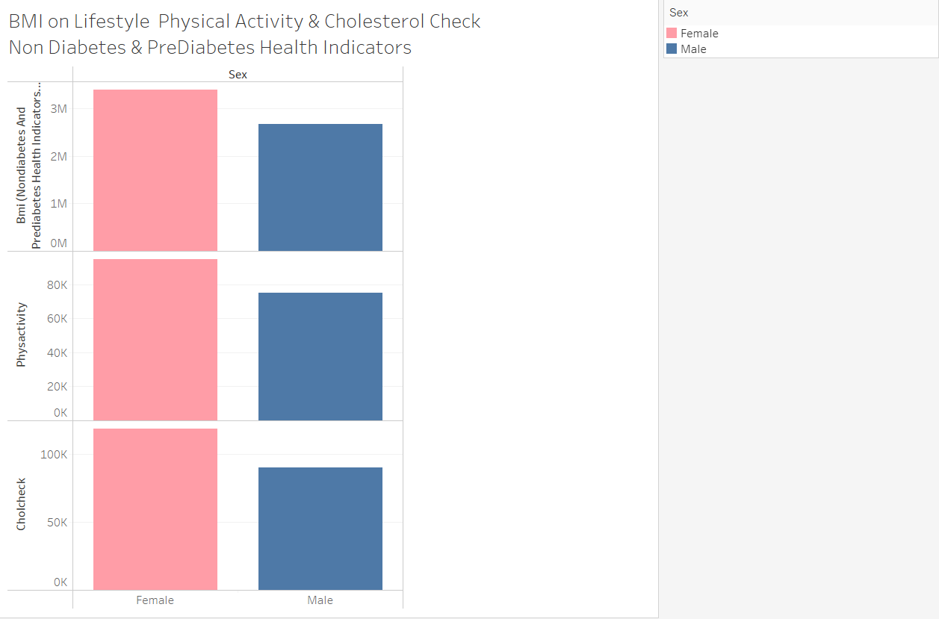
BMI- Lifestyle

Slide 7
BMI- Socioeconomic

Slide 8
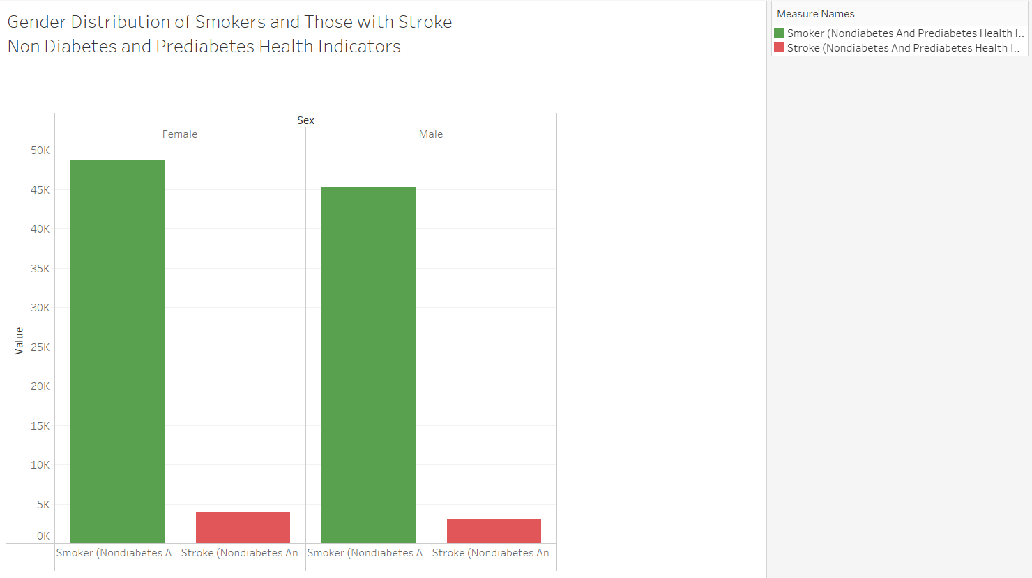
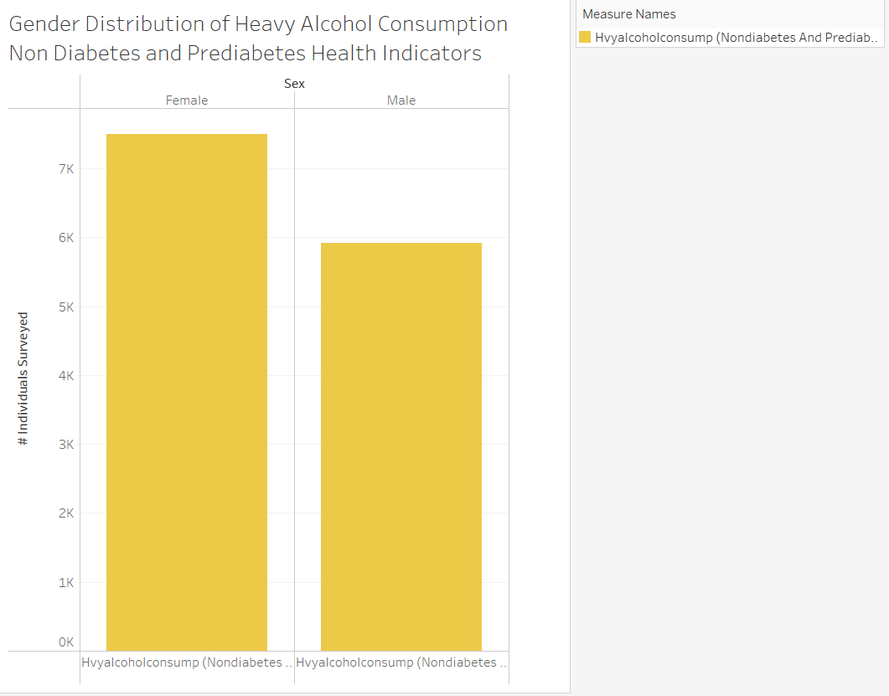
Gender- NonDiabetes and Pre-Diabetes
More Females than Males are Smokers.
About the same # of Males and Females have Strokes.
More Females than Males consume Heavy Alcohol.

Slide 9
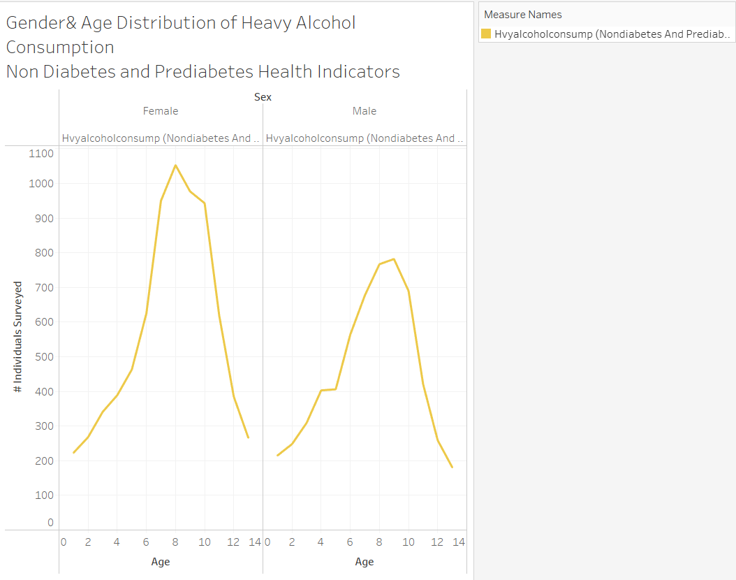
Gender- NonDiabetes and Pre-Diabetes
More Females than Males are Smokers.
About the same # of Males and Females have Strokes.
More Females than Males consume Heavy Alcohol.
Females in Age Groups 45-64 consume more Heavy Alcohol than Men.

Slide 10
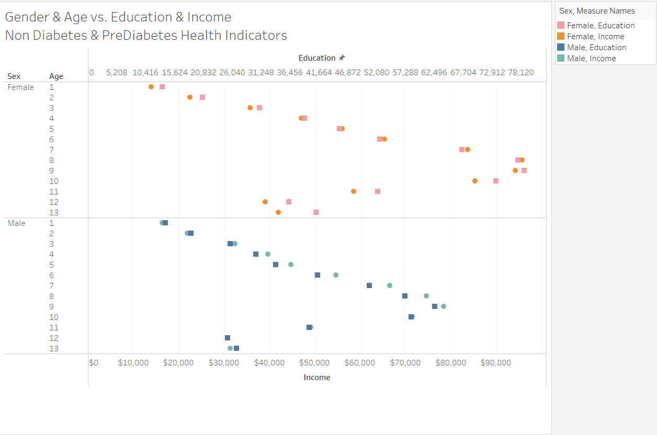
Gender- NonDiabetes and Pre-Diabetes
More Females than Males are Smokers.
About the same # of Males and Females have Strokes.

Slide 11
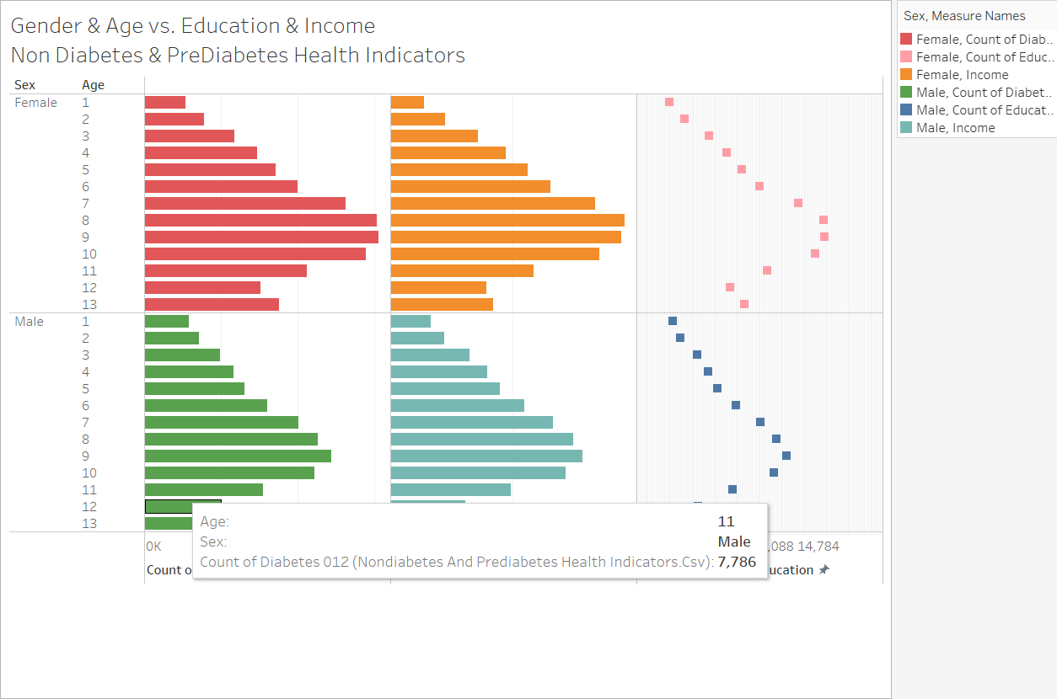
Gender- NonDiabetes and Pre-Diabetes
More Females than Males are Smokers.
About the same # of Males and Females have Strokes.

Slide 12
Gender- Lifestyle

Slide 13
Gender- Socioeconomic

Slide 14
Income- NonDiabetes & Prediabetes

Slide 15
Income- Lifestyle

Slide 16
Income- Socioeconomic

Slide 17
Machine Learning
Insert Machine Learning Screenshots here

Slide 18
Conclusions

Slide 19
Presentation- Mastery
Machine Learning Model- Mastery
✓ Selected topic
✓ Reason why they selected their topic
✓ Description of their source of data
✓ Questions they hope to answer with the data
✓ Description of the data exploration phase of the project
✓ Description of the analysis phase of the project
✓ Technologies, languages, tools, and algorithms used throughout the project
✓ Result of analysis
✓ Recommendation for future analysis
✓ Anything the team would have done differently
✓ Description of data preprocessing
✓ Description of feature engineering and the feature selection, including the
team's decision-making process
✓ Description of how data was split into training and testing sets
✓ Explanation of model choice, including limitations and benefits
✓ Explanation of changes in model choice (if changes occurred between the
Segment 2 and Segment 3 deliverables)
✓ Description of how model was trained (or retrained, if they are using an
existing model)
✓ Description and explanation of model’s confusion matrix, including final
accuracy score
Additionally, the model obviously addresses the question or problem the team
is solving.
Note: If statistical analysis is not included as part of the current analysis,
include a description of how it would be included in the next phases of the
project.

Slide 20
Database
Dashboard
✓ Database stores static data for use during the project
✓ Database interfaces with the project in some format (e.g., scraping updates
the database, or database connects to the model)
✓ Includes at least two tables (or collections, if using MongoDB)
✓ Includes at least one join using the database language (not including any
joins in Pandas)
✓ Includes at least one connection string (using SQLAlchemy or PyMongo)
Note: If you use a SQL database, you must provide your ERD with
relationships.
The dashboard presents a data story that is logical and easy to follow for
someone unfamiliar with the topic. It includes all of the following:
✓ Images from the initial analysis
✓ Data (images or report) from the machine learning task
✓ At least one interactive element
Either the dashboard is published or the submission includes a screen capture
video of it in action.

Slide 21
GitHub
Main Branch
All code in the main branch is production-ready.
All code is clean, commented, easy to read, and adheres to a coding standard
(e.g., PEP8)
Main branch should include:
✓ All code necessary to perform exploratory analysis
✓ All code necessary to complete machine learning portion of project
✓ Any images that have been created (at least three)
✓ Requirements.txt file
README.md
README.md must include:
✓ Cohesive, structured outline of the project (this may include images, but
should be easy to follow and digest)
✓ Link to dashboard (or link to video of dashboard demo)
✓ Link to Google Slides presentation
Note: The descriptions and explanations required in all other project
deliverables should also be in your README.md as part of your outline, unless
otherwise noted.
Individual Branches
✓ At least one branch for each team member
✓ Each team member has at least four commits for the duration of the final
segment (16 total commits per person)

