Slide 1
Team Members: Panagioti (Pete) Tsivis, John Murphy Kyle Norton, Sharda Raj
Data Science Capstone 2021 Project

Slide 2
What lifestyle or socioeconomic factors can help predict diabetes
Reason they selected the topic
10.5% of US population has diabetes.
We chose this topic because we found a robust data set that could help us achieve our goals.
To determine what health indicators, lifestyle and socio-economic attributes indicate the likelihood of developing diabetes.

Slide 3
Description of our Data
Our data has over 250,000 records and 22 columns. This data is from the 2015 health survey conducted annually by the Center for Disease Control (CDC).

Slide 4
Questions we hope to answer with the data
With this large dataset we hope to see what factors can predict diabetes.
How are the results affected by Age, Gender and BMI?
Which health indicators affect Males vs. Females the most?

Slide 5
Technologies we will use
Github for collaboration.
PostgreSQL for our database.
Supervised Machine Learning using logistic regression & classification methods for data exploration and analysis to determine trends among health indicators, socioeconomic and lifestyle indicators.
Tableau for our visualizations and dashboard.
AWS for web hosting.
Flask & Heroku for deployment.

Slide 6
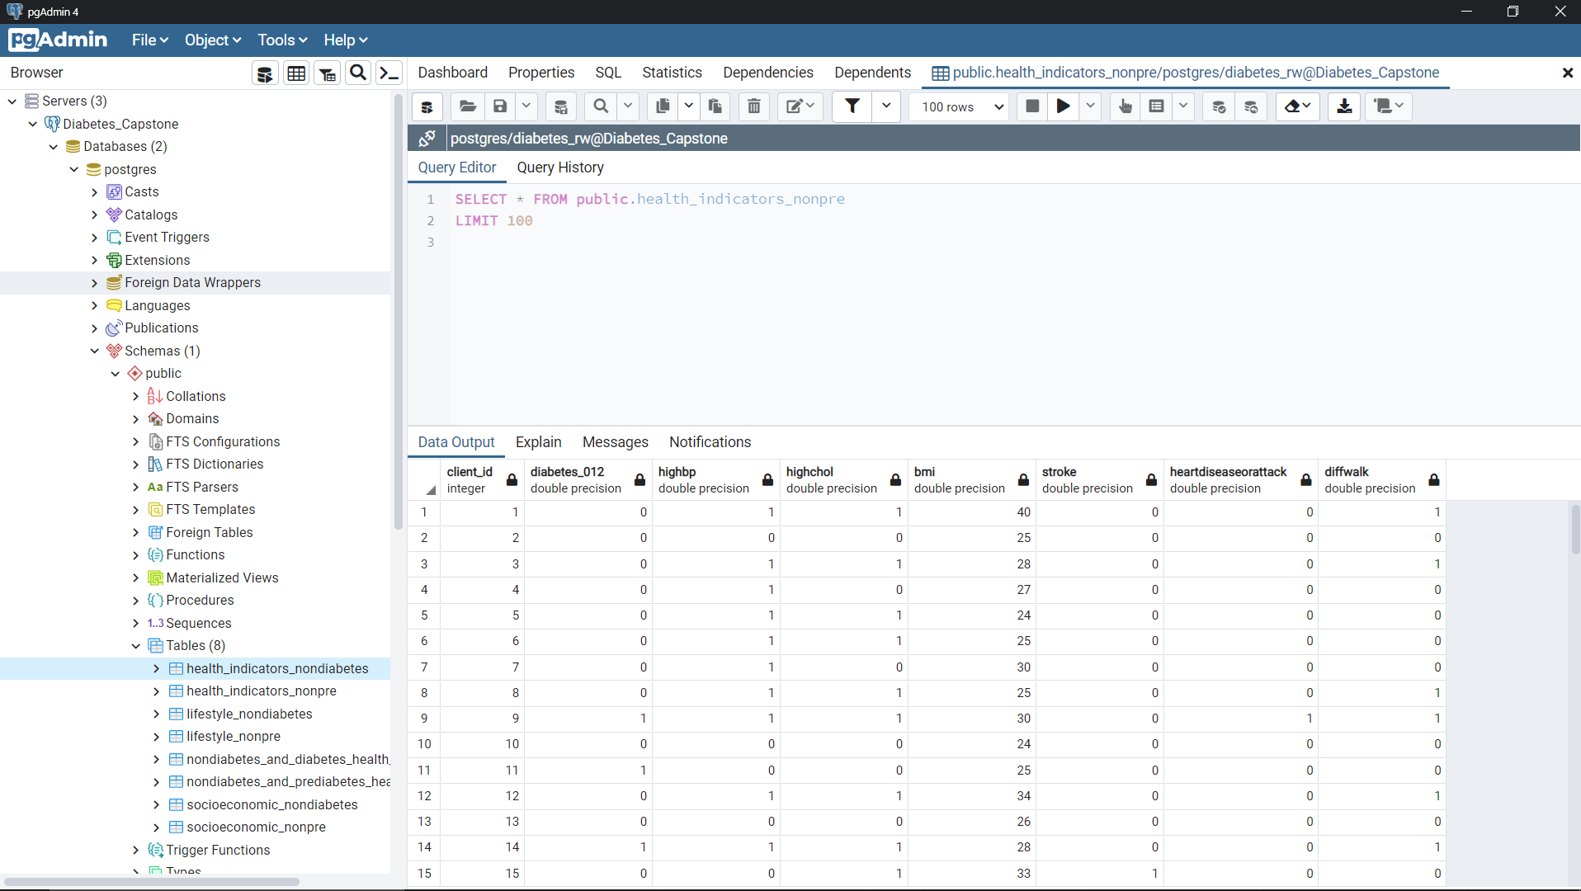
Postgres SQL

Slide 7
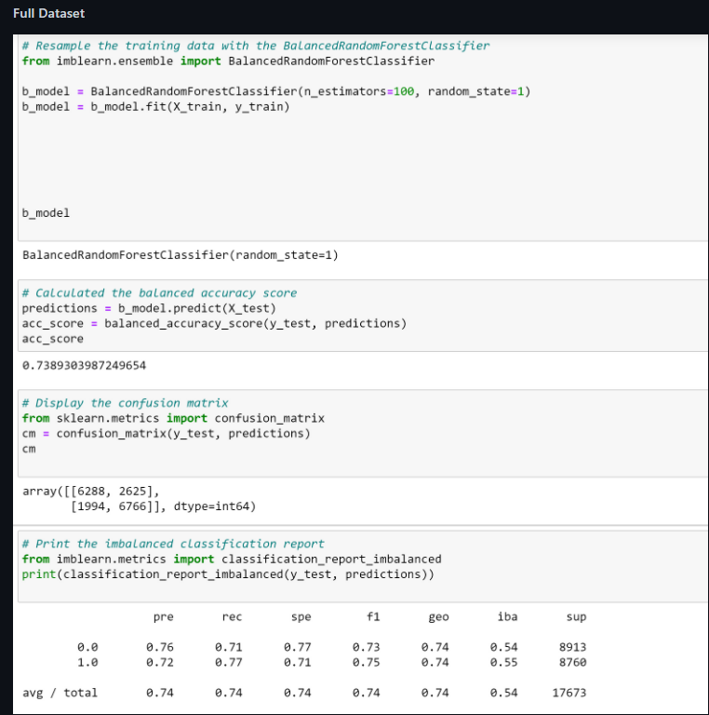
Analysis Phase of the Project- Machine Learning
We created 4 logistic regression models.
One of these was for the full dataset and the other 3 were divided up into health indicators, socioeconomic factors and lifestyle factors.
We used oversampling, undersampling and combination methods.
Results for the 3 subsets were not impressive. Our best results came from using the full dataset.
The classification method worked better than the logistical regression on the full dataset.

Slide 8
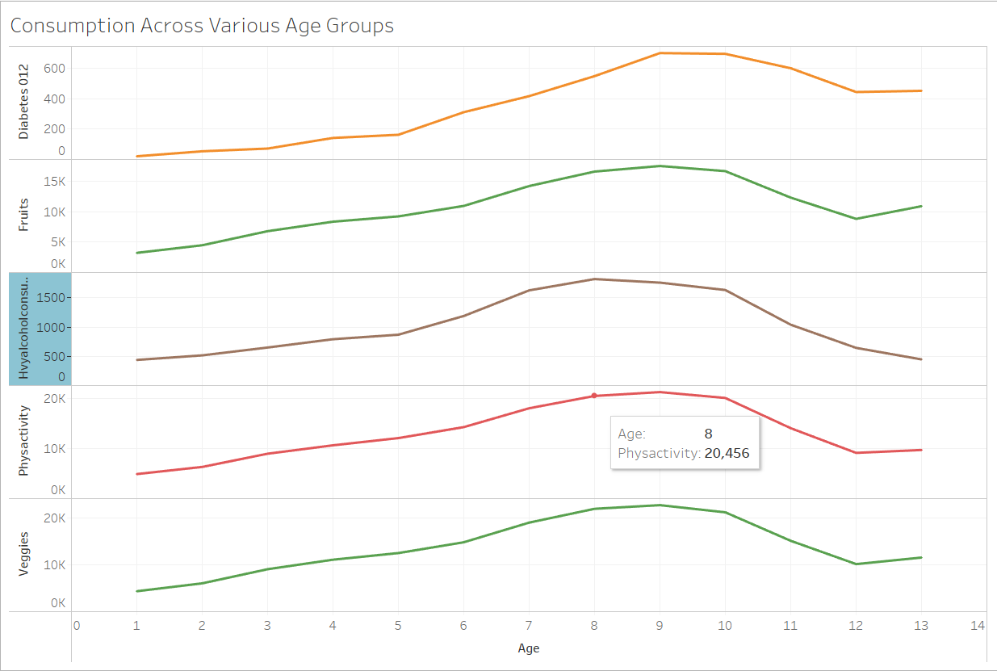
Age
Between ranges 7-10 (Ages 50-54, 55-59, 60-64 & 65-69) the highest amt of alcohol is consumed.
Diabetes is the highest amongst age group ranges 9-10 (60-64, & 65-69)
Fruit consumption decreases among ages 65-74 and increases among ages 75-80+.

Slide 9
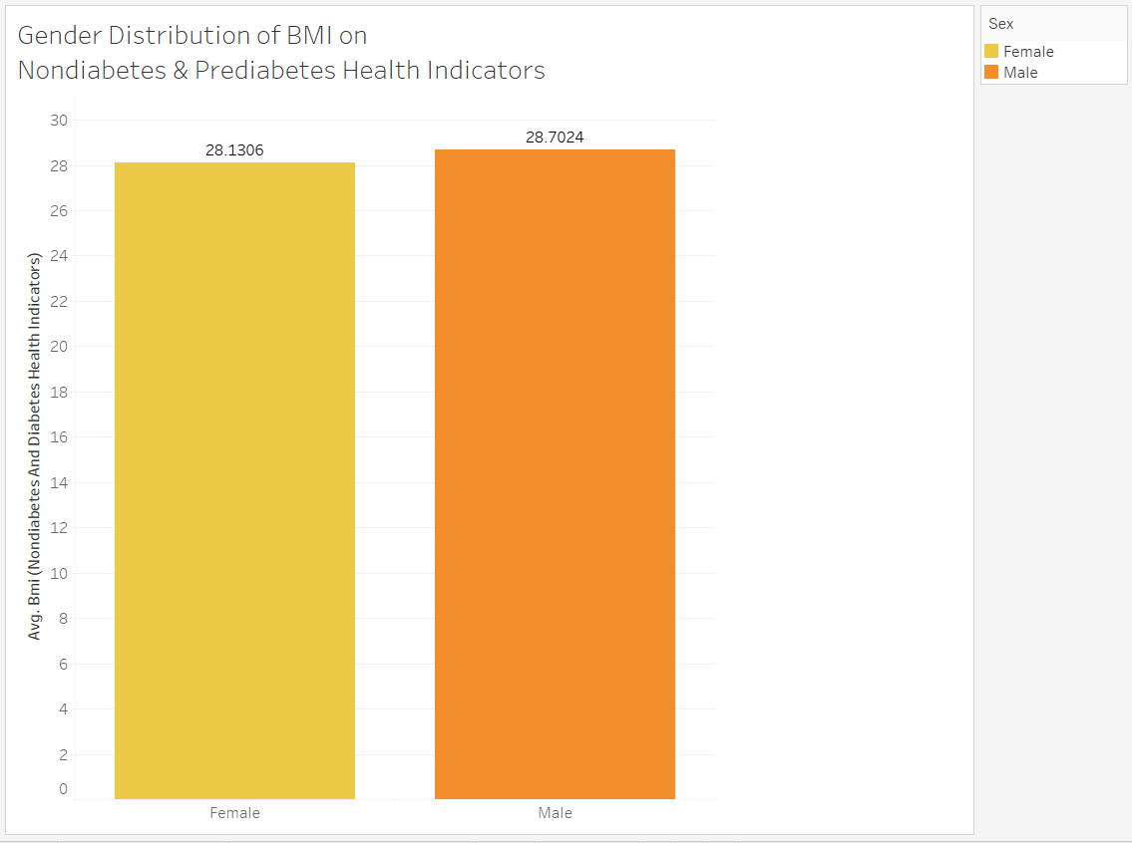
BMI- Nondiabetic & Prediabetic
Males have slightly higher BMI than Females.

Slide 10
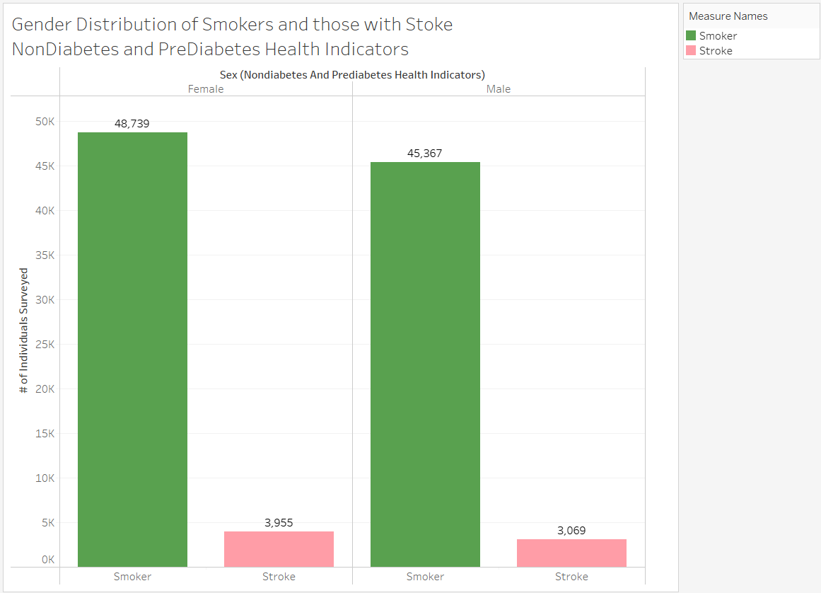
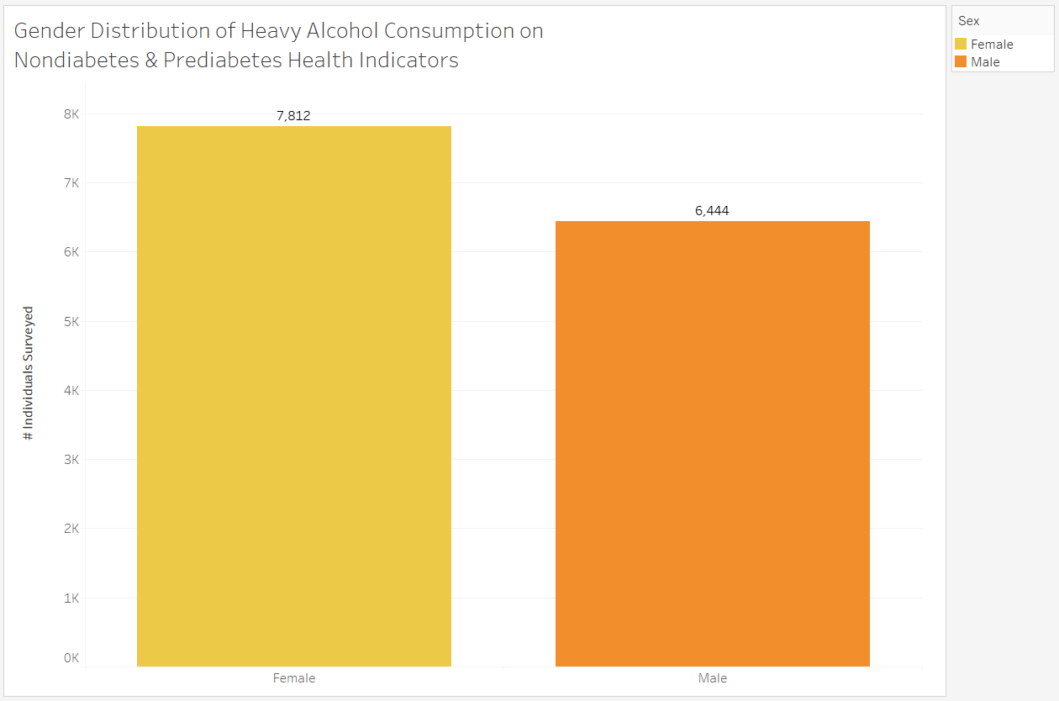
Gender- NonDiabetes and Pre-Diabetes
More Females than Males are Smokers.
About the same # of Males and Females have Strokes.
More Females than Males consume Heavy Alcohol.

Slide 11
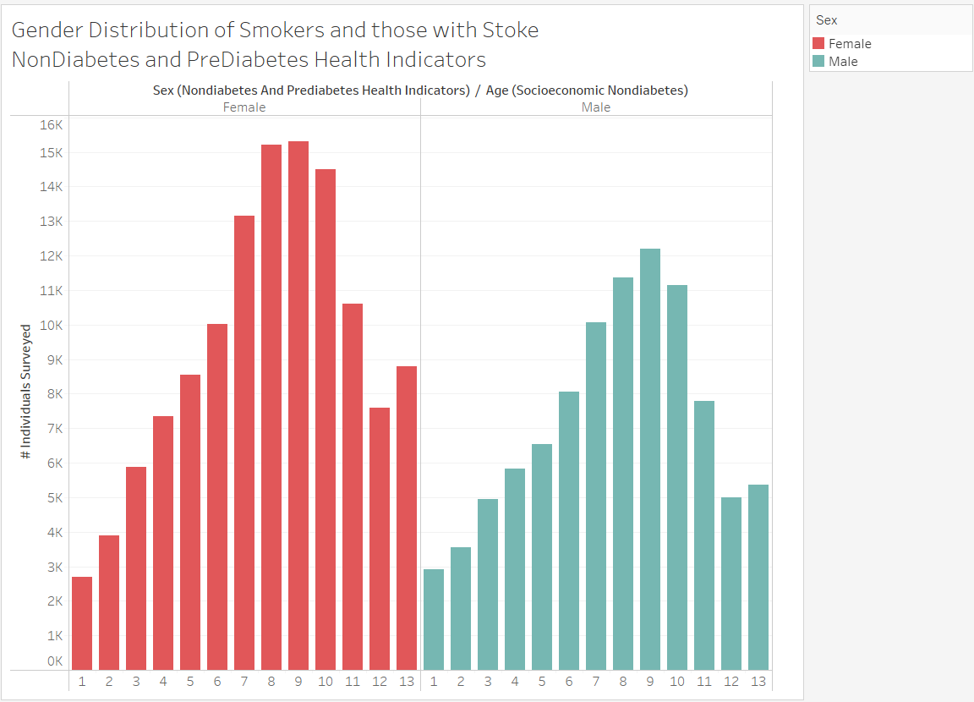
Gender- NonDiabetes and Pre-Diabetes
More Females than Males are Smokers.
About the same # of Males and Females have Strokes.
More Females than Males consume Heavy Alcohol.
Females in Age Groups 45-64 consume more Heavy Alcohol than Men.

Slide 12
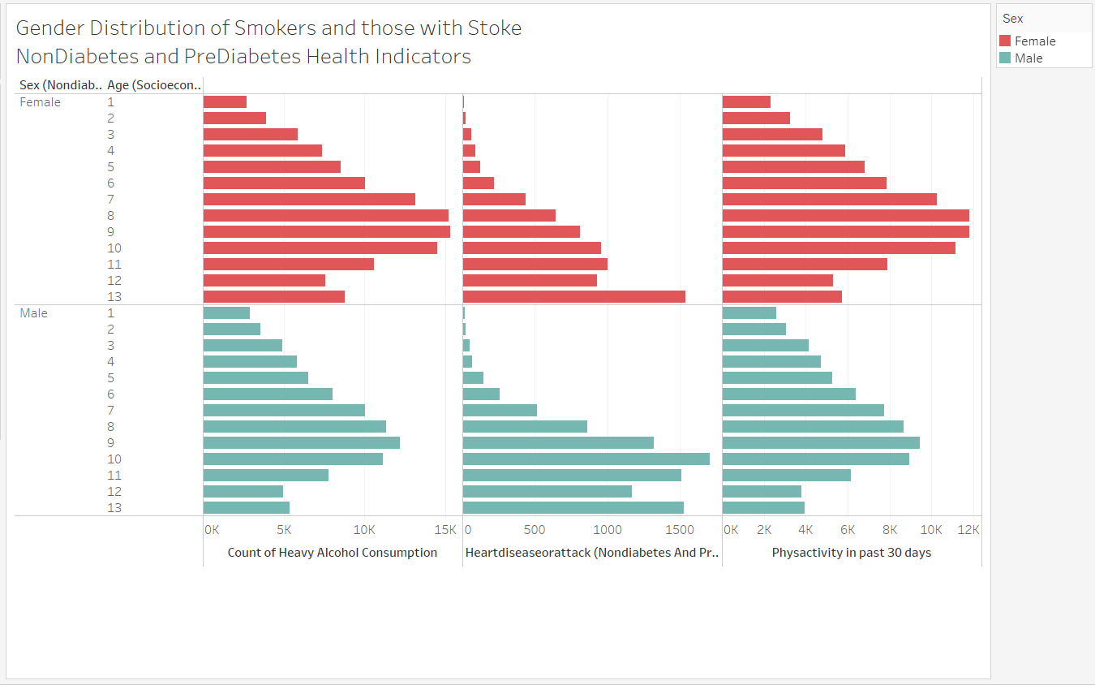
Health Indicators of NonDiabetes and Pre-Diabetes
Females in Age Range (8-10) are the most educated and consume heavy alcohol of those surveyed.
Men in Age Range (8-9) consume most alcohol. The Most Heart Attacks occur in Males in Age range 10-13.
Men and Women in the age range (8-10) were the most Physically Active in the past 30 days.

Slide 13
Recommendations for Future Analysis
A larger dataset would be preferred for machine learning to be able to utilize a higher performing model.
It may be interesting to have 2 datasets with the same individuals 5 years apart/over a 5 yr span.
The effects of geography on diabetes may also be an area of future analysis.

Slide 14
Things we would have done differently
Begin work on dashboard prior to Week 4.
Utilize Tableau to analyze additional variables within health indicators and lifestyle to identify trends in addition to what we found.
Better understanding of Heroku so we could have utilized the tool better.

Slide 15

THANK YOU!!

Slide 16
Presentation- Mastery
Machine Learning Model- Mastery
✓ Selected topic
✓ Reason why they selected their topic
✓ Description of their source of data
✓ Questions they hope to answer with the data
✓ Description of the data exploration phase of the project
✓ Description of the analysis phase of the project
✓ Technologies, languages, tools, and algorithms used throughout the project
✓ Result of analysis
✓ Recommendation for future analysis
✓ Anything the team would have done differently
✓ Description of data preprocessing
✓ Description of feature engineering and the feature selection, including the
team's decision-making process
✓ Description of how data was split into training and testing sets
✓ Explanation of model choice, including limitations and benefits
✓ Explanation of changes in model choice (if changes occurred between the
Segment 2 and Segment 3 deliverables)
✓ Description of how model was trained (or retrained, if they are using an
existing model)
✓ Description and explanation of model’s confusion matrix, including final
accuracy score
Additionally, the model obviously addresses the question or problem the team
is solving.
Note: If statistical analysis is not included as part of the current analysis,
include a description of how it would be included in the next phases of the
project.

Slide 17
Database
Dashboard
✓ Database stores static data for use during the project
✓ Database interfaces with the project in some format (e.g., scraping updates
the database, or database connects to the model)
✓ Includes at least two tables (or collections, if using MongoDB)
✓ Includes at least one join using the database language (not including any
joins in Pandas)
✓ Includes at least one connection string (using SQLAlchemy or PyMongo)
Note: If you use a SQL database, you must provide your ERD with
relationships.
The dashboard presents a data story that is logical and easy to follow for
someone unfamiliar with the topic. It includes all of the following:
✓ Images from the initial analysis
✓ Data (images or report) from the machine learning task
✓ At least one interactive element
Either the dashboard is published or the submission includes a screen capture
video of it in action.

Slide 18
GitHub
Main Branch
All code in the main branch is production-ready.
All code is clean, commented, easy to read, and adheres to a coding standard
(e.g., PEP8)
Main branch should include:
✓ All code necessary to perform exploratory analysis
✓ All code necessary to complete machine learning portion of project
✓ Any images that have been created (at least three)
✓ Requirements.txt file
README.md
README.md must include:
✓ Cohesive, structured outline of the project (this may include images, but
should be easy to follow and digest)
✓ Link to dashboard (or link to video of dashboard demo)
✓ Link to Google Slides presentation
Note: The descriptions and explanations required in all other project
deliverables should also be in your README.md as part of your outline, unless
otherwise noted.
Individual Branches
✓ At least one branch for each team member
✓ Each team member has at least four commits for the duration of the final
segment (16 total commits per person)

