Slide 1

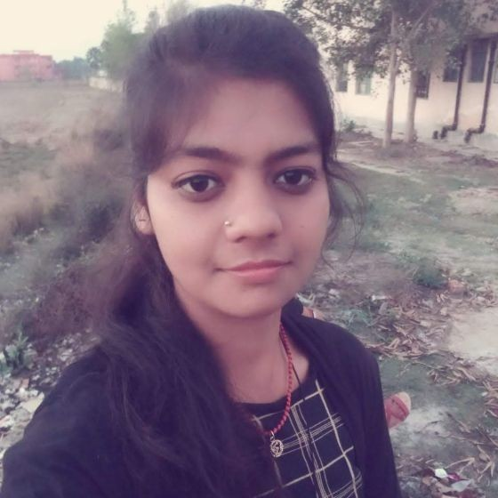



POOJA KUMARI
Education and certificates : Lok Nayak Jai Prakash Institute Of Technology :2017 - 2021
Skills
Analyst/Software Engineer
Base Location: Mumbai
Email ID: POOJA.T.KUMARI@CAPGEMINI.COM
Mobile No: +918404945932, 6200733266
Grade: A4
java | java,OOPS,Generics, Collections, Array,Loops,
Backend | Spring Boot,Spring Rest Services, Spring RestFul Service
Database | Postgre SQL
UI Tech | HTML 5 & CSS, JavaScript,Es6,Bootsrap 4,
Tools | Git & GitHub, Eclipse, STS Post Man,Swagger,Visual Stu dio, Visual Studio Code, Pg Admin 4, SQL shell.
Add On skills | Immersive Learning and Java
Strengths
Full Stack Developer
Hands on experience on Core java, Post gre SQL, Entityframework, SqlServer, Spring Restfull Services.
Proficient in creating Single page Web Application in React with Authentication with routing
Hands on experience in developing web pages using HTML5, CSS, Object TypeScript, Good understanding of Document Object Model (DOM) and DOM Functions
Ready to learn new technologies and implement them for the Future Knowledge improvement.
Achievement
E-Health insurance
Case study of E- Health Insurance (the system will provide screen to show the policies available calculate Premium, register and login to purchase the policies.) along with API Gateway, Swagger, responsive UI with HTML5, CSS, Bootstrap and React used as User Interface.
Check out my work on GitHub
Presentation Title | Author | Date © Capgemini 2017. All rights reserved | 1

